Slide 1

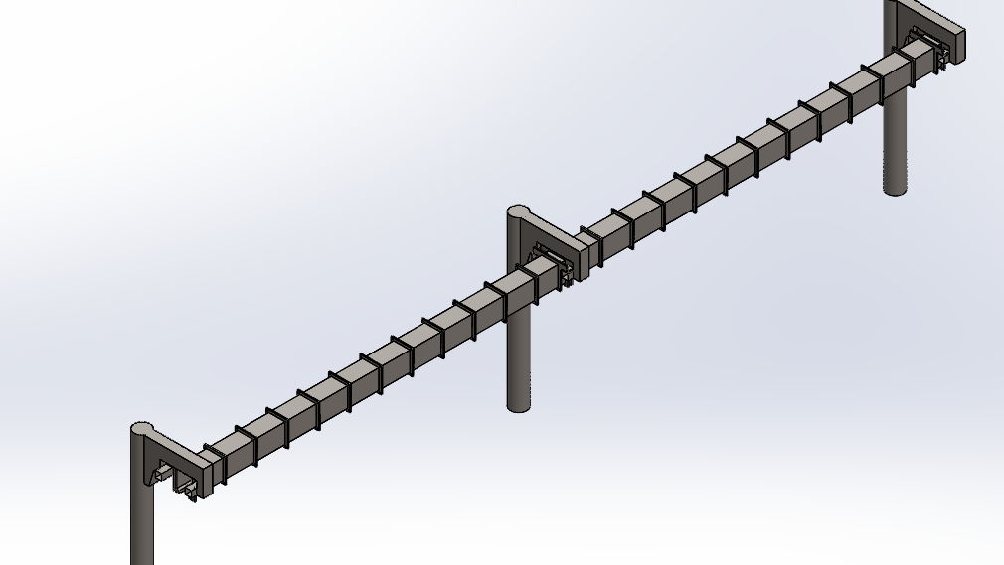
Present by:
Liwei Lu
Mechanical Engineering Department
San Jose State University
Date: 5/14/2020
GUIDEWAY DESIGN AND FABRICATION METHOD FOR THE SPARTAN SUPERWAY

Slide 2
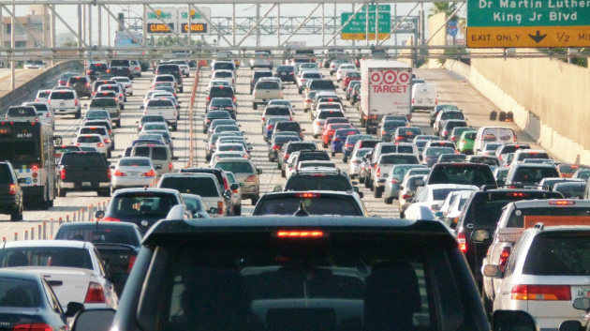
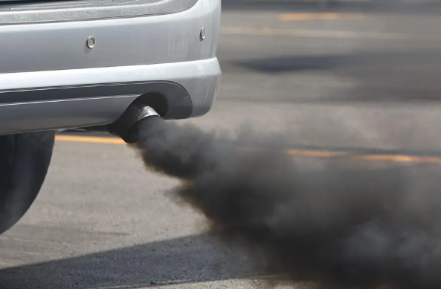

We are having problems with the current mode of transportation
Heavy Traffic
Air Pollution
Fossil fuel crisis
Notes:
We are having problems with the current mode of transportation
1 The traffic is heavy, there’s a study shows that people spend approximately 1.7 hours in traffic daily.
2. Air pollution is getting worse and worse, which is causing climate change.
3. Majority of the vehicles we are using nowadays consume fossil fuel. If we keep the current rate of fuel consumption, our known oil deposits could run out in just over 53 years

Slide 3
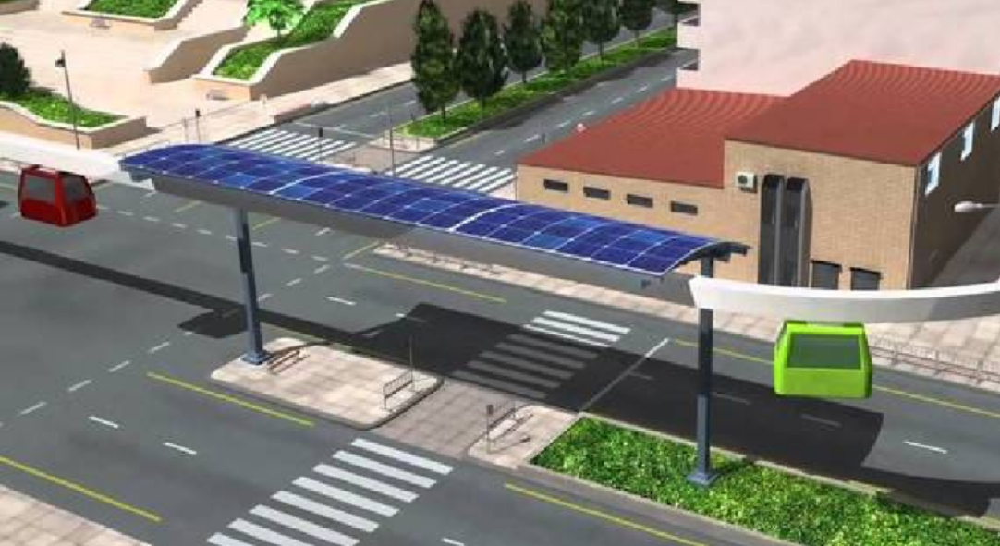
We have one solution to resolve all those problems:
The SPARTAN Superway
Suspended guideway, utilize vertical space
Electic motor, zero emission
Solar-powered, no fossil fuel needed
Notes:
Fortunately, we have one solution to resolve all three problems: the SPARTAN Superway. SPARTAN stands for Solar Powered Automated Rapid Transit Ascendant Networks.
First of all, it will suspended guideway system, which utilized the vertical space in the current compact urban environment, helps to reduce traffic flows while not impacting the current transportation system.
The bogie will use electric motor, which has zero emission, helps to reduce pollution
All the electricity needed for vehicle running is generated by solar panels, no fossil fuel needed.

Slide 4



My Goals for the project are:
Design the Guideway
Define the manufacturing process
Summarize the cost
Notes:
As one of the team member for the SPARTAN Superway project, my goals are to design the guideway, define the manufacturing process and summarize the cost for building the guideway system.

Slide 5

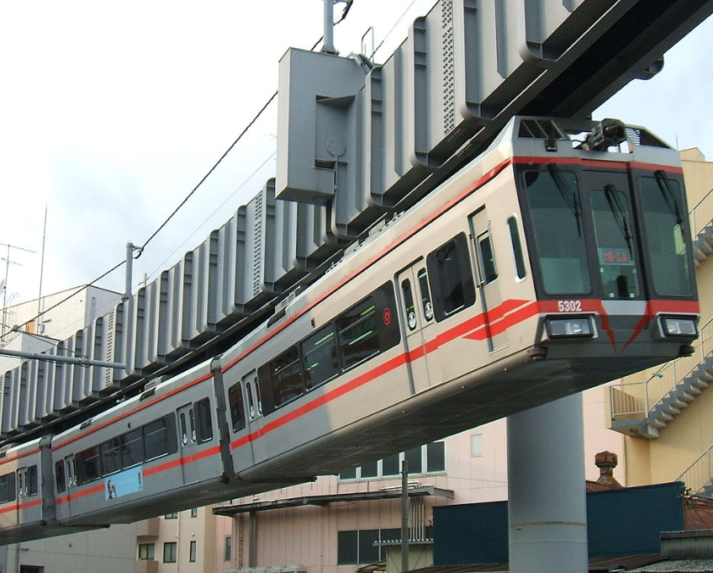
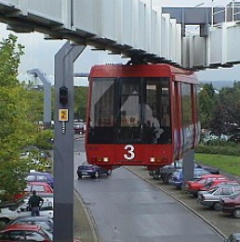
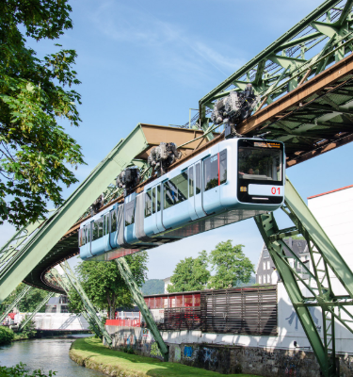
Wuppertal Schwebebahn
Shonan Monorail
H-Bahn
Existing Suspended Guideway System
Notes:
There are quite a few suspended guideway system existed around the world already, like the Wuppertal and H-Bahn in Germany and the Shonan Monorail in Japan.
Wuppertail is using a traditional trust and beam guideway structure, while H-Bahn and Shonan Monorail are using the enclosed guideway

Slide 6
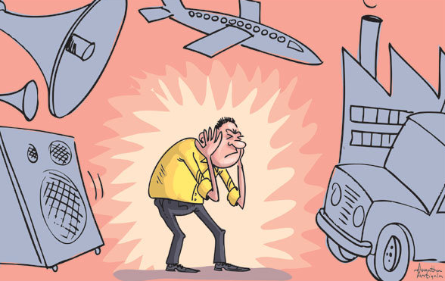

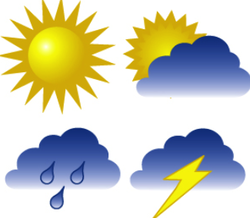
I choose to design the guideway similar to H-bahn and Shonan Monorail for the following 3 reasons:
Noise Level
Easy to Manufacture
Weather Proof
Notes:
I choose to design the guideway similar to H-bahn and Shonan Monorail for the following 3 reasons:
Since the guideway is enclosed, radiated noise will be reduced compared to an open guideway such as train. this is a big win, since the first route planned for the SPARTAN Superway is going to be located at downtown San Jose, and it’s going to pass by offices, libraries, schools, and neighborhoods. If the noise level is too high, it will significantly affect people’s daily lives.
The guideway is relatively easy to manufacture, main component are just steel hollow tube and the ribs
Also, since the bogie is using battery and electric motors, it will be weather sensitive. By having this enclosed guideway design, the weather effect on those electric components are minimized since sunlight or rain water will never reach to the bogie.

Slide 7
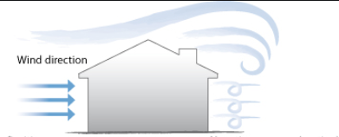
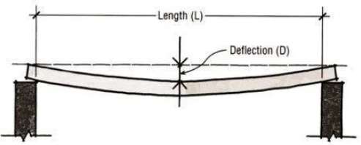
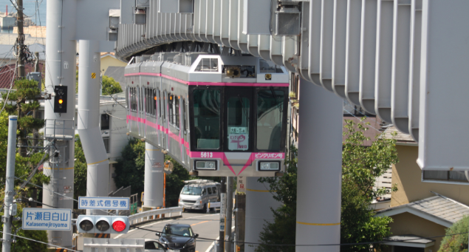
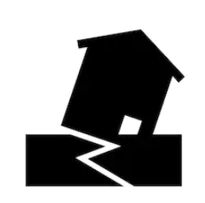
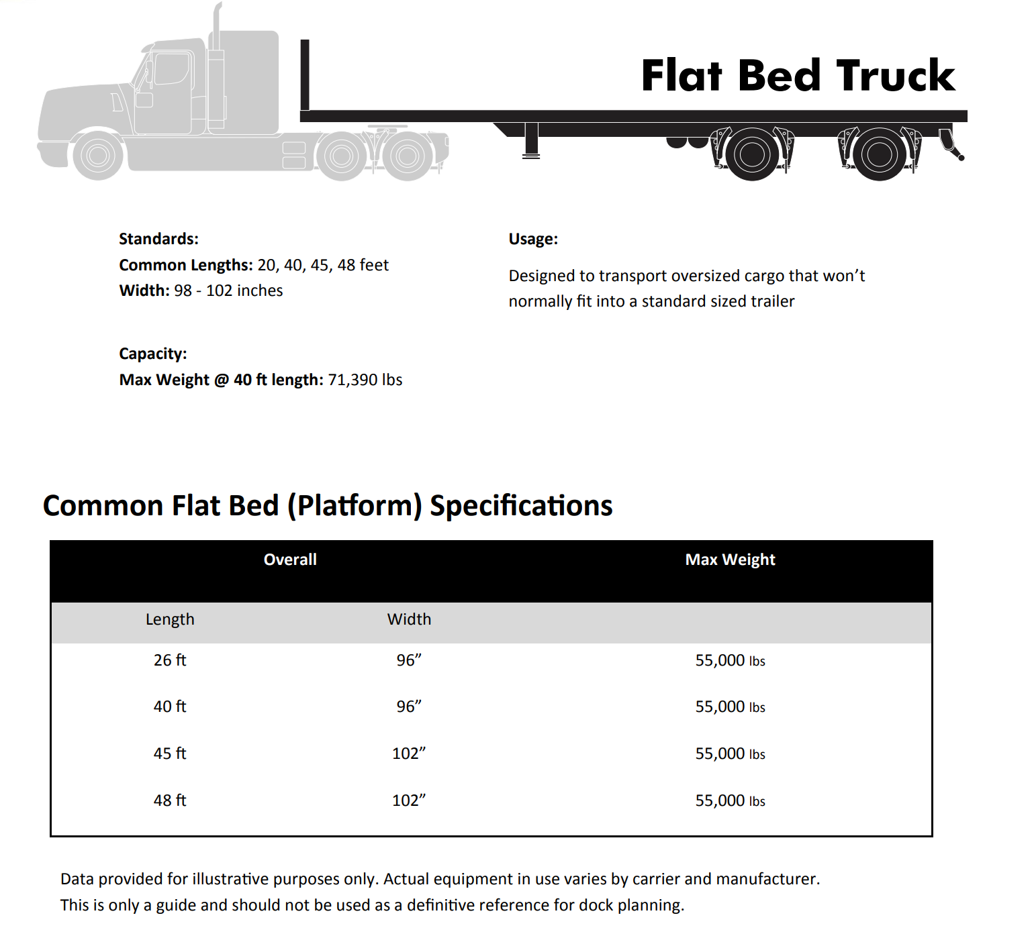
1 / 800 span length deflection
Meet wind load requirement
Guideway segment length
Meet loading requirement
Here are some design requirements
Earthquake
Notes:
There are a couple of requirements we need to consider for the guideway design
First of all, the guideway need to be able to withstand the load from vehicle and passenger. Since we don’t know the final design for the bogie and passage cabinet yet. We are using the spec sheet for a similar ATN system called Vectus, and we get the maximum weight for the bogie and cabinet including passengers is about 2500kg,
Guideway need to be able to withstand wind load. According to a wind map from American society of civil engineer (ASCE), the wind speed requirement in San Jose area is 115 mph
Deflection level of the guideway need to be controlled for passenger comfort. According to American Association of State Highway and Transportation Official (AASHTO) recommendation, deflection of the bridge should not excess 1/800 of the span length
Guideway need to be able to handle earthquake to some level
Segment length of the guideway. Since we want to use regular freight truck for transportation, we will make the segment length of the guideway to be 48 feet as that is the largest size of flat bed truck

Slide 8
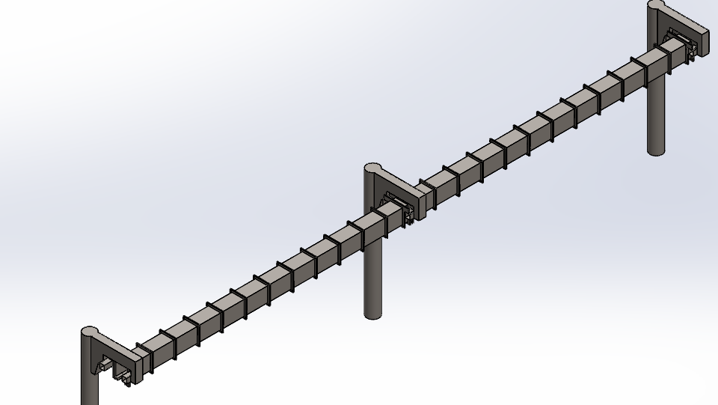
This is the guideway I designed
Guideway Straight Section
Supporting Structure
Notes:
Here is an overview of the guideway I designed.

Slide 9
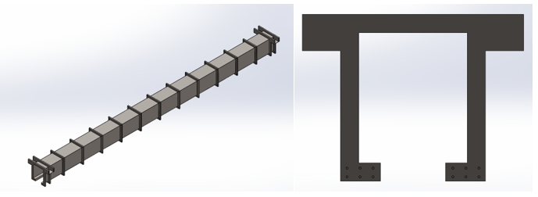
This is the straight section of the guideway
Overall length: 48 feet
Crosses section: 25 x 30 ‘’
Notes:
The geometry of the guideway it’s basically a rectangular steel hollow beam with an open bottom as shown.
Outside of the Rectangular beam, there are multiple “ribs” that are welded onto the outer surface to prevent the shape of the guideway from collapsing while the vehicle passes by.
The ribs are 4x2 rectangular steel tube with wall thickness of .25’’
Overall length for the guideway is 48 feet, as I explain earlier, that is the maximum truck.
Inner dimension is 25’’ wide and 30’’ high. The dimension is determined to fit the bogie design

Slide 10
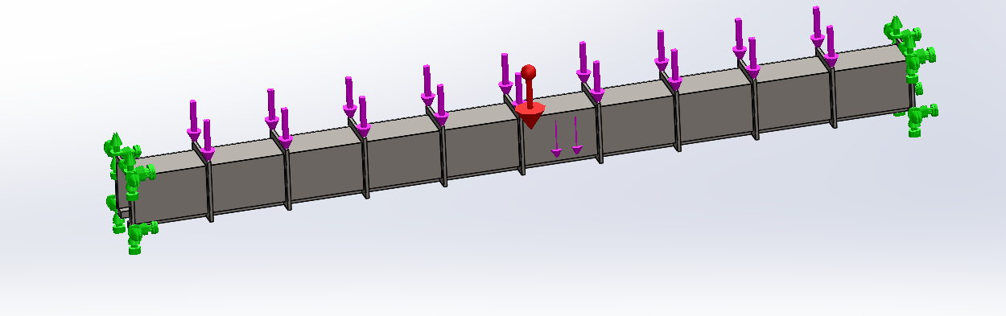
Design study has been done to determine the wall thickness and rib spacing
Model fixed at both end
24517N of load at the middle of the guideway
Self Weight
Notes:
The most important feature for the guideway design is the wall thickness of the guideway and rib spacing.
To determine these two dimension, a design study need to be performed.
To setup the study, fix the geometry on both end of the model, add the 2500kg, which is 24517N load at the middle of the guideway, also add self weight to the force.

Slide 11
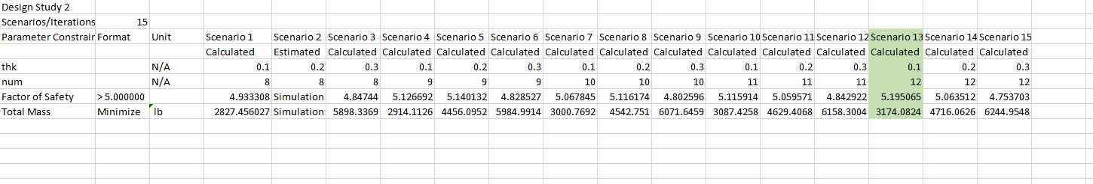
Result of the design study
Notes:
Set wall thickness and number of ribs we need for each segment as the 2 variables.
wall thickness varies from 0.1 to 0.3 inch, with a step of .1 inch. The number of ribs is set to be 8 - 12, with a step of 1. The guideway model will be modified automatically according to each combination of the two variables, which means 15 case of FEA were performed in total. After running the simulation, the result is shown in Table 2 in the Appendix. The combination of .1-inch wall thickness and 12 ribs (which means the spacing between ribs are 48 inches) has the highest factor of safety 5.2 against yield and the lightest total mass of 3174 lb

Slide 12
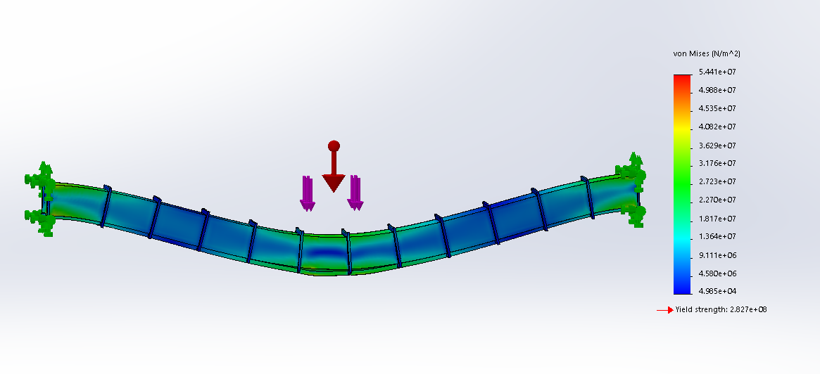
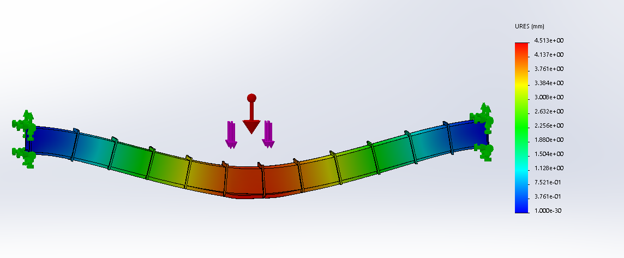
The FEA result for stress and deflection
Maximum stress is 5.44x 10⁷ N/m² located at the middle of the guideway.
Maximum deflection is 4.5 mm located at the middle of the guideway.
Notes:
The detail for the FEA analysis for the .1-inch wall thickness and 12 ribs guideway model is shown in Figure 18 and 19. The maximum stress is 5.44x 10⁷ N/m², and the maximum deflection of the guideway is about 4.51mm. As one might expect, the highest stress is located at the middle where the 24571N loading. The region of maximum deflection area is also located where the force acts. According to the AASHTO LRFD Bridge Design Specification as mentioned above, the deflection allowed will be L /800. The guideway segment is about 576 inches long, so the deflection allowed will be about 0.72 inches, which is about 18mm. So the 4.5 mm deflection is acceptable.

Slide 13
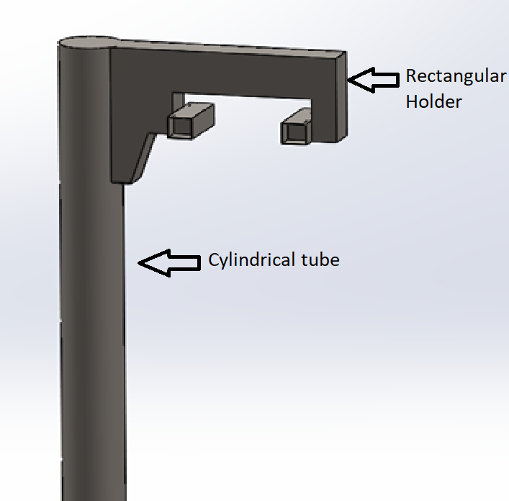
This is the supporting structure for the guideway
Notes:
The supporting structure for the guideway is pretty simple. It has a cylindrical tube with one end fixed to the ground. On the top side of the cylindrical tube, there is a rectangular holder welded onto the tube.

Slide 14
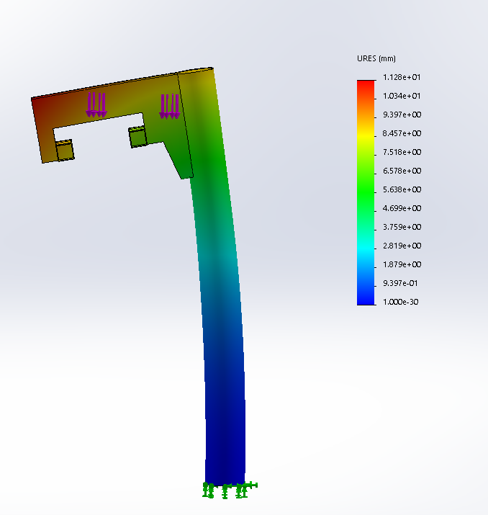
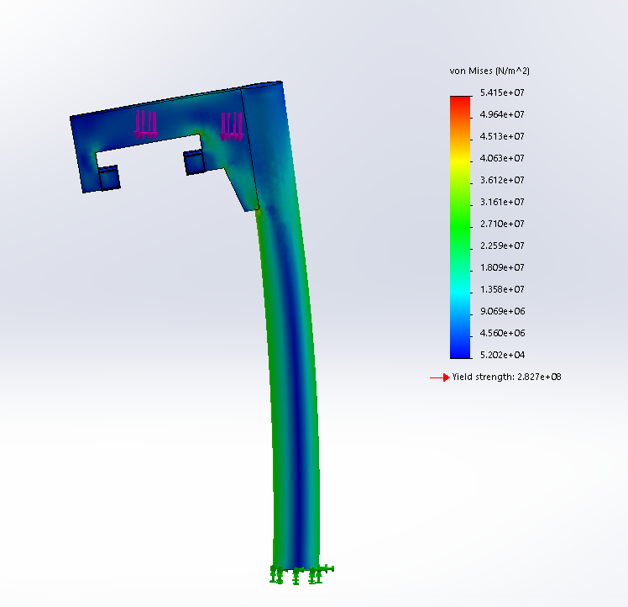
The FEA result for stress and deflection
Factor of safety against yield is 5.2
Maximum stress is 5.41 x 10⁷ N/m².
Maximum deflection is 1.1 mm
Notes:
The supporting structure needs to be able to hold the weight of the guideway, the bogie and passenger cabin, as well as the solar panel racking. The combination of all those forces becomes a loading of about 48790 N total acting on the supporting surface. An FEA study has been performed to evaluate the performance of the supporting structure. As we can see from Figures 21 and 22, the maximum stress is about 5.41 x 10⁷ N/m², which provides a factor of safety (against yield) about 5.2. The maximum displacement is about 1.1mm.

Slide 15

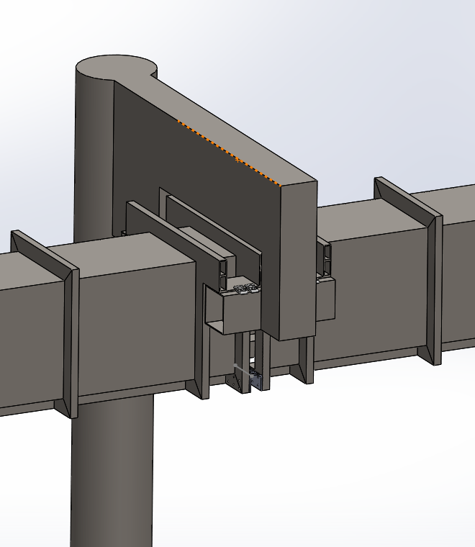
Guideway Assembly
Guideway is sitting on the supporting structure
Fixed by rail clips
Heat expansion joints between guideway segments
Notes:
Here shows how the guideway and supporting structure is assemble together.
Guideway will be lifted and sit on the flat surface on the supporting structure, then a rail clip on each side will lock the position of the guideway to the supporting structure.
There are also heat expansion joints installed in between the guideway

Slide 16
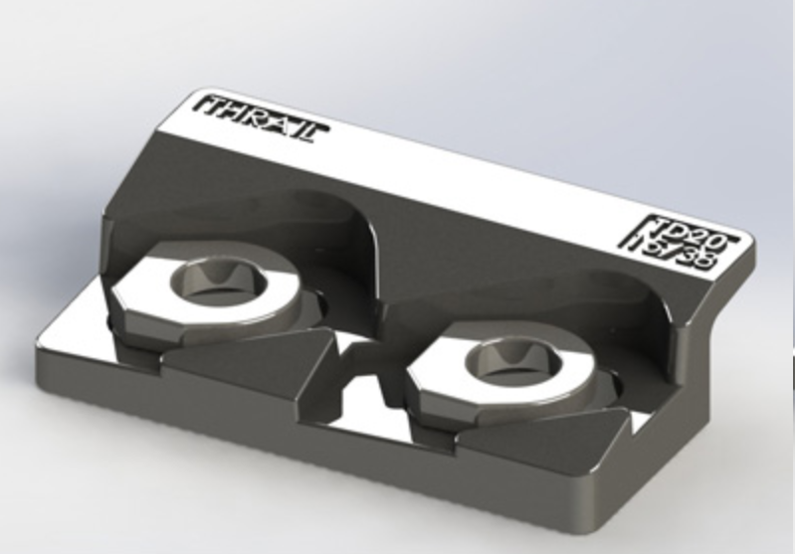
This is how the rail clip works
Clamp down the guideway on this side
Fixed on the supporting structure by bolts
TD2015 Bolted rail fixing clips, 15mm horizontal rail adjustment and max side load of 250kN
Notes:
Here is how the rail clip will look like, it will be installed 1 each on both side of the guideway.
2 bolts are used to fixed the rail clip on the supporting structure, and the guideway will be clamp down on the other side. This design will allow guideway to move slightly due to heat expansion

Slide 17
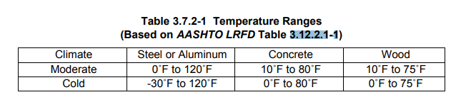
American Association of State Highway and Transportation Official (AASHTO) recommended temperature range
Notes:
To prevent the guideway from buckling due to heat expansion, we will need to know how much the guideway can expand in extreme conditions. According to the Bridge Design Specification (AASHTO, 2017), in a moderate climate area as San Jose, a bridge needs to be able to handle temperature from 0 to 120 F. We will use the same specification for our guideway design.

Slide 18
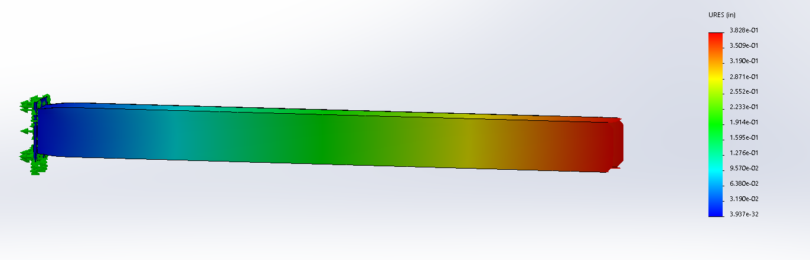
The maximum heat expansion due to temperature change is about 9.7mm
Notes:
By setting the initial temperature to be 0 and the steady state temperature to be 120°F, the simulation result shows that the guideway can expand by about 9.7 mm (See Figure 28), so we will leave a gap 9.7mm minimum in between the heat expansion joint.

Slide 19
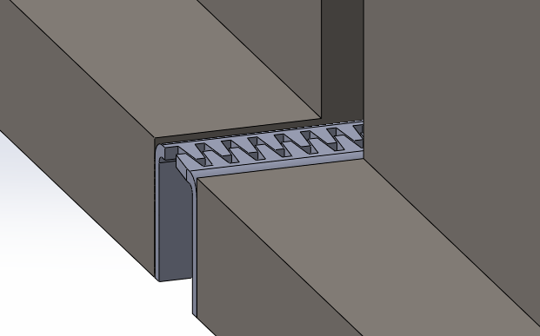
Allowing the 9.7mm heat expansion
Heat expansion joint
Provide continuous running surface between guideways
Notes:
This is how the heat expansion joint looks like, they are installed in pairs between the guideway segments, which provide continuous running surface, which still allowing the 9.7 mm heat expansion

Slide 20
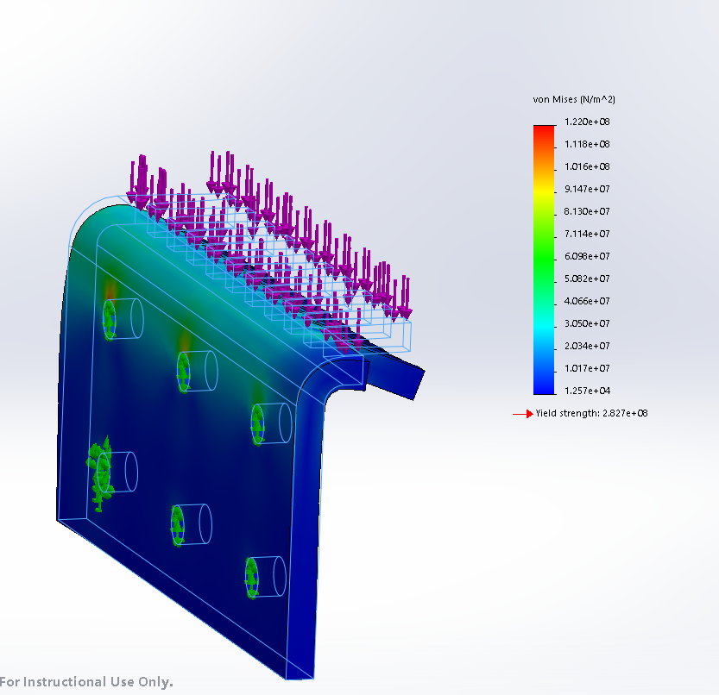
The maximum stress due to a 6125N load is about 1.22x10⁸ N/m².
Factor of Safety against yield is 2.3
Notes:
Since the bogie has 4 wheels, a downward force about ¼ of the total weight will be acted to the heat expansion joint when the bogie travel pass, which is about 6125N. the FEA result is shown in Figure 29. The maximum stress is seen to be about 1.22x10⁸ N/m², so the factor of safety against yield is about 2.3.

Slide 21
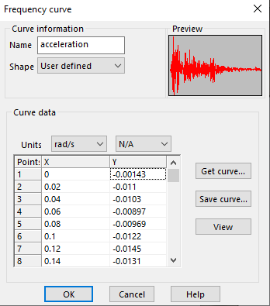
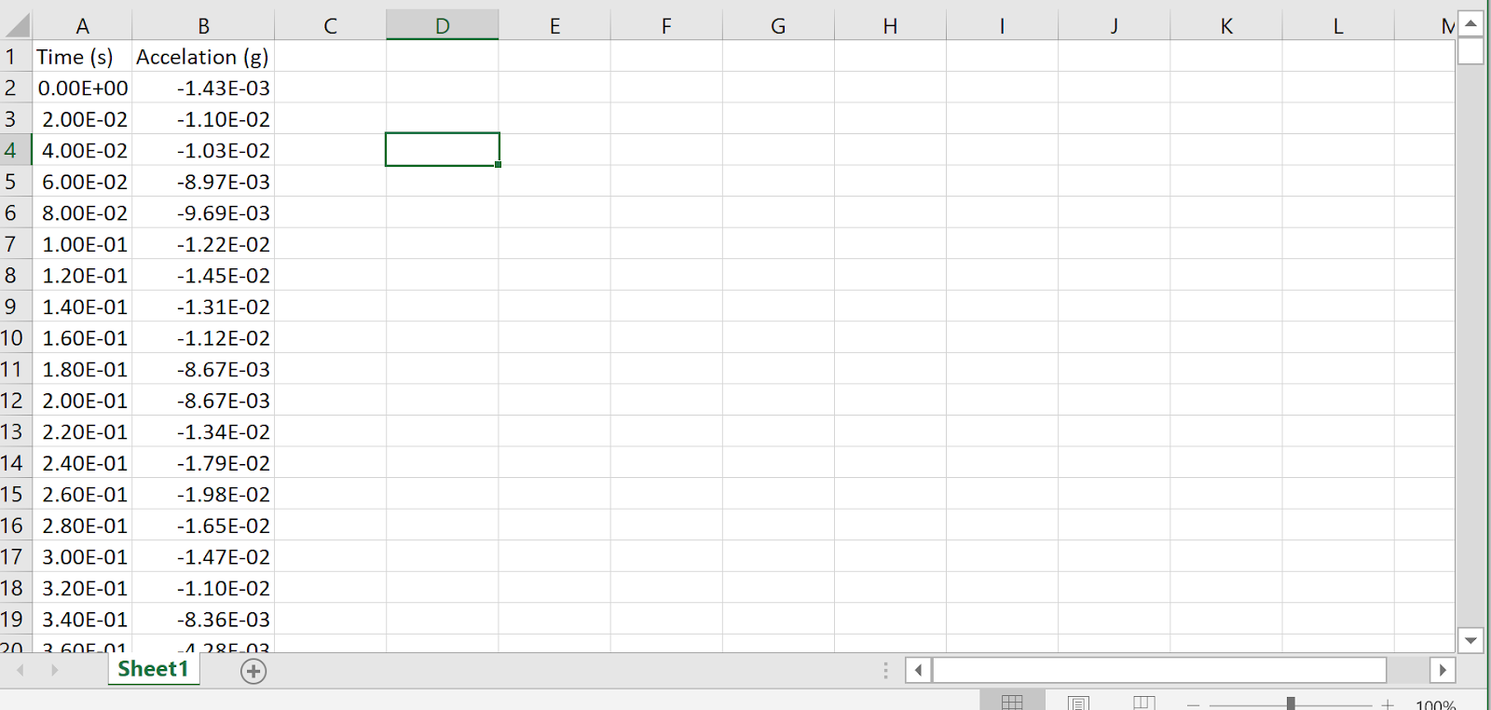
To simulate the earthquake effect to the guideway, I use the response spectrum from an actual earthquake (El Centro, 1940)
Notes:
Besides the static loading, we also need to evaluate how the supporting structure reacts to an earthquake. As mentioned in the literature review section, the seismic response spectrum method can be used to simulate the earthquake movement. I found the response spectrum data from an actual earthquake of Magnitude 6.9 that happened in El Centro 1940. The data has two columns, the first column is time, and the second column is the corresponding acceleration in g’s, gravity. With such data, Solidworks Dynamics Study can be used study to simulate the earthquake. For the external loads setting, choose base excitation in the Solidworks program, and enter the raw data from the response spectrum, then we are getting a graph as shown

Slide 22
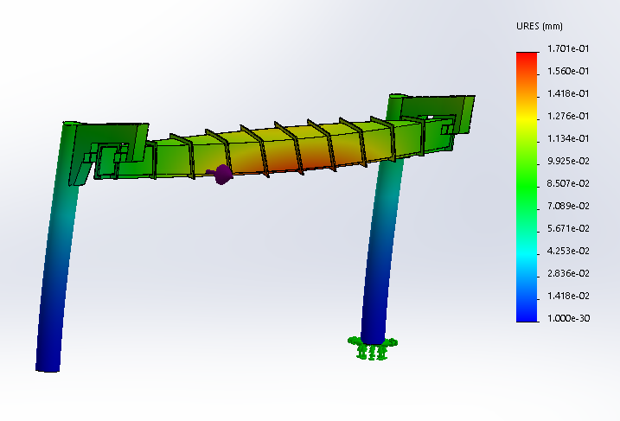
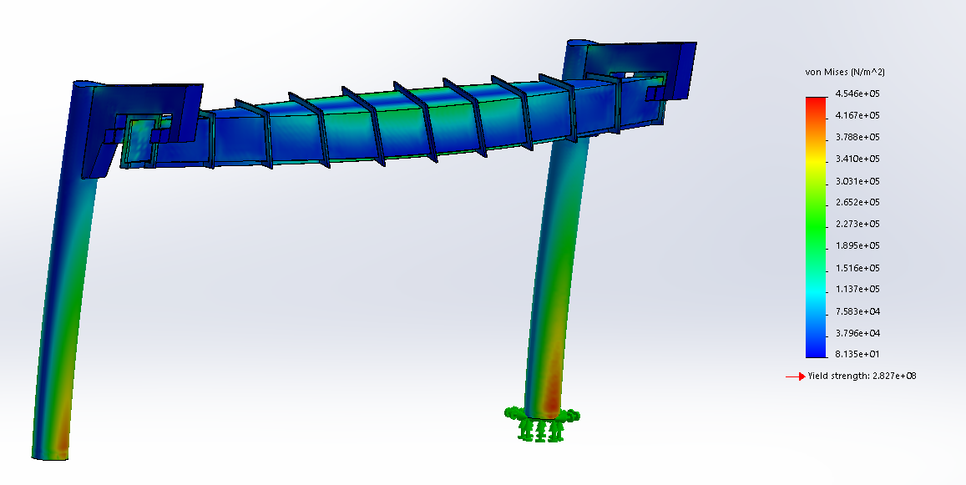
Earthquake simulation result
Maximum stress is 4.55 x 10⁶ N/m².
Maximum deflection is 1.7 mm
Notes:
The result from running the simulation is shown in Figures 24 and 25. The maximum stress we have in the supporting structure is about 4.55 x 10⁶N/m², and the maximum deflection during the earthquake is about 1.7mm.
This simulation is not exactly how an actual earthquake supposed to be, instead, it’s a simplified version of an earthquake. An actual earthquake wave will have vertical movement as well as horizontal moment. However, we know that most of the damage caused by an earthquake comes from the horizontal wave, which will make a building shake horizontally. That’s why I choose to just use the horizontal acceleration as the input to simplify the simulation. So even though the maximum stress for the guideway is going to be a larger value during an actual earthquake, it should not be too much different from the simulation result.

Slide 23
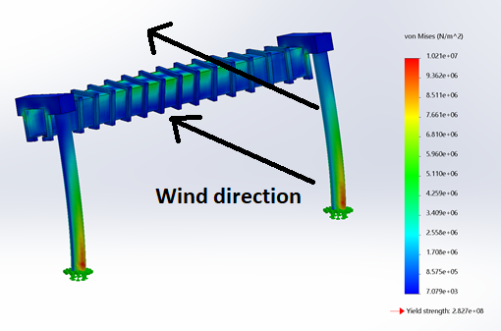
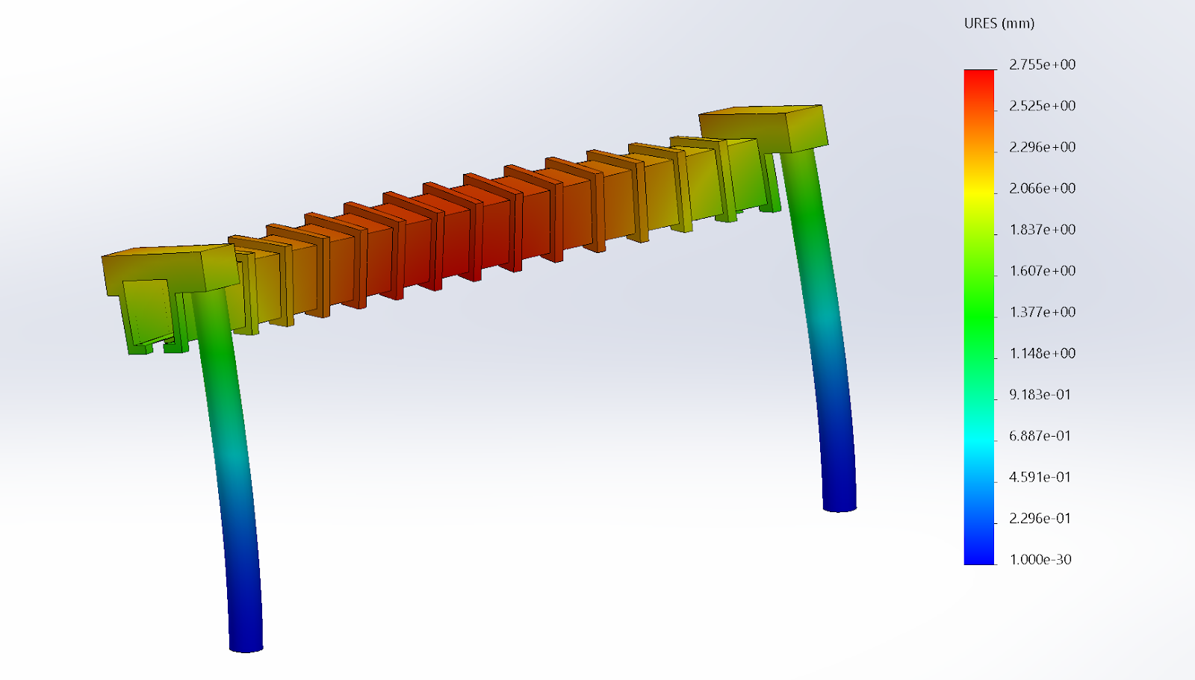
Wind load simulation result
(115 mph wind speed was used according to ASCE)
Maximum stress is 1.02 x 10⁷ N/m².
Maximum deflection is 2.75 mm
Notes:
To similar wind affect to the guideway, The wind is set to blow horizontally in 115 mph, and perpendicular to the direction of the guideway. The simulation result is shown. The maximum stress that caused by the wind load is about 1.02x10⁷ N/m², and the maximum deflection that cause by wind load is about 2.75mm. The maximum stress that caused by wind load is relatively small compare to the yield strength of the material (Carbon steel), so the structure will be safe from wind loading.

Slide 24
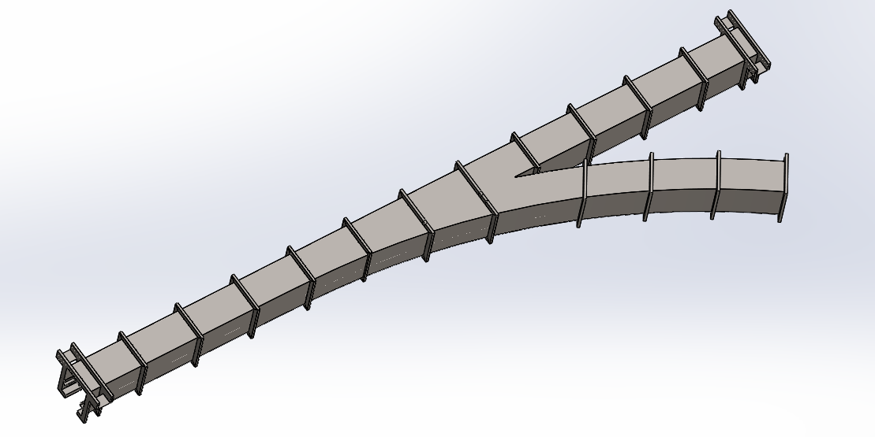
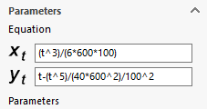
When the bogie need to change direction, we need a Y joint guideway segment
Overall length: 48 feet
Turning radius 50 feet (15m)
Transactional spiral between the straight section and 50 feet radius
Notes:
When the bogie need to change direction, we need a Y joint guideway segment.
Overall length of the Y joint segment is the same as the straight section, 48 feet
The turning radius is 50 feet, which is about 15 meter
Between the straight section and the curved section, there’s a transactional spiral to make sure the bogie make a comfortable turn for the passangers.

Slide 25
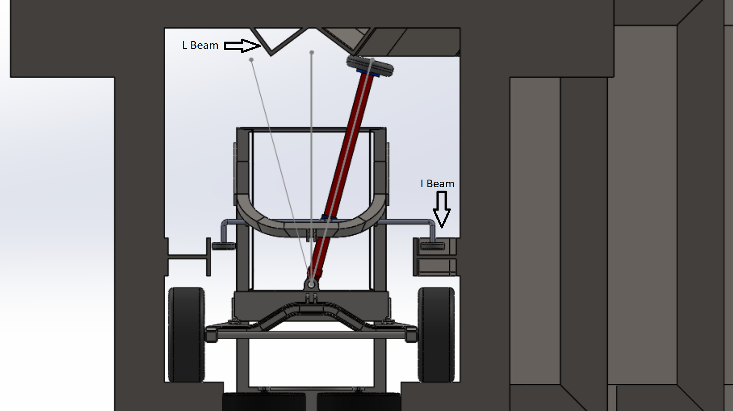
Switching Mechanism
Notes:
Here is the switching mechanism.
There is an I beam welded on the inner vertical wall on each side, as well as two L beams welded on ceiling of the guideway. When the bogie needs to turn right, the guide wheels on the bogie will slide to the right and engage with the I beam on the right side as well as the L beam on the right side, dragging the bogie to turn right. When the bogie needs to go straight, it’s guide wheels will need to slide to the left side instead.

Slide 26
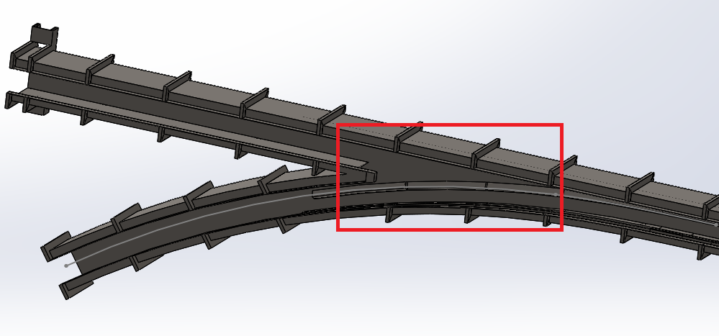
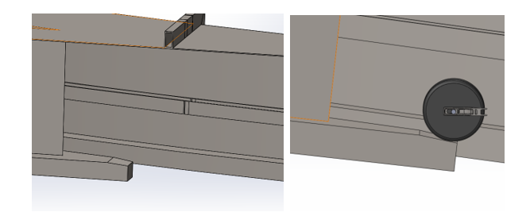
Transaction area
In the splitting section of the guideway, there will be an area where the bogie is running through with no support on one side
Notes:
In the splitting section of the guideway, there will be an area where the bogie is running through with no support on one side. Even we have the side track and upper track to keep the bogie in position, the position of the driving wheel will be lower due to the shock displacement. To prevent the driving wheel from hitting the guideway, we create a small transaction area in the splitting section as shown in Figure 16. The transaction area is a small incline with about 0.5-inch offset from the normal running surface, this will help the driving wheel of the bogie to engage back to the running surface smoothly.

Slide 27

Conclusion of current progress
Current guideway and supporting structure design has factor of safety 5.2 against yield
Maximum deflection due to vehicle load is 4.51mm, meets the 1/800 span length requirement (18mm)
Handle magnitude 6.9 earthquake
Handle 115 mph wind load

Slide 28
Recommendation for Future Work
Need more FEA analysis for curved guideway segment
Different design for supporting structure for curved segment
Finalize all design models and detail drawings
Define manufacturing process
Build prototype
Cost summary

