Slide 1
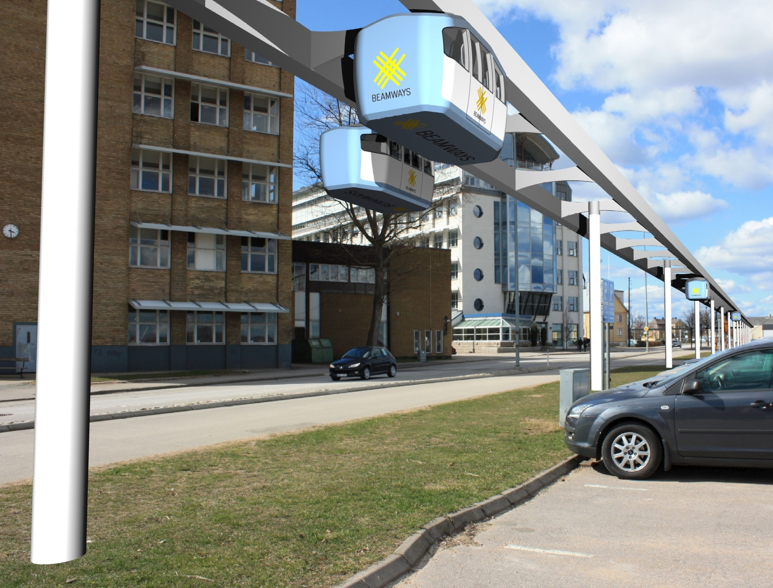
Automatic transit networks explained.
Bengt Gustafsson, 2014-01-27

Slide 2
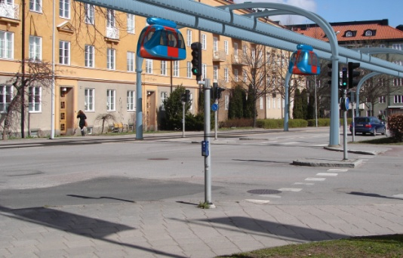
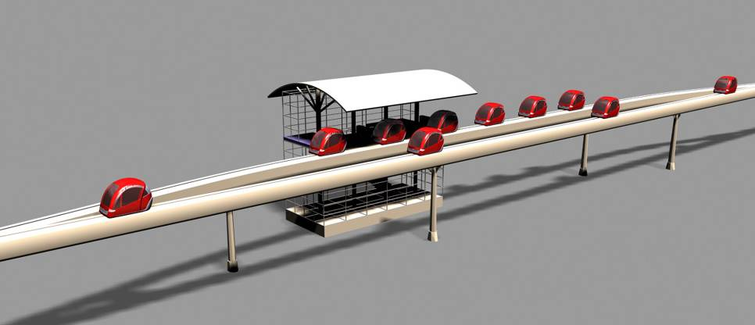

ATN system features
Vehicles wait for you at stations
Small vehicles, 3-4 pass.
Direct, non-stop travel.
40-60 km/h line speed
Electric, no local emissions
ADA-compliant
Vehicle dedicated to each trip
Stations on side tracks
Very light and slim guideway
Always available, no time table
Very little land use
Reasonable investment level
Automatic, safe and reliable!

Slide 3
Podcars – For the passenger
Advantages
Disadvantages
Car like service level
High mean speed
No congestion
No accidents
No parking hazzles
No driving skills required
Fewer cars per household
Walk to station required
No goods storage
Limited vehicle size

Slide 4
Podcars – For the society
Advantages
Disadvantages
No emissions
Replaces bus system
No operating subsidies
Reduced parking areas
Reduced street noise
Cheap way to add capacity
Large initial investment
Unproven technology
Small network ineffective
Lack of standards
Visual intrusion effects

Slide 5
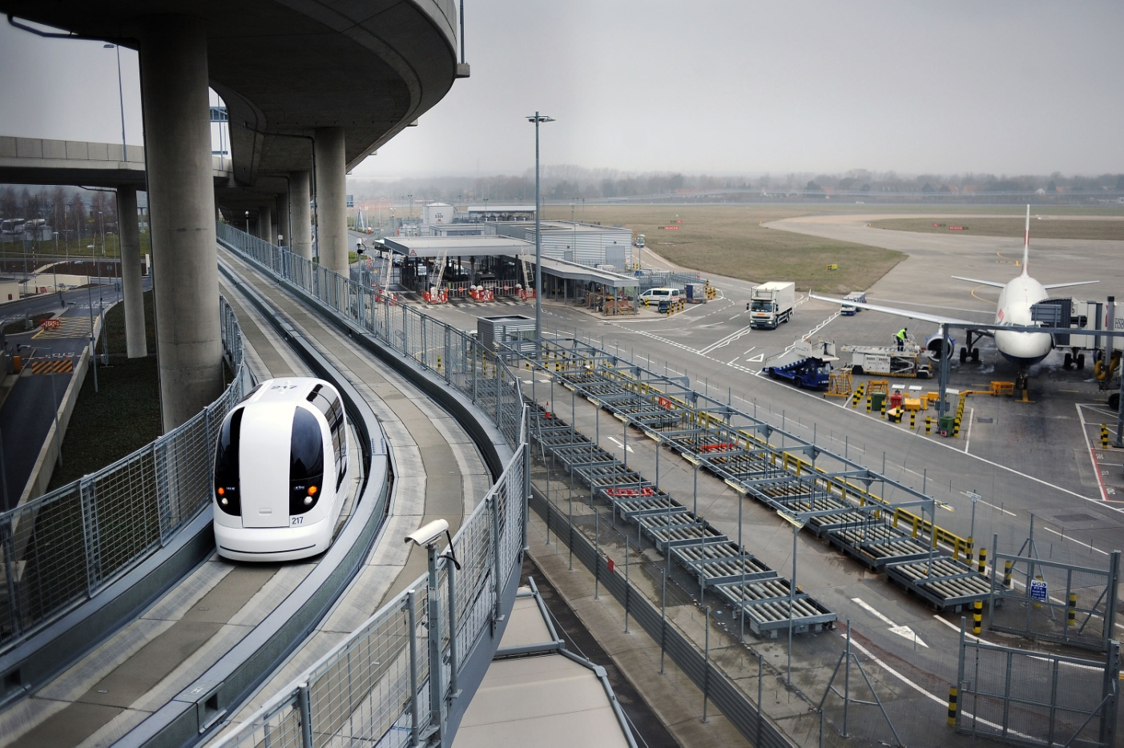
Podcars – ULTra
Key properties
Small steerable car
Laser guidance
Batteries
36 km/h (22 mph)
Not weather proof
Approved in 2003
4 s headway
2.2 m wide track

Slide 6
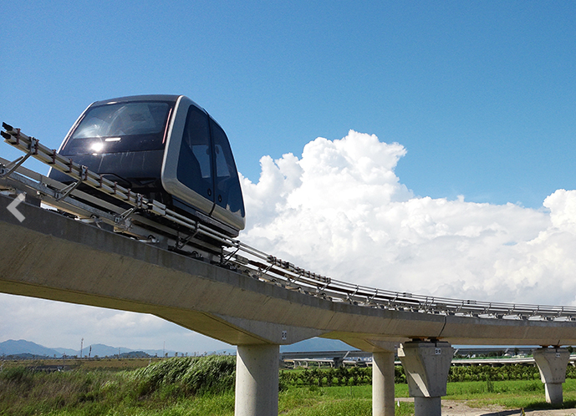
Podcars – Vectus
Key properties
Rotary motor
Switching wheels
Power rail
45 km/h (28 mph)
Weather proof
Approved in 2007
3 s headway
1.3 m wide track

Slide 7
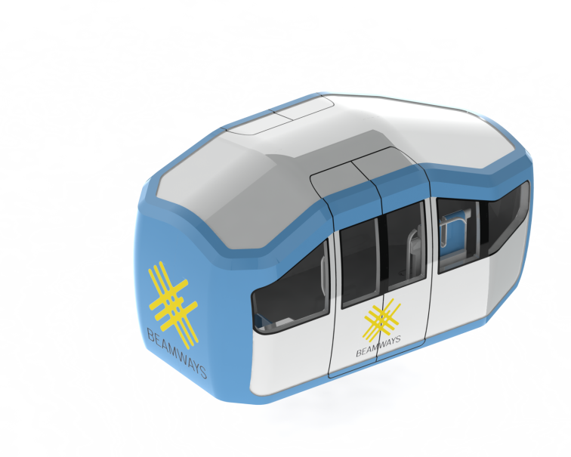
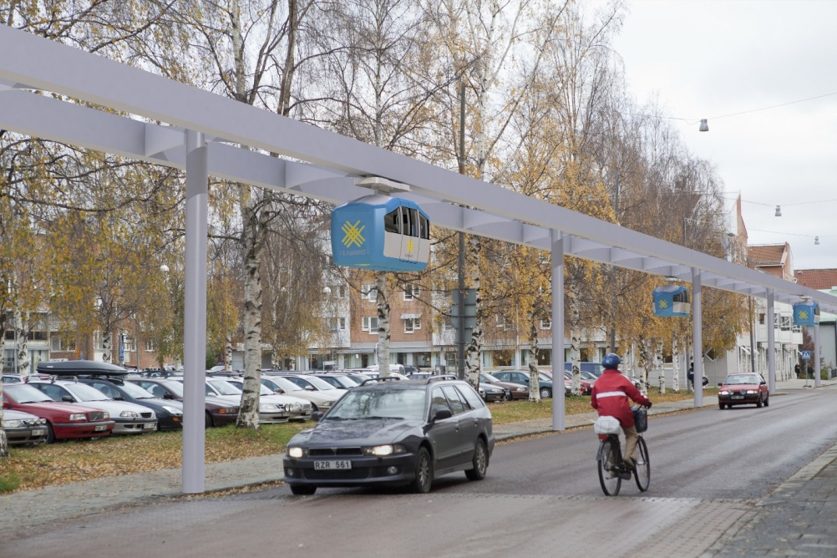
Podcars – Beamways
Key Properties
Suspended design
Dual direction lines
Active tilting and banking
Rotary motor
Wheel based switch
Grades up to 30%
Curve radius down to 3 m
50 km/h (35 mph)
0.5 m wide track

Slide 8
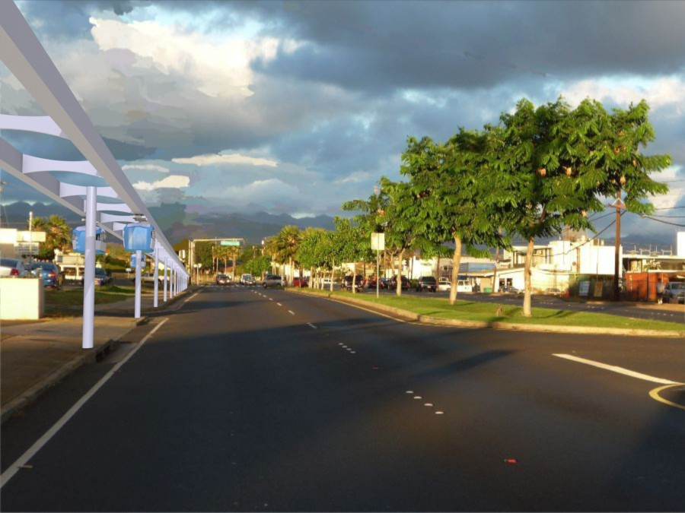
Beamways advantages
Cost effective to build.
High capacity.
Small intrusion in the city.
Low energy consumption.
All weather operation.
Flexible track layouts.
No trespassing possible.

Slide 9
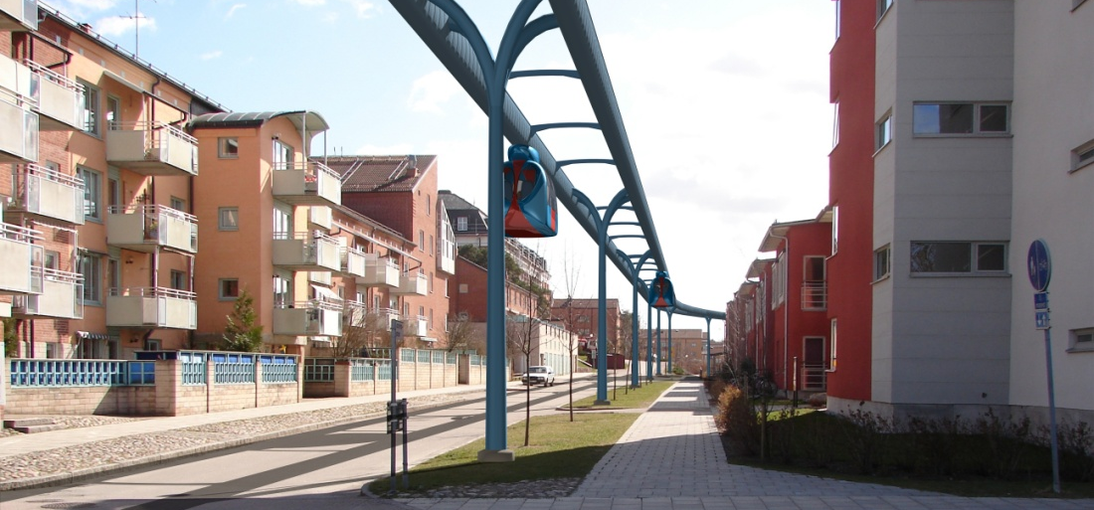
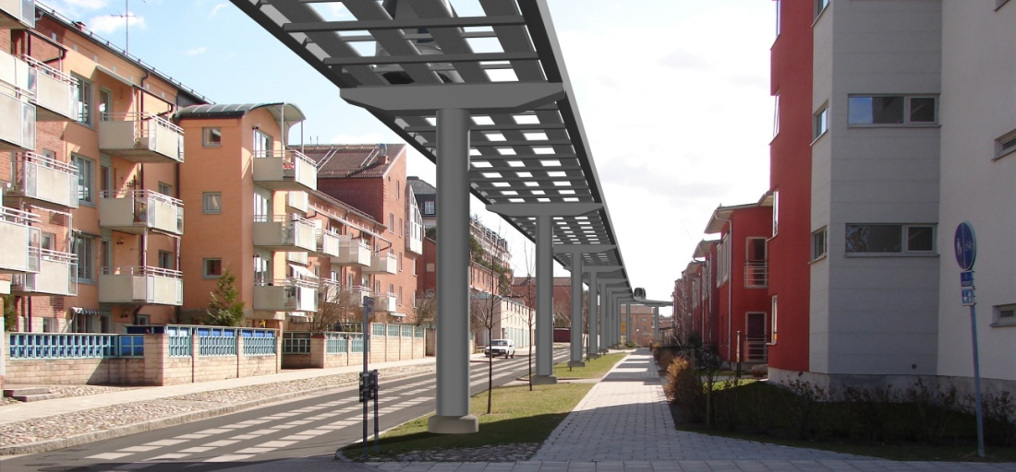

Slide 10
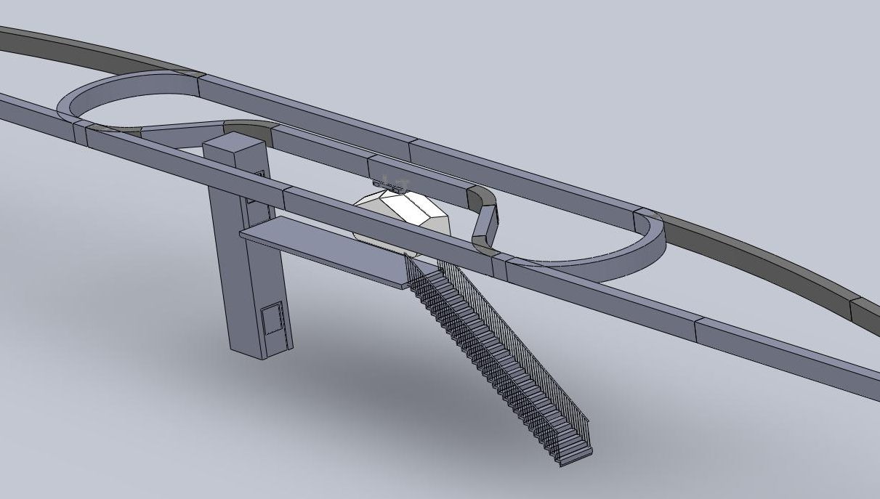
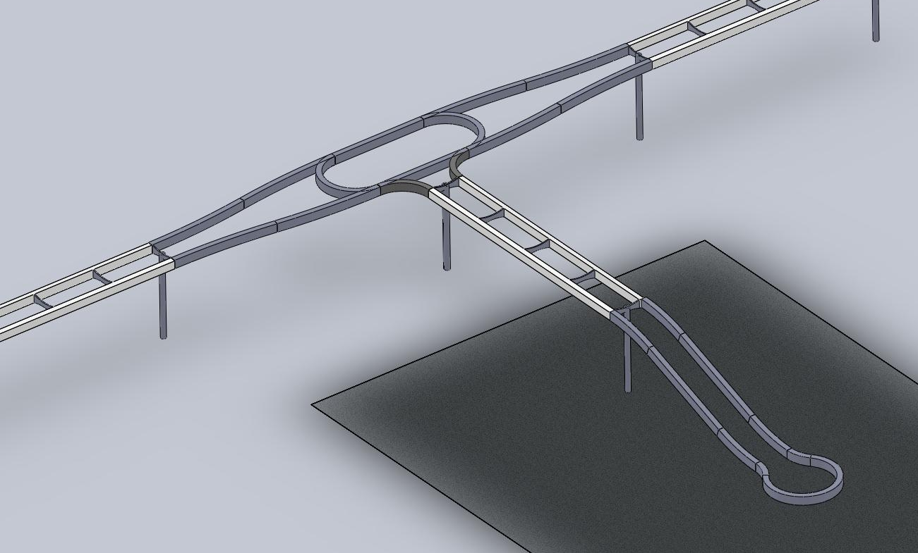
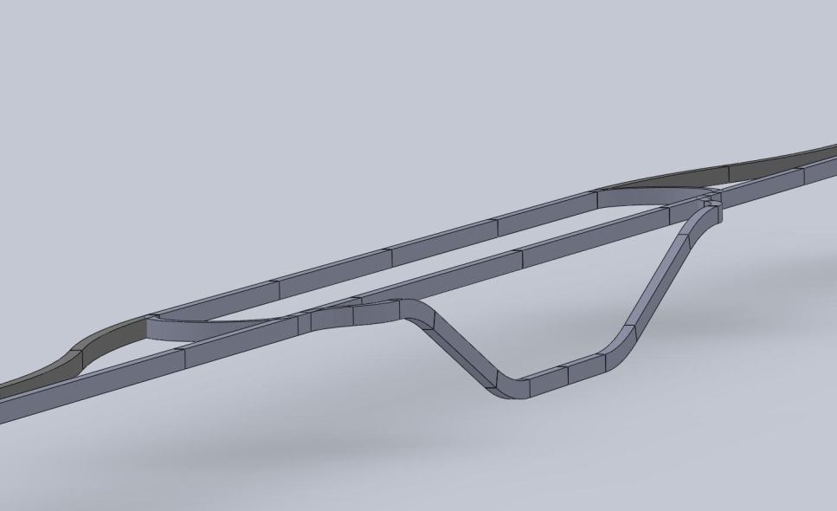
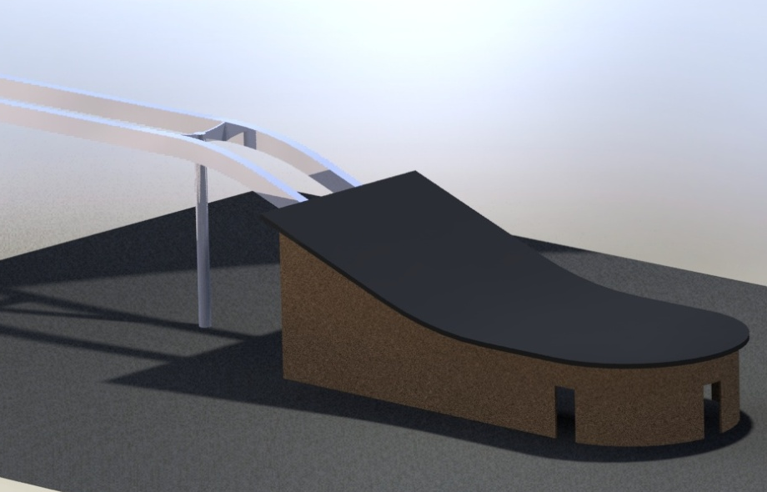

Slide 11
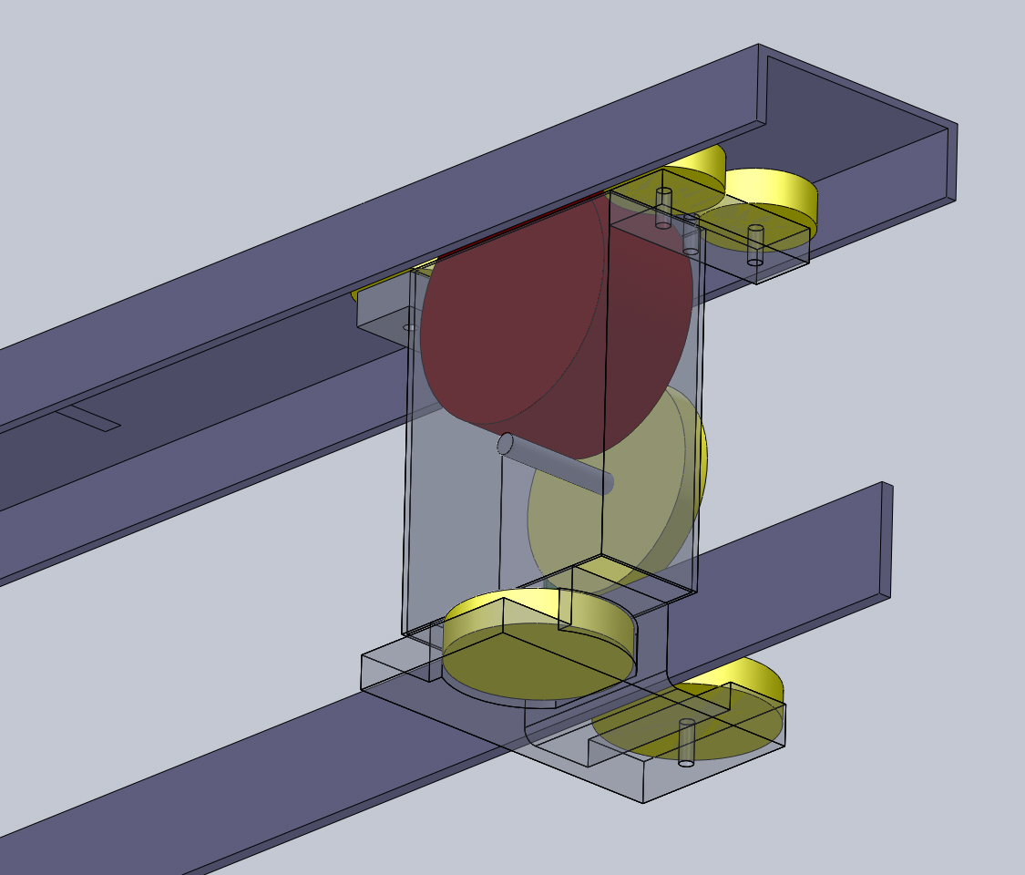
Traction principle

Slide 12
BeamEd

Slide 13
BeamEd simulator
Drag and drop creation of PRT networks.
Import of multiple raster maps.
Settable PRT system characteristics.
Advanced trip generation functions.
Simulation of thousands of trips per second.
Full statistics of simulation results.
Available for free on line at www.beamways.com

Slide 14
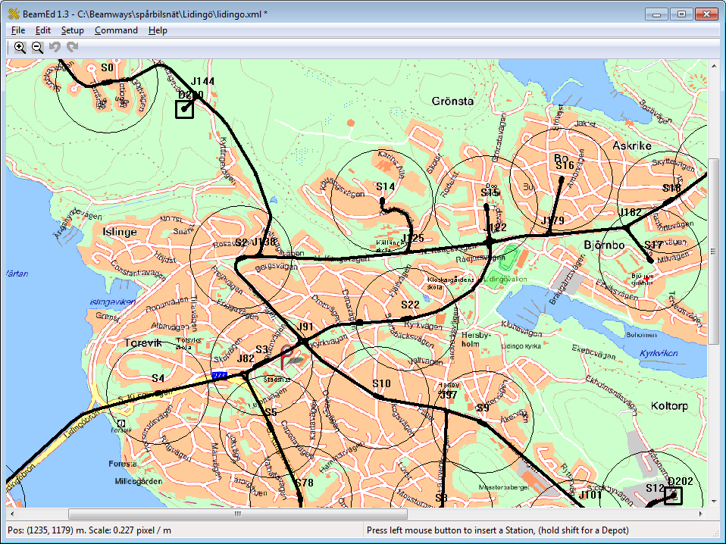

Slide 15
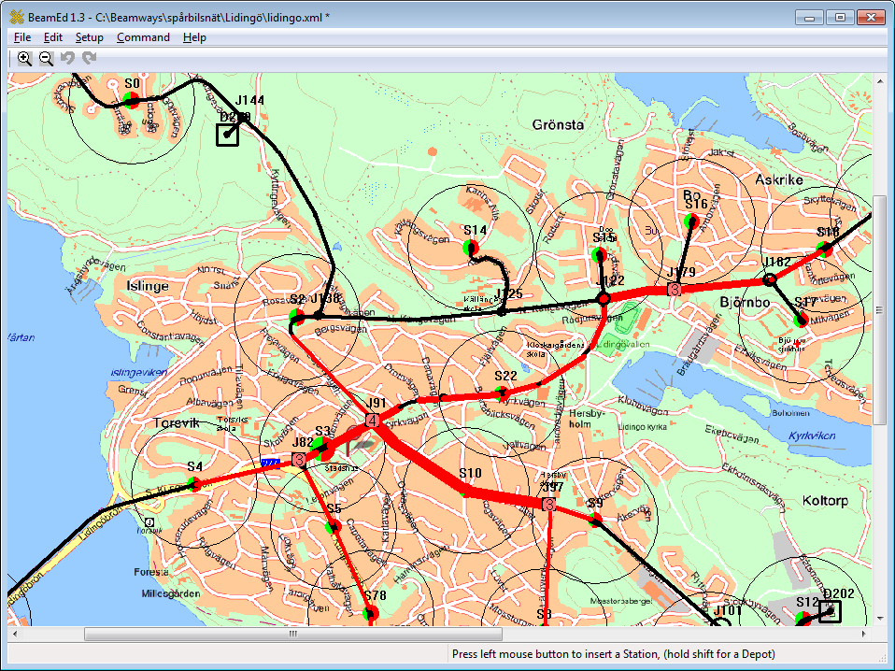

Slide 16
Larger example – Linköping
76 km mostly double direction track
109 stops
2500 vehicles
Investment: 3-5 billion SEK ($500-$800 million).
Passengers: 100 000 daily, 35 millions/year.
Revenue: 500 million SEK ($80 million) / year
O&M cost: 250 millon SEK ($40 million) / year
CBA Net benefit: about 2 ($3 value per $ invested).

Slide 17
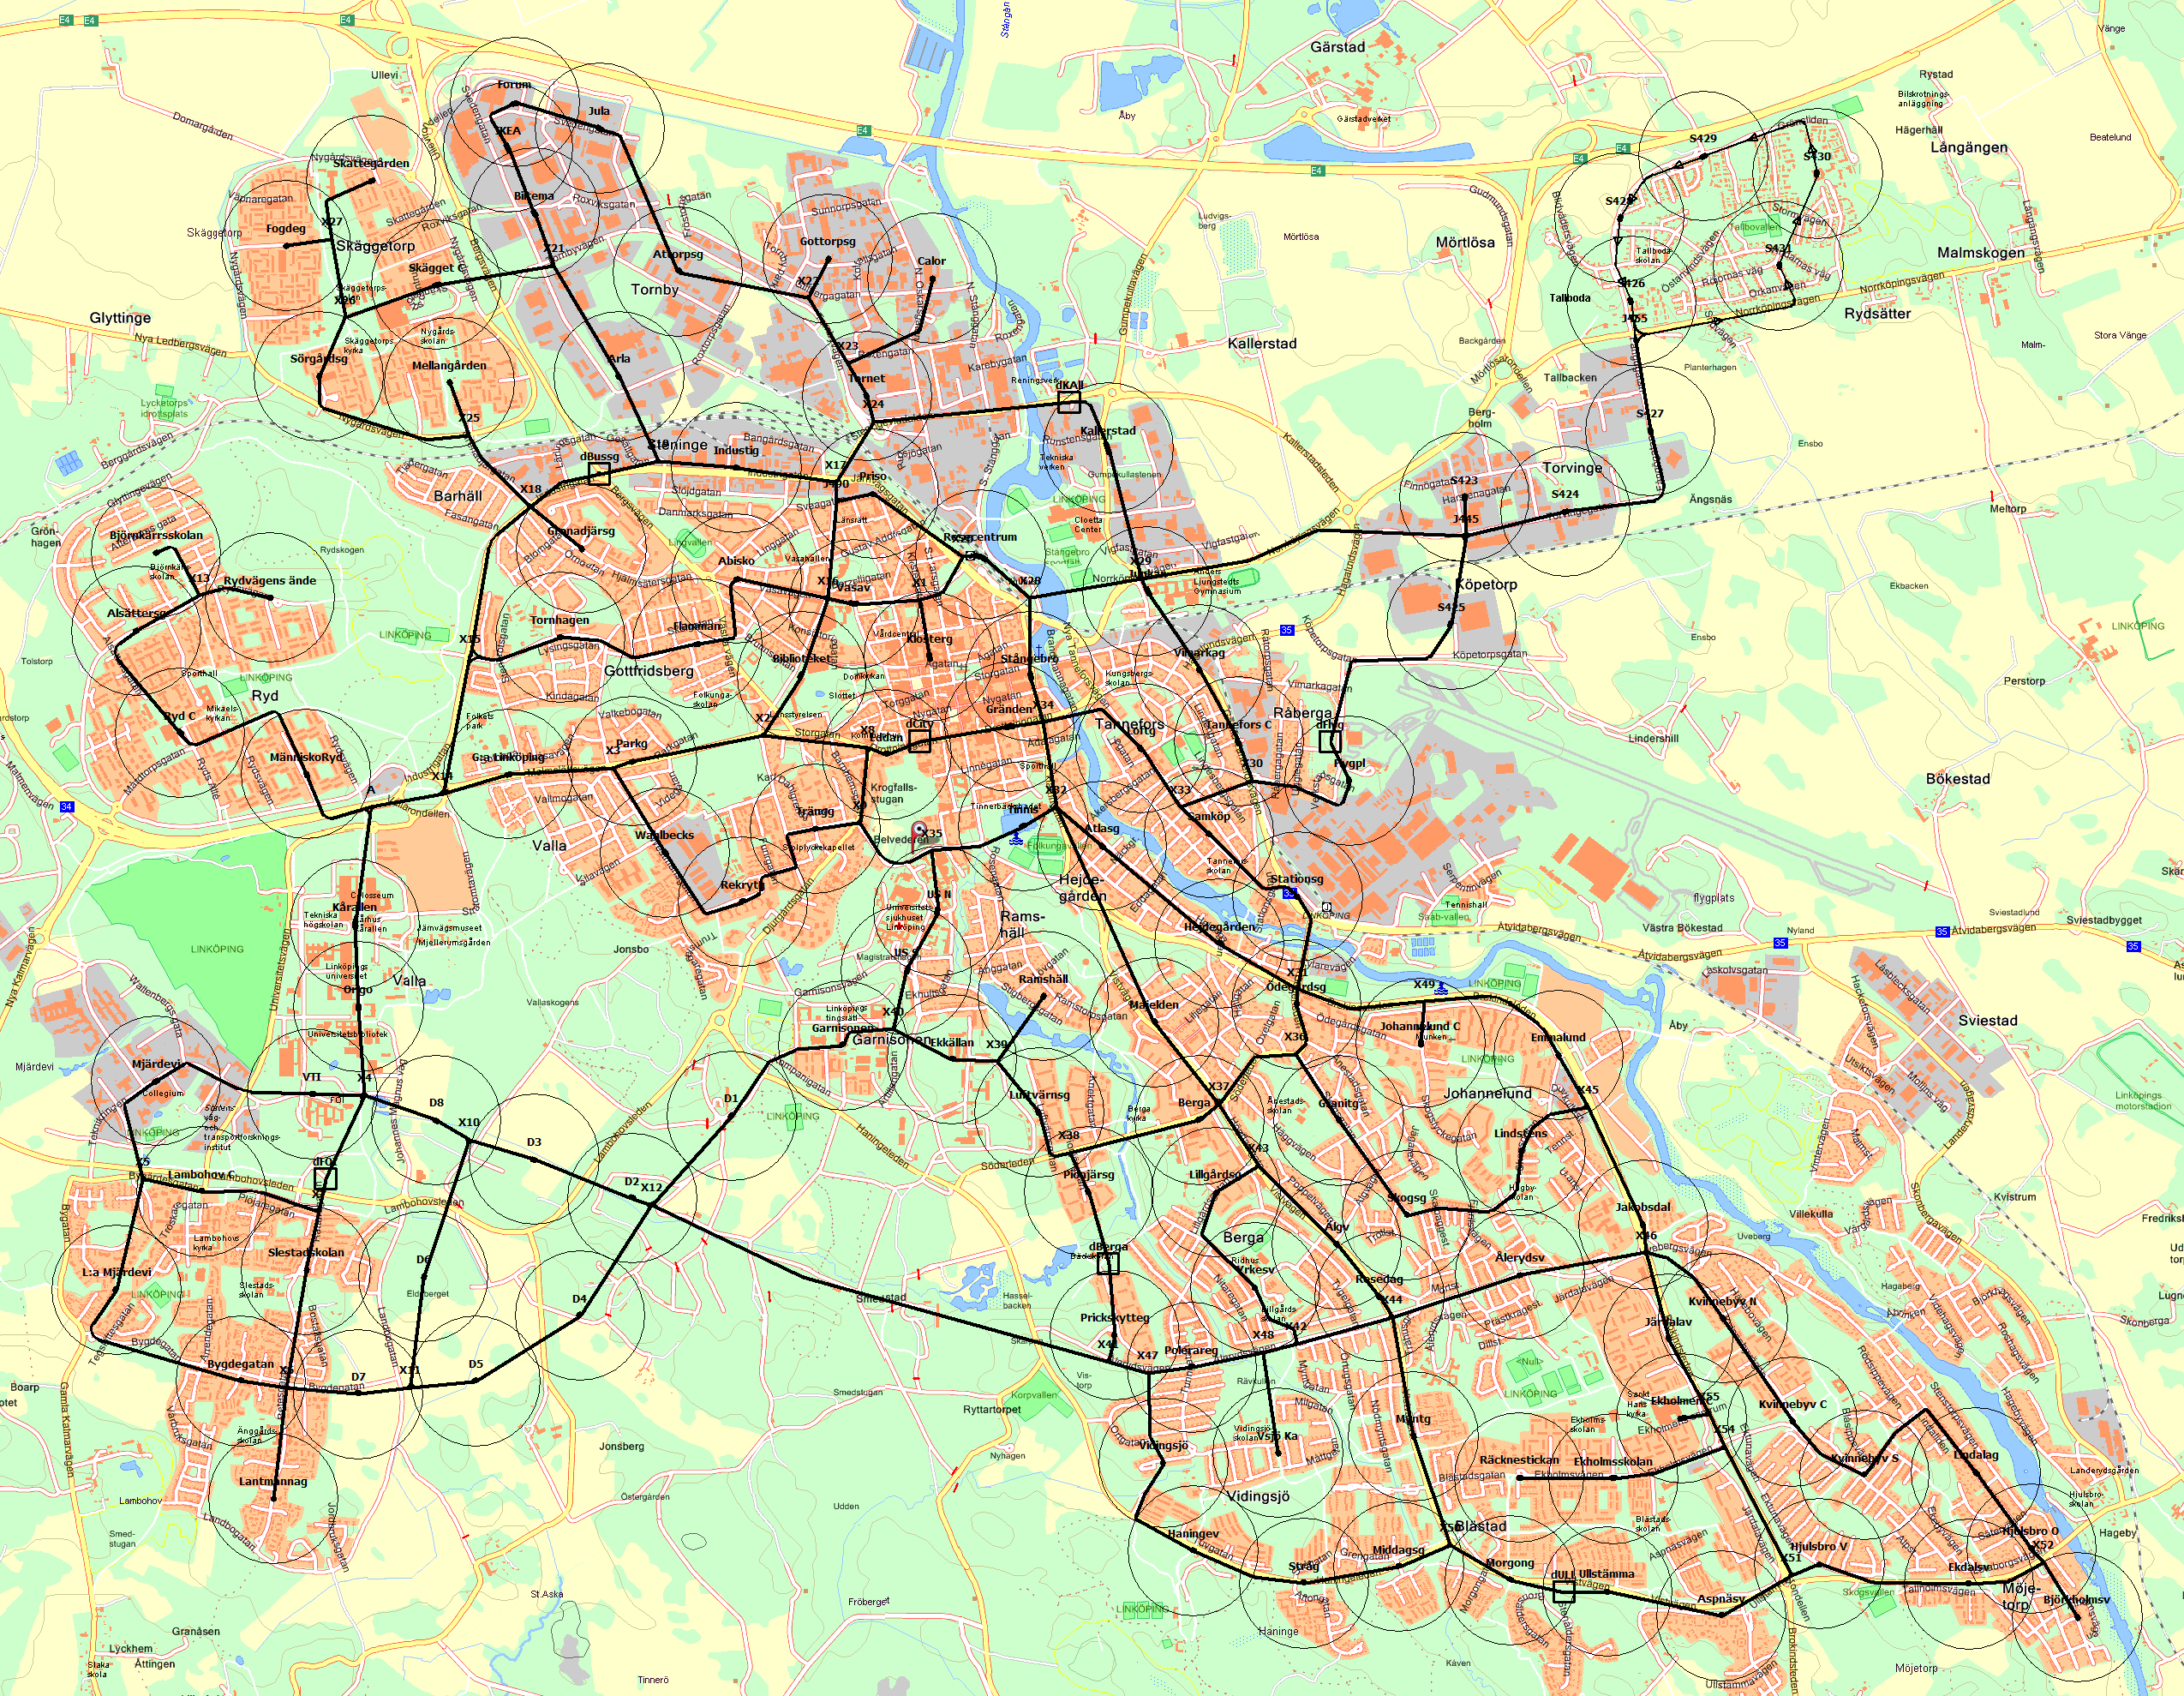

Slide 18
BeamEd 3D
Feature preview

Slide 19
BeamEd 3D features
Import and manage landscape and building information.
Manage libraries of PRT system components.
Create PRT networks on a detailed level.
Micro simulation of PRT vehicle movements.
Import images and videos and overlay 3D data.
Export images and videos of results.
Interface to CAD, GIS, PRT control software and virtual worlds such as Encitra.

Slide 20
Data & Workflow
Micro-simulator
Videos
Images
Map data
Camera Registration
3D Rendering
Images
Videos
Height data
Coordinate
Handling
Project Database
3D Export
Object Library
Building data
3D Editing

Slide 21
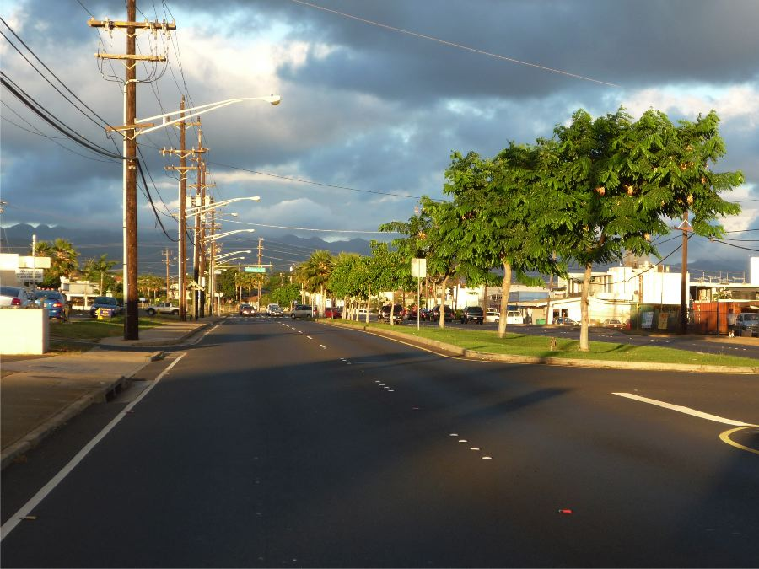
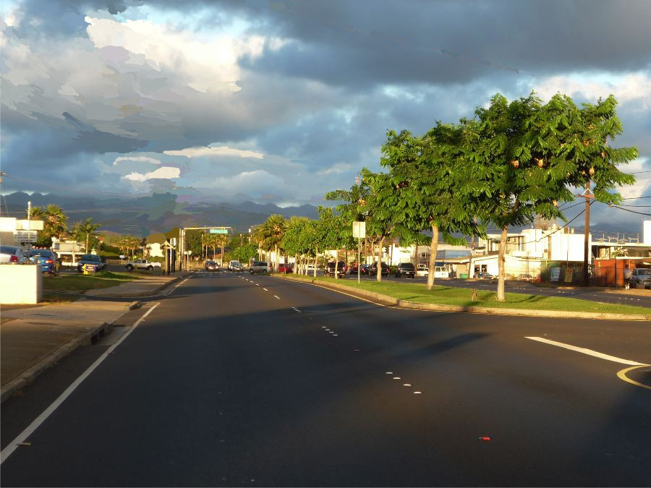
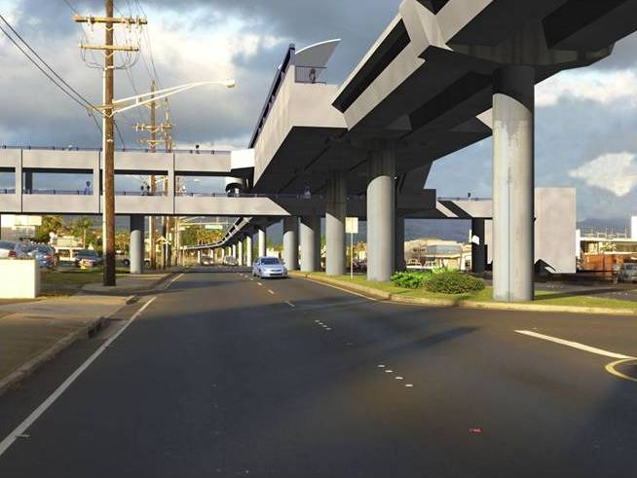
Retouch
3D
3D

Slide 22
Import background information
Import raster and vector maps.
Import height data.
Import 3D models of buildings and objects.
Create or modify buildings inside software.
Align data from multiple sources.
Visualize all data using an advanced 3D engine.

Slide 23
Manage PRT system components
Import 3D models of vehicles.
Create track cross-sections.
Create models of posts and other parts.
Create parameterized sections of track.
Create complete PRT system models including dynamic system properties.

Slide 24
Create PRT networks
Import rough network design from BeamEd.
Build complete PRT networks in 3D model.
Use predefined track sections or create custom.
Create multi-level designs and slopes.
Place individual pillars accurately and easily.
Place and customize 3D station models.
Design rule checking and creation.

Slide 25
Micro-simulation
Realistic movements of PRT vehicles.
Vehicles adhere to system max acc, jerk etc.
Vehicle patterns imported from BeamEd.
Vehicle movement such as banking, tilting, door operation supported.
PRT system characteristics can be changed and simulation rerun, including the 3D appearance.

Slide 26
Export images and videos
Create virtual cameras in 3D model.
Export photos from cameras to any format.
Create videos showing vehicle movement.
Program camera motion with time.
Refer camera motion to any object including vehicles.

Slide 27
Interface to other software
Output 3D model to CAD, GIS.
Output detailed track info to simulators, eg. BeamEd, Encitra.
Create BOM (bill of materials) for procurement.
Output network layout to PRT control software.

Slide 28
Conclusions for BeamEd 3D
Developing BeamEd 3D is a major undertaking.
Some features are available in mainstream CAD, GIS packages. - Dedicated software can offer much easier operation, guide your work and check for errors.
BeamEd 3D works for any PRT system.
Customization and ongoing support is important.

