Slide 1
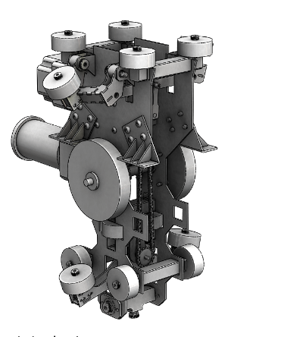
2019-2020 Half Scale Team
Bogie Design & Controls
ME195B Senior Design Project II
Dr. Burford Furman
Section Number (04)
05-08-2020
Gregory White (Lead)
Brandon Scully
Pinqian Lin (Edward)
Keanu Heggem
Notes:
Slide 1: Title of your project. (Ex: Spartan Superway - Small-Scale Model Development). Include a compelling graphic that is clear and captures the essence of your project. Include these items too:
San José State University
Charles W. Davidson College of Engineering
ME195B Senior Design Project II
name of professor (Dr. Burford Furman)
Section Number (04)
Date (May 8, 2020)
[ (Ex. "Good morning, my name is..., and along with my team members, we will share with you our work on..." ) ]
10 sec

Slide 2
Team members had specified responsibilities throughout the project’s duration
Bogie Redesign
Switch Mechanism
Mechanical Repair
Mechanics/Electronics Team
Control Box Repair/Redesign
Half-Scale Track Assembly
Mechanics Team
Greg White (Lead)
Pinqian Lin (Edward)
Switch Mechanism
Mechatronics Coding
Controller Redesign
Electronics Team
Half-Scale Track Redesign
CAD Modeling/Documentation
Mechanics Team
Keanu Heggem
Brandon Scully
Notes:
Slide 2: Thumbnail pictures of team members with names beneath picture and main responsibilities on the project. All you need to do is name your team mates. Don't spend time explaining responsibilities.
[ (Ex. "Our team consists of...") ] 10 sec

Slide 3
3a: Background of Issue
Background on the larger societal problems with urban transportation that the Superway aims to solve
Brandon

Slide 4
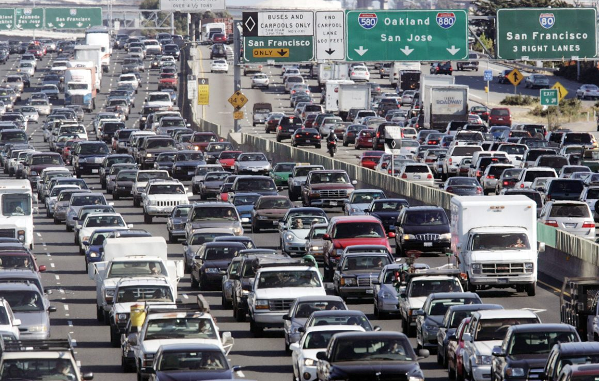
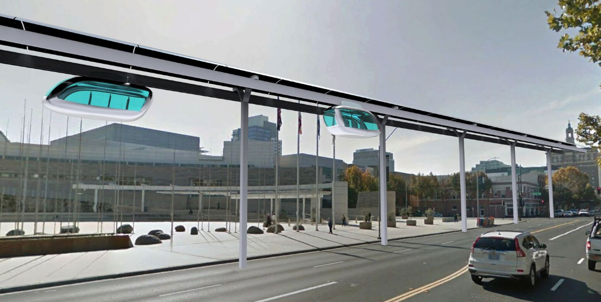
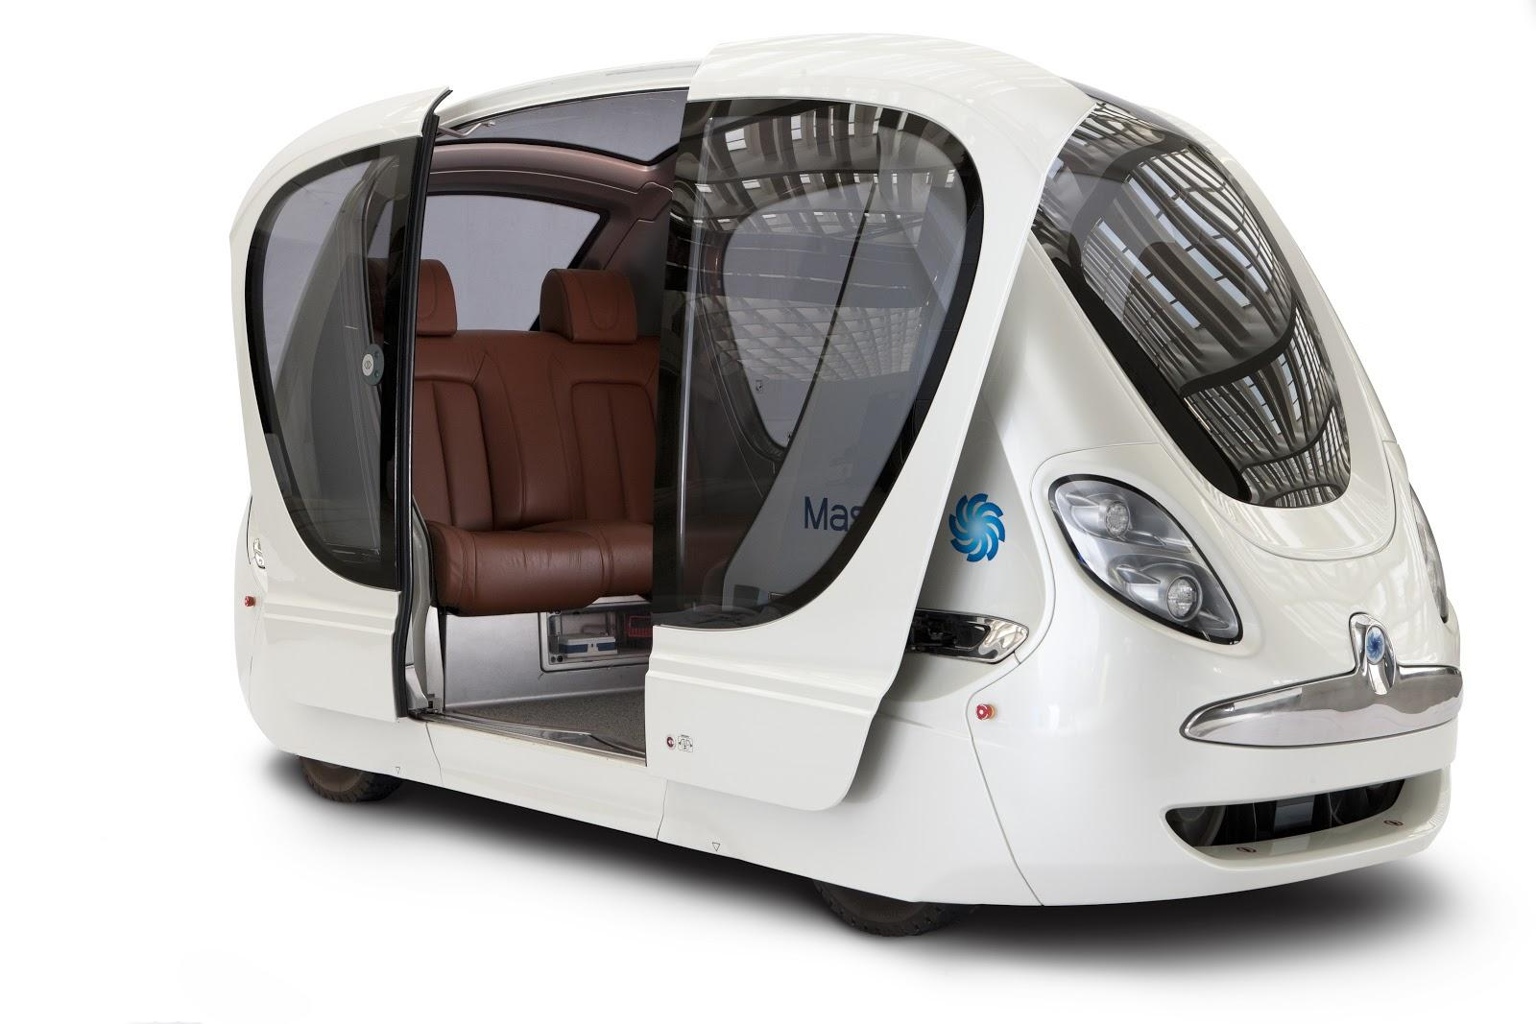
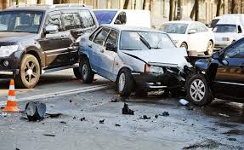
The Spartan Superway is designed to be a solar powered autonomous Personal Rapid Transit System(PRT) that utilizes unoccupied air space and is safer than current transport modes
Brandon
Notes:
Slides 3a... : Background on the larger societal problems with urban transportation that Superway aims to solve.
E.g., use of fossil fuels, pollution+GHGs, safety, congestion, poor livability, social inequity. 1 min

Slide 5
4a: Background of Superway
Background on ATN (what is it?) and Superway (solar ATN)
Brandon

Slide 6
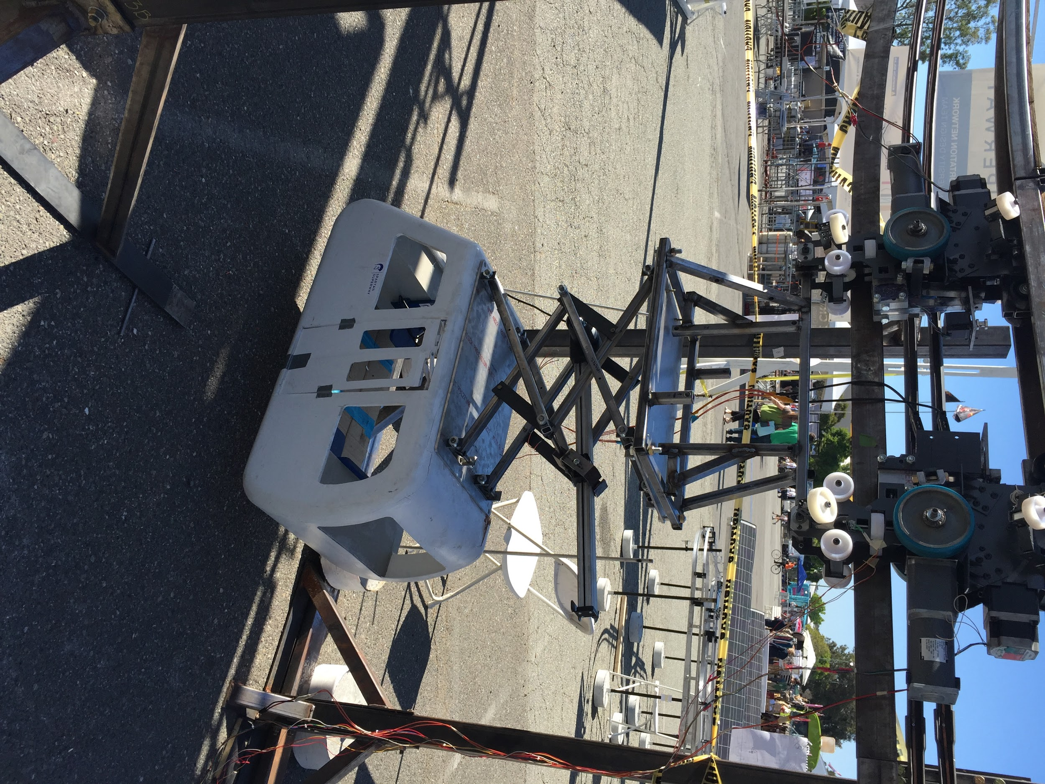
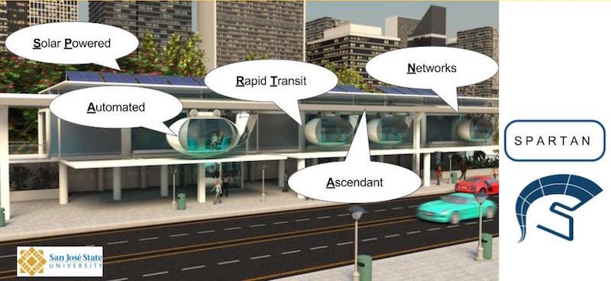
The Spartan Superway is a Solar Automated Transit Network (ATN), it operates autonomously using solar energy
Brandon
Notes:
Slides 4a... : Background on ATN (what is it?) and Superway (solar ATN)
Explain what the ATN concept is (key elements) and what Superway is (year 7 of research and development of solar-powered ATN; technology innovation and demonstration of function). See p.7 in http://transweb.sjsu.edu/PDFs/research/1227-automated-transit-networks.pdf)
(Links to an external site.)
. Show existing systems (Morgantown, Heathrow (Ultra), Masdar City (to_get_there), Rotterdam shuttle, and Suncheon Bay (Vectus) ). Show a slide with a compelling vision of what the Superway system could look like. 1 min

Slide 7
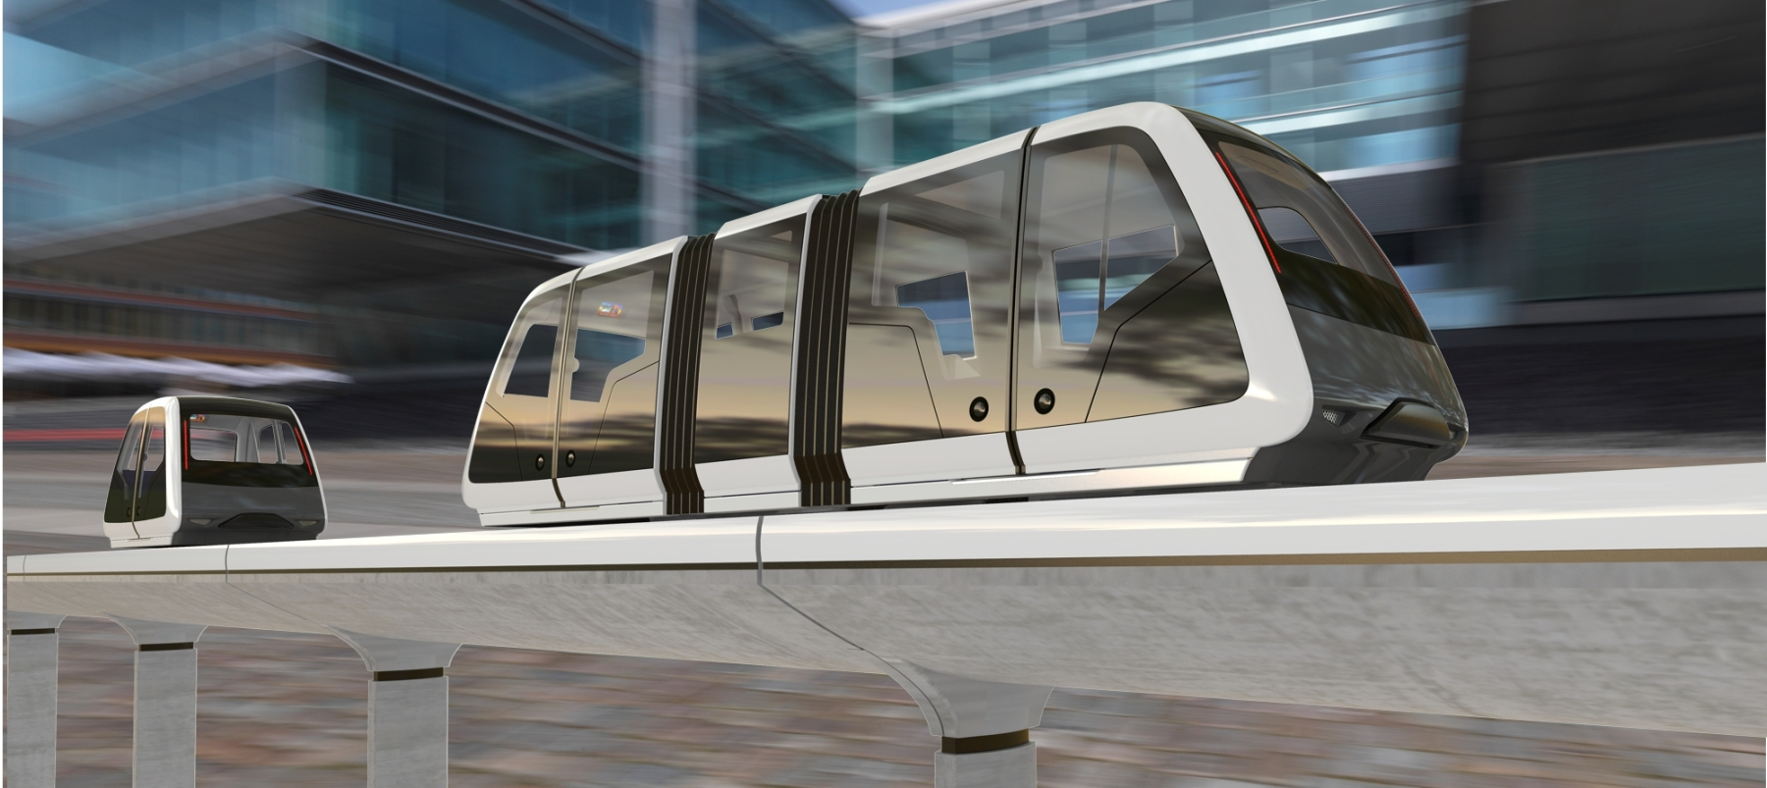
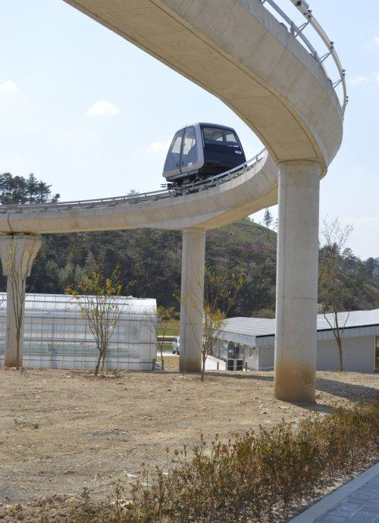
The Suncheon Bay VECTUS system, which has been operating as a Personal Rapid Transit System (PRT) since 2013, is similar to the Superway system
Keanu

Slide 8
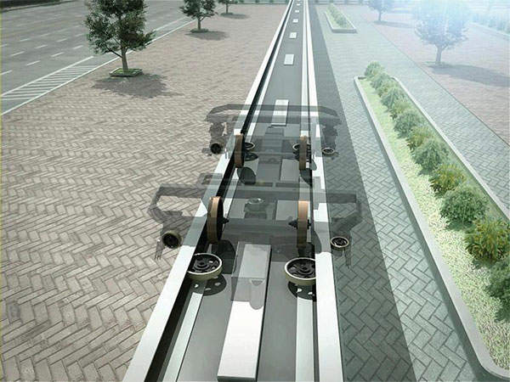
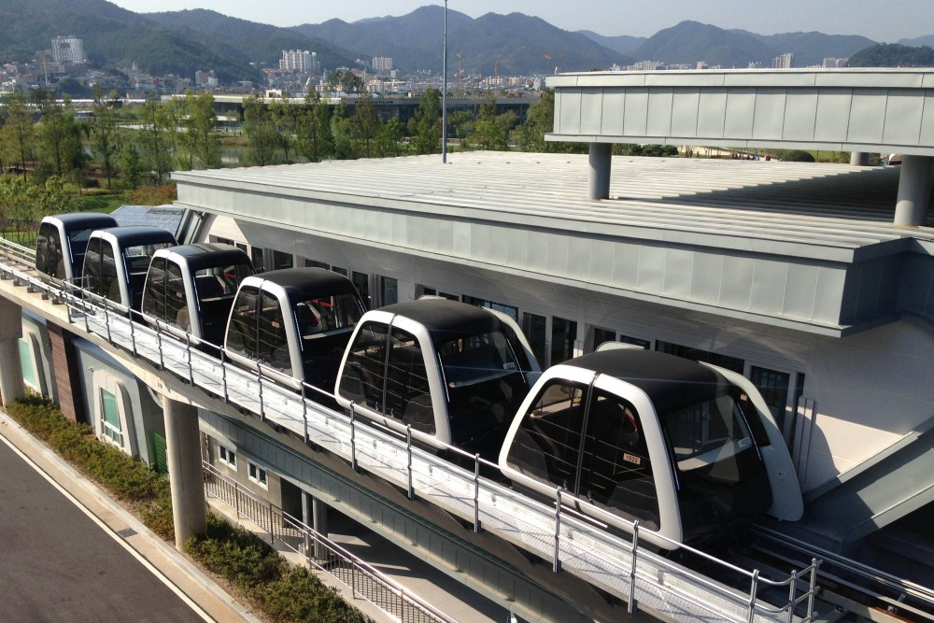
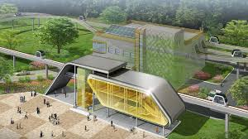
The Spartan Superway is designed with similar concepts as the VECTUS, but will take them further to create a transit system that can span an urban area
Keanu

Slide 9
5a: Motivations
Background and motivation for your specific project in the context of solar ATN development
Edward
Notes:
Motivations of the half scale project

Slide 10
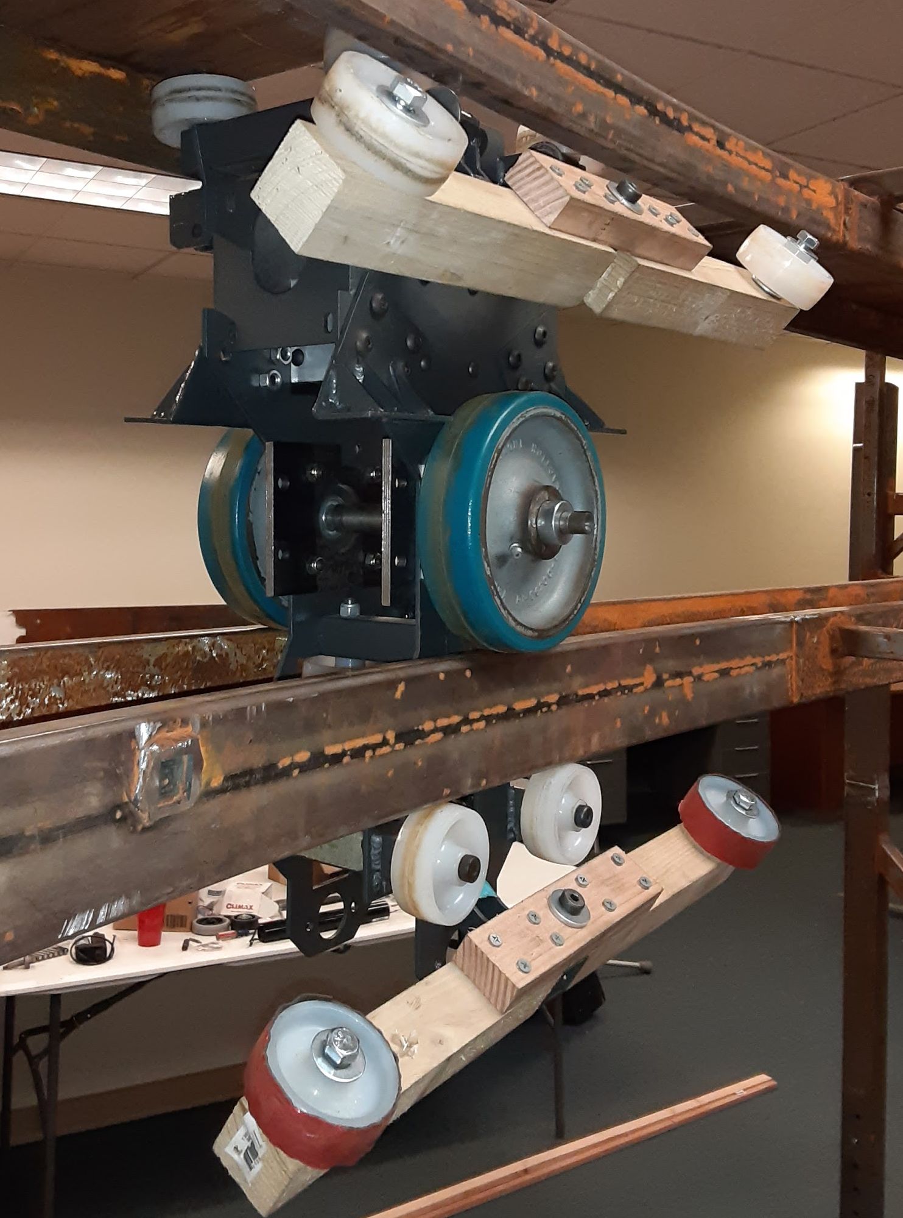
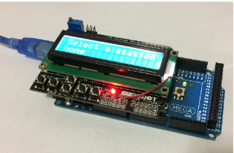
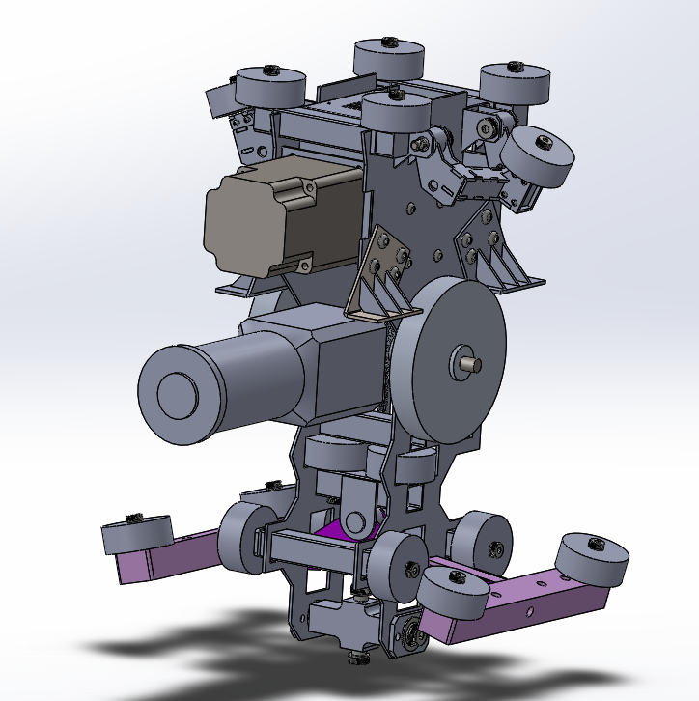
The Half-Scale model is used for quick prototyping, combining the mechatronics component of the Small Scale model with the functional modeling element of the Full Scale model
Edward
Notes:
Combine the bogie, switch arm and the control system to demonstrate the full mechanism of the half scale prototype

Slide 11
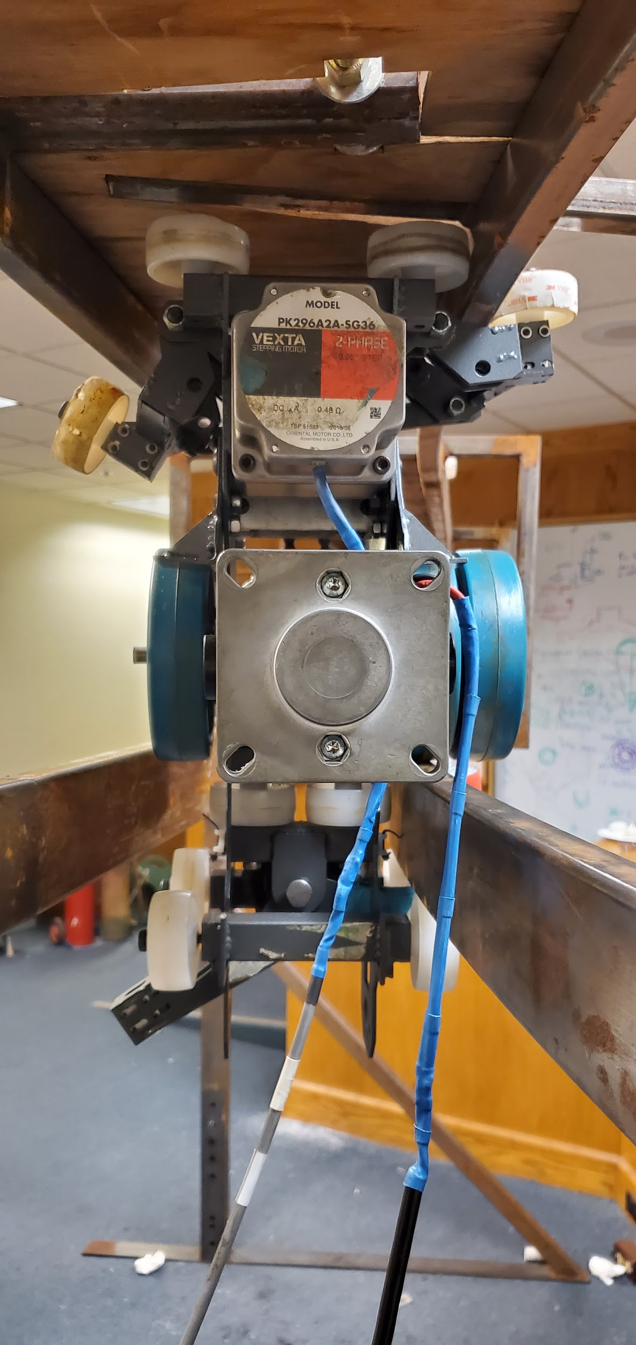
A successful half scale design would provide a sufficient proof of concept to push the Superway project towards full scale implementation
Edward
Notes:
And potential combining with the wayside power or the power module team to create full track simulations

Slide 12
6a: Objectives
Project objectives and design specifications
Edward
Notes:
Edward and Gres will explain the goal of the half scale team this year

Slide 13
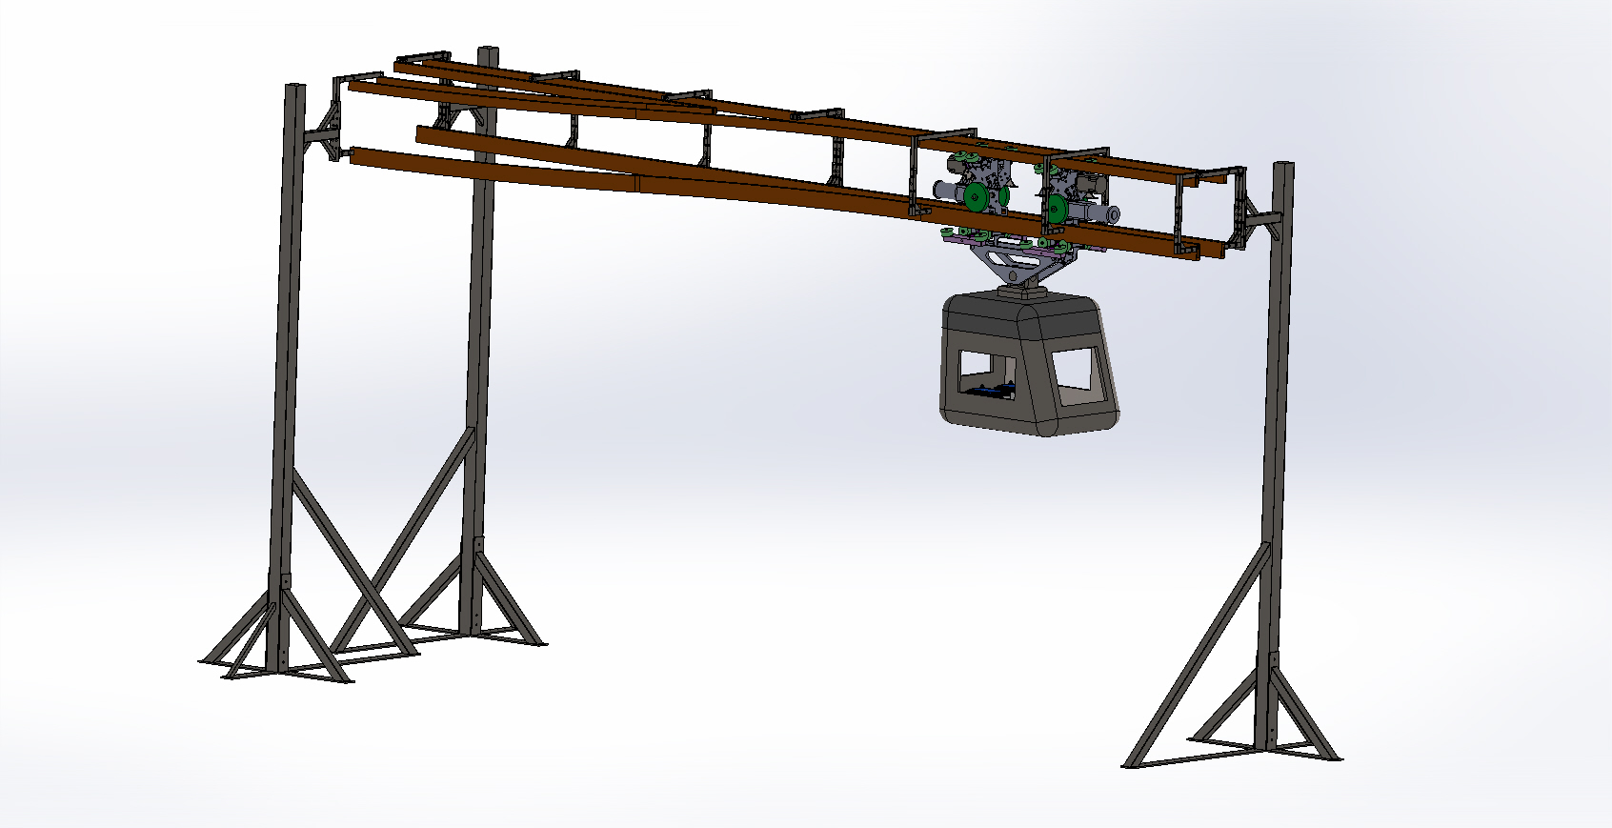
The objective of the Half-Scale Team was to build a model bogie that could simulate the function of the proposed transport system
Edward
Notes:
Slides 6a... : Project objectives and design specifications 1 min
Explain what your objectives were for your project and list quantified design specifications

Slide 14
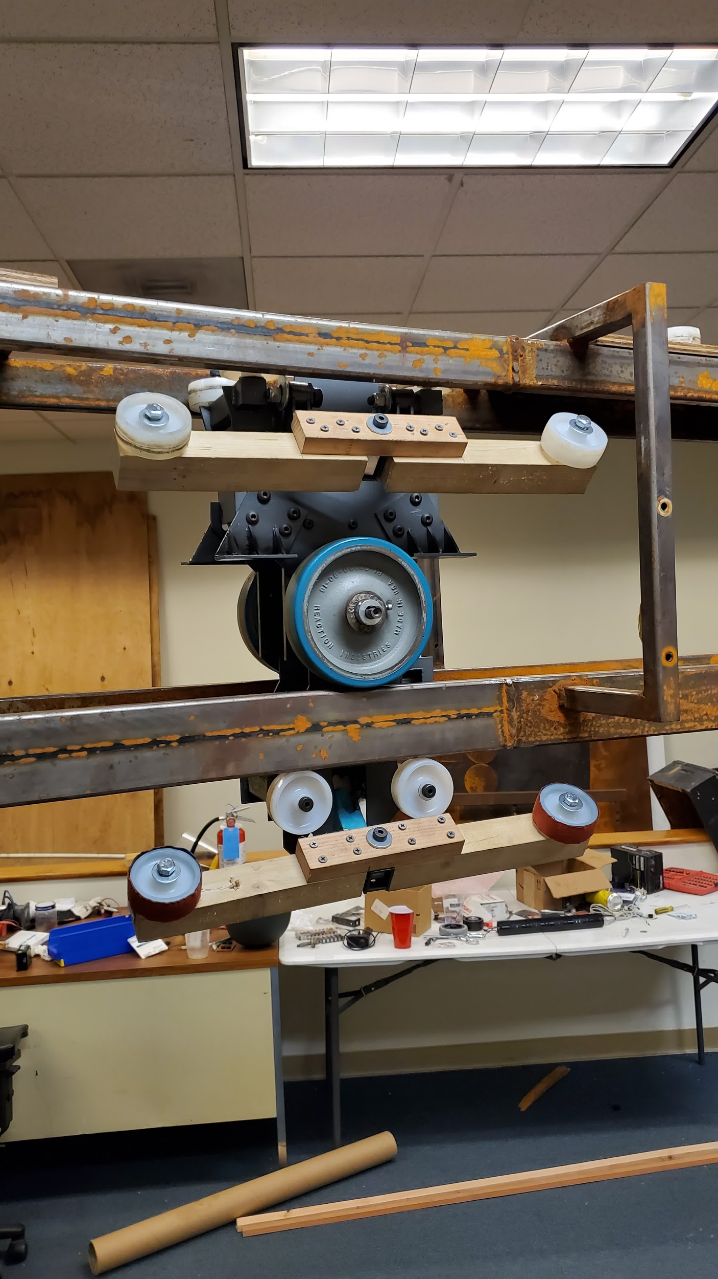
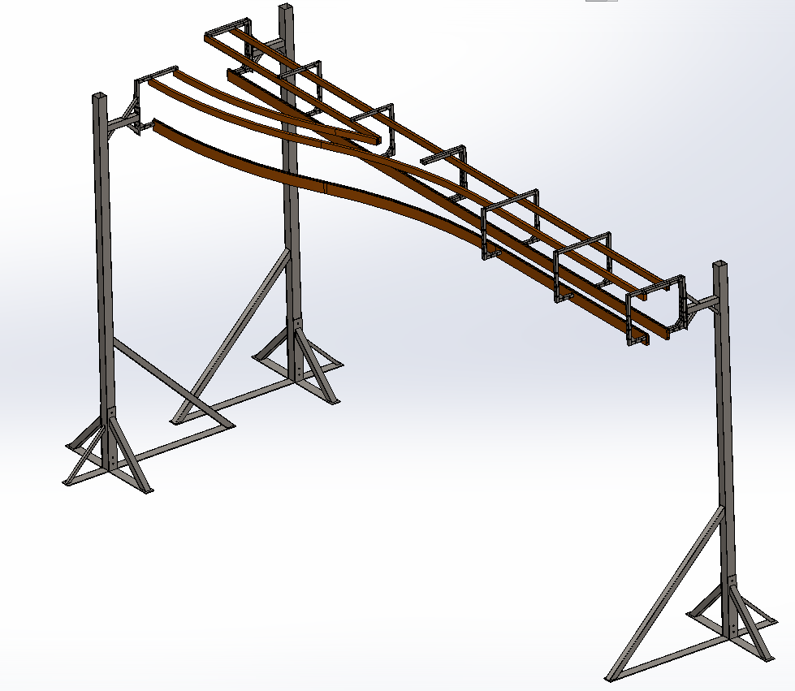
A successful switch mechanism allows the half-scale bogie to move between track arms, satisfying the passive track switching requirement for the Superway project
Greg
Notes:
Slides 6a... : Project objectives and design specifications 1 min
Explain what your objectives were for your project and list quantified design specifications

Slide 15
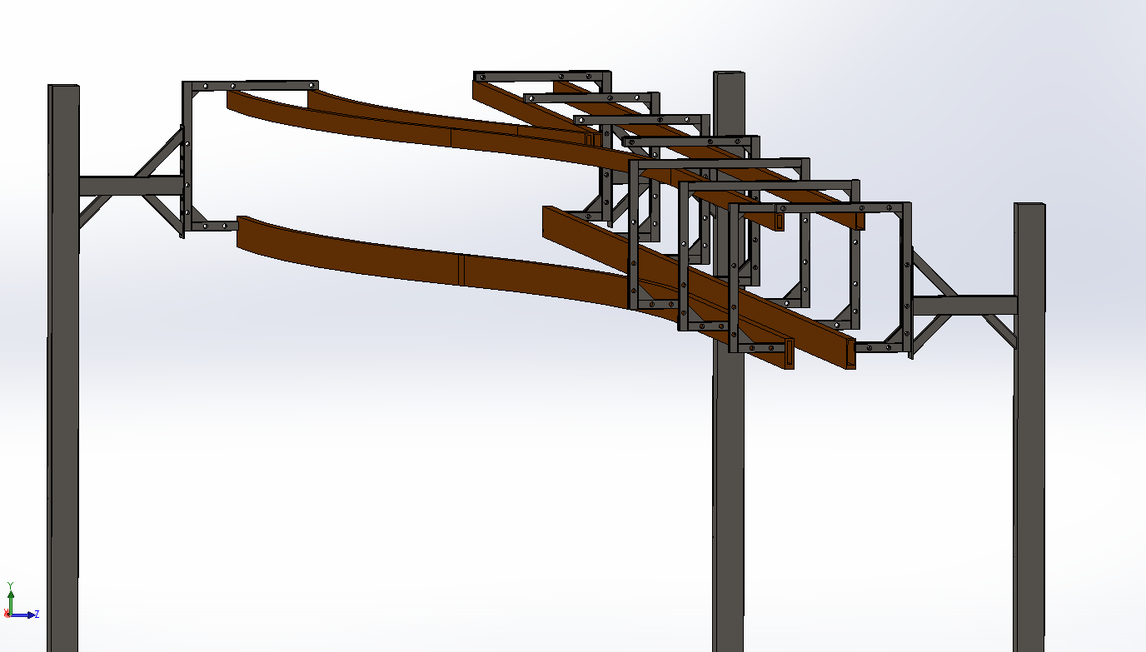
A successful control box design and track design is evidenced by the creation and simulation of CAD designs of these two objectives
Greg
Notes:
Slides 6a... : Project objectives and design specifications 1 min
Explain what your objectives were for your project and list quantified design specifications

Slide 16
7a: Design
Describe your design and how you arrived at it
Greg

Slide 17
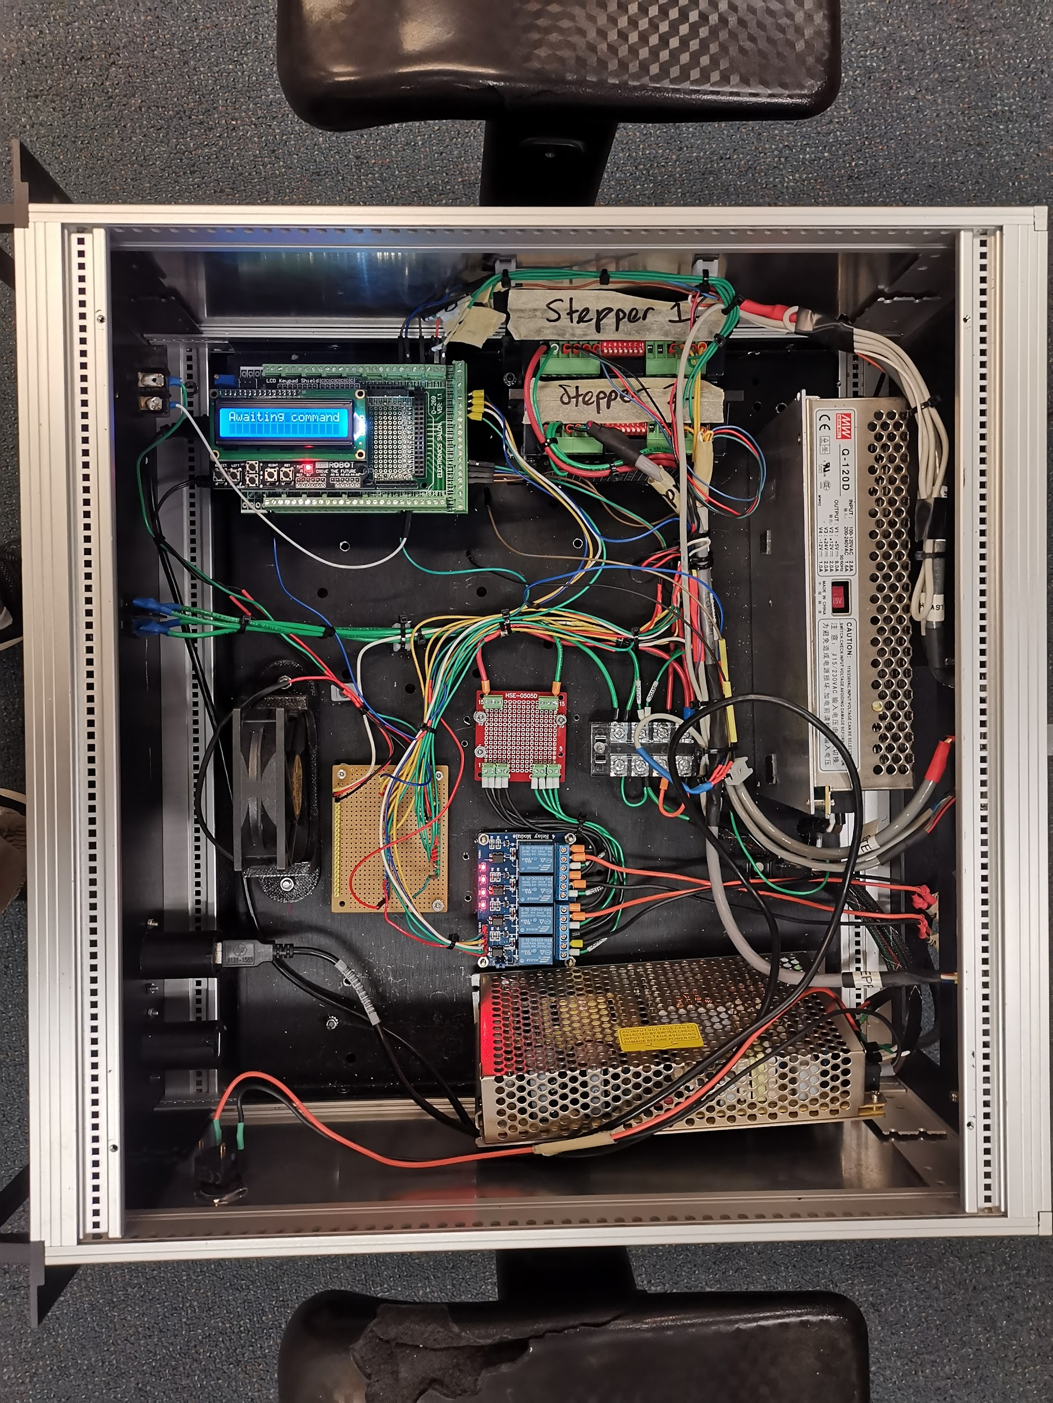
The final design of the control system and the compartment housing allow us to use 12V batteries to power the control system.
Edward

Slide 18
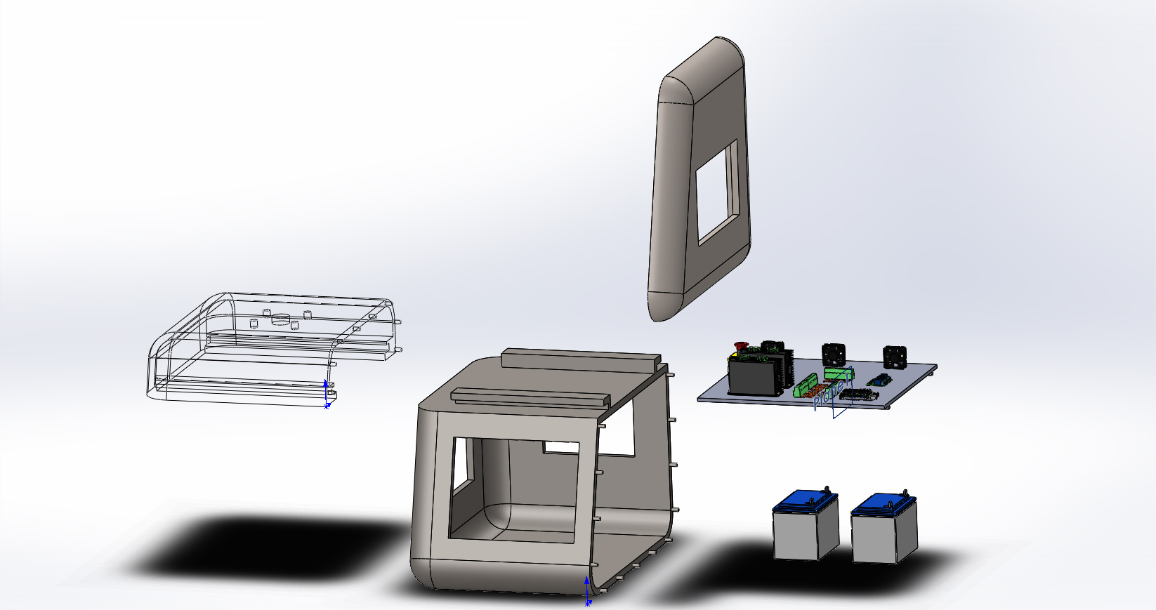
An exploded view of our final design for our final control system and compartment cabin.
Edward

Slide 19
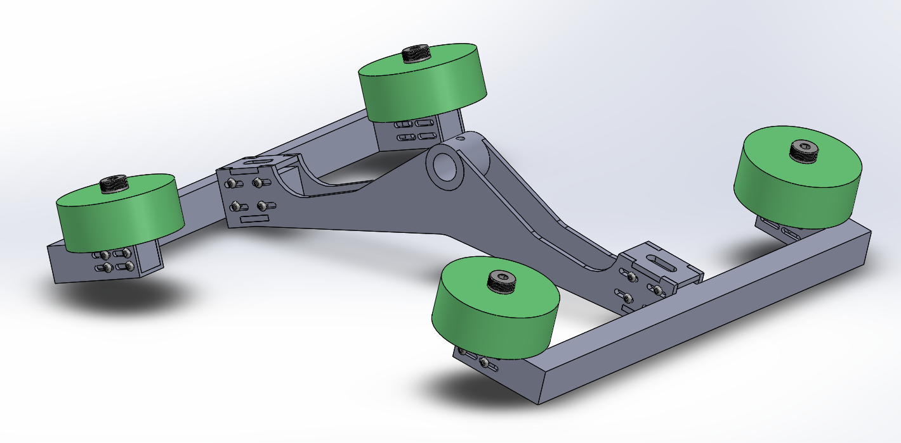
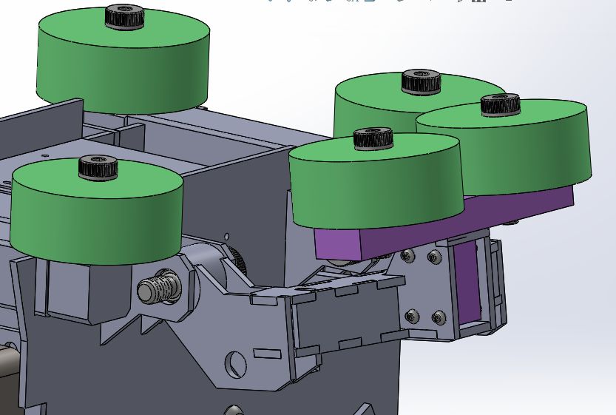
The final prototype along with changes to the current bogie mechanism is the product of design studies of prior switch arm models
Brandon
Notes:
Slides 7a... : Describe your design and how you arrived at it. 7 min
Start this section with your literature/state-of-the-art review, so you can show what research you did to, 1) Avoid reinventing the wheel, and 2) Use existing knowledge, standards, etc. to guide your design decisions to your final design. Make good use of multiple views of solid models, cut-aways, exploded views, etc. to communicate your design and how it works. Explain how your designs were or would be fabricated.

Slide 20
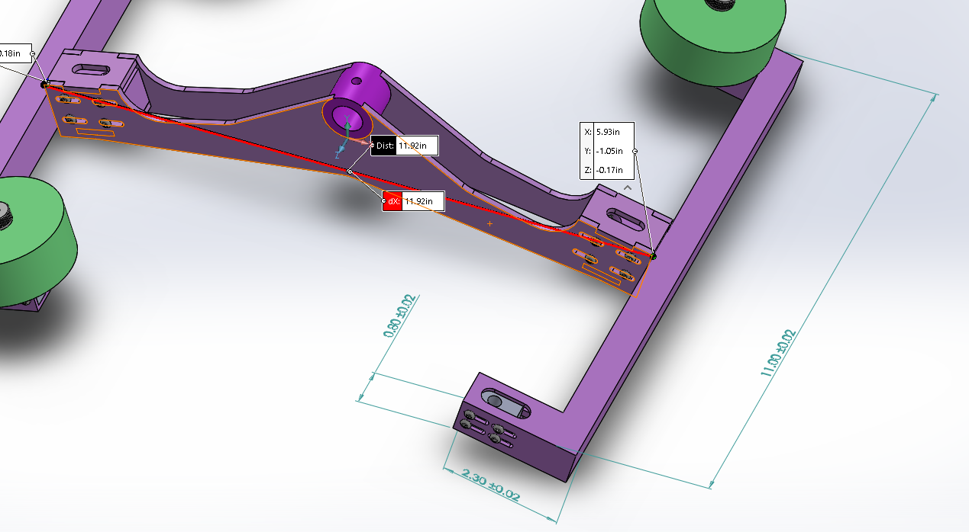
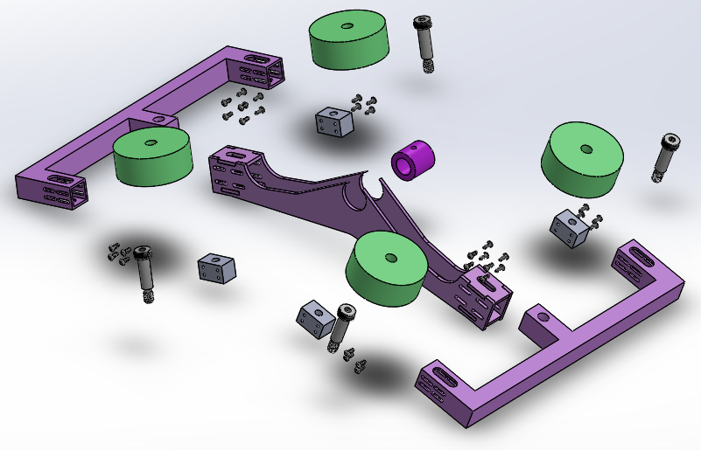
An exploded view of our final prototype design for our switch arm is shown
Slots enable adjustable translational motion of the wheels
Brandon

Slide 21
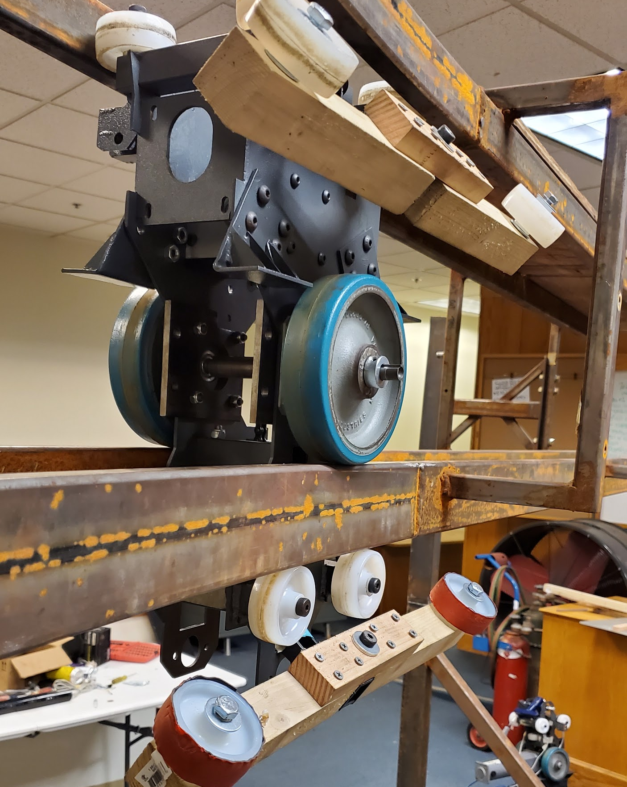
A CAD redesign of the track has been completed by increasing its length by 0.35 inches. This design compensates for the interference between the track and the lower switching arm.
Brandon
Notes:
Brandon: Track CAD

Slide 22
A CAD redesign of the track has been completed by increasing its length by 0.35 inches. This design compensates for the interference between the track and the lower switching arm.
Brandon
Notes:
Brandon: Track CAD

Slide 23
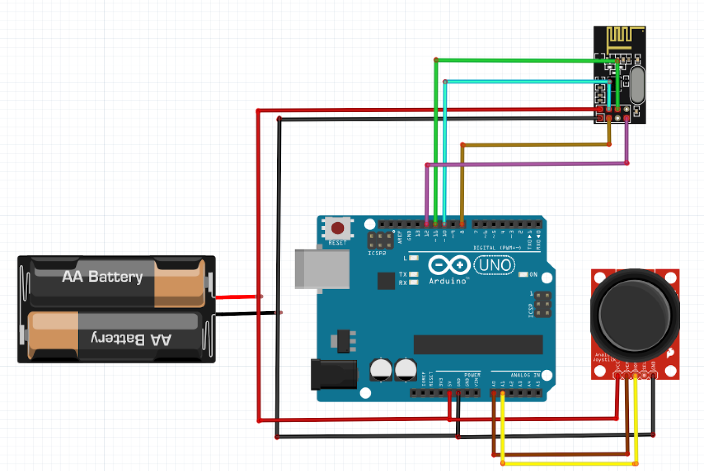
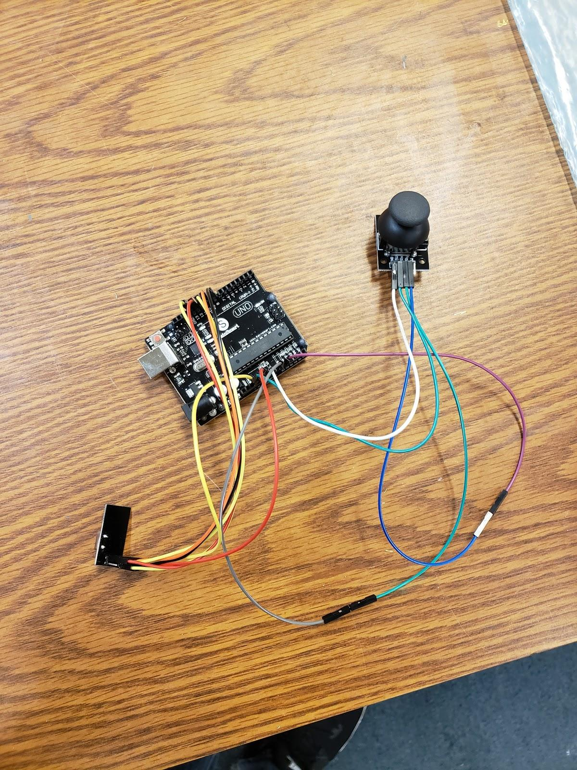
Concerns over the effectiveness of the LED display/button panel in the control box led to the creation of the wireless controller concept
Keanu
Notes:
Slides 7a... : Describe your design and how you arrived at it. 7 min
Start this section with your literature/state-of-the-art review, so you can show what research you did to, 1) Avoid reinventing the wheel, and 2) Use existing knowledge, standards, etc. to guide your design decisions to your final design. Make good use of multiple views of solid models, cut-aways, exploded views, etc. to communicate your design and how it works. Explain how your designs were or would be fabricated.

Slide 24
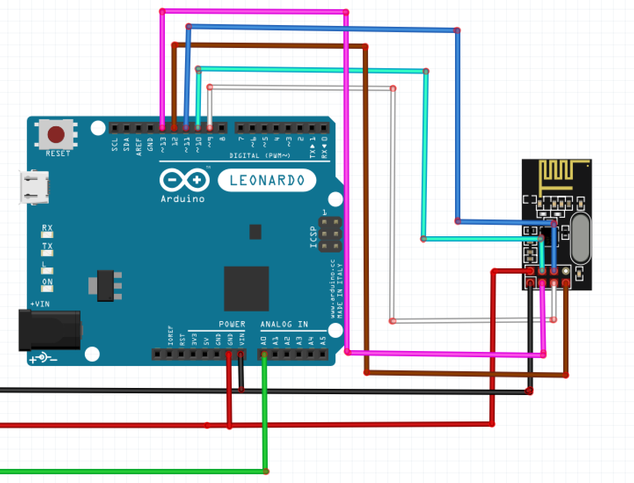
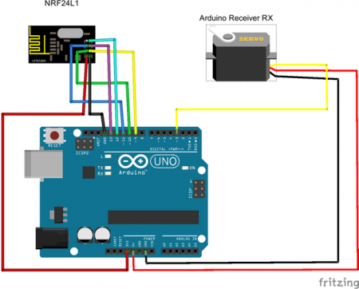
The wireless controller would supplement the initial wirelessly linked master-slave bogie system put forth by the previous year’s team
Keanu
Notes:
Slides 7a... : Describe your design and how you arrived at it. 7 min
Start this section with your literature/state-of-the-art review, so you can show what research you did to, 1) Avoid reinventing the wheel, and 2) Use existing knowledge, standards, etc. to guide your design decisions to your final design. Make good use of multiple views of solid models, cut-aways, exploded views, etc. to communicate your design and how it works. Explain how your designs were or would be fabricated.

Slide 25
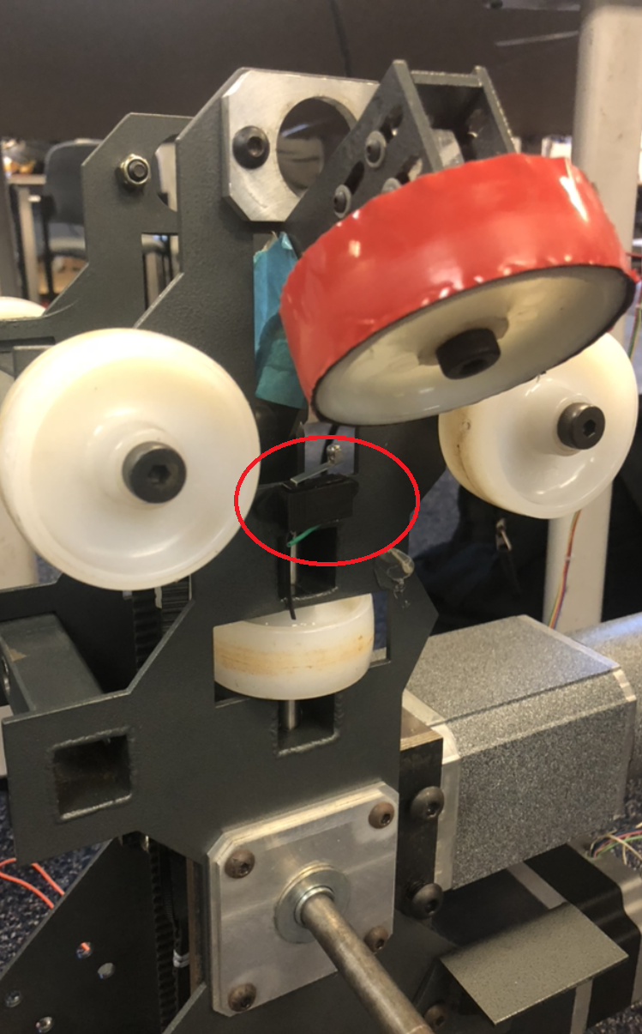
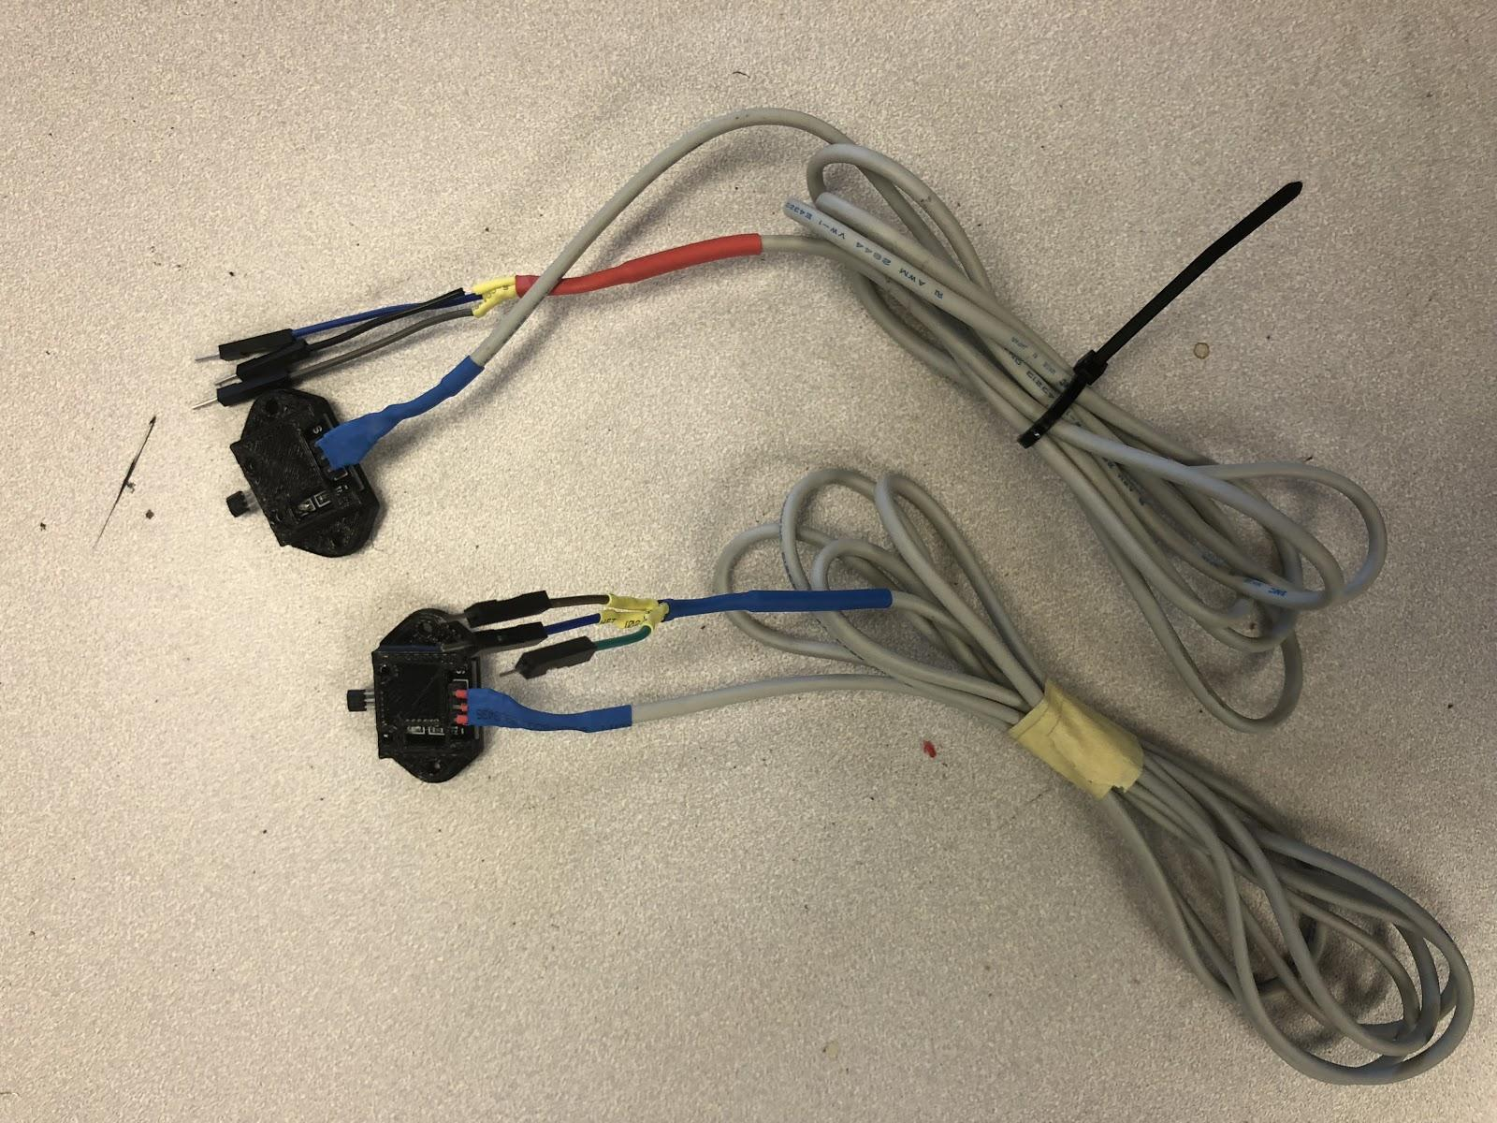
The limit switch has become properly functional and stops the rotation of the arm within milliseconds
Keanu
Notes:
Slides 7a... : Describe your design and how you arrived at it. 7 min
Start this section with your literature/state-of-the-art review, so you can show what research you did to, 1) Avoid reinventing the wheel, and 2) Use existing knowledge, standards, etc. to guide your design decisions to your final design. Make good use of multiple views of solid models, cut-aways, exploded views, etc. to communicate your design and how it works. Explain how your designs were or would be fabricated.

Slide 26
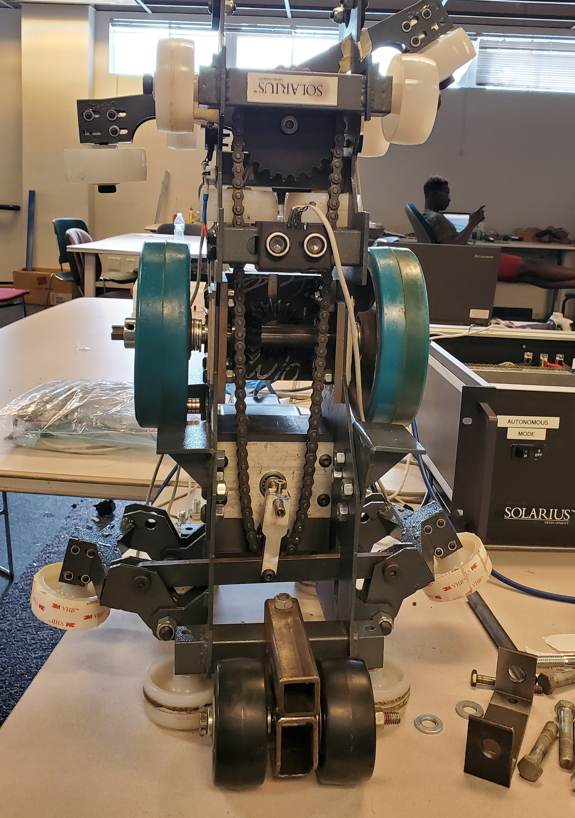
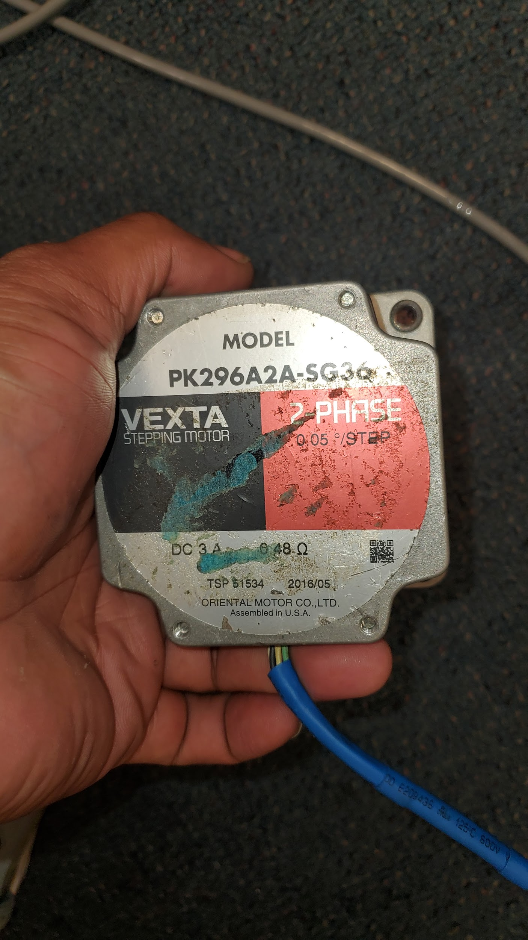
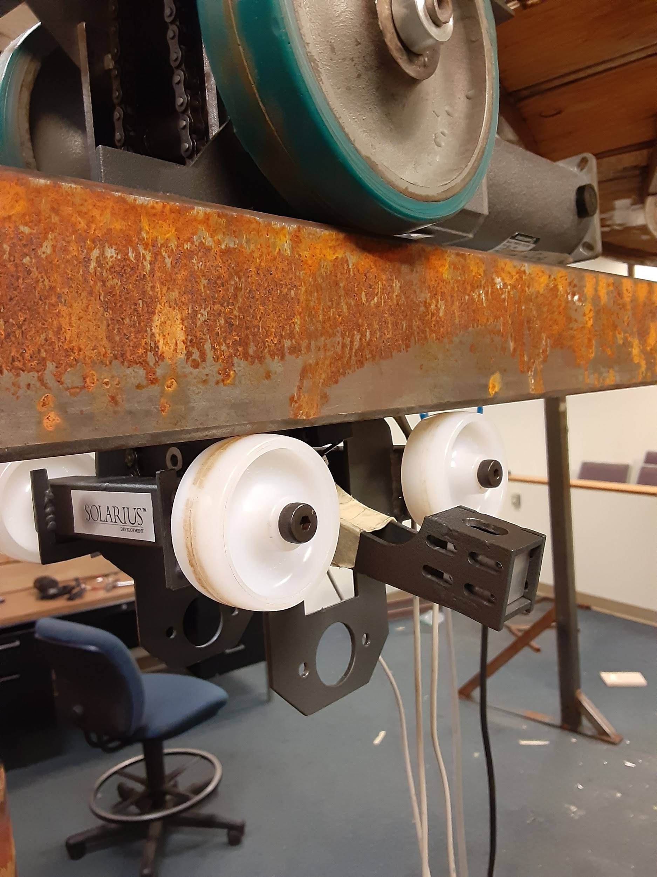
The stepper motor moves in small steps so to accurately stop upon touching the limit switch during testing.
Keanu
Notes:
Slides 7a... : Describe your design and how you arrived at it. 7 min
Start this section with your literature/state-of-the-art review, so you can show what research you did to, 1) Avoid reinventing the wheel, and 2) Use existing knowledge, standards, etc. to guide your design decisions to your final design. Make good use of multiple views of solid models, cut-aways, exploded views, etc. to communicate your design and how it works. Explain how your designs were or would be fabricated.

Slide 27
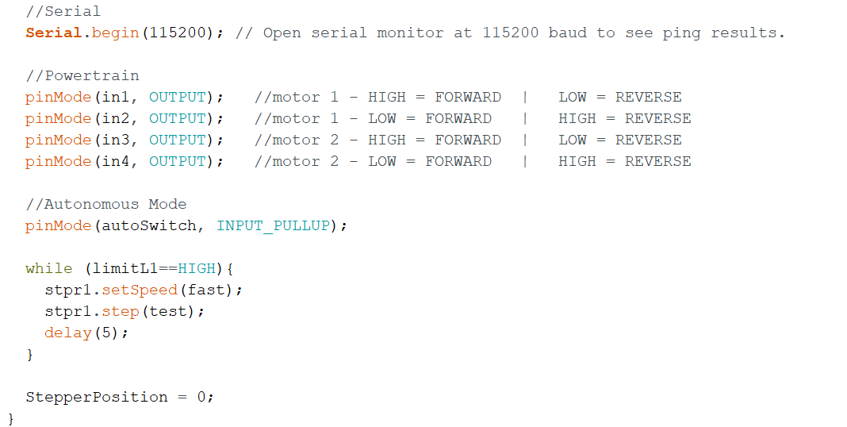
A test code for a homing function that would allow the switch mechanism to move smoothly between the two extremes has been created
Keanu
Notes:
Slides 7a... : Describe your design and how you arrived at it. 7 min
Start this section with your literature/state-of-the-art review, so you can show what research you did to, 1) Avoid reinventing the wheel, and 2) Use existing knowledge, standards, etc. to guide your design decisions to your final design. Make good use of multiple views of solid models, cut-aways, exploded views, etc. to communicate your design and how it works. Explain how your designs were or would be fabricated.

Slide 28
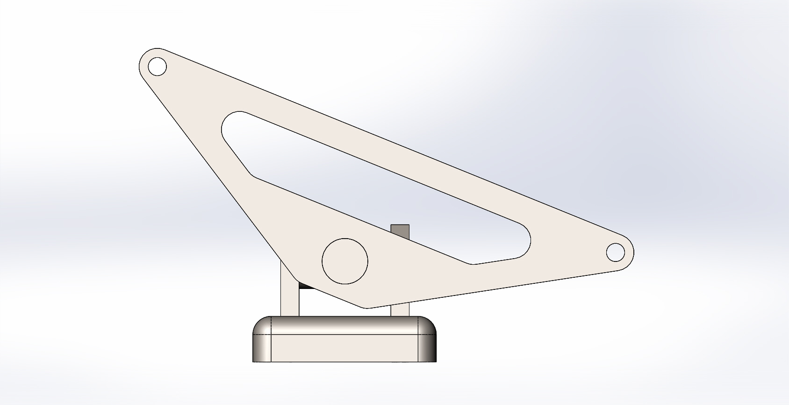
A two degree of freedom rotational connection arm is designed to keep the compartment cabin horizontal at all time.
Edward

Slide 29
8a: Analysis, Validation, Tests and Simulations
What is the results of design analyses? Does the validation and testing of the design meets the design requirements and specifications?
Edward

Slide 30
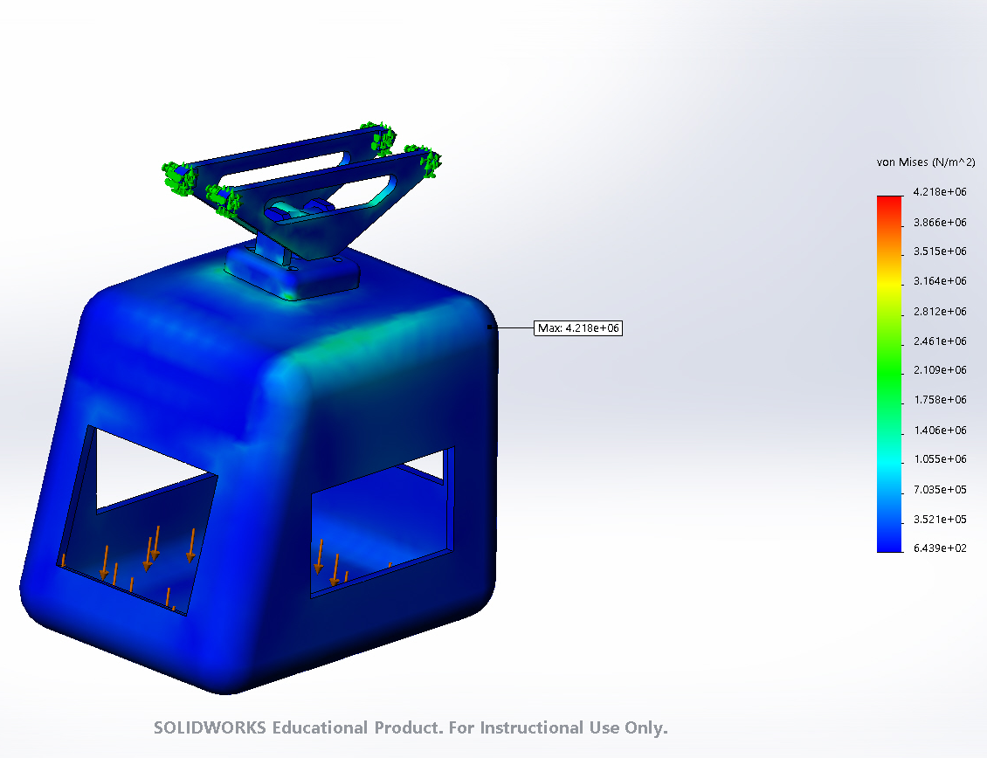
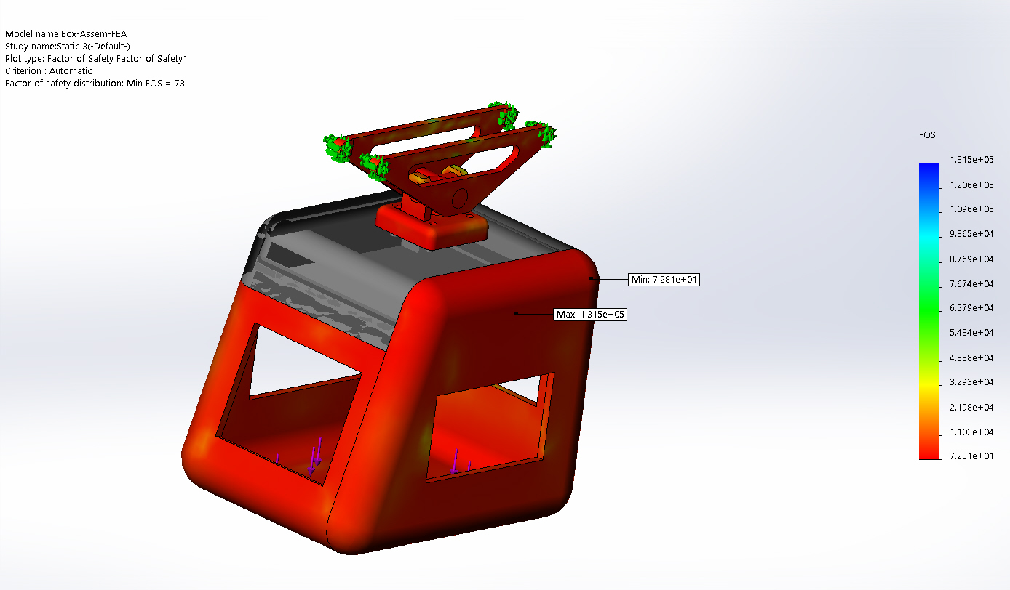
The new design for the control box has undergone FEA simulation and is ready for manufacturing
Edward
Notes:
Slides 8a... : Describe your analysis, validation, tests, simulations, etc. that will give evidence that your design meets the design specifications 5 min
Explain your design analyses, and how you validated and tested that your design meets your design requirements and specifications. Here is where you can show how you applied your engineering knowledge to frame, guide, and validate your design choices. Here is also where you can show simulations of how your design works.

Slide 31
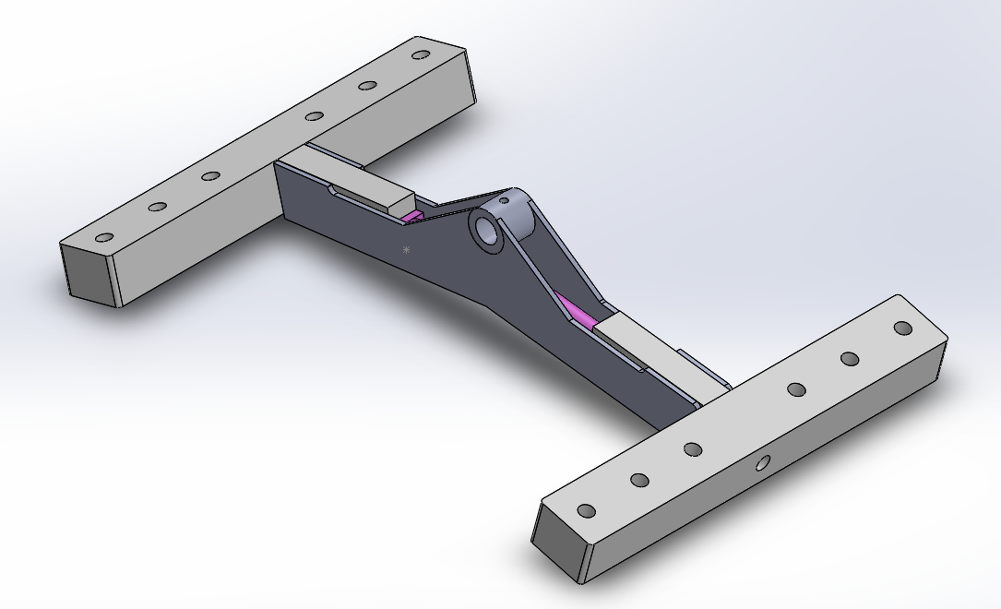
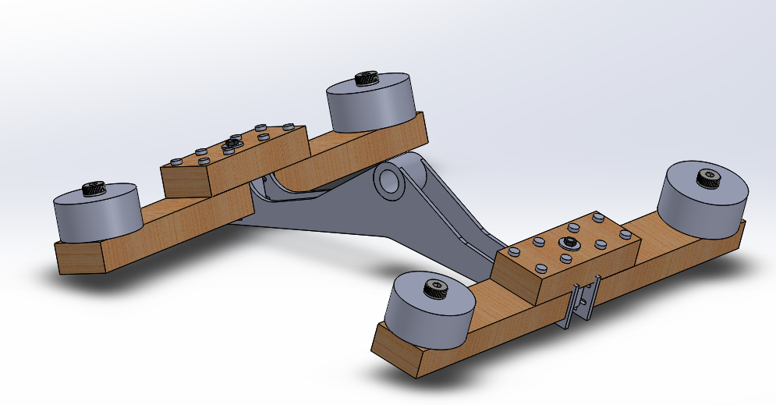
The final prototype addresses inconsistencies in prior switch arm models and is ready to be machined by the 2020-21 team
Prototype #1
Prototype #3
Prototype #2
Final Prototype
Brandon
Notes:
Slides 8a... : Describe your analysis, validation, tests, simulations, etc. that will give evidence that your design meets the design specifications 5 min
Explain your design analyses, and how you validated and tested that your design meets your design requirements and specifications. Here is where you can show how you applied your engineering knowledge to frame, guide, and validate your design choices. Here is also where you can show simulations of how your design works.

Slide 32
A Solidworks simulation of our modified bogie mechanism with our final switch arm prototype on the new track design is shown below
Brandon
Notes:
Slides 8a... : Describe your analysis, validation, tests, simulations, etc. that will give evidence that your design meets the design specifications 5 min
Explain your design analyses, and how you validated and tested that your design meets your design requirements and specifications. Here is where you can show how you applied your engineering knowledge to frame, guide, and validate your design choices. Here is also where you can show simulations of how your design works.

Slide 33
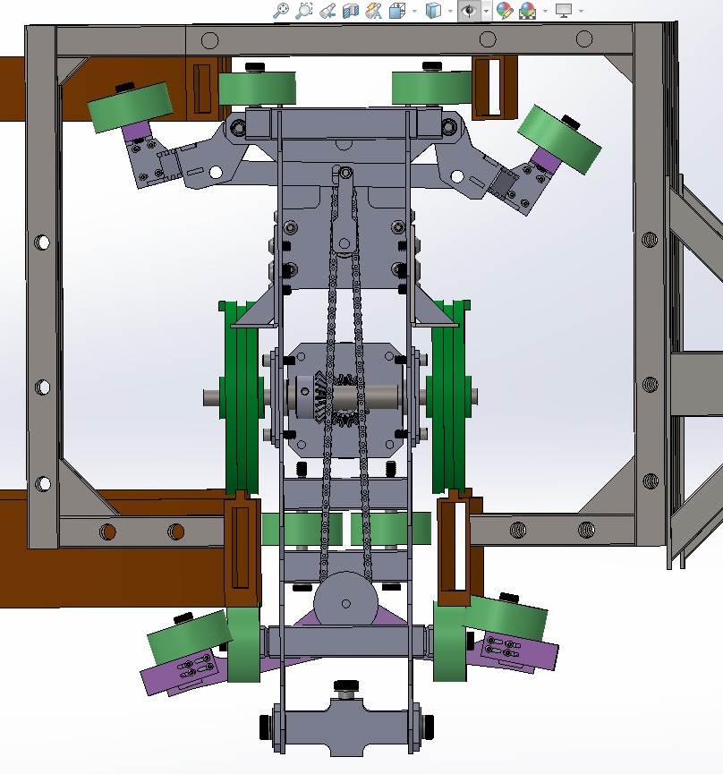
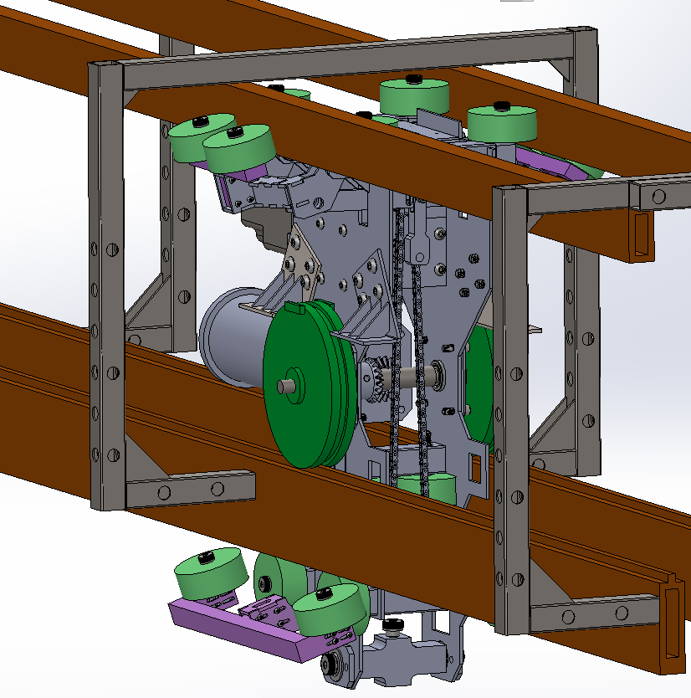
The different views of the of the improved bogie with the new switch arm prototype shows its relations and specifications align with the track dimensions
Brandon
Notes:
Slides 8a... : Describe your analysis, validation, tests, simulations, etc. that will give evidence that your design meets the design specifications 5 min
Explain your design analyses, and how you validated and tested that your design meets your design requirements and specifications. Here is where you can show how you applied your engineering knowledge to frame, guide, and validate your design choices. Here is also where you can show simulations of how your design works.

Slide 34
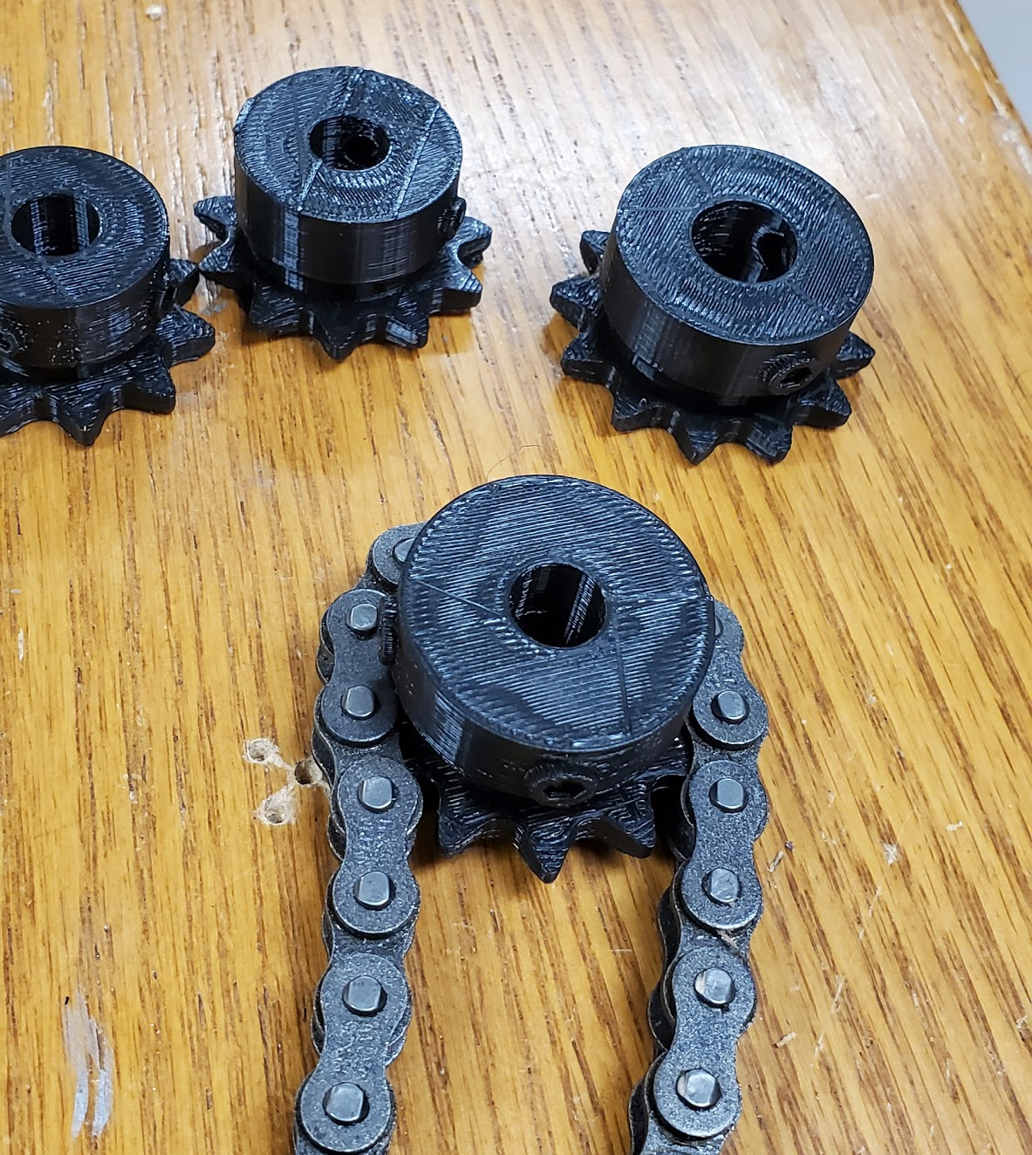
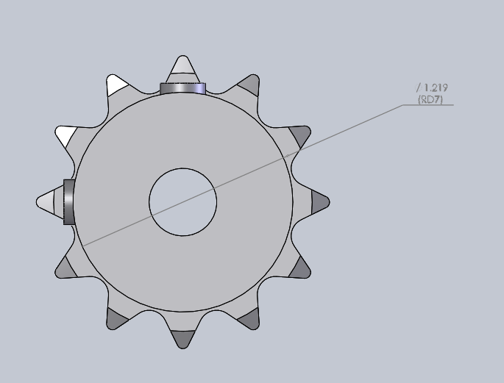
A redesigned upper gear was 3D printed and reduced chain slack* on the switch arm
Old: 9 teeth
1.219
New: 11 teeth
Greg
Notes:
Slides 8a... : Describe your analysis, validation, tests, simulations, etc. that will give evidence that your design meets the design specifications 5 min
Explain your design analyses, and how you validated and tested that your design meets your design requirements and specifications. Here is where you can show how you applied your engineering knowledge to frame, guide, and validate your design choices. Here is also where you can show simulations of how your design works.

Slide 35
The wood prototype switching mechanism was trial tested on the track with successful results and final prototype was designed
https://youtu.be/nWPCZ6Lqgi8
Greg
Notes:
Slides 8a... : Describe your analysis, validation, tests, simulations, etc. that will give evidence that your design meets the design specifications 5 min
Explain your design analyses, and how you validated and tested that your design meets your design requirements and specifications. Here is where you can show how you applied your engineering knowledge to frame, guide, and validate your design choices. Here is also where you can show simulations of how your design works.

Slide 36
9a: Conclusions and Future Work
Did our design meet our goals? What should future Half-Scale teams aim to accomplish?
Greg

Slide 37
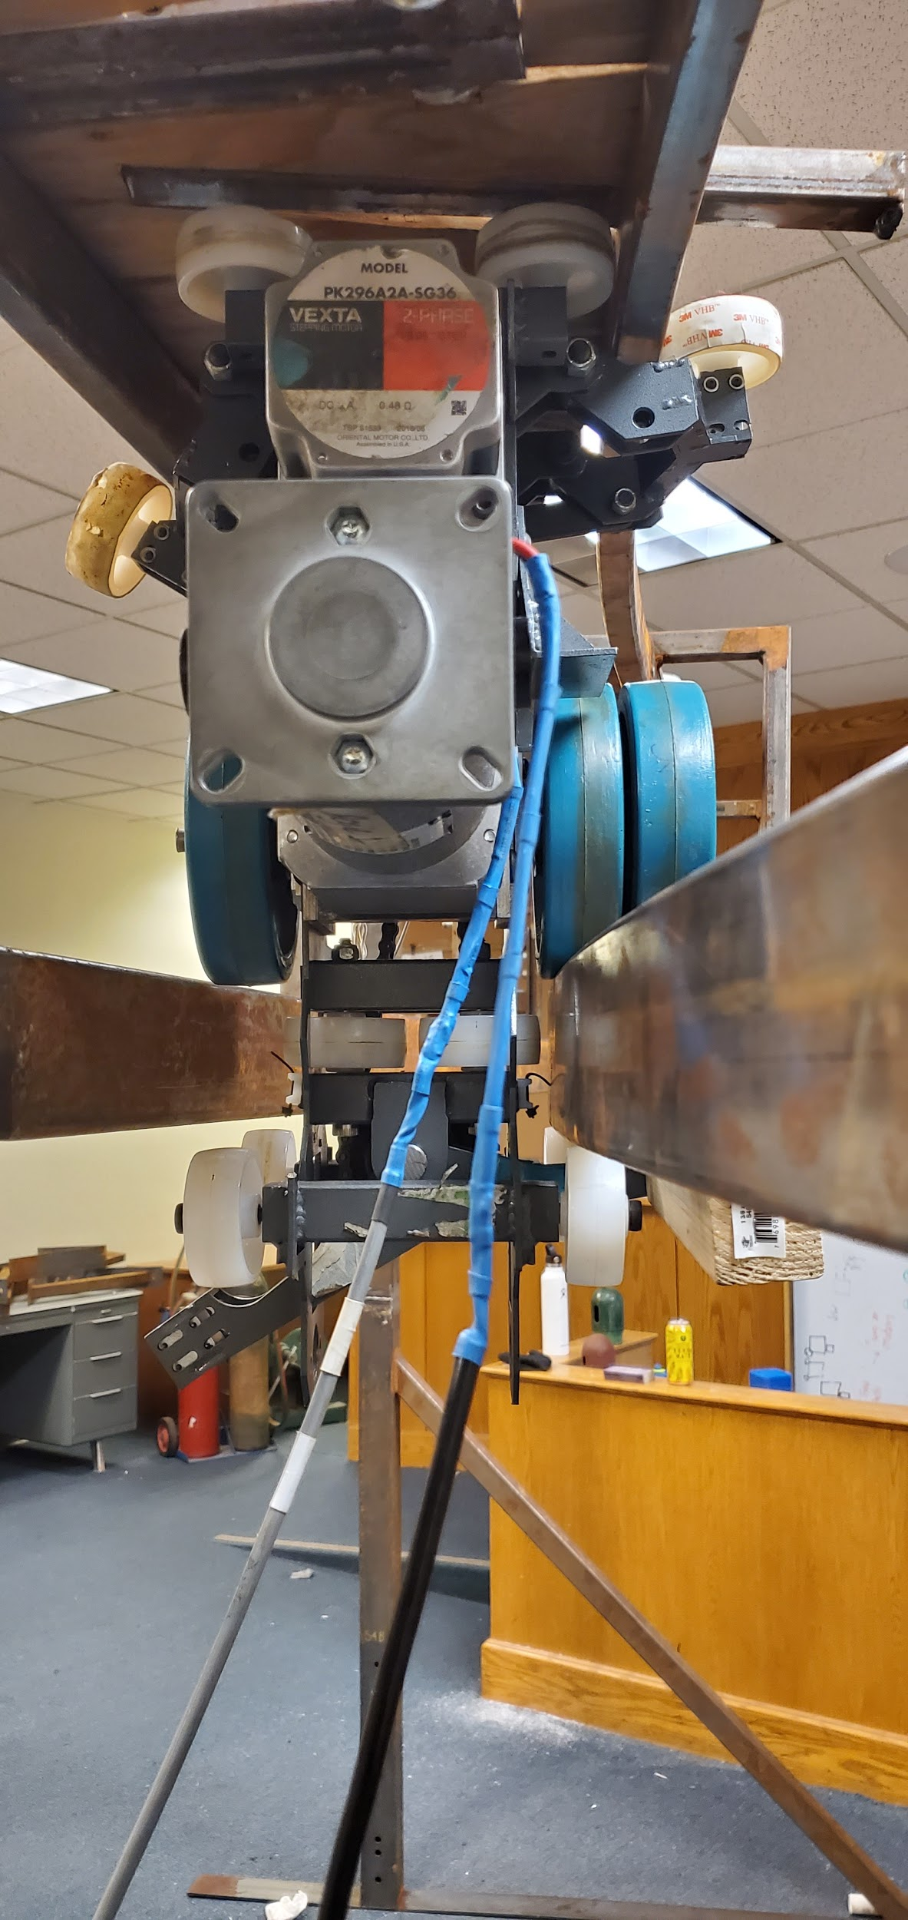
The successful navigation of the track switch means that the design met every goal.
Greg
Notes:
Slides 9a... : Conclusion and suggestions for future work 3 min
Sum up your work. Did you meet your design specs? If not, why not? What would/should you have done differently to have been successful? What did you learn over this last year? This section of your presentation is very important, so don't skimp on it!
Explain what should be done by the next group of Superway engineers to improve upon your work and take it to the next level?
Explain the broader societal impacts of your work. Explain how what you accomplished impacts sustainable transportation and society more broadly

Slide 38
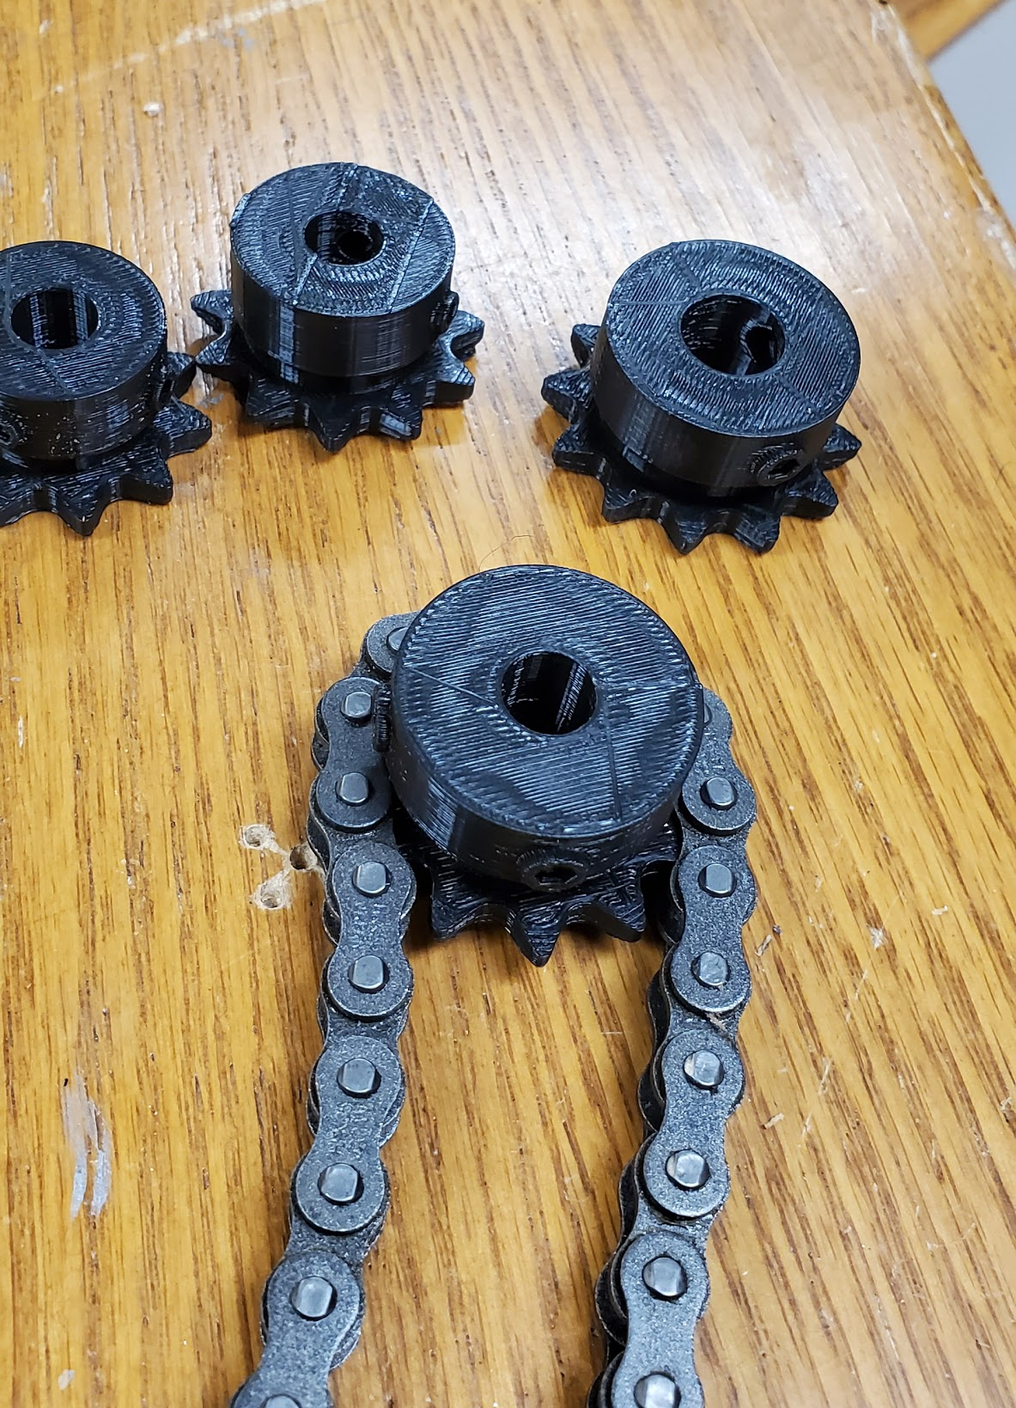
Manufacturing the prototype switching arm and purchasing a proper gear would complete the switching mechanism
Greg
Notes:
Slides 9a... : Conclusion and suggestions for future work 3 min
Sum up your work. Did you meet your design specs? If not, why not? What would/should you have done differently to have been successful? What did you learn over this last year? This section of your presentation is very important, so don't skimp on it!
Explain what should be done by the next group of Superway engineers to improve upon your work and take it to the next level?
Explain the broader societal impacts of your work. Explain how what you accomplished impacts sustainable transportation and society more broadly

Slide 39
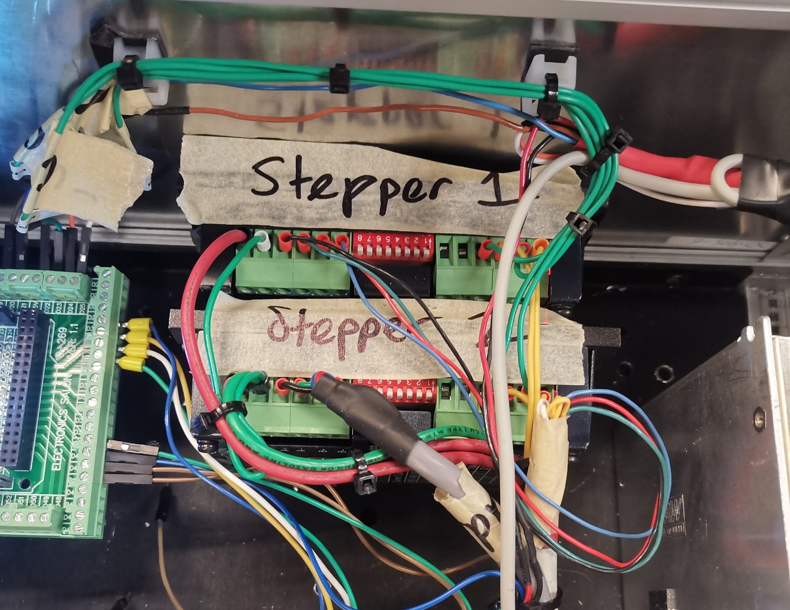
The current team should have taken more consideration into the scope of work necessary to make the control box properly functional for trial testing
Edward
Notes:
Slides 9a... : Conclusion and suggestions for future work 3 min
Sum up your work. Did you meet your design specs? If not, why not? What would/should you have done differently to have been successful? What did you learn over this last year? This section of your presentation is very important, so don't skimp on it!
Explain what should be done by the next group of Superway engineers to improve upon your work and take it to the next level?
Explain the broader societal impacts of your work. Explain how what you accomplished impacts sustainable transportation and society more broadly

Slide 40
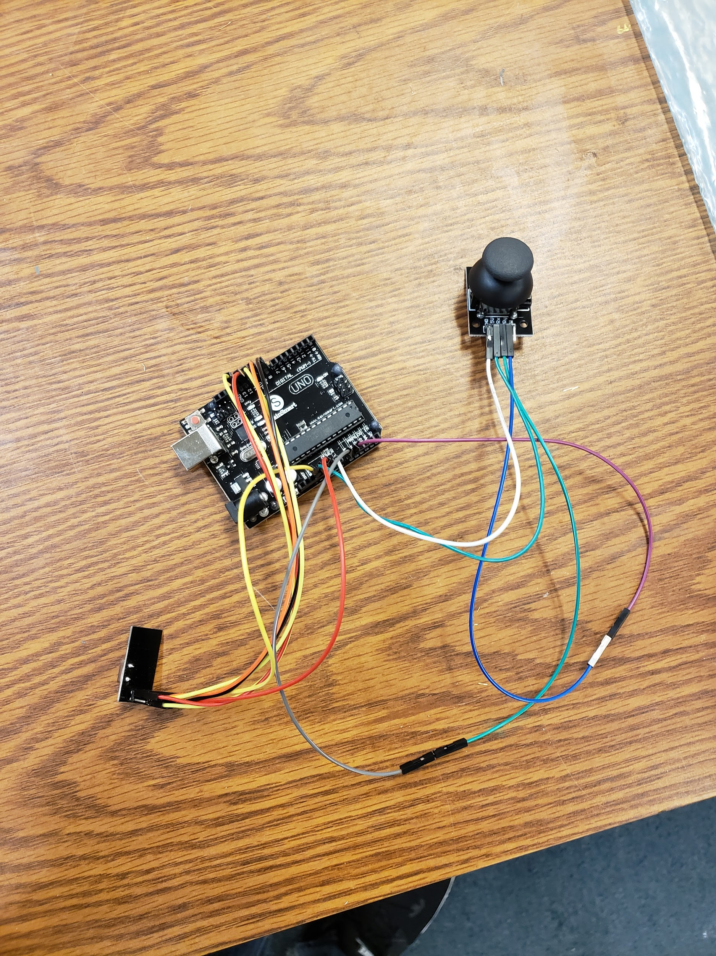
The upcoming Half-Scale team should focus on these aspects of design
Bogie Mechanics
Mechatronic Systems
Track Design
Drive Shaft Stability
Manufacture Control Box
Bracket Interference
Order New Gear
(chain tension)
Wireless Controller
Contact Width
Manufacture Switch Arm
(prototype #4)
Sensor Arduino (Slave)
Greg
Notes:
Slides 9a... : Conclusion and suggestions for future work 3 min
Sum up your work. Did you meet your design specs? If not, why not? What would/should you have done differently to have been successful? What did you learn over this last year? This section of your presentation is very important, so don't skimp on it!
Explain what should be done by the next group of Superway engineers to improve upon your work and take it to the next level?
Explain the broader societal impacts of your work. Explain how what you accomplished impacts sustainable transportation and society more broadly

Slide 41
Thank You
Brandon
Notes:
A big thank you to Professor Furman and Mr. Swenson for all their invaluable advice, support, providing us with the materials and facilities to carry out this project throughout this school year.

Slide 42
Pilot holes for all shafts of the bogie

Slide 43
The stepper motor utilizes mini steps to accurately position itself while trial testing
https://youtu.be/7ZQBWuJv3Kw

Slide 44
The exploded view of the compartment cabin and the side view.

Slide 45
The control system after and before modifications
Arduino
Stepper Driver
Replay
Power Supply

Slide 46
Our Bill of Materials consists of purchased items as well as items provided by the Spartan Superway team
Total Cost
Brandon

Slide 47
Our budget for the 2019-2020 Half-Scale Team is mainly broken down into 3 sections: Cost of Materials, Cost of Manufacturing and Cost of Transportation
Brandon

Slide 48
A preview of the new bogie mechanism if all design changes were implemented as a blueprint for future Half-Scale team members
Brandon
Notes:
Brandon: Track CAD

