Slide 1
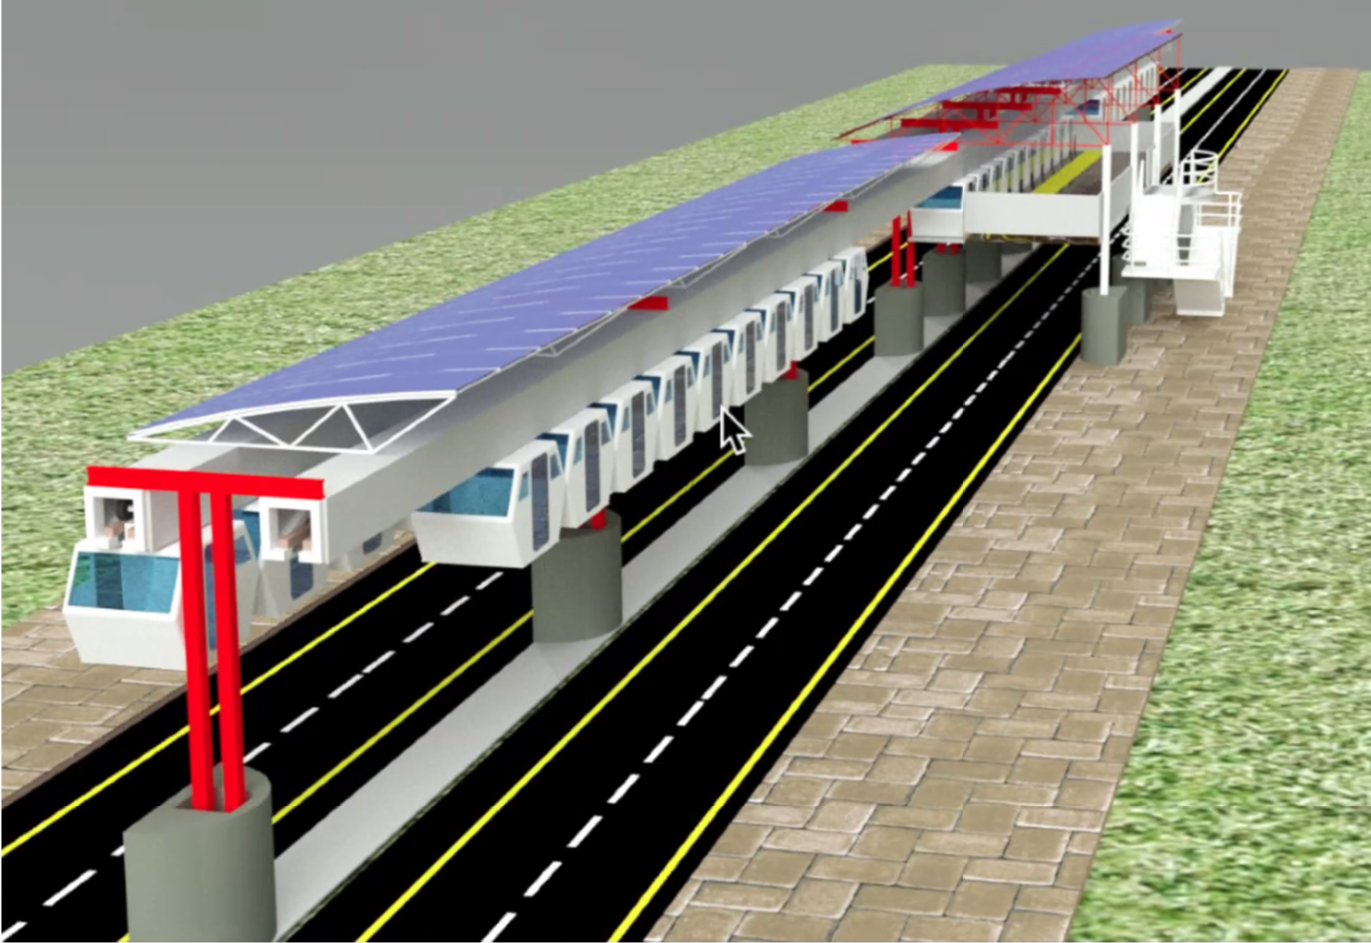
Solar Racking for an Automated Transit Network: The Spartan Superway
Replace this box with key image to introduce talk’s scope, importance, or background
Sumeet Shastri
Department of Mechanical Engineering
San José State University
May 14, 2020

Slide 2
ATNs provide an efficient means of transportation, but most existing systems are powered by the electric grid.
[Futran, n.d.]

Slide 3
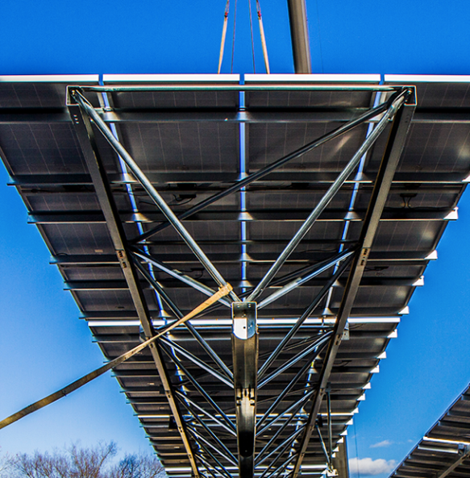
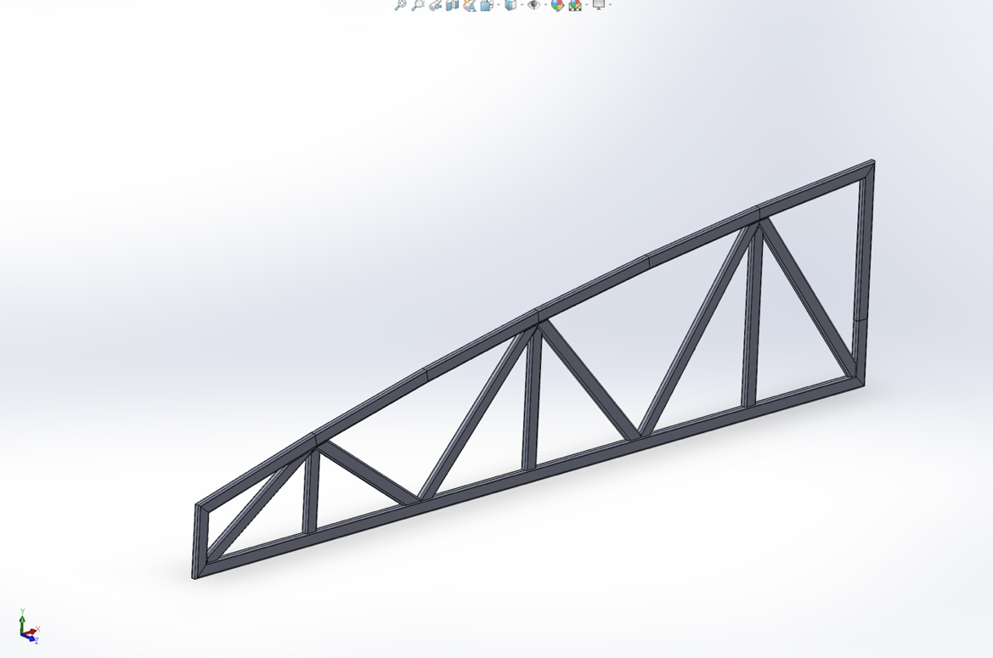
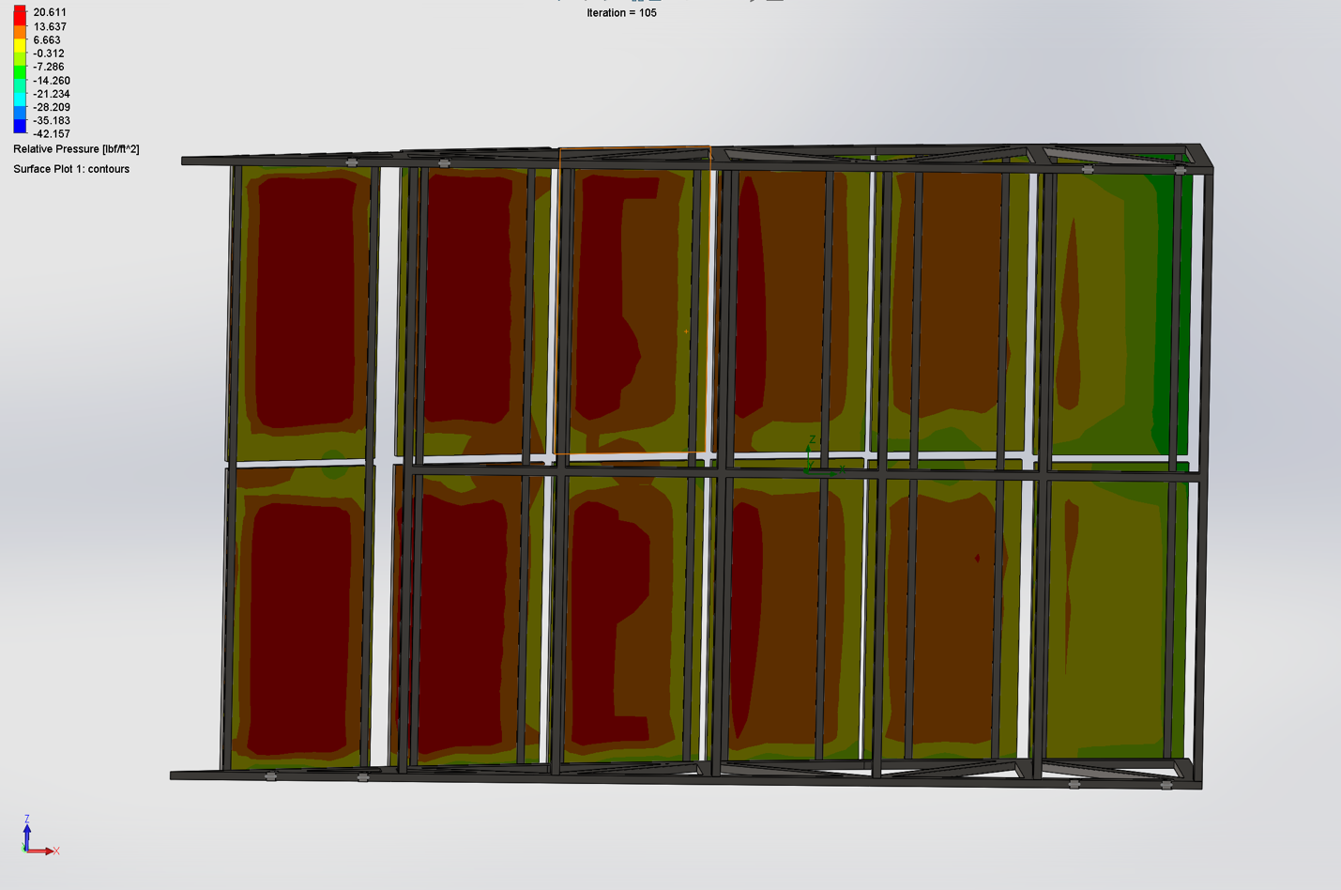
This presentation highlights the literature review, design, and simulation progress to develop mounting for the Superway.
Image for
Topic 1
Literature Review
Image for
Topic 2
Design Progress
Image for
Topic 3
Simulation Progress
Notes:
Mapping slide for the presentation (note that a background slide or a slide justifying the importance might precede this slide). A common mistake with mapping slides is to give the audience simply an unmemorable bulleted list of topics (including the names “Introduction” and “Conclusion” and “Questions”). Such a list is quickly forgotten after the slide is removed.
On a mapping slide, take the opportunity to show a key image or perhaps a representative image for each major section of the presentation. In the second case, each image would be repeated on the first visual of the corresponding section and would remind the audience that they have arrived to a major section of the presentation’s middle.
In regards to the names “Introduction” and “Conclusion,” every talk has those sections, and the names are ignored by audiences. So why state them? Also, for the divisions that you do have, find a logical and parallel grouping. Note that groups of two’s, three’s, and four’s are much easier to remember and are not so nearly intimidating as groups of five’s, six’s, and seven’s. See the discussion of mapping slides in The Craft of Scientific Presentations, 2nd ed. (pages 177-181).

Slide 4
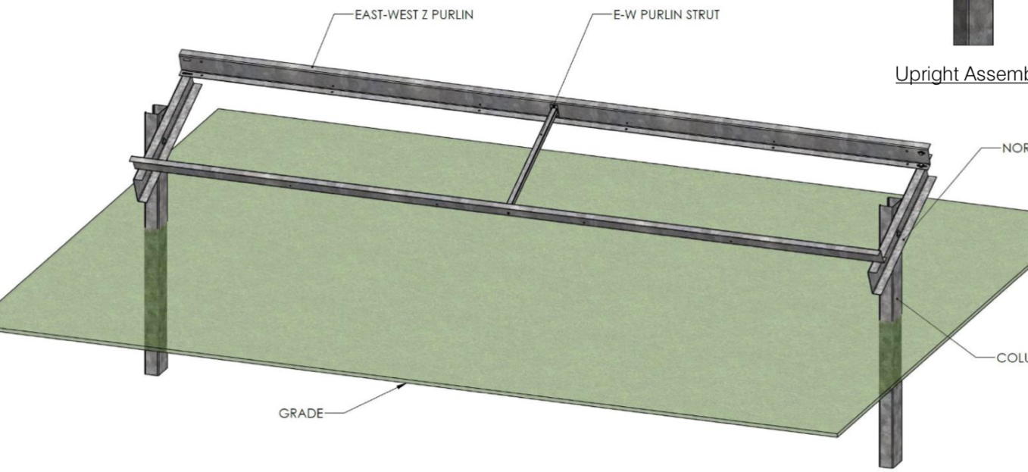
Existing mounting designs use hollow sections bolted together in perpendicular arrangements to achieve modularity.
[Quest Renewables, 2020] & [Genmounts, n.d]

Slide 5
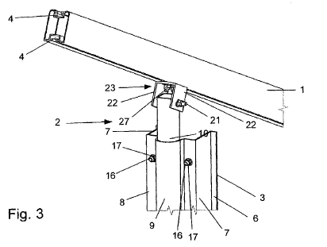
Patents of elevated mounting follow a theme of hollow sections bolted together by intermediate brackets.
[Nitzko, 2011]

Slide 6
Solar mounting should be designed to achieve a factor of safety of two under critical loads.
Key Considerations
Steel over Aluminum
Size of members
Dead Loads
Aerodynamic Wind Loading
[Messenger & Ventre, 2003]

Slide 7
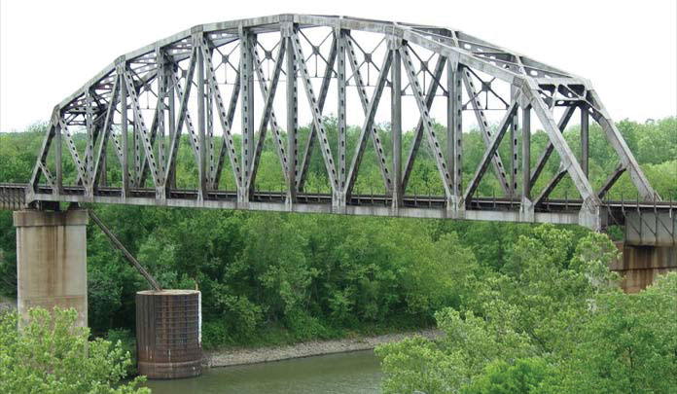
Several existing sloped structures including roofs and bridges use trussing for reliable supports.
[Griggs, 2015]

Slide 8
Uplift from wind on an array is the most critical force to consider; the resulting loading needs to follow a complete path.
Uplift Force
PV Panel
Mounting
Supporting Structure
[Maffei et al., 2014]

Slide 9
Common practice in the solar industry is to design mounting with a FOS of two against 55psf of uplift acting on the array.
ASCE Wind Pressure
Design Wind Pressure
Velocity Pressure
[“Wind loads: General requirements,” 2016]

Slide 10
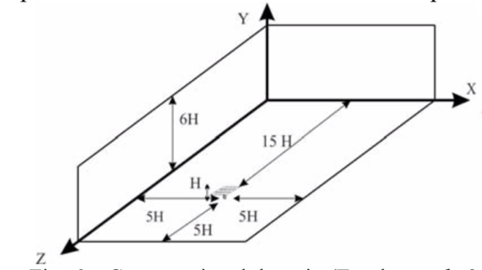
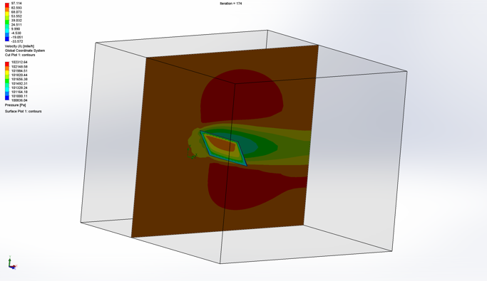
Specific dimensions for the flow domain and a refined mesh near the surface are needed for CFD simulations.
[Baetu et al., 2013]

Slide 11
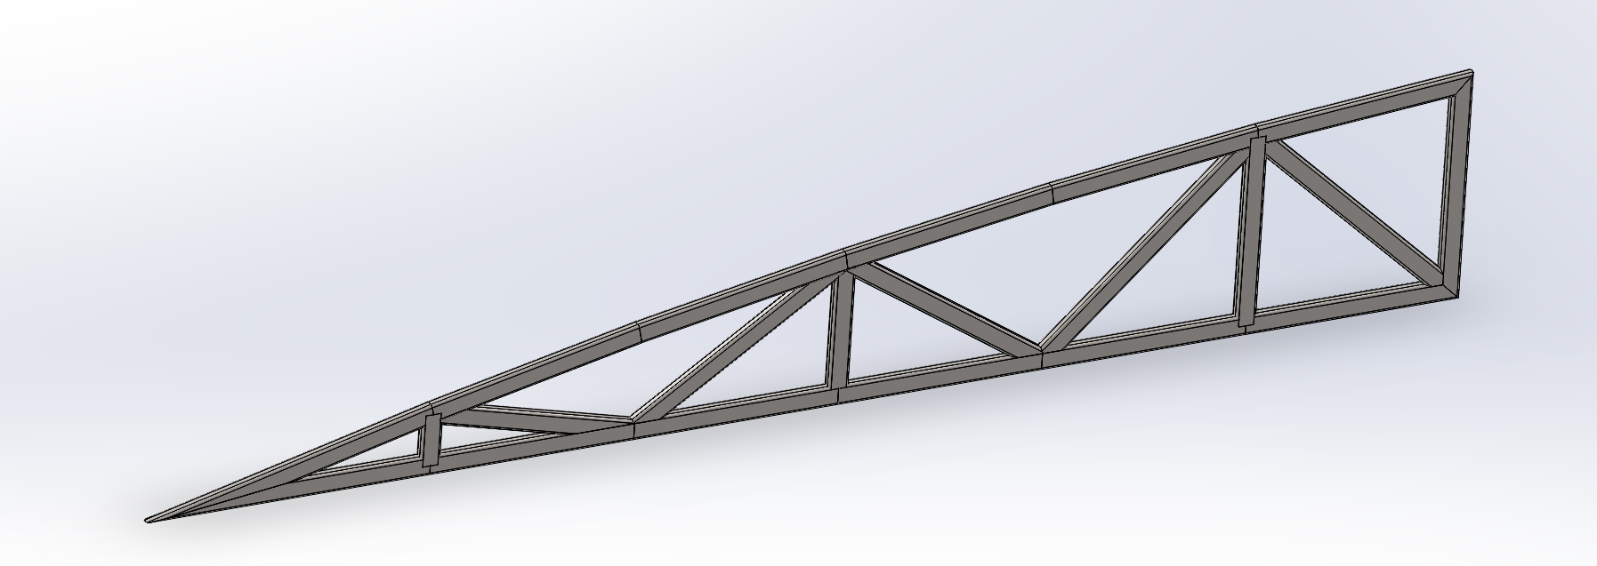
Trussing profiles can be adapted to the specified slope to create a reliable foundation for the Superway’s canopy.

Slide 12
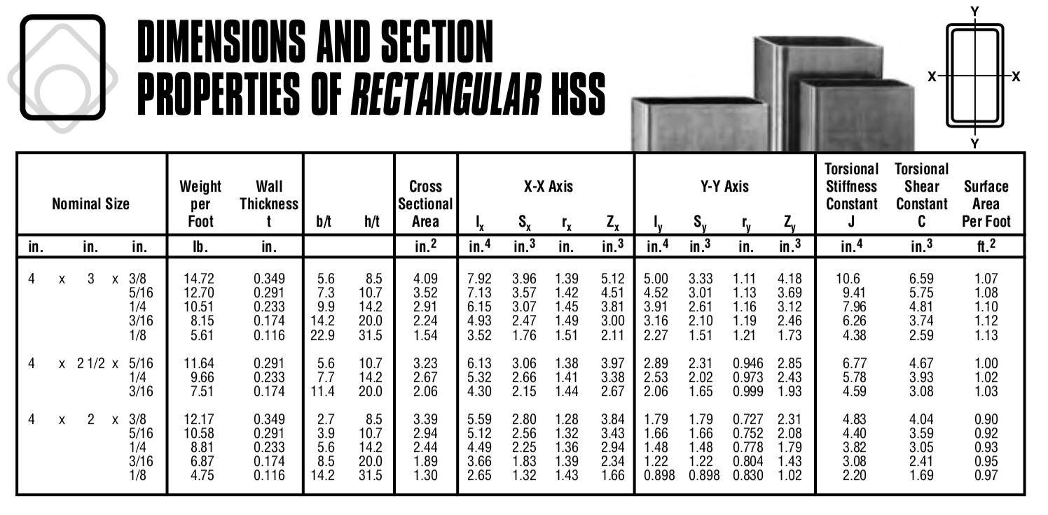
Hollow rectangular steel sections provide structural integrity and are used to satisfy aesthetical requirements.
[Steel Tube Institute, n.d.]
Notes:
Blank slide for drafting mapping slide

Slide 13
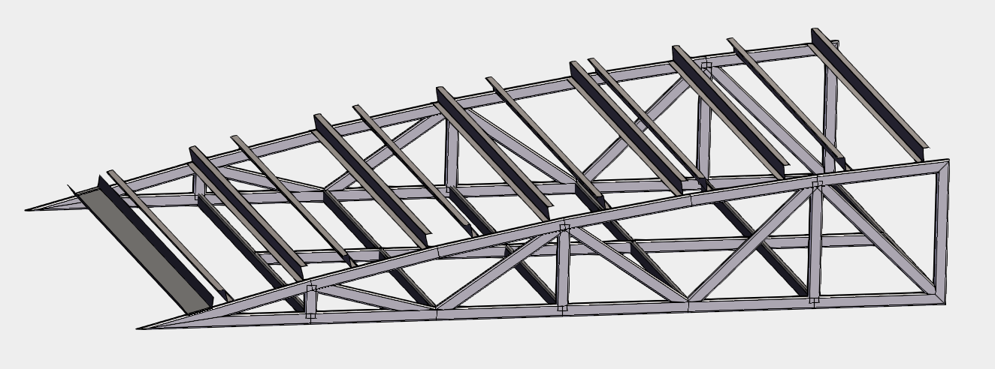
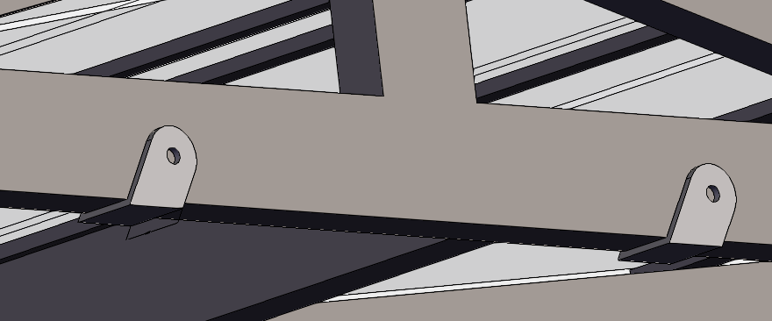
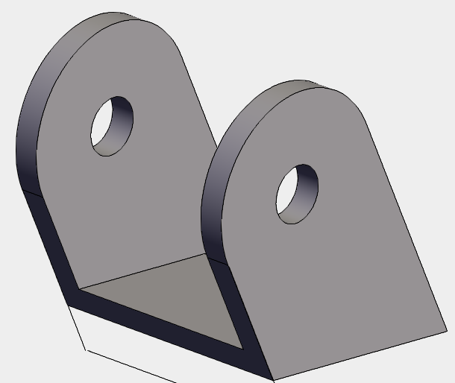
U-brackets, Z-purlin, and a lateral truss attached to the side trusses form a complete unit of a modular mounting structure.

Slide 14
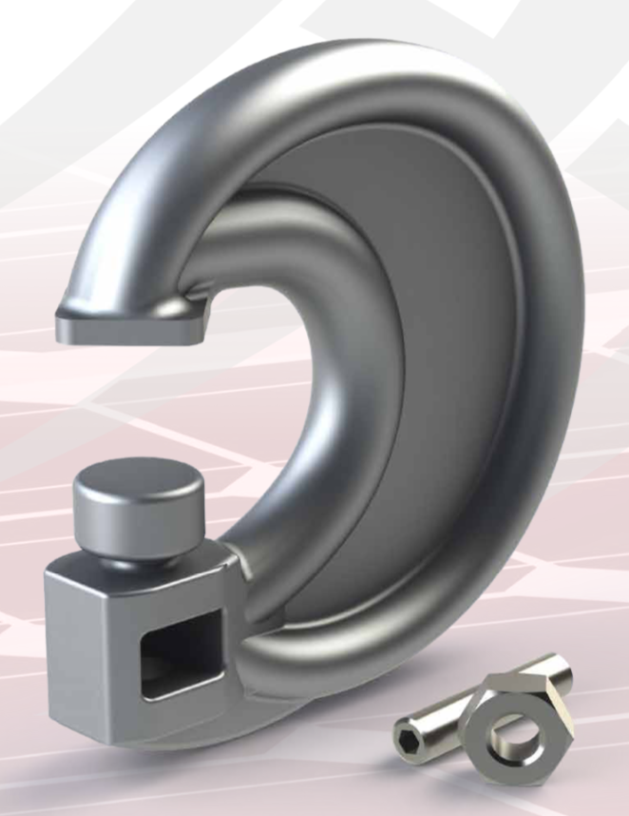
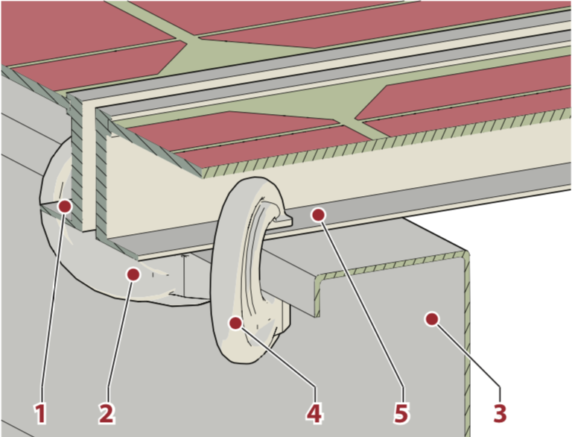
C-clamps provide for efficient installation of panels and facilitate removal of individual panels for maintenance.
[Mechatron, 2020]

Slide 15
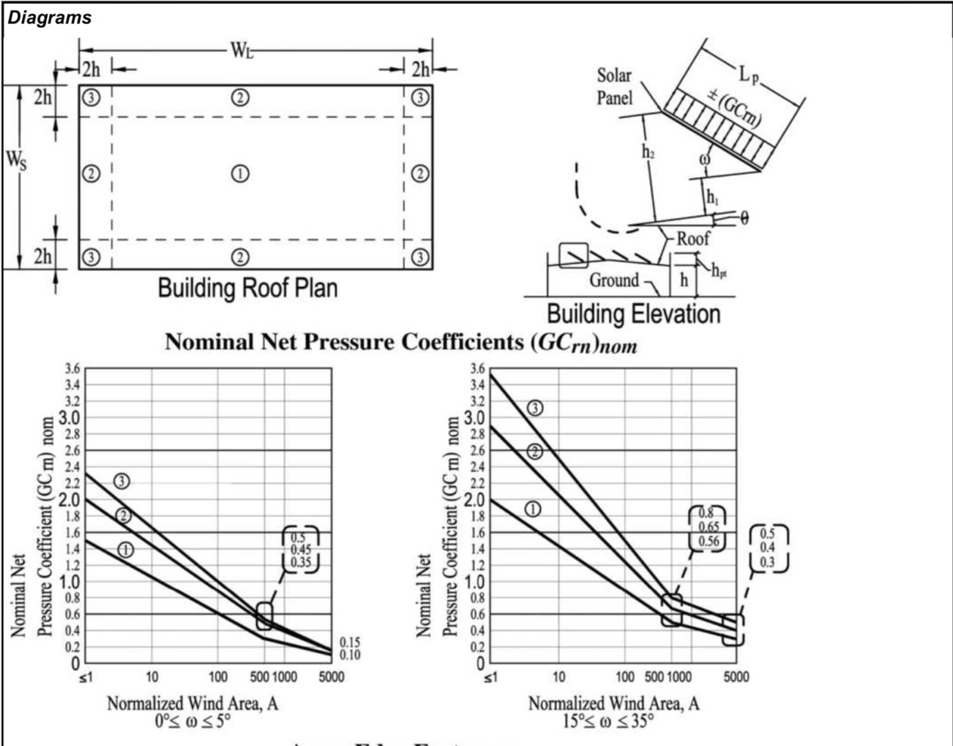
Comparing ASCE pressures with CFD simulation results ensures geometrical assumptions are reasonable.
[Nominal Net Pressure Coefficient, from (“Wind loads: General requirements,” 2016)]

Slide 16
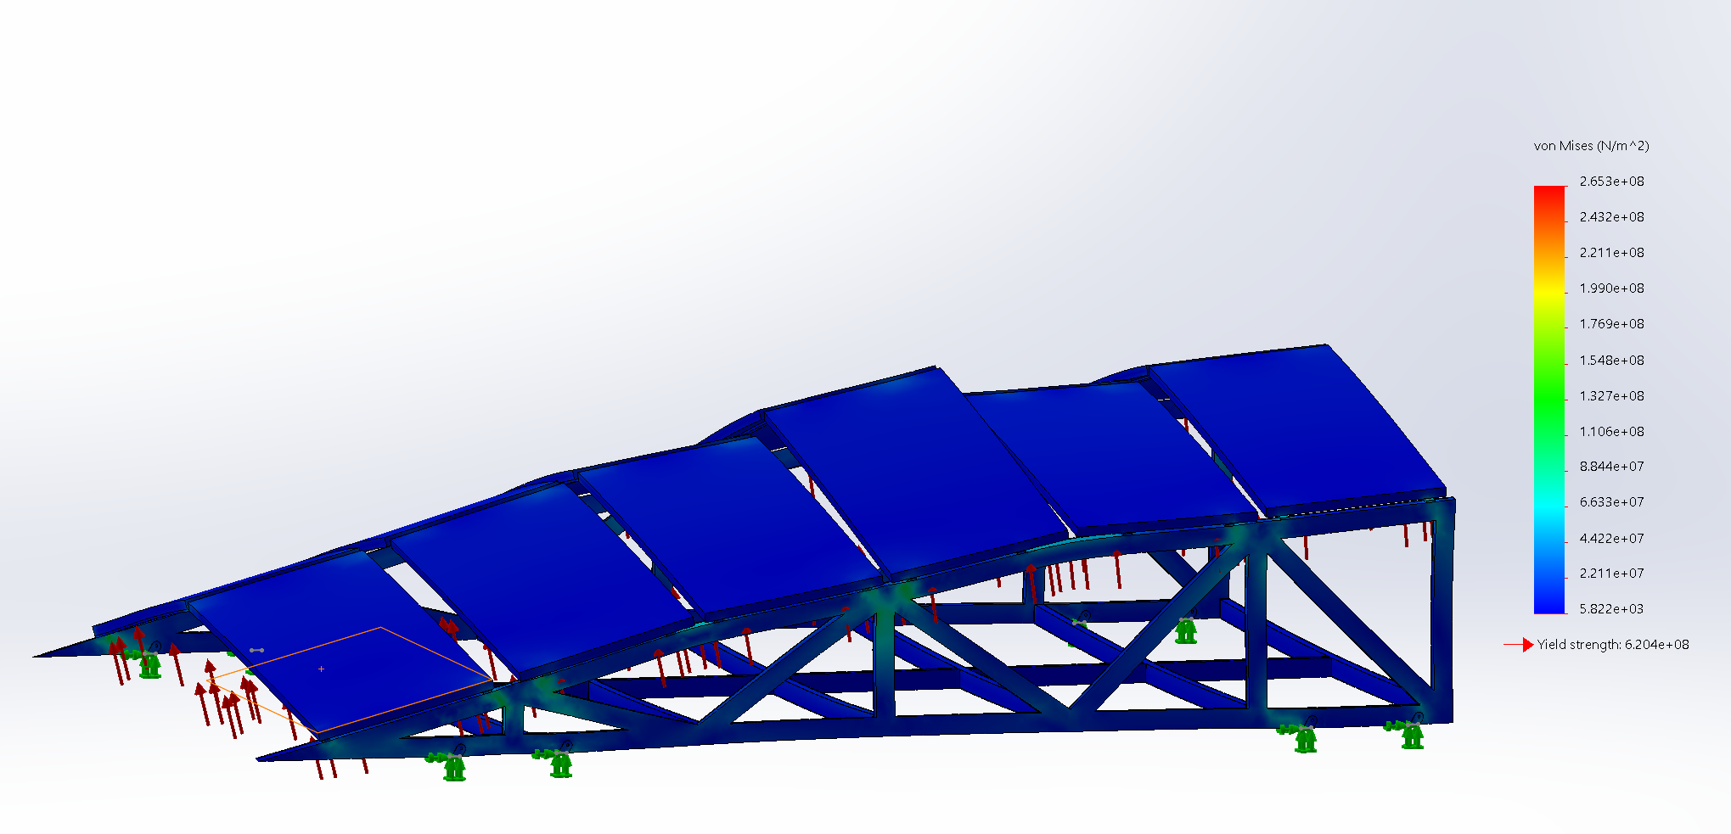
FEA simulation results on the canopy under 55psf of uplift show that a complete load path is formed.

Slide 17
Reactions at connections to the guideway versus wind speed increase exponentially, proving a complete load path is formed.

Slide 18
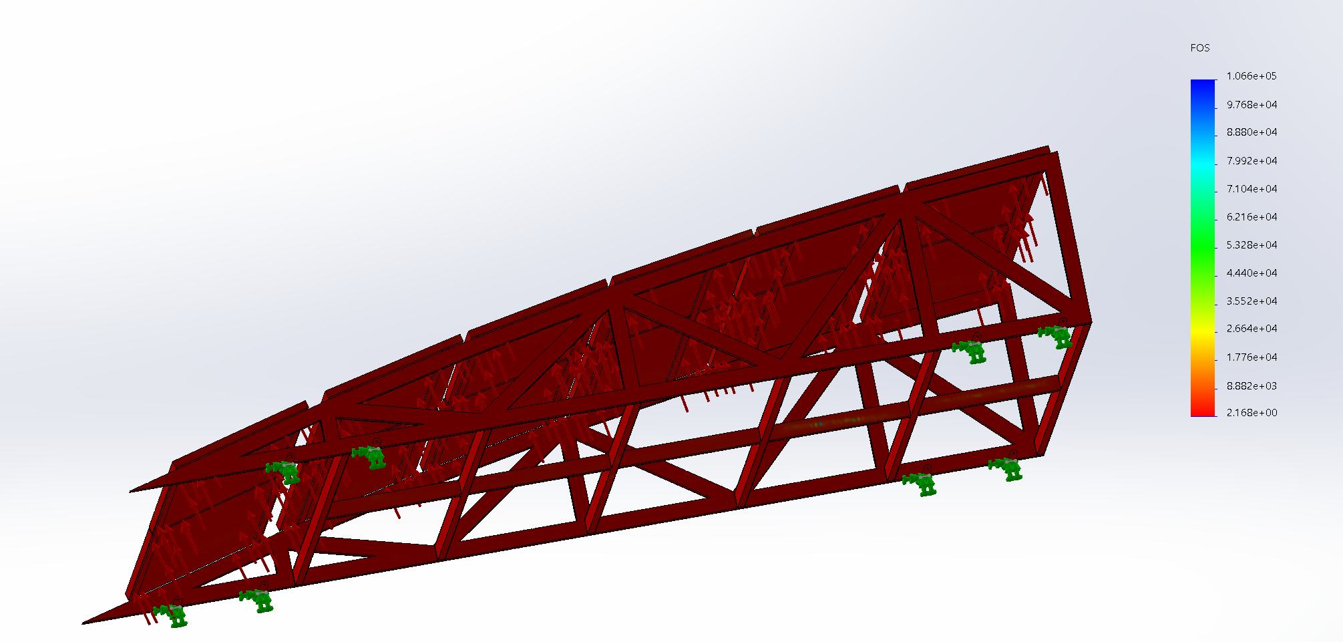
Simulation results indicate a safety factor of two under critical uplift; this design is comparable in strength to other mounting.

Slide 19
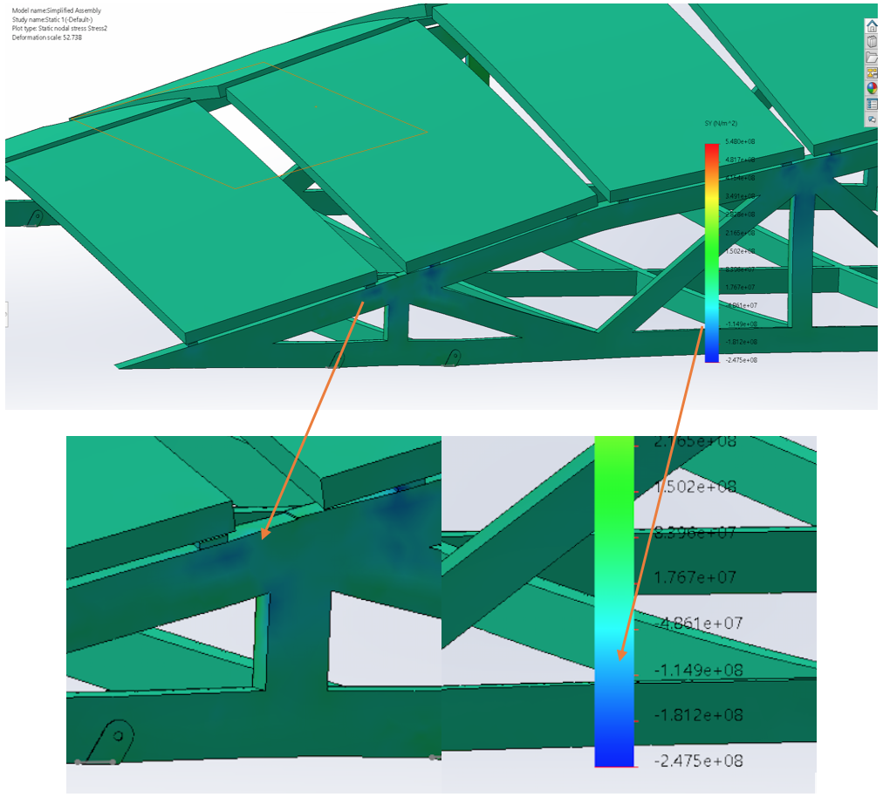
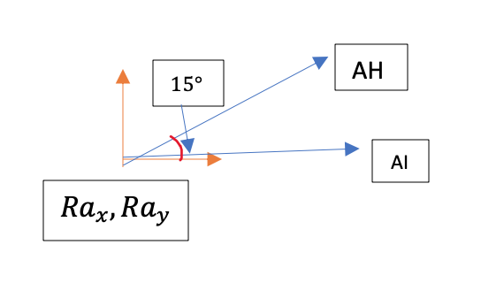
Statics calculations used to validate the simulation results lead to normal stresses that are in the same order of magnitude.
Notes:
Blank slide for drafting a body slide.

Slide 20
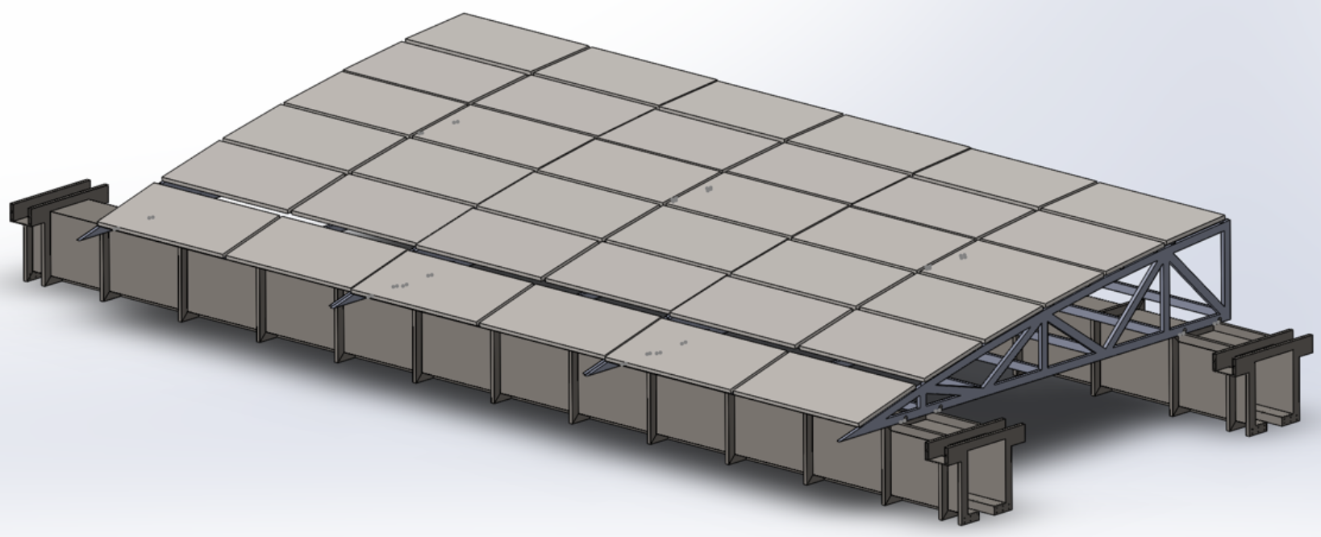
In conclusion the solar racking is viable for straight segments of the Superway, but there is room for more modularity.
Profile of structure is sound
Gusset plates can help increase modularity
Questions?
Notes:
Sample conclusion slide. Notice how the presenter showed the connection between words blocks on this slide—a strategy that is much more effective than a bullet list, which hides the connections between details.
Reference:
Manning Seltzer, “Failure Analysis of the Ice Detector in the Austria 13 Helicopter,” presentation (Hartford, CT: Sikorsky Helicopter, 30 April 2004).

Slide 21
References
Baetu, G., Carmen, T., Axinte, E., & Roşca, V. (2013). Numerical simulation of wind action on a solar panels array for different wind directions.
Futran, n.d.
Genmounts | Renewable Energy Holdings, 97 River Road 2 Floor, Flemington, N. 0., & T: 908-788-7750 | F: 908-837-9021.Genmounts vector 1.0 (1 column) post driven installation manual
Griggs, F. (2015, July 1,). The warren truss ., 1-2. Retrieved from https://www.structuremag.org/?p=8715
Maffei, J., Telleen, K., Ward, R., Kopp, G. A., & Schellenberg, A. (2014). Wind design practice and recommendations for solar arrays on low-slope roofs. Journal of Structural Engineering, 140(2), 04013040 (10 pp.). doi:10.1061/(ASCE)ST.1943-541X.0000806
Mechatron.PV - clamp . Retrieved from https://mechatron.eu/products/hardware/clamp/
Nitzko, M., Geis, S., Rothfuchs, K., Schaller, S., Baumann, N., Lagaly, C., & Foster, S. (2011). System for mounting an elevated solar installation . Germany:
QuadPod long span canopy . Retrieved from https://questrenewables.com/products/surface-lot/
Roger A. Messenger, & Jerry Ventre.Mechanical considerations . Photovoltaic systems engineering (pp. 159-195) CRC Press.
Steel Tube Institute of North America.Dimensions and section properties of rectangular HSS. Retrieved from http://www.cim.mcgill.ca/~paul/HollowStruct.pdf
Wind loads: General requirements . (2017). ASCE 7-16 minimum design loads and associated criteria for buildings and other structures (pp. 245-387)

