Slide 1
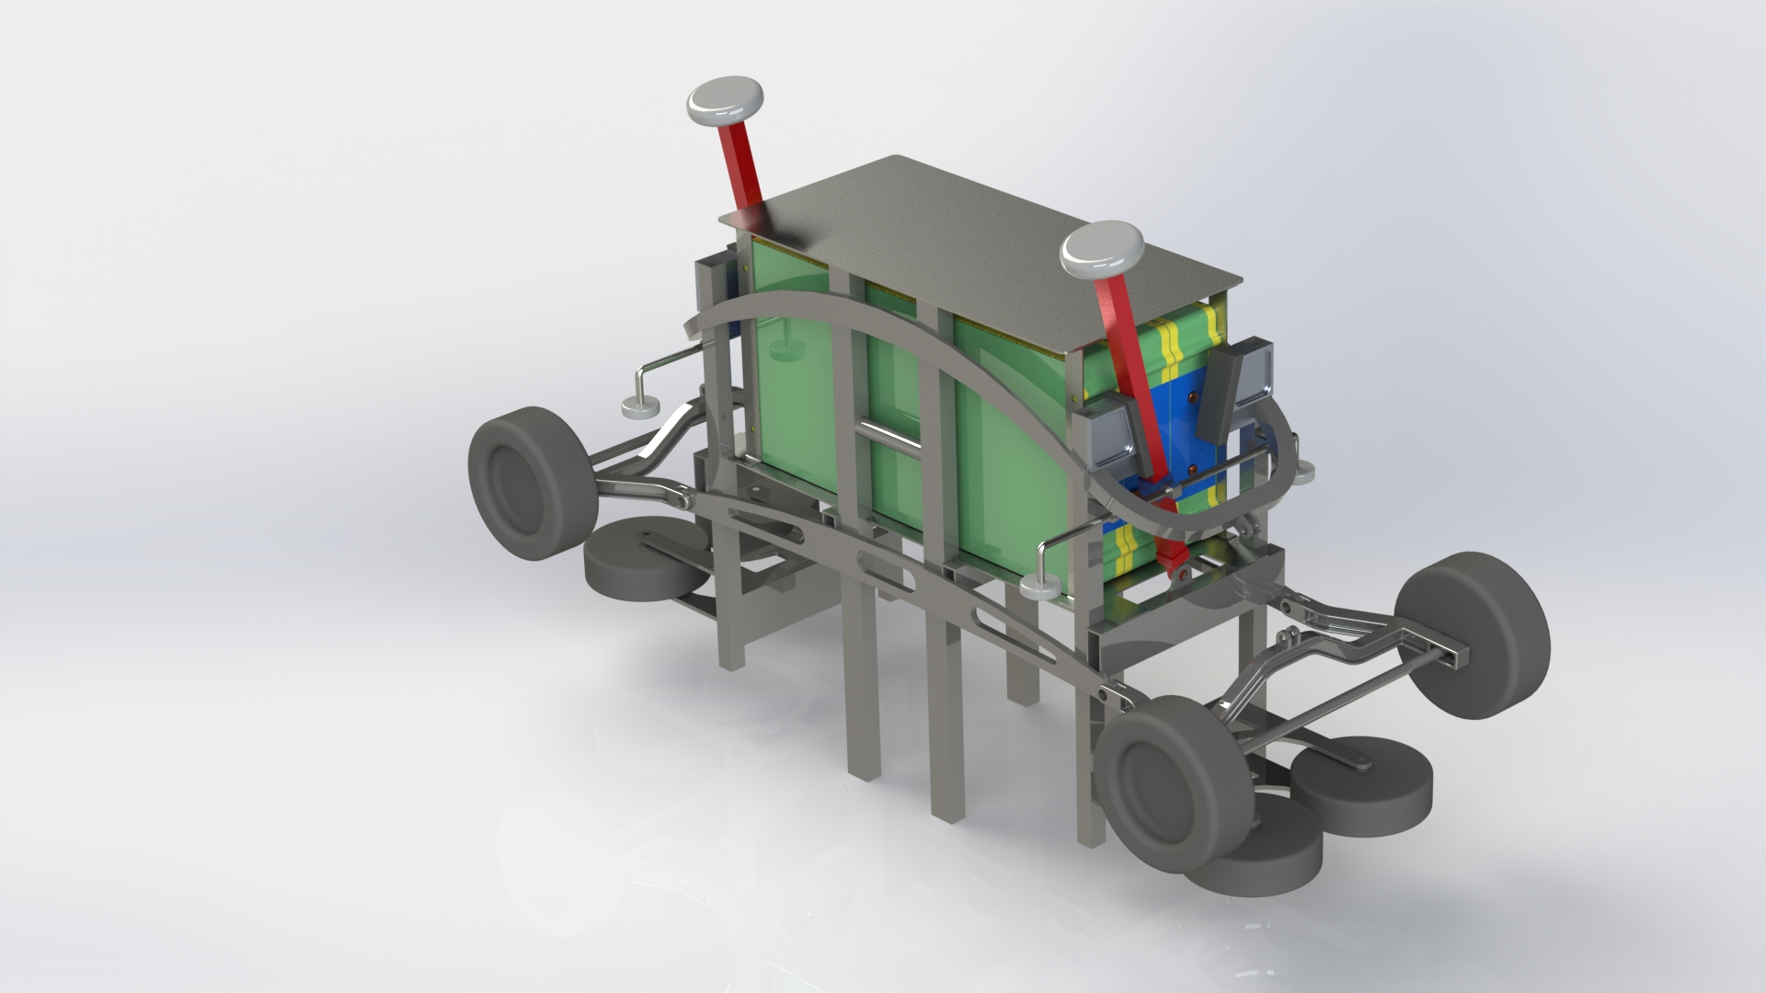
Bogie Design for a Suspended Solar-Powered ATN Vehicle
Mohammed Saiyed
Department of Mechanical Engineering
San Jose State University
May 14th, 2020

Slide 2
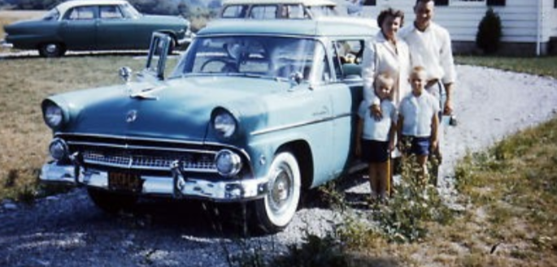
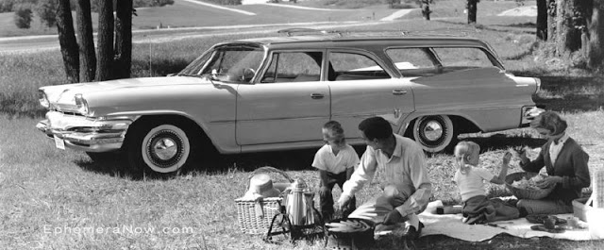
Automobiles are a huge part of American Culture.
A typical “American Dream” involves a family, a house and a shiny car in the driveway

Slide 3
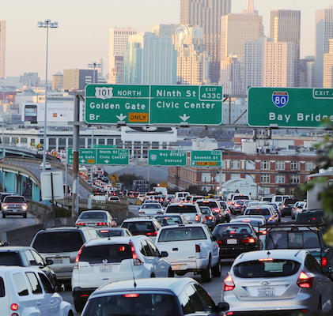
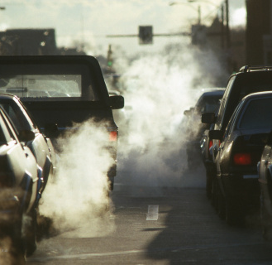
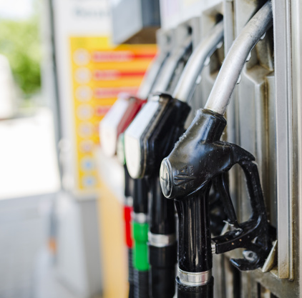
Major problems that are created by the automobile industry
Traffic
Air Pollution
Fuel Dependency

Slide 4
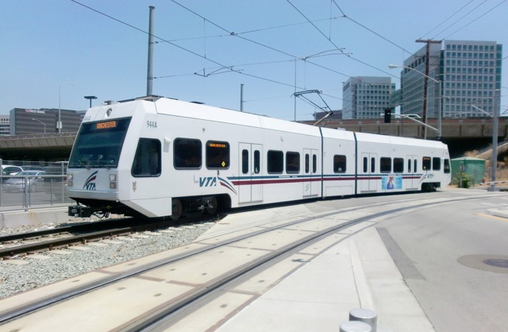
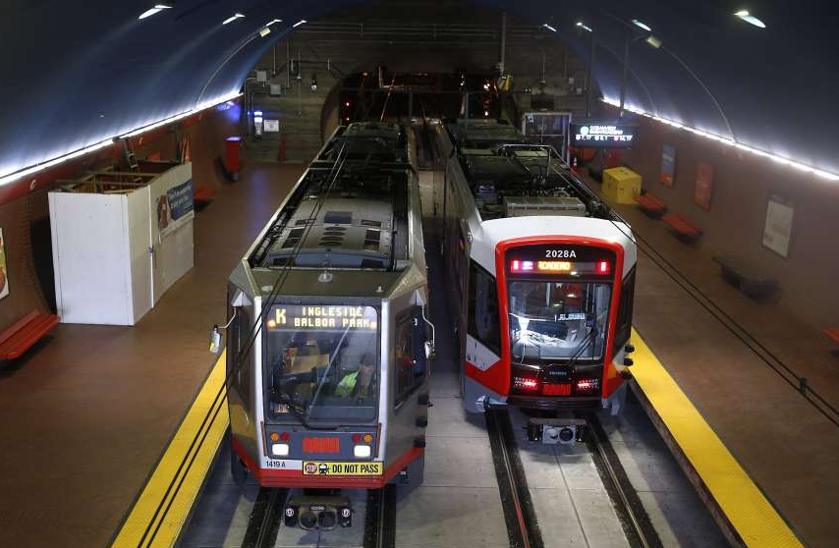
State of Public Transportation in Big Cities
San Jose
San Francisco
Requires more land & adds to the street traffic
Requires expensive tunnel system to operate under ground

Slide 5
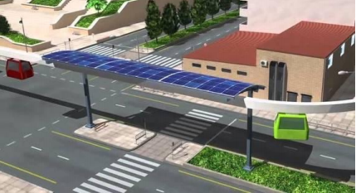
SPARTAN Superway solves most transportation problems by using Solar Power to operate & rising above the street level
Solar
Powered
Automated
Rapid
Transit
Ascendant
Network

Slide 6
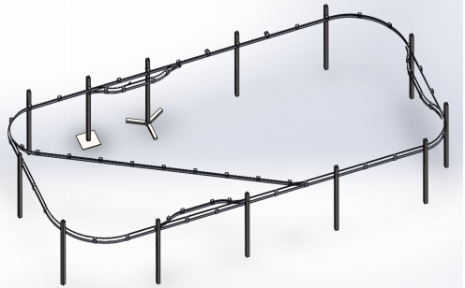
SPARTAN Superway provides an uninterrupted travel from origin to destination with the use of offline stations.
Offline Stations
Solidworks model of SPARTAN Superway track designed by 2014-2015 students showing offline stations on a guideway

Slide 7
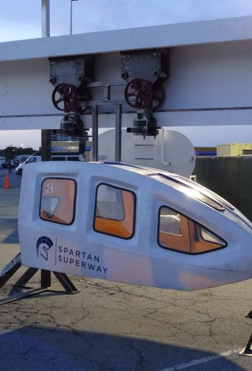
Design a bogie for Spartan Superway from which a passenger cabin is suspended below, which will allow the bogie to take one path or the other at a junction on the guideway

Slide 8
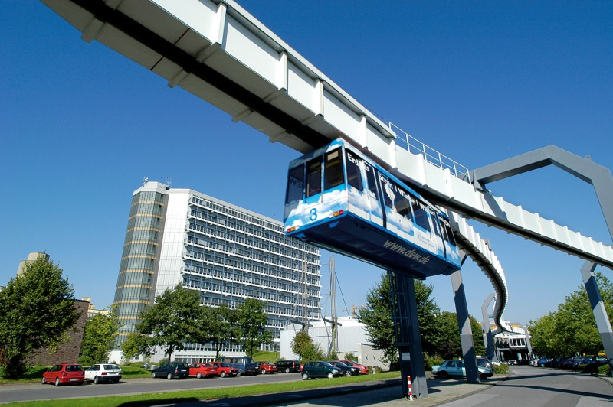
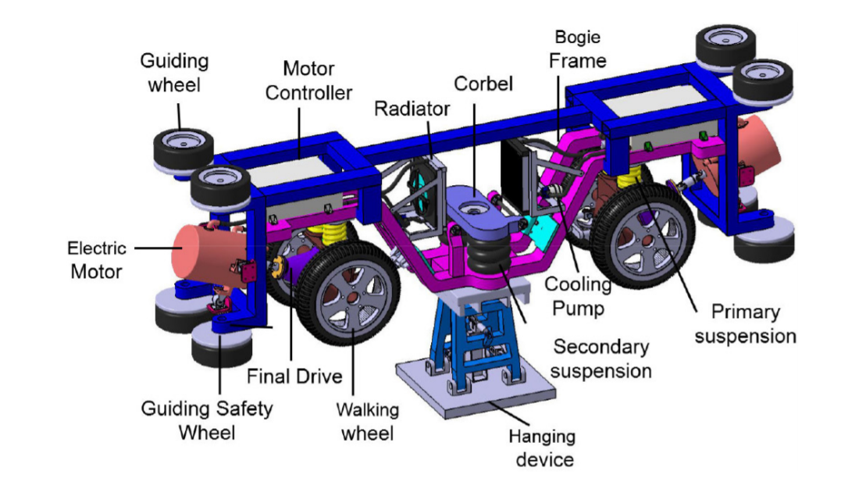
Suspended monorails that are already in service.
H-Bahn Cabin Suspended From the Bogie
H-Bahn Bogie Frame

Slide 9
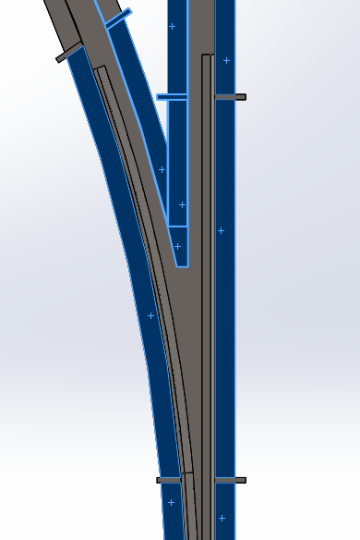
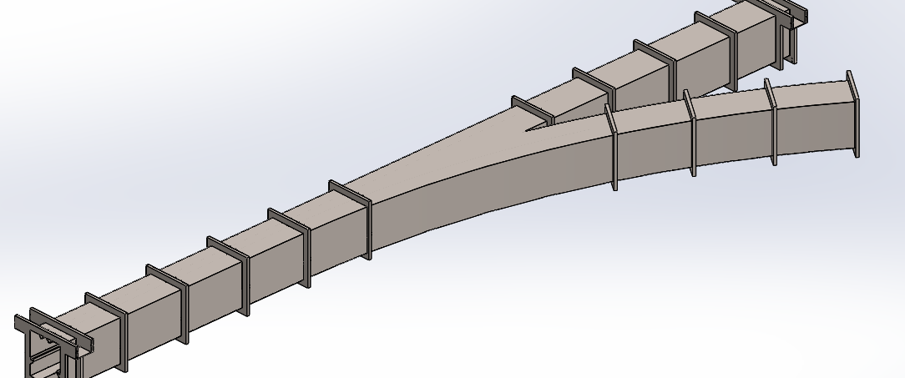
Designing a bogie system that can maneuver a passive guideway with junctions without derailing
Isometric view of guideway junction
One wheel will be hanging during the turns
Bogie wheels rests on highlighted surface
Working in conjunction with Liwei Lu
Bottom view of guideway junction

Slide 10
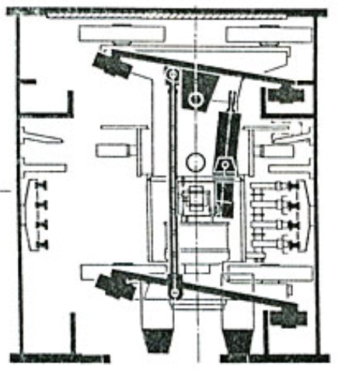
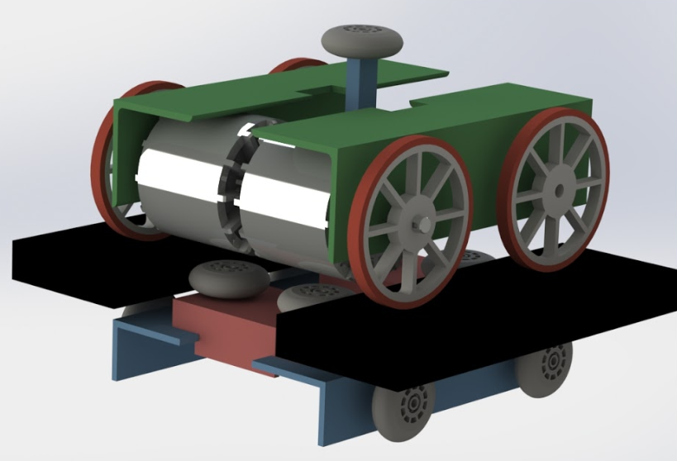
Different switching mechanism used commercially and previous work done by SPARTAN Superway.
H-Ban switching mechanism
Bill’s design (SPARTAN Superway), 2020

Slide 11
Design Overview for Bogie Assembly showing major components
Switching Mechanism
Switch support
Frame Shock Mount
Swingarm
Battery Pack
Bogie Frame
Cabin is Attached Here
Drive Wheels
Guide Wheels

Slide 12
Bogie on top of a guideway with switching mechanism in action
Switch hooks theses wheels into the track to turn the bogie
Bottom guide wheels making contact with the track to keep the bogie centered on the track

Slide 13
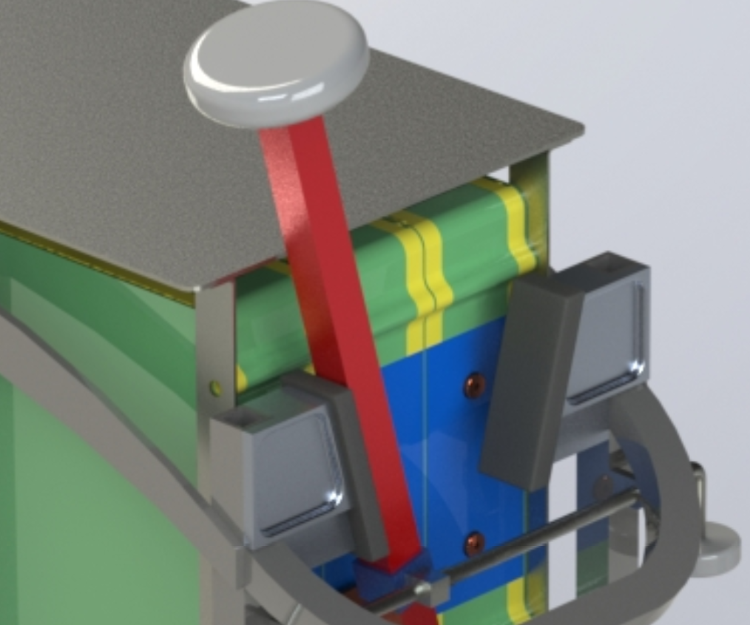
Switch bar support to compliment the switching mechanism
Direction of Load
Rubber to reduce noise
Transfers load to the frame

Slide 14
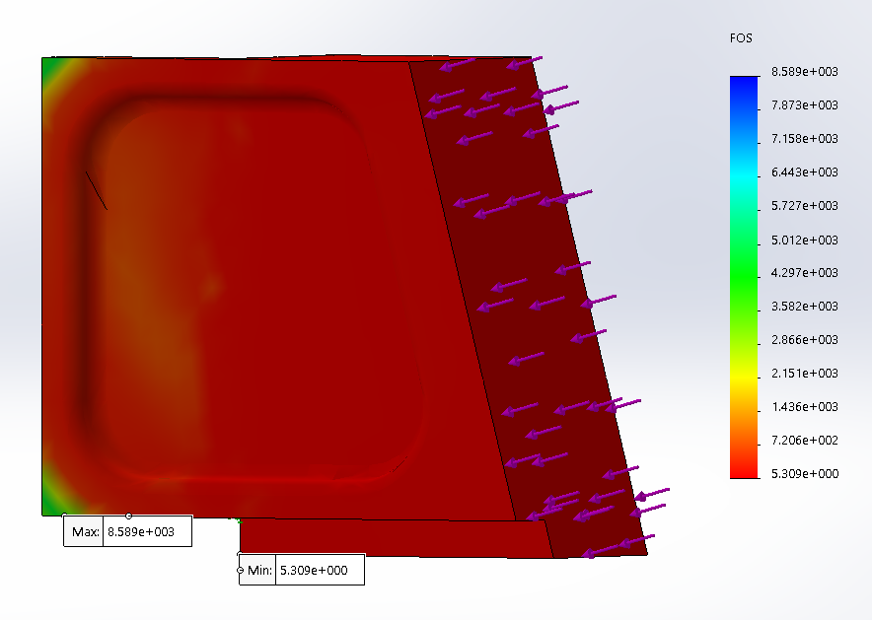
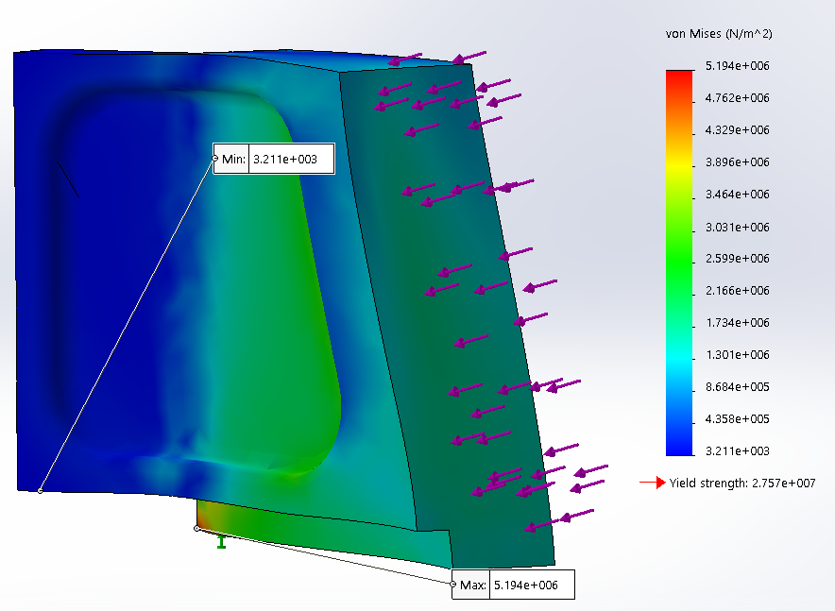
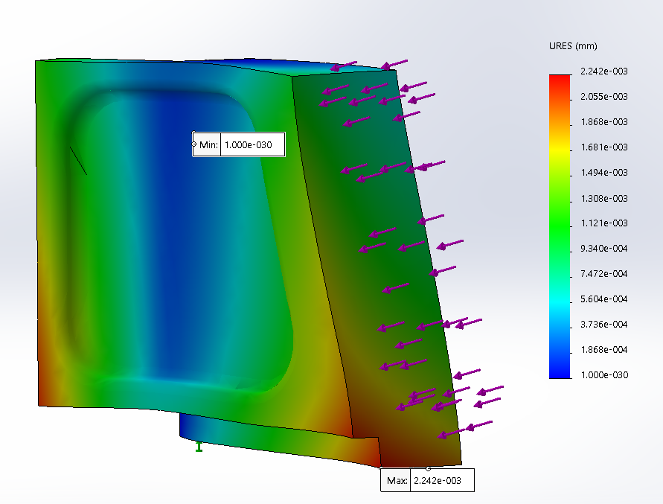
FEA analysis results of the support block to transfer load to the frame.
Von Mises (maximum 5.1E6Pa)
Factor of Safety (minimum = 5.3)
Deflection (maximum = 0.0022mm)

Slide 15
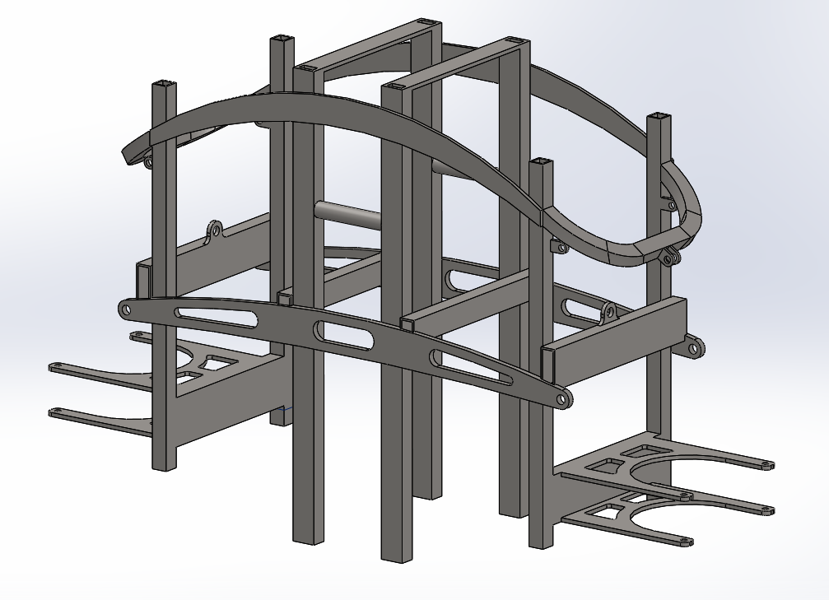
Frame components
Attached using L brackets and bolts
Weight Saving cutouts
Follows the curve to transfer load to the frame
Forks for guidewheels
Cabin Attached Here

Slide 16
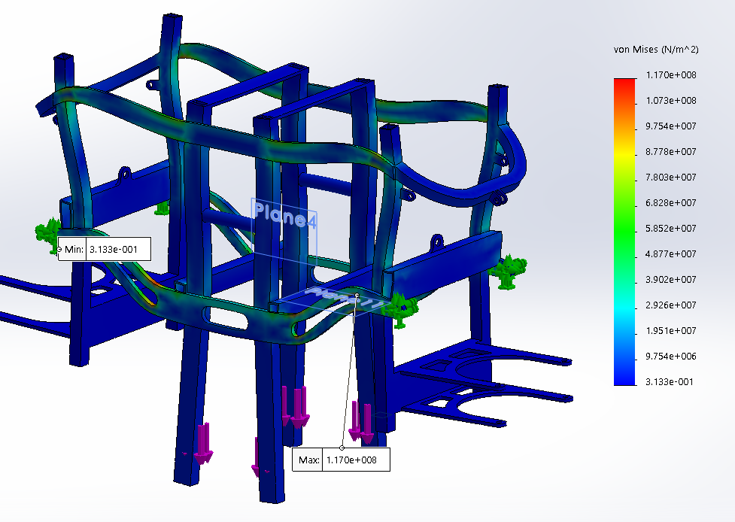
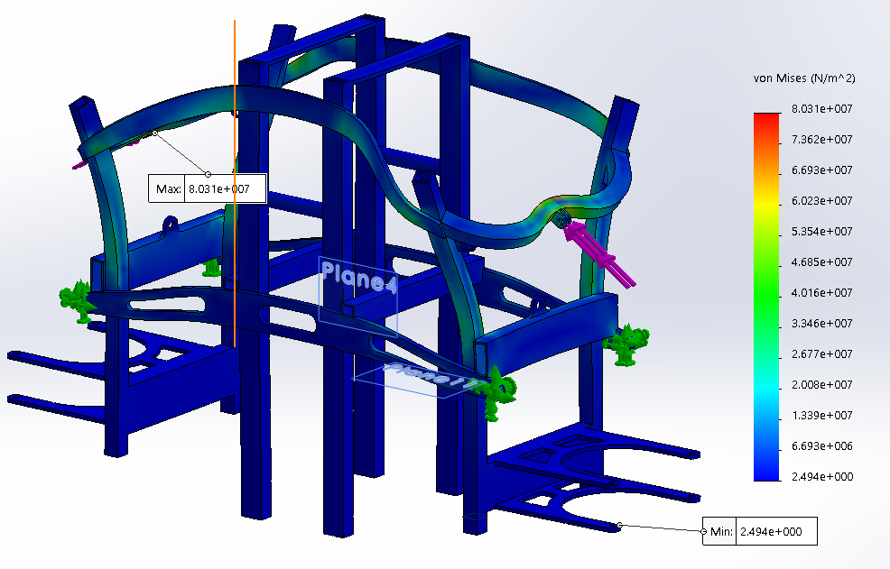
FEA analysis results for the bogie frame and frame shock mount
2500N
10000N
Maximum Stress 1.17E8 Pa
Minimum Factor of Safety 5.3
Maximum Deflection 0.40mm
Maximum Stress 8.03E7 Pa
Minimum Factor of Safety 4.3
Maximum Deflection 0.32mm

Slide 17
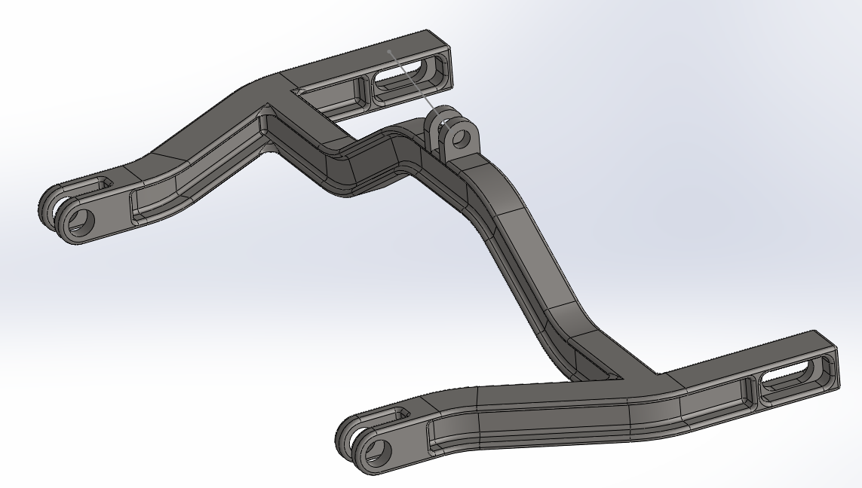
Swingarm design ang how it works with the frame
Shock Mount
Swing Arm Pivot Points
Adjustable Axle

Slide 18
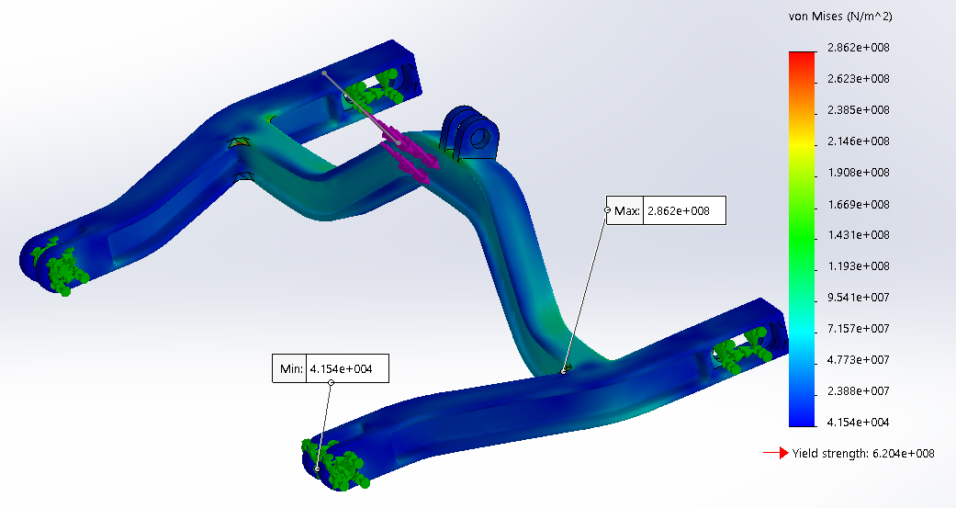
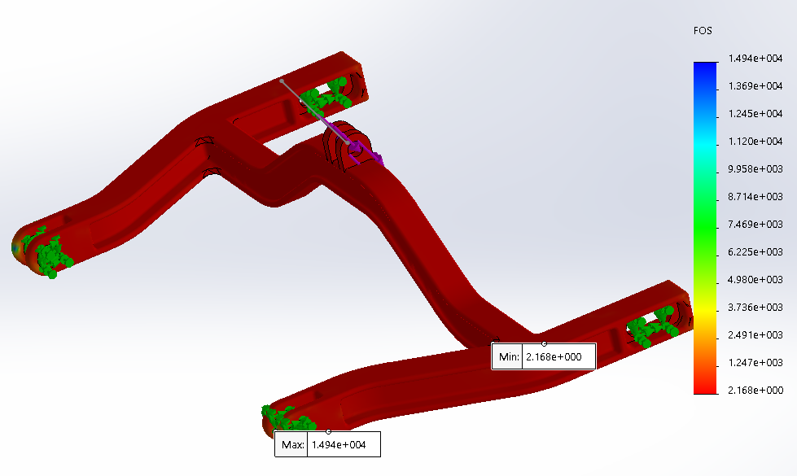
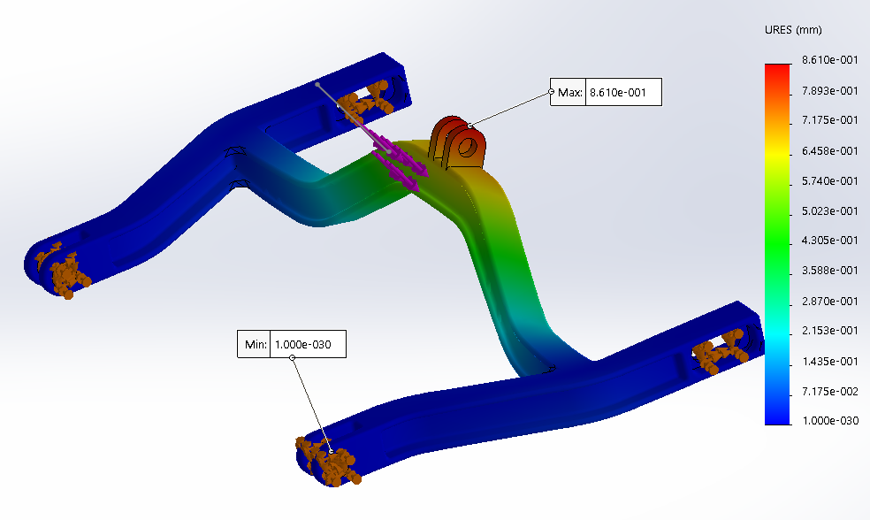
Swingarm FEA analysis results
2500N
Fixed
Von Mises (maximum 2.8E8Pa)
Factor of Safety (minimum = 2.1)
Deflection (maximum = 0.86mm)

Slide 19
Battery pack specifications
High Voltage Pack
Parallel Connections | 16
Series Connections | 72
Total Cells | 1152 Cells
Voltage | 273.6 V
Capacity | 21,888 Wh
Cell Weight | 74.88 Kg
Low Voltage Pack
Parallel Connections | 32
Series Connections | 36
Total Cells | 1152 Cells
Voltage | 136.8 V
Capacity | 21,888 Wh
Cell Weight | 74.88 Kg

Slide 20
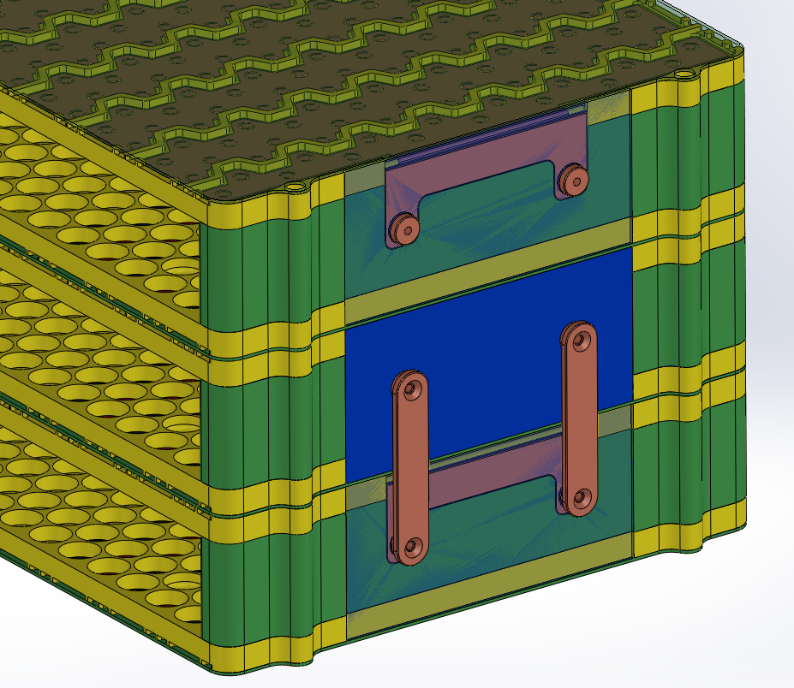
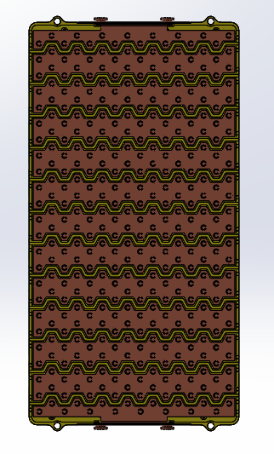
Battery pack assembly showing all major components.
End copper plates
Copper Plates
LHS ABS Side Plate
Cross brace
Local Busbar
RHS ABS Side Plate
Terminal Busbar
G10 Terminal cover
1/16” G10 Sheet

Slide 21
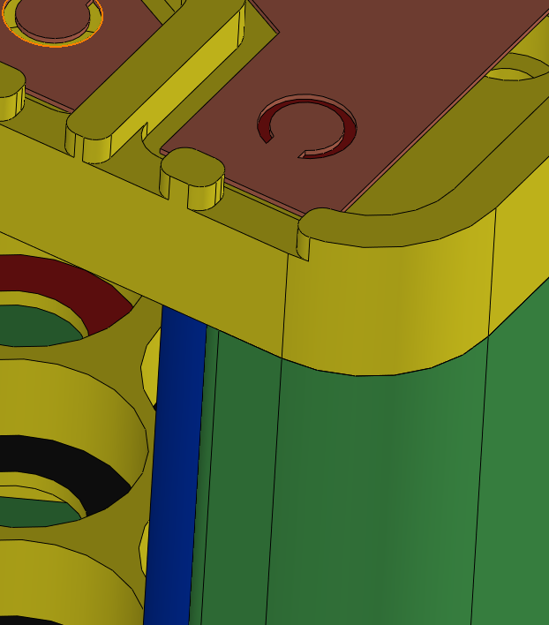
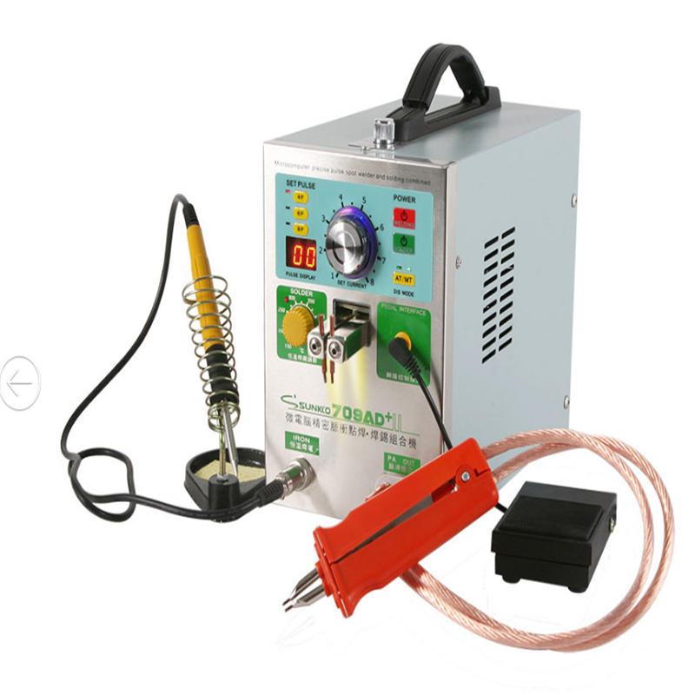
Using pulse spot welding to weld the cells to the copper plates
Press in and spot weld
Pulse Spot Welder

Slide 22
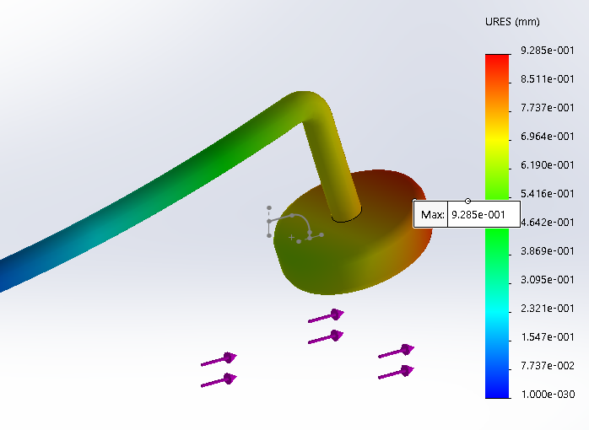
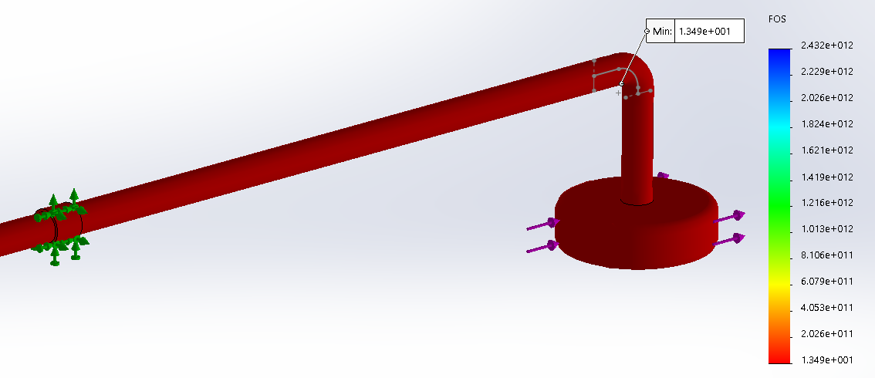
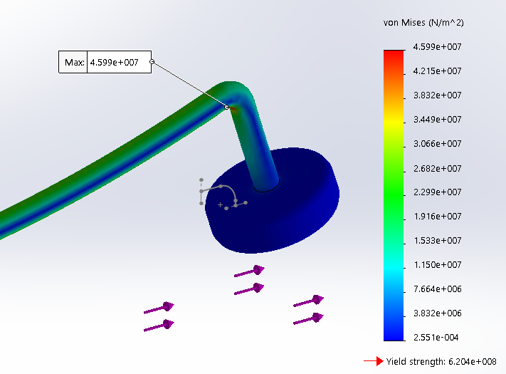
FEA analysis results for horizontal switch bar
Deflection (maximum = 0.92mm)
Fixed
50N
Factor of Safety (minimum = 13)
Von Mises (maximum 4.5E7Pa)

Slide 23
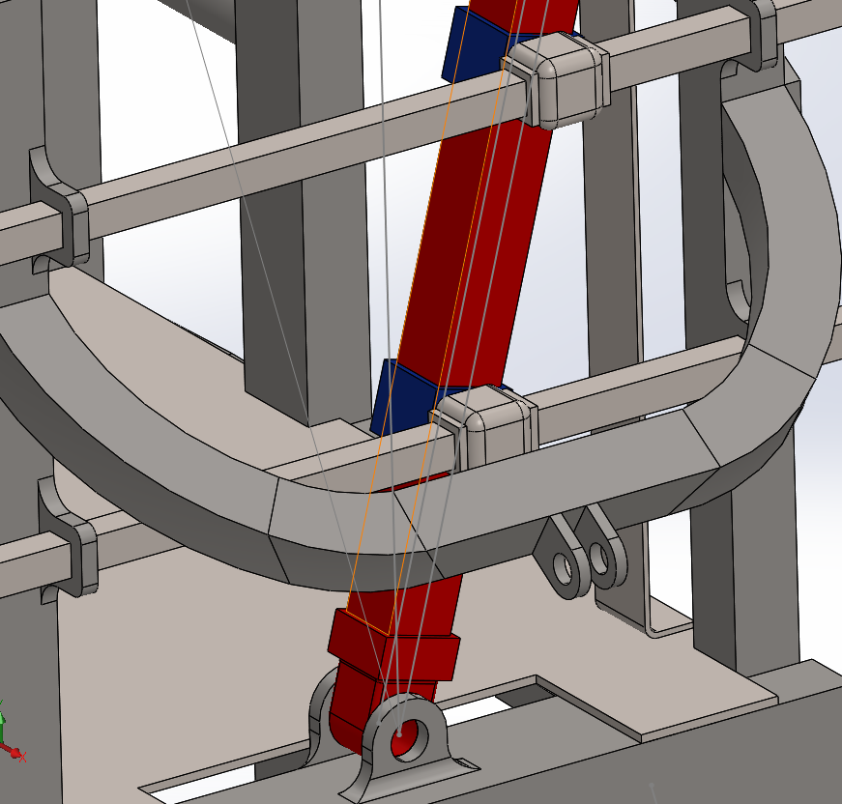
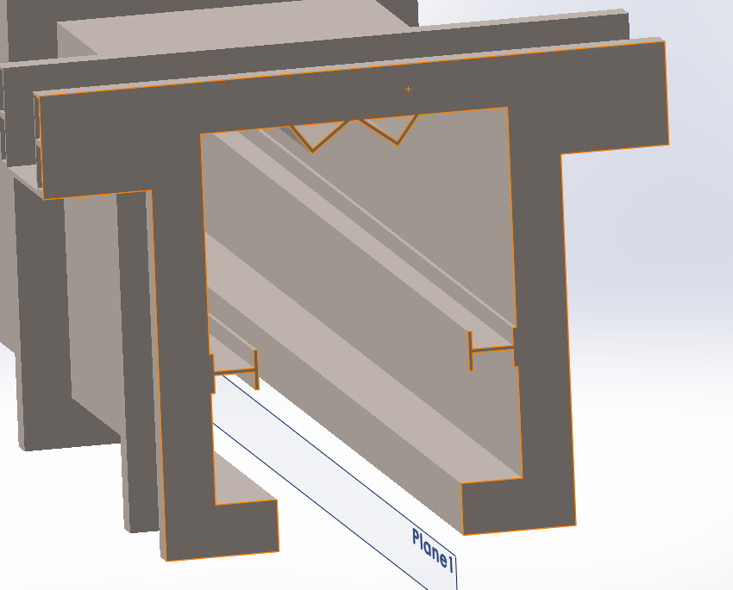
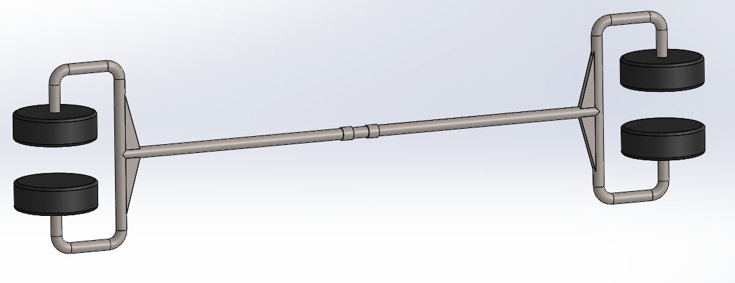
Improved switching mechanism design
Using two Separate bars instead of one
Using I Beams instead of U

Slide 24
Relationship between wheel diameter and RPM at constant velocity of 25mph.
Wheel Diameter | RPM
8” = 0.2032m | 1050
10” = 0.254m | 840
12” = 0.3048m | 700

Slide 25
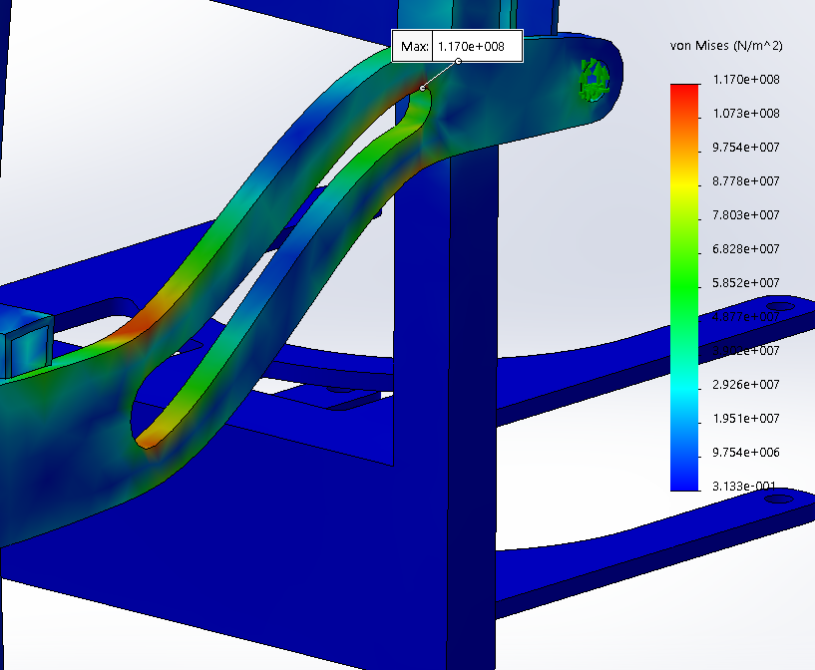
Future Work: Using ANSYS to optimize dimensions for the parts that are custom.
This can reduce the maximum stress and the weight of the part at the same time. Mostly used to calculate dimensions of weight reduction holes in part.

Slide 26
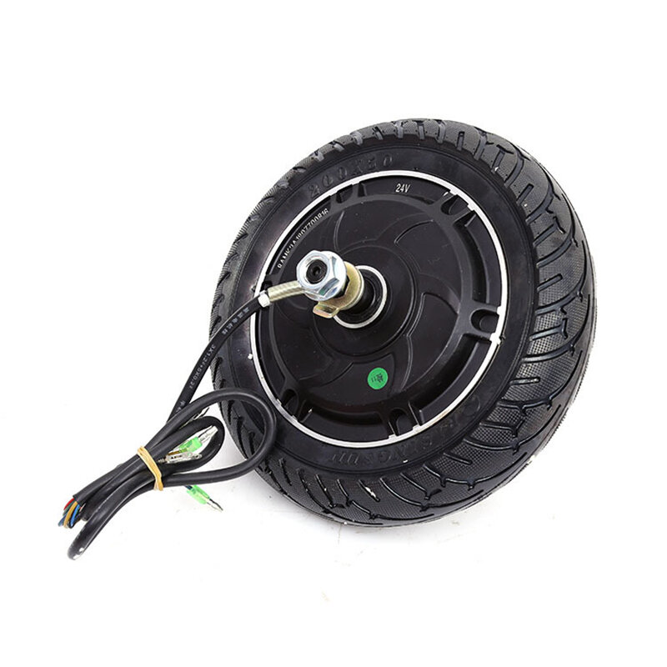
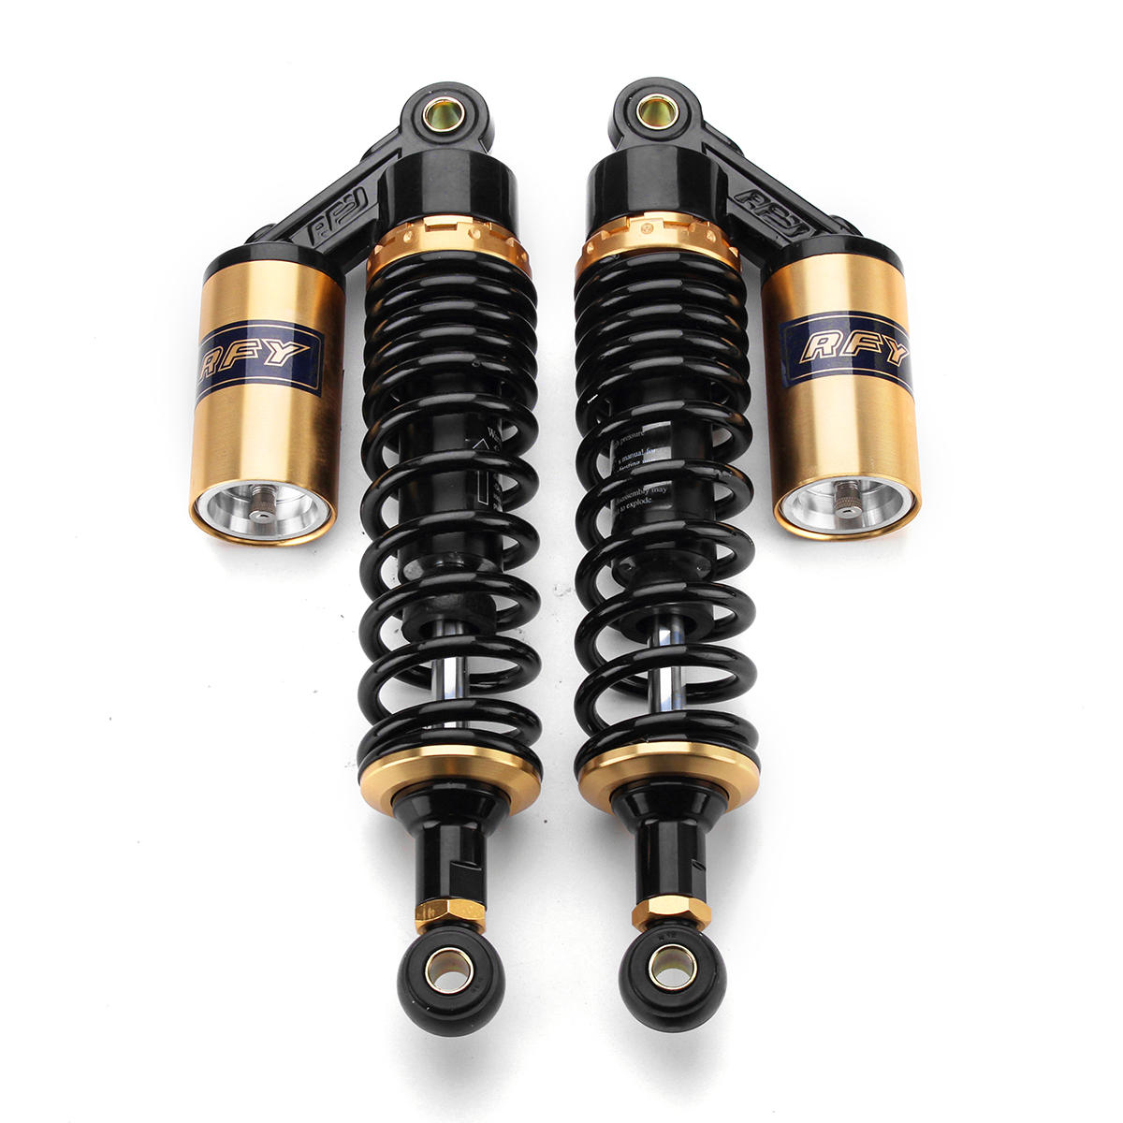
Future Work: Finding a shock absorber and a hub motor that works with the system.
Might have to change the swingarm to accommodate longer shock absorber.

Slide 27
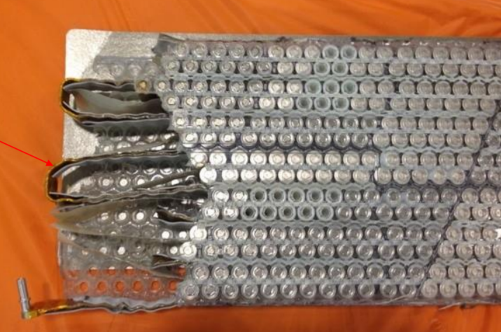
Future Work: Introduce water cooling to the 21700 battery pack
Tesla Model S Battery Module
Thermal Management System
2D CFD analysis using ANSYS Fluent
Outlet
Inlet
Temperature contour of 2D CFD analysis of water cooling battery cells

Slide 28
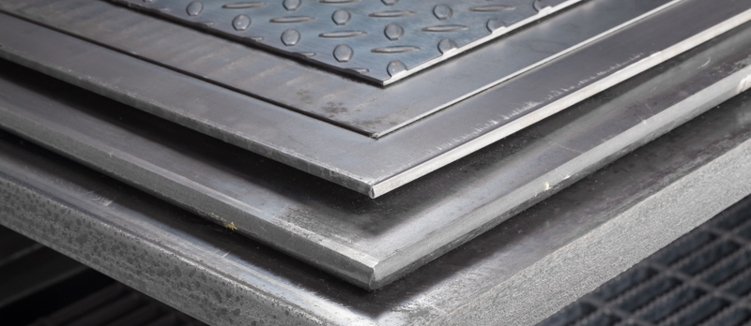
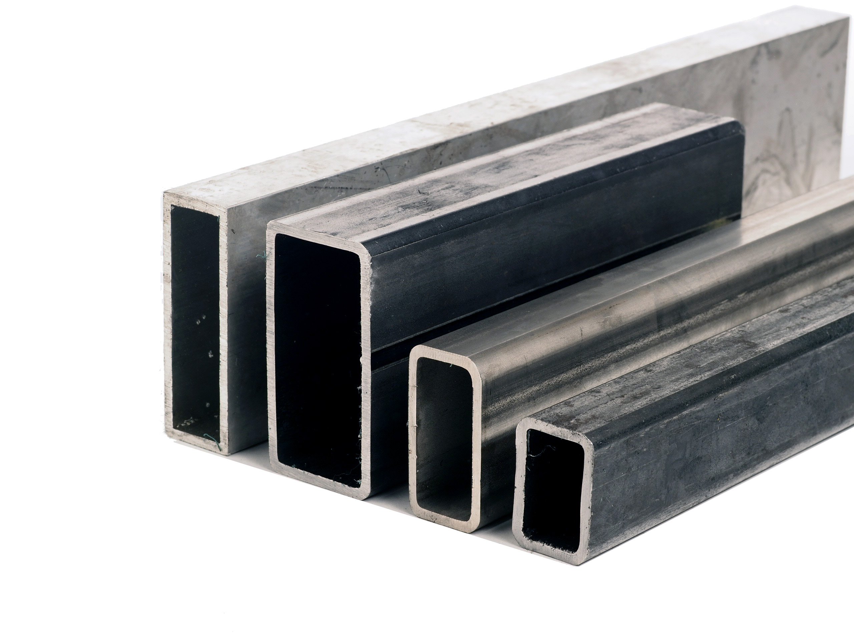
Future Work: Building a prototype
Frame uses standard dimension tubing, which are easy to find off the shelf, and weld them together.

Slide 29
ACKNOWLEGEMENTS
Burford Furman
Ron Swenson
James Mokri
Liwei Lu
Eric Hagstorm
Dan Espinosa

