Slide 1
Team Members
Julio Flores Molina
Jeffrey Kelly
Hila Matas
Project Advisor
Prof. Juan De Dios Calderon
of Tecnologico de Monterrey

Slide 2
Overview
Introduction and motivation
Literature review
Preliminary work
Summary and conclusions

Slide 3
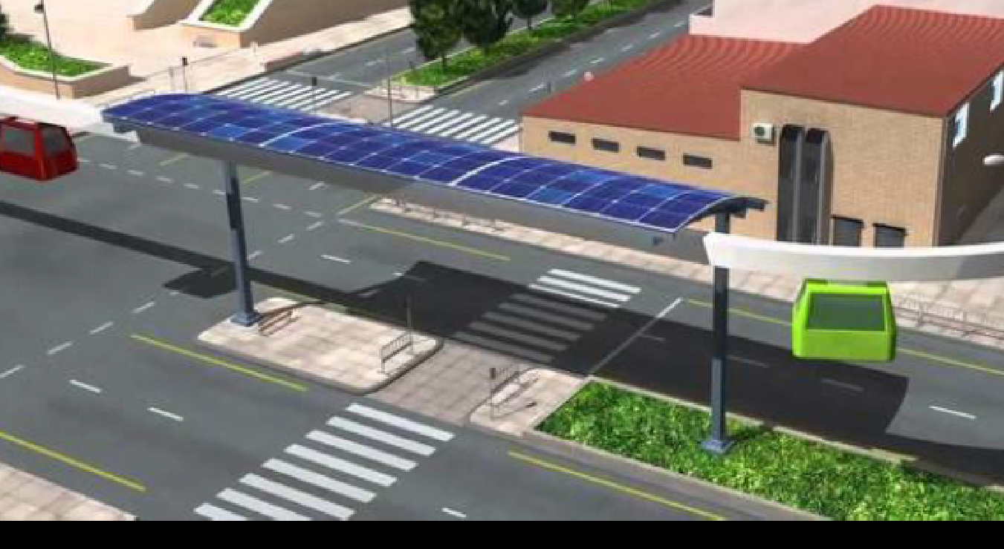
Spartan Superway
Juan de Dios Calderón PhD. Tecnológico de Monterrey
Ron Swenson
Burford Furman PhD.

Slide 4
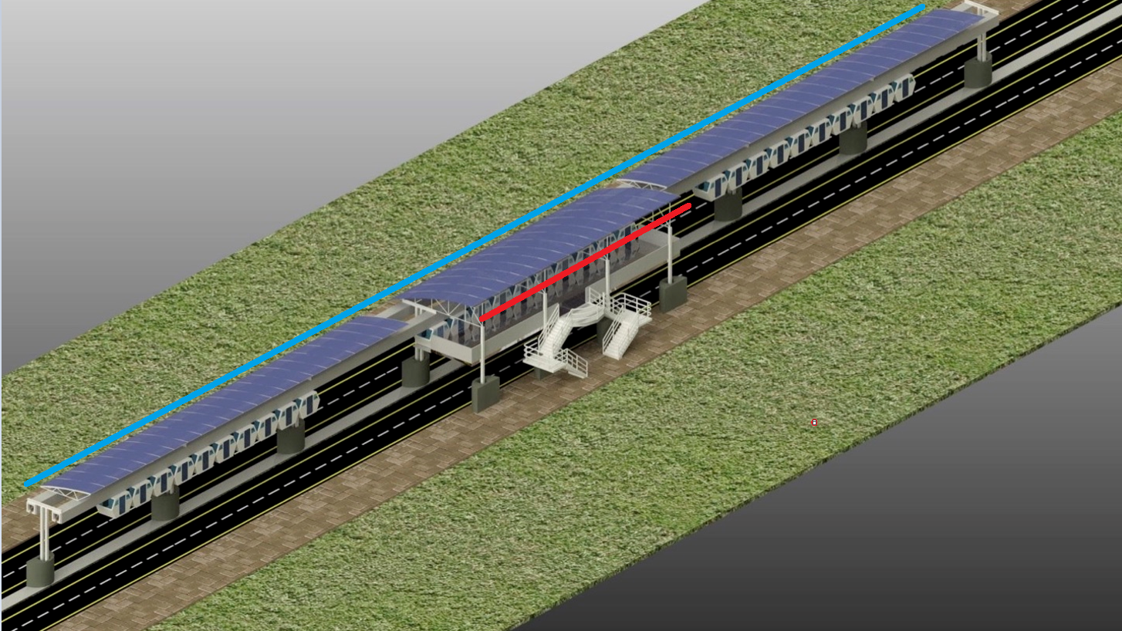
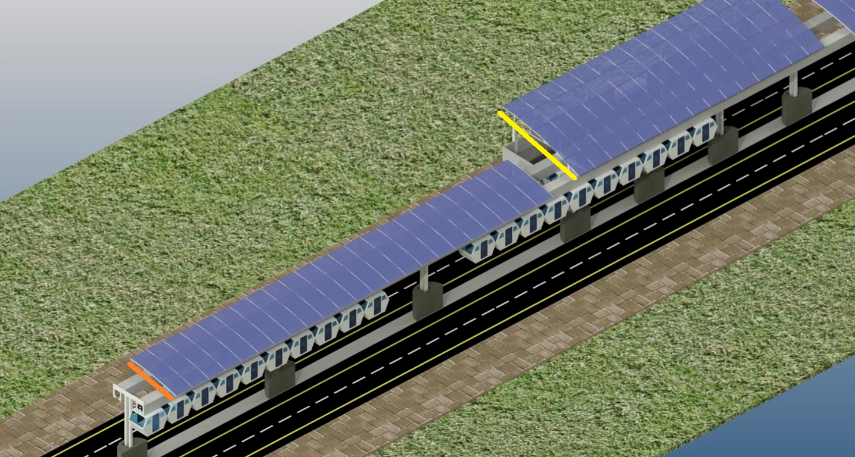
Available Solar Energy
MAIN DATA
Station information |  | Unit
Distance L | 500 | m
Distance S | 30 | m
Wide L | 6 | m
Wide S | 10 | m
Area L | 3120 | m^2
Panel information |  | Unit
Energy/area | 170 | W/m^2
Total energy | 530400 | W/Station
Hours of equivalent sunshine per day | 5 | hours
Energy/day | 2652000 | W*h/day
Energy/day | 2652 | kW*h/day

Slide 5
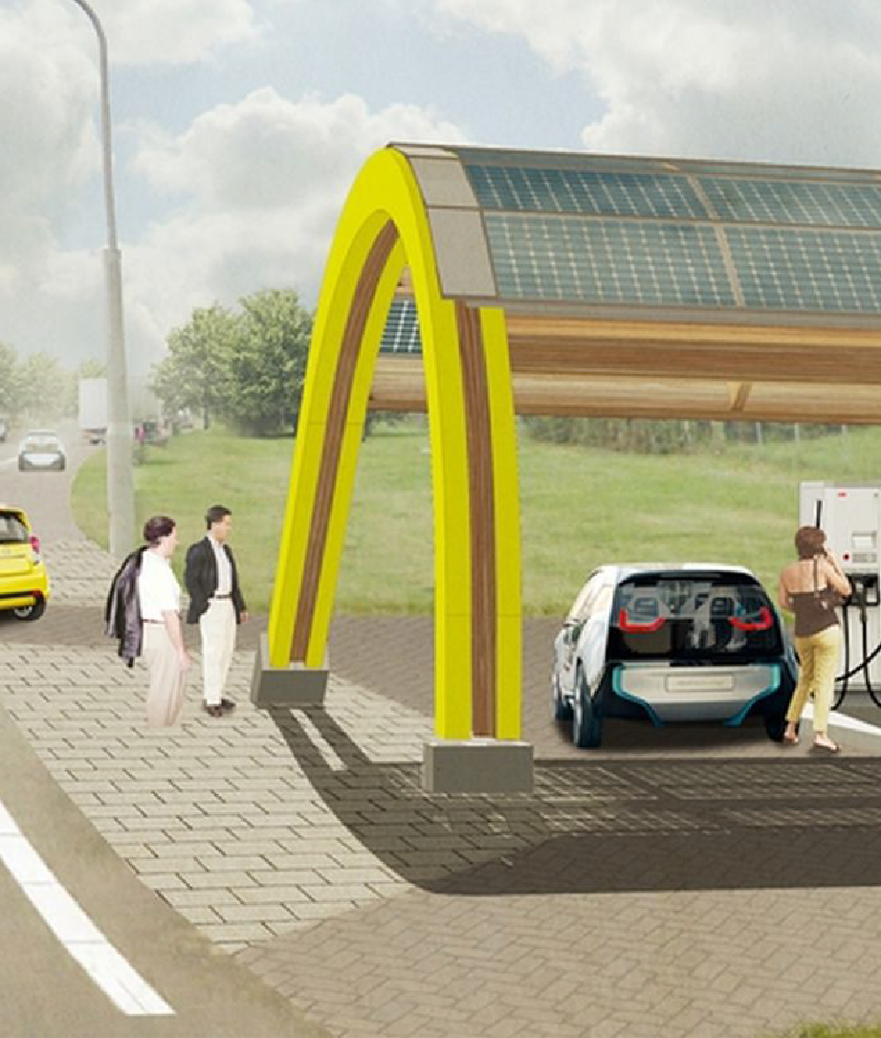
The Charging station Challenge
1. Quantify energy requirements
2. Design flexible hybrid architecture
A. Energy to grid (bidirectional)
B. Design subsystem
• Select/Design components
• Simulation
C. Financial analysis

Slide 6
Energy Storage Elements at Charging Station
Batteries
Fuel Cell / Hydrogen
Ultra Capacitor
DC/DC Converters
Optimized Controllers

Slide 7
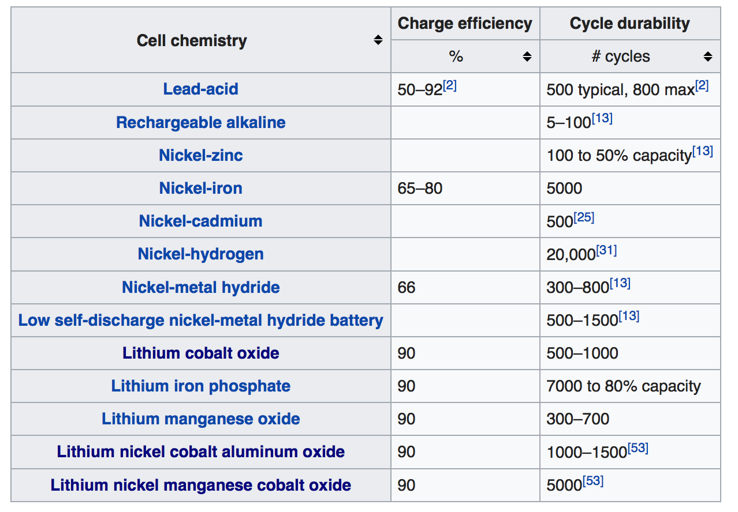
Battery Technology

Slide 8
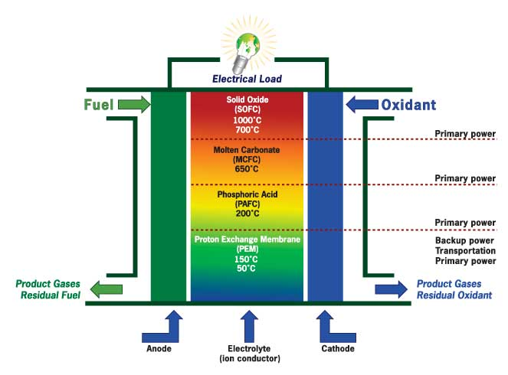
Fuel Cell
Fuel is electrochemically oxidized and electrons are harvested, instead of being burned in a combustion engine.
Efficiency of the same fuel grows from 30% for internal combustion engine to 60% in Fuel cell, while emissions go down.
When H₂ is used as fuel – H₂O is the oxidized waste product.
Fuel Cells supply constant current - They don’t start and stop, and they don’t change the current.

Slide 9
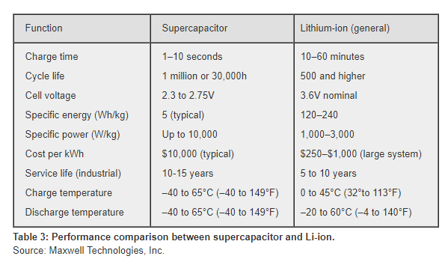
Summary comparison Battery Vs. SuperCapacitors

Slide 10
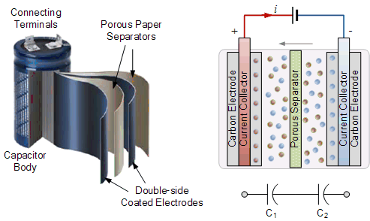
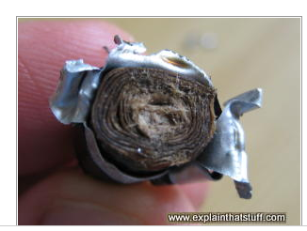
Super Capacitors
Must SuperCapacitors are made out of activated charcoal (activated graphite), separated by a paper separator and carbon electrodes are impregnated with the liquid electrolyte with an aluminium foil used in between the two to act as the current collector
Reference: https://www.electronics-tutorials.ws/capacitor/ultracapacitors.html

Slide 11
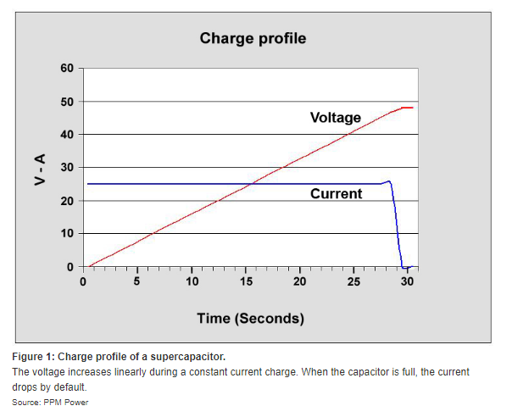
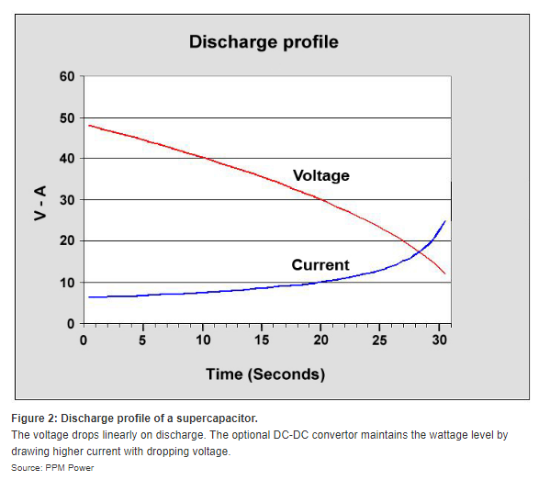
Disadvantage of Supercapacitors/Ultracapacitors
Low specific energy density, (1Wh/kg to 30Wh/kg, 10–50 times less than Li-ion.)
Linear discharge voltage prevents using the full energy spectrum (e.g. 2.7 to 0 volts) DC-DC converter is required.
High Cost.
http://batteryuniversity.com/learn/article/whats_the_role_of_the_supercapacitor

Slide 12
Revisit Literature Review
A Comparative Study of Fuel-Cell–Battery, Fuel-Cell–Ultracapacitor, and Fuel-Cell–Battery–Ultracapacitor Vehicles
Solar Hydrogen Production for Fuel Cells

Slide 13
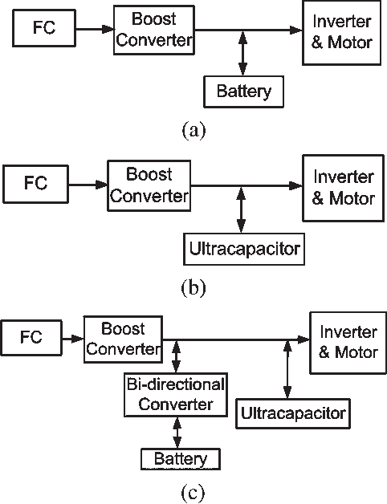
A Comparative Study of Fuel-Cell–Battery, Fuel-Cell–Ultracapacitor, and Fuel-Cell–Battery–Ultracapacitor
Vehicles Jennifer Bauman and Mehrdad Kazerani, IEEE March 2008
Use simulation tools to compare 3 configurations:
Compare Energy efficiency, cost and weight

Slide 14
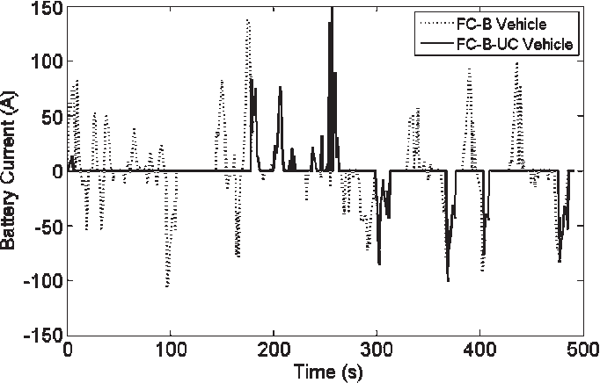
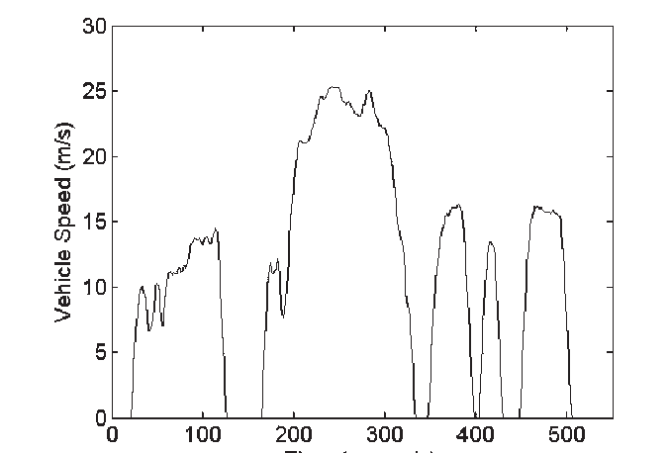
Study Results

Slide 15
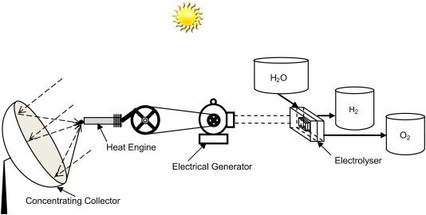
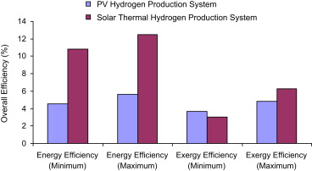
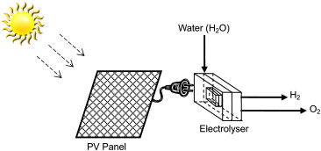
Solar Hydrogen Production
Solar hydrogen production: A comparative performance assessment
Anand S. Joshi, Ibrahim Dincer, Bale V. Reddy, International journal of hydrogen energy 36 (2011)

Slide 16
Solar Hydrogen Production
“It is found that the solar thermal hydrogen production via electricity production is an environmentally benign method and possesses higher exergy efficiency than PV hydrogen production.
However, the latter is better in a way that it does not involve any moving parts.”
Solar hydrogen production: A comparative performance assessment
Anand S. Joshi, Ibrahim Dincer, Bale V. Reddy, International journal of hydrogen energy 36 (2011)

Slide 17
Preliminary Work - Design
Analysing available data
System requirements - Understanding system requirements and propose model that satisfied .
Understanding Assumptions and their flexibilities

Slide 18
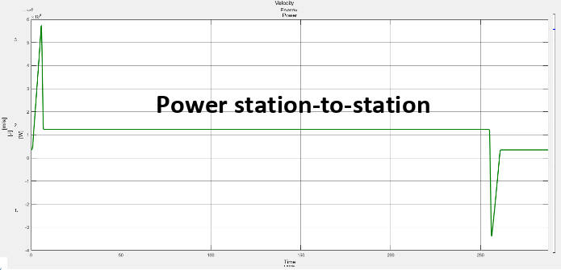
Simulation
Understand System Model and make sure it applies to existing technologies. e.i. No average power source since we are using renewable sources. Battery Charging, DC-to-DC, AC-to-DC Conversion requirements. Hydrogen Generation.
Currently using Excel
but if necessary Matlab Simulink,or Python.

Slide 19
Simulation - Testing
Data Validation
AVX donations allows us to build a system. Most likely, it will be build in Tecnologico de Monterrey, Mexico.

Slide 20
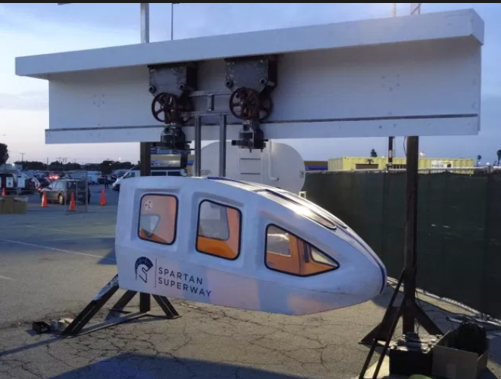
Analysis - Future
Our project should be Flexible systems - Modular Systems - Scalable
Application’s beyond Spartan Superway
Different power sources.

Slide 21
Conclusions (What’s ahead?)
Continue refining the model
Super Capacitor Testing
Define the DC/DC Converter Parameters
Finite the recommendation for what kind of battery, fuel cell and ultracapacitor to use

