Slide 1
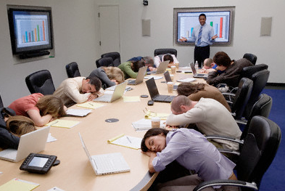
How to give effective technical presentations
http://www.mechanicalengineeringsite.com/
Burford Furman
SJSU Department of Mechanical Engineering, ME 195B
February, 14, 2018

Slide 2
We want you to gain the skills to give effective presentations
http://2ch0ii35pfo82tskhvz2b23217-wpengine.netdna-ssl.com/wp-content/uploads/2014/06/dilbert1.gif

Slide 3
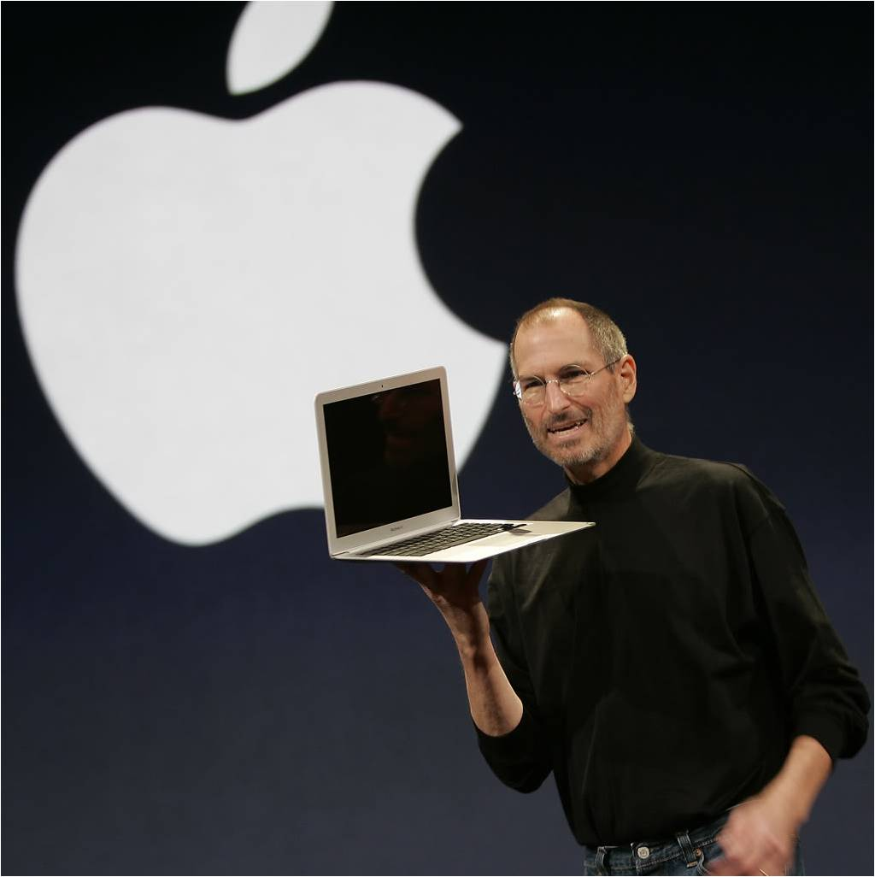
Your success as an engineer will depend on your skill at presenting your work
https://fyi09.files.wordpress.com/2009/12/apple-inc.jpg

Slide 4
As far as your presentations slides go…
www.slideshare.net/HubSpot/what-would-steve-do-10-lessons-from-the-worlds-most-captivating-presenters
Notes:
Unfortunately, the vast majority of technical and other presentations almost exclusively use and ABUSE bullets.

Slide 5
www.slideshare.net/HubSpot/what-would-steve-do-10-lessons-from-the-worlds-most-captivating-presenters

Slide 6
www.slideshare.net/HubSpot/what-would-steve-do-10-lessons-from-the-worlds-most-captivating-presenters

Slide 7
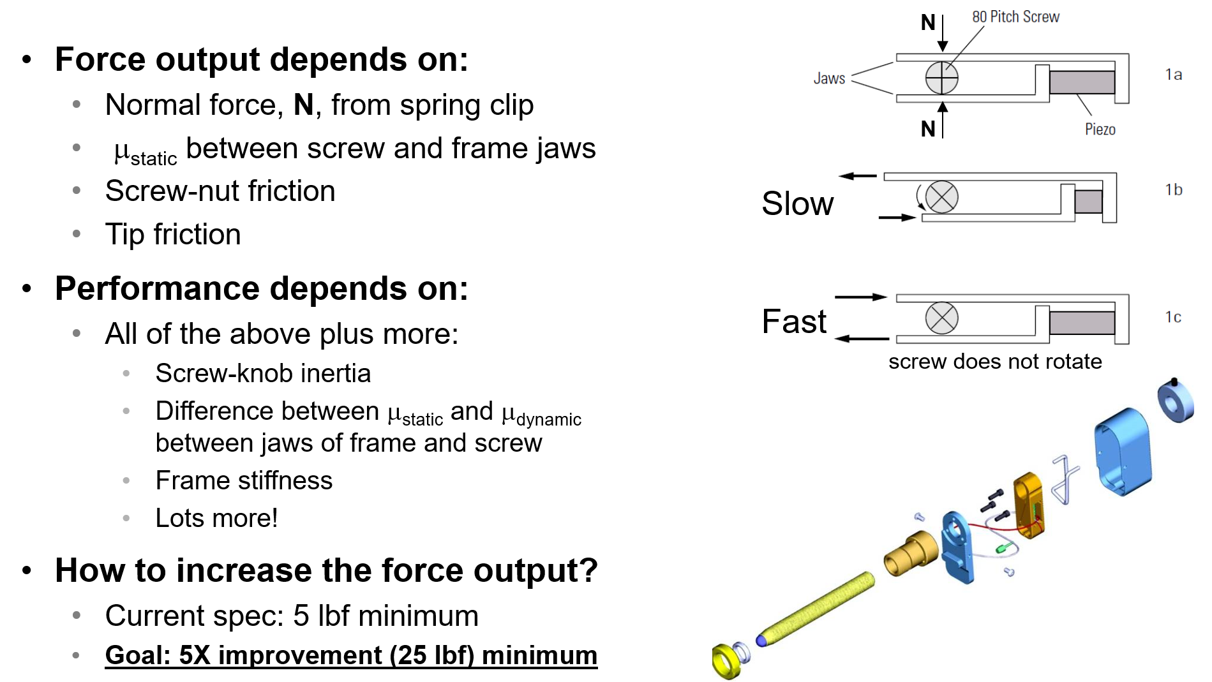
The typical PowerPoint slide is not effective for helping the audience understand and remember the content
Phrase title
Topic, sub-topic
bullet structure
Notes:
The phrase heading and topic, sub-topic structure does not provide enough coherent structure between them. The phrase heading does not prompt the presenter to generate a paraphrased statement that connects with the bullets. The typical slide leaves it up to the viewer to piece the message together from a bunch of unconnected pieces.
Bullets reduce the area for large explanatory figures. Bullets also do not clearly articulate the connection or relations among the items listed.

Slide 8
The Assertion-Evidence method for building Powerpoint slides is vastly superior to bullets
Michael Alley
Associate Professor
Leonhard Center
Mechanical and Nuclear Engineering
PennState
College of Engineering
https://www.assertion-evidence.com/
Notes:
Research supporting the assertion:
Joanna K. Garner, Michael Alley, Keri Wolfe, and Lauren Sawarynski International Journal of Engineering Education (vol. 29, no. 6, 2013) 2012 ASEE Annual Conference 2011 ASEE Annual Conference Main Takeaway: Two audiences learned a technical subject by hearing the exact same words, but viewing different slides. One set of slides followed the common practice of slides in science and engineering: a topic-phrase headline supported by a bulleted list or a bulleted list and a graphic. The other set of slides followed the assertion-evidence structure of a sentence headline that states the main message of the slide (or scene). In this structure, that message headline is supported by visual evidence. This study found that the assertion-evidence audience understood and remembered the content better than the common-practice audience. In addition, the difference between the learning was statistically significant (p < .01).

Slide 9
How could the typical Powerpoint slide be improved by assertion-evidence?
Notes:
The phrase heading and topic, sub-topic structure does not provide enough coherent structure between them. The phrase heading does not prompt the presenter to generate a paraphrased statement that connects with the bullets
Bullets reduce the area for large explanatory figures. Bullets also do not clearly articulate the connection or relations among the items listed.

Slide 10
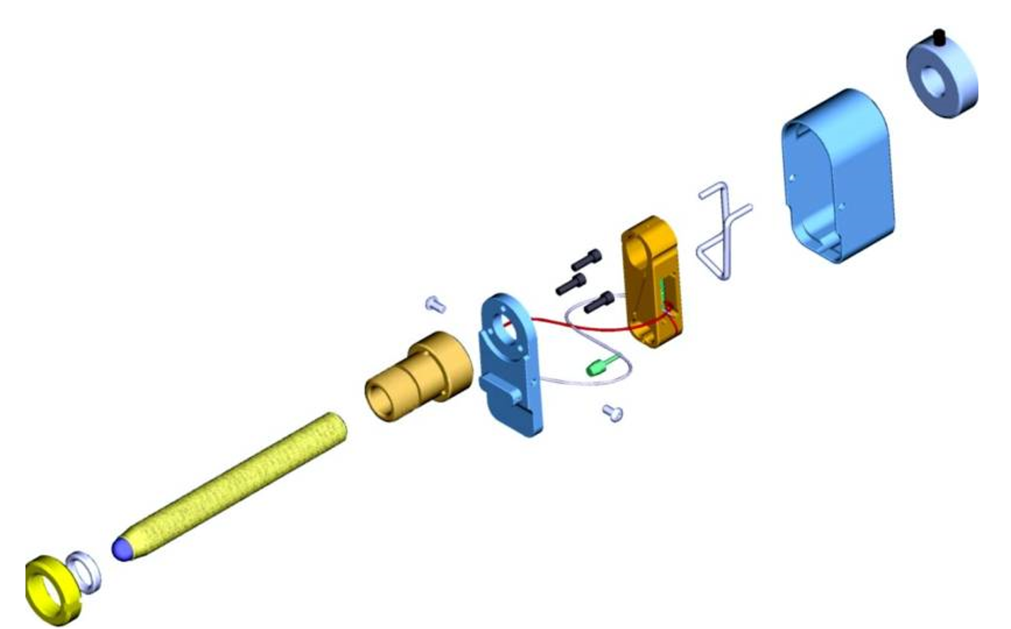
The output force of a PicoMotor depends on many factors
The title is now an assertion, i.e., the message you want to convey
keep to two lines (18–24 point type)
μ_{static} between screw and frame jaws
Normal force from spring clip
Use call-outs, if necessary: keep to one or two lines. Consider animating entry/exit, if extensive
The graphics provide the visual evidence for the assertion
Include the name of the presenter here
Dr. Furman
Notes:
One of the most important aspects of using A-E is including compelling graphics that provide solid evidence and support for the message you want to convey. Leverage Solidworks and your smart phone! NO CLIP ART! This is a common misunderstanding by some who are exposed to the concepts of the A-E method. You all, are able to or can, generate compelling images, graphs, equations to support your messaging, so just put some thought into it!
Make the graphics large enough, sharp enough, and bright enough that all in the venue will be able to easily see.
Animations allow you to keep everything to one slide. Another way is to put the information on multiple slides using the same base graphic.
Put the name of the person presenting at the bottom of the slide(s)

Slide 11
Analytical results and equations should be presented using the same A-E approach
https://www.assertion-evidence.com/research_models.html
Notes:
Graphs, charts, etc. need to have axes clearly labeled with units.
See: https://www.assertion-evidence.com/research_models.html Jacob Snyder’s model research presentation.

Slide 12
https://www.assertion-evidence.com/research_models.html
Notes:
Graphs, charts, etc. need to have axes clearly labeled with units.
See: https://www.assertion-evidence.com/research_models.html Jacob Snyder’s model research presentation.

Slide 13
There is much more that can be said about the A-E method
Visit
https://www.assertion-evidence.com/
https://www.assertion-evidence.com/research_models.html
Notes:
The site has templates, example, evidence of the effectiveness of the method, and more.

Slide 14
Create an outline to plan your presentation
Title Slide
Make sure the title slide contains the key information (fully descriptive title, names, affiliation, DATE!!!) and is evocative)
Context Message 1
(Answer the viewer’s question: ‘Why should I care?’)
Context Message n
Content Message 1
Content Message n
Conclusion Messages 1-n
Ending
For each message (assertion), develop compelling graphical evidence that will support your assertion
Backup slides 1-n
Notes:
How to compose your slide deck
Start with an outline
The subpoints under each section of the talk will be the messages you are asserting
Create effective graphics that will provide the evidence for your assertions
Take pictures using your phone cams. Review them to make sure they are sharp and bright
It’s okay to use multiple slides to convey each message
Have a closing slide, and plan your ending rather than awkwardly terminating
Have back up slides that anticipate likely questions or that can go into more depth on some of the topics you have covered. Create and index page with hyperlinks to these additional pages.

Slide 15
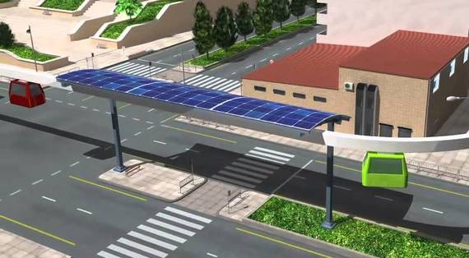
Thank you for your attention!
Notes:
Sample ending slide. Use a compelling graphic to seal your presentation in the memory of the audience and signal that the presentation has concluded. You can then ask for questions.

Slide 16
As far as the ‘mechanics’ of your presentation goes…
https://www.slideshare.net/AndersLindgren4u/stop-the-powerpoint-abuse-28551073/5
Notes:
The converse is turn and face the audience!

Slide 17
Make eye contact…
http://zinnyfactor.com/2016/11/09/mastering-the-art-of-eye-contact/
Notes:
Think ‘lawn sprinkler’

Slide 18
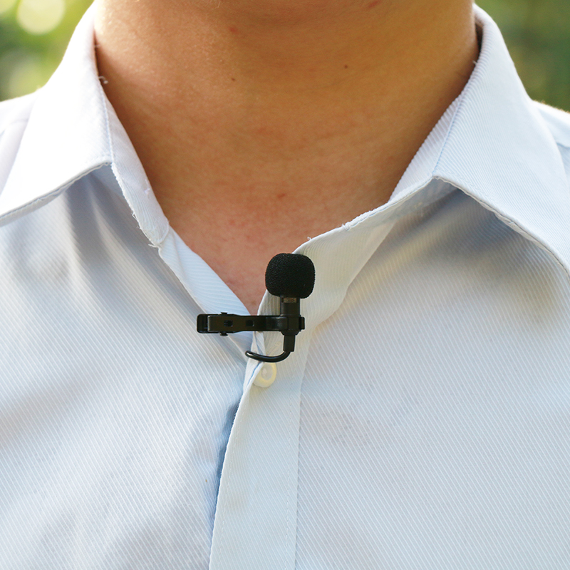
Speak so all can hear…
http://tinyurl.com/ybxezoos
Notes:
Think ‘lawn sprinkler’

Slide 19
Dress appropriately…
‘business casual’
Quote from Darlene Price of Well Said, Inc.:
"Many highly intelligent, well-qualified, capable men and women are often disqualified or dismissed because 'they don't sell for what they're worth,'" Price says. "They've left the 'business' out of 'business casual' and the lack of professional appearance holds them back. It's frustrating, because clothing certainly does not determine one's actual competence and credibility; it does, however, influence others' perception of those qualities — and that reality impacts career opportunities."
http://www.businessinsider.com/what-business-casual-really-means-2014-8
Notes:
Quote from Darlene Price of Well Said, Inc.:
"Many highly intelligent, well-qualified, capable men and women are often disqualified or dismissed because 'they don't sell for what they're worth,'" Price says. "They've left the 'business' out of 'business casual' and the lack of professional appearance holds them back. It's frustrating, because clothing certainly does not determine one's actual competence and credibility; it does, however, influence others' perception of those qualities — and that reality impacts career opportunities."

Slide 20
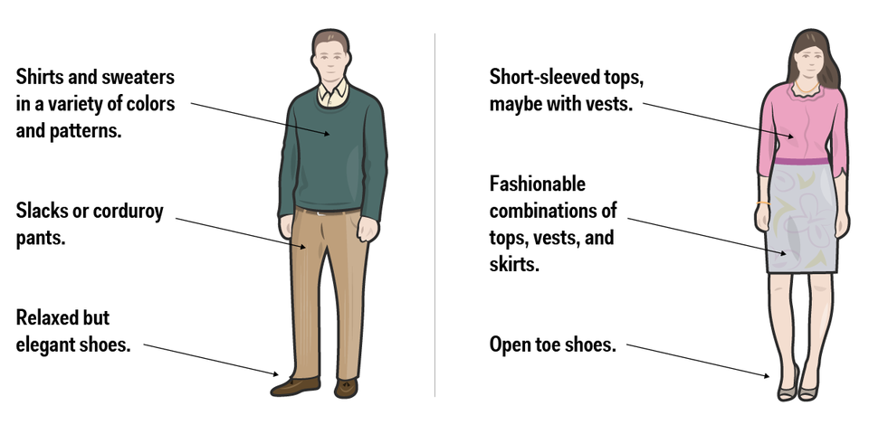
Dress appropriately…
‘business casual’
http://www.businessinsider.com/what-business-casual-really-means-2014-8
Notes:
Quote from Darlene Price of Well Said, Inc.:
"Many highly intelligent, well-qualified, capable men and women are often disqualified or dismissed because 'they don't sell for what they're worth,'" Price says. "They've left the 'business' out of 'business casual' and the lack of professional appearance holds them back. It's frustrating, because clothing certainly does not determine one's actual competence and credibility; it does, however, influence others' perception of those qualities — and that reality impacts career opportunities."

Slide 21
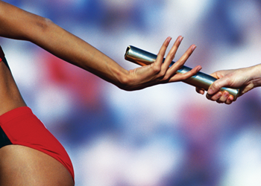
Work through the details and choreography of your presentation
http://dev2ops.org/wp-content/uploads/2012/11/SmoothHandoff.png
Notes:
This is especially important with group presentations. Make sure everyone is working from the same script and knows the order of slides and who is presenting what. Having the name at the bottom of the presentation can be of help in this regard.
Stand straight, hands at your side if you are not using them for gestures.
Invest in a good, bright laser pointer.
Think carefully about bringing/including hardware: Tradeoffs: engineers love to geek out and get hands on, but takes time and can distract. Make good use of pictures and SHORT video clips
Watch your time! Especially important for your final presentation, and in conference sessions with back-to-back presentations on a tight schedule.
Spell check! Look through your presentation before you give it. There should be NO surprises!!
Address questions crisply and concisely. No BS if you are caught short. Acknowledge and seek to meet offline to follow up.

Slide 22
Anticipate and expect the unexpected…
https://filestore.community.support.microsoft.com/api/images/6eacc9b6-e0e4-4176-8cda-8f0d2a6323dc
Notes:
For example, make sure the computer you will be presenting from has been recently updated, and make sure it is fully charged and/or that you have your charger and an extension cord. Make sure you have adapters for common interfaces (HDMI, but also VGA). Macs need extra care.
Scout out the venue you will be presenting in, and understand what technology is or is not present. Best is to do a practice run in the venue ahead of time. Queue up your presentation, so it is ready to go BEFORE you step up to the podium, so you don’t have to fiddle with it when you should have been presenting.
Have a backup on a second computer that is ready to go. Have a backup on a USB stick, so you could give your presentation from someone else’s computer if your primary and secondary machines fail.

Slide 23
Let’s take a look an a good example of a technical presentation using A-E and best practices
https://www.assertion-evidence.com/research_models.html
Notes:
https://www.assertion-evidence.com/research_models.html Jacob Snyder’s model research presentation.

Slide 24
Thank you for your attention!
http://tinyurl.com/y9t85g3h
Notes:
Sample ending slide. Use a compelling graphic to seal your presentation in the memory of the audience and signal that the presentation has concluded. You can then ask for questions.

Slide 25
References
Alley, M. (2018). Rethinking Presentations in Science and Engineering. https://www.assertion-evidence.com/
7 Public Speaking Tips From the World's Best Speakers & Presenters [SlideShare]
What Would Steve Do? 10 Lessons from the World's Most Captivating Pre…
8 Tips for an Awesome Powerpoint Presentation
Fix Your Really Bad PowerPoint by @slidecomet : based on an ebook by …
10 Powerful Body Language Tips for your next Presentation
Fresh and Clean Powerpoint Template [Free Download]

