Slide 1



Solar Powered Automated Rapid Transit Ascendant Networks (SPARTAN) - a new mode of sustainable transportation
BJ Furman and Ron Swenson
SJSU Mechanical Engineering
And the
International Institute of Sustainable Transportation (INIST)
May 30, 2017

Slide 2
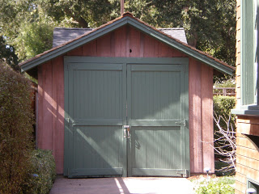
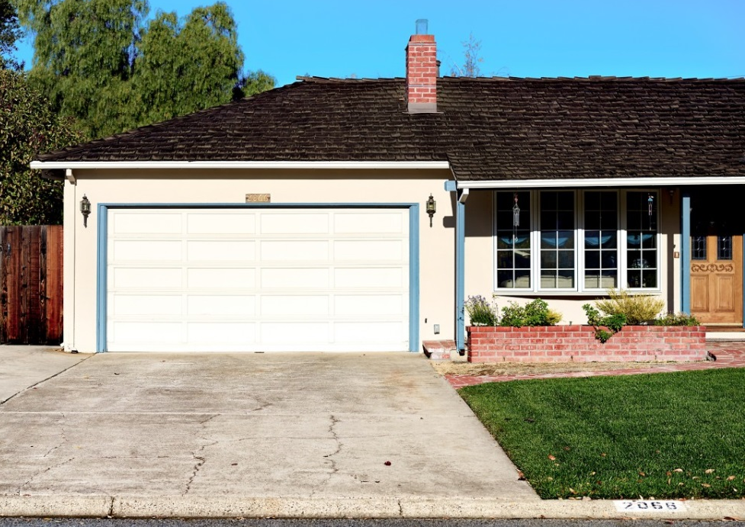
Garages have an important place in the lore of Silicon Valley
Bill and Dave’s
Steve’s parents

Slide 3
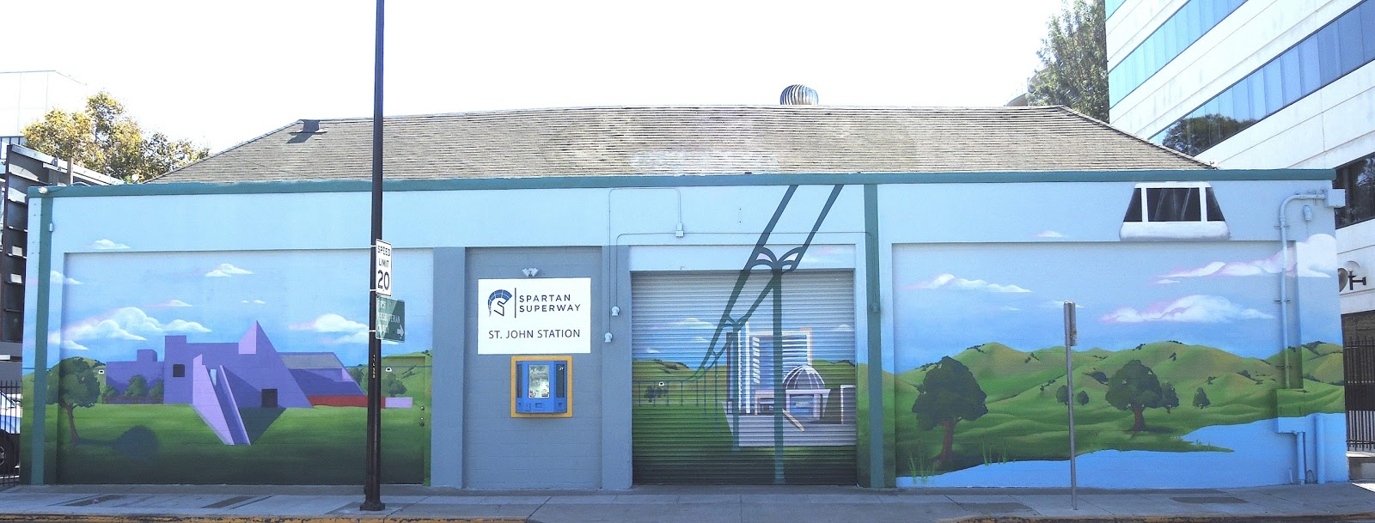
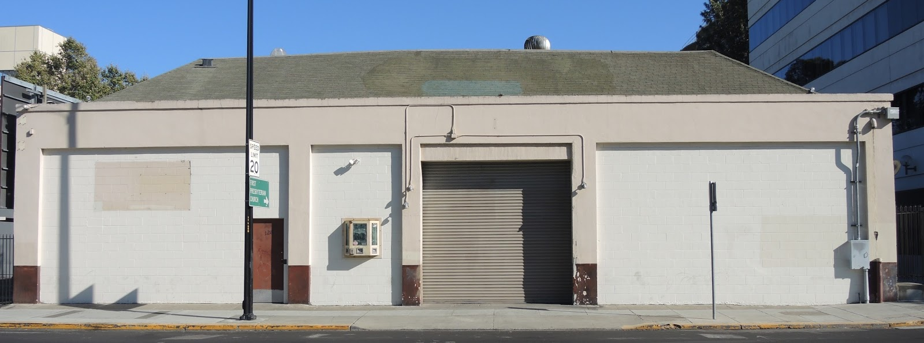
You are in the third important garage!
Spartan Superway

Slide 4
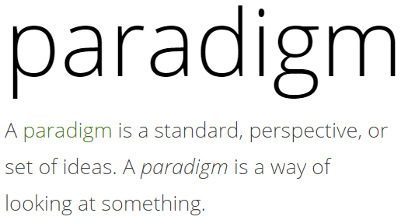
We are creating a new paradigm for urban transportation
Why is a new paradigm needed?

Slide 5
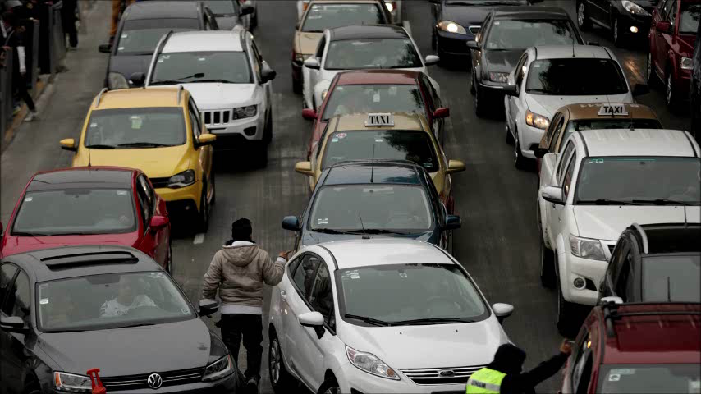
What is wrong with this picture?
Notes:
Click on the image to play the video.

Slide 6
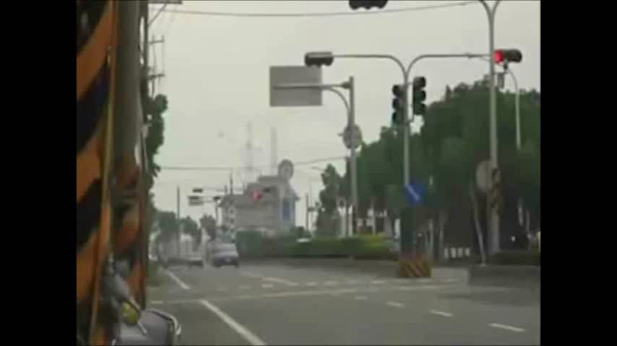
Can the laws of physics be abolished by automation?
1350
Mass of a passenger vehicle, M₁ ≈ ___________ kg
68
Mass of a human, M₂ ≈ ___________ kg
Who fares better when they collide…?
Source: https://www.youtube.com/watch?v=xZPbFikLxkQ
Notes:
Advance elements ending at, ‘Who fares better…”, then click on video to find out. Then click for arrows: which one, this one (red arrow, car) or this one (blue arrow, person)? Note the mass ratio. Over an order magnitude ==> you don’t stand a chance against a car. How about a bus (13,500 kg, which is 10x a car)? Worse! How about a light rail vehicle (about 30,000 kg, which is 20x a car)? Even worse. This brings me to my next point… (next slide)
This problem will not be overcome with automation.
In Latin America 67.9 kg avg

Slide 7
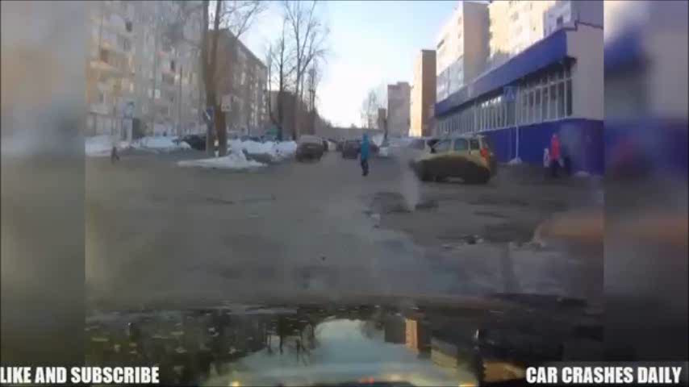
People don’t come equipped with air bags
Notes:
So, no one seems to be equipped with air bags. We are no match for a vehicle from a mass/momentum perspective, and we don’t come equipped with air bags. These are fundamental problems with current approaches to mobility.

Slide 8
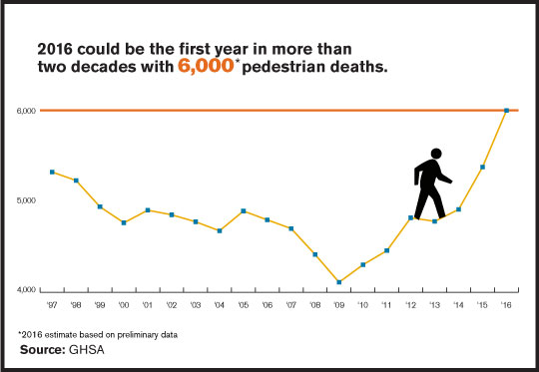
The statistics in the U.S. are grim
Source: http://www.ghsa.org/sites/default/files/publications/files/GHSA-Pedestrian-3.jpg
Notes:
How big of a problem is it?

Slide 9
The statistics in the U.S. are grim
2015 Data
2.4 million people injured
Crashes cost $242B
Source: https://www-fars.nhtsa.dot.gov/
Notes:
35k people killed. Note the number injured is >68X no. of deaths! Was it just a bad year?
To put into perspective, according to icasualties.org, the wars in Iraq (4,841) and Afghanistan (3,536) claimed about 8,400 coalition member lives and upwards of 75,000 wounded (http://watson.brown.edu/costsofwar/costs/human/military) over 14 years (2003 – 2017). The carnage on our roads in ONE YEAR dwarfs (4X the number killed, 30X the number wounded) the numbers of killed and wounded over 14 years. There was (and is) justifiable moral outrage over the wars in Iraq and Afghanistan. Where is the moral outrage over the carnage on our streets every year?

Slide 10
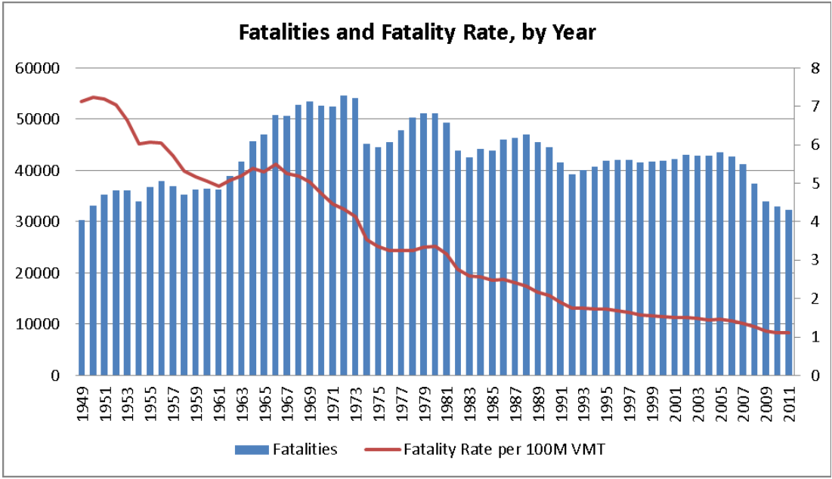
Was 2015 just a bad year?
U.S.
https://crashstats.nhtsa.dot.gov/Api/Public/ViewPublication/812013
Notes:
Unfortunately, NO, this is not just some fluke! About that many (or more) have died on U.S. roads EVERY year since 1949! To put this in perspective, In contrast, 4,491 U.S. service members died in Iraq between 2003 and 2014 and 32,226 wounded; In Afghanistan 2,386 died, 20,049 wounded. Many people around the world protested, with justification. How many protests have you seen with regard to the daily carnage that takes place in our cities and on our roads?

Slide 11
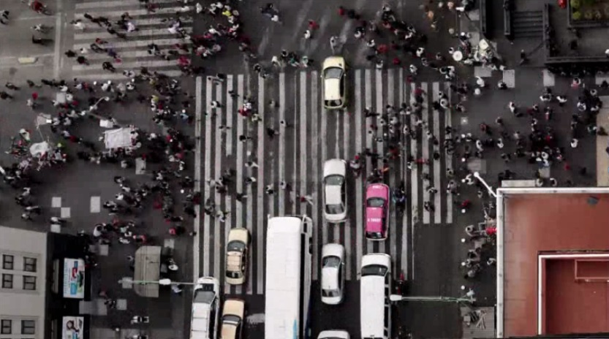
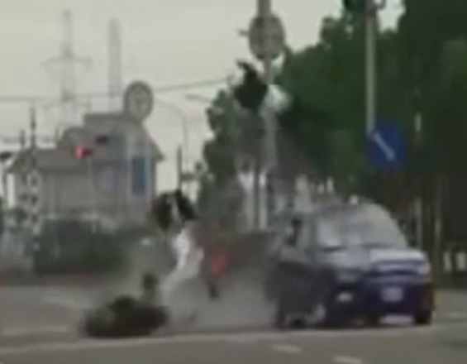
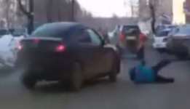
Things look pretty bad so far…
Competition for space at ‘grade’
U.S.
Not good for humans!
+
Mass disadvantage
No personal airbags
+
Notes:
The system we have is not good for humans!

Slide 12
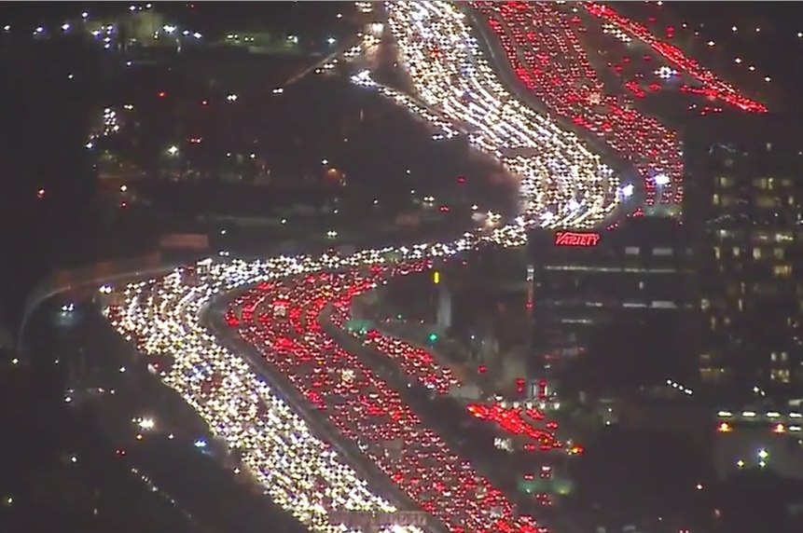
Congestion is a big deal economically
In 2014, congestion in the U.S. cost $124B
Notes:
This is the 405 freeway in Los Angeles. Note 6 lanes in each direction. Jammed for miles! One lane of freeway can cost $10M/km
Congestion is also a big deal economically:
Congestion in the U.S. cost $124 billion dollars in 2014 (expected to rise to $186B by 2030)
$78B in direct costs, $45B in indirect costs

Slide 13
Adding more roadways will not fix the problem!
Notes:
This is the 405 freeway in Los Angeles. Note 6 lanes in each direction. Jammed for miles! One lane of freeway can cost $10M/km
Congestion is also a big deal economically:
Congestion in the U.S. cost $124 billion dollars in 2014 (expected to rise to $186B by 2030)
$78B in direct costs, $45B in indirect costs

Slide 14
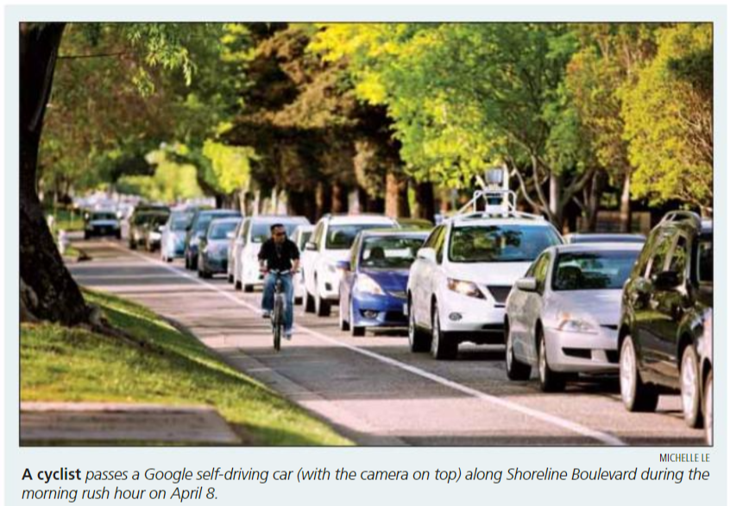
Adding self-driving cars will not fix the problem!
https://issuu.com/mountainviewvoice/docs/2014_04_11.mvv.section1
Notes:
This is a road in my city that leads over a freeway to the headquarters of Google. Note how fast the self-driving car is moving! https://issuu.com/mountainviewvoice/docs/2014_04_11.mvv.section1

Slide 15
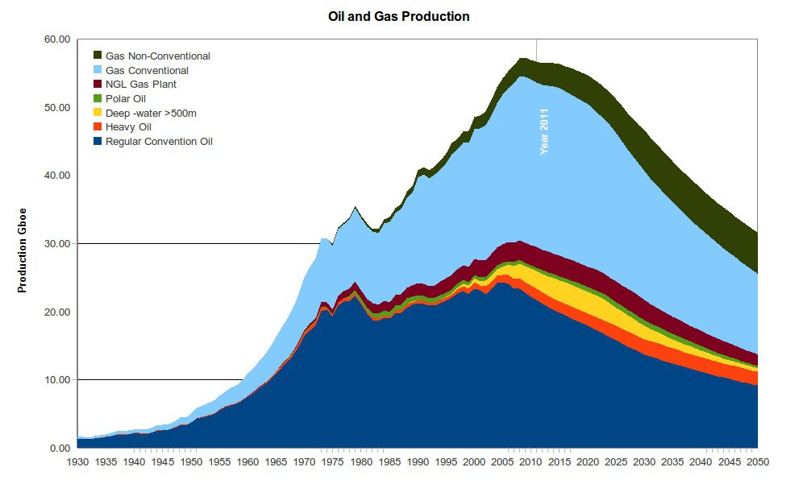
There are additional significant problems
Oil is a finite resource
http://peakoil.com/wp-content/uploads/2010/04/oilandgas.jpg
Ron Swenson
Notes:
The first on is that oil is finite resource. World discovery of oil peaked in the 1960s, and has declined since then. If the 40 year cycle seen in the US holds true for world oil production, that puts global peak oil production, right about now; after which oil becomes less available, and more expensive.
Peak oil theory states: that any finite resource, (including oil), will have a beginning, middle, and an end of production, and at some point it will reach a level of maximum output as seen in the graph to the left.
Oil production typically follows a bell shaped curve when charted on a graph, with the peak of production occurring when approximately half of the oil has been extracted. With some exceptions, this holds true for a single well, a whole field, an entire region, and presumably the world. The underlying reasons are many and beyond the scope of this primer, suffice to say that oil becomes more difficult and expensive to extract as a field ages past the mid-point of its life.
In the US for example, oil production grew steadily until 1970 and declined thereafter, regardless of market price

Slide 16
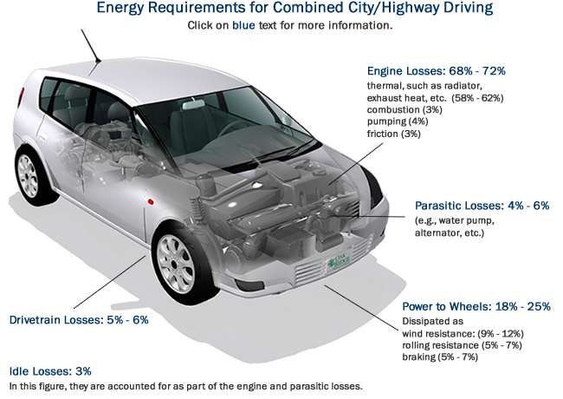
I.C.-based vehicles are not efficient
14 – 30% fuel to wheel
https://www.fueleconomy.gov/feg/atv.shtml
Ron Swenson
Notes:
Automobiles were an advance (of sorts) over horses, walking, biking, etc., but they waste most of the fuel energy in the form of heat.

Slide 17
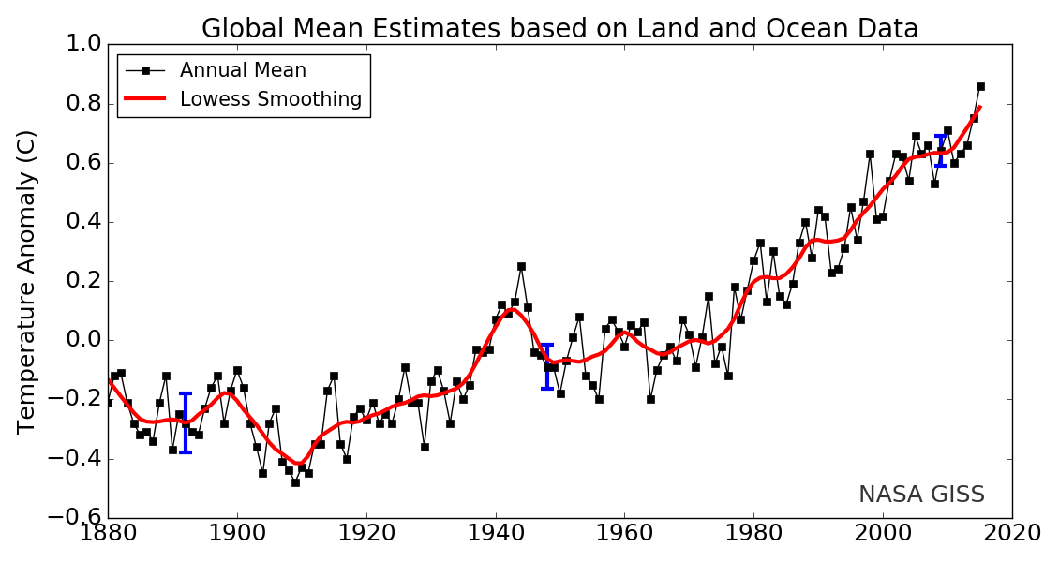
There are additional significant problems
Human use of fossil fuels is warming the planet
http://tinyurl.com/kyysag3
Ron Swenson
Notes:
All motorized mobility options are polluting!

Slide 18
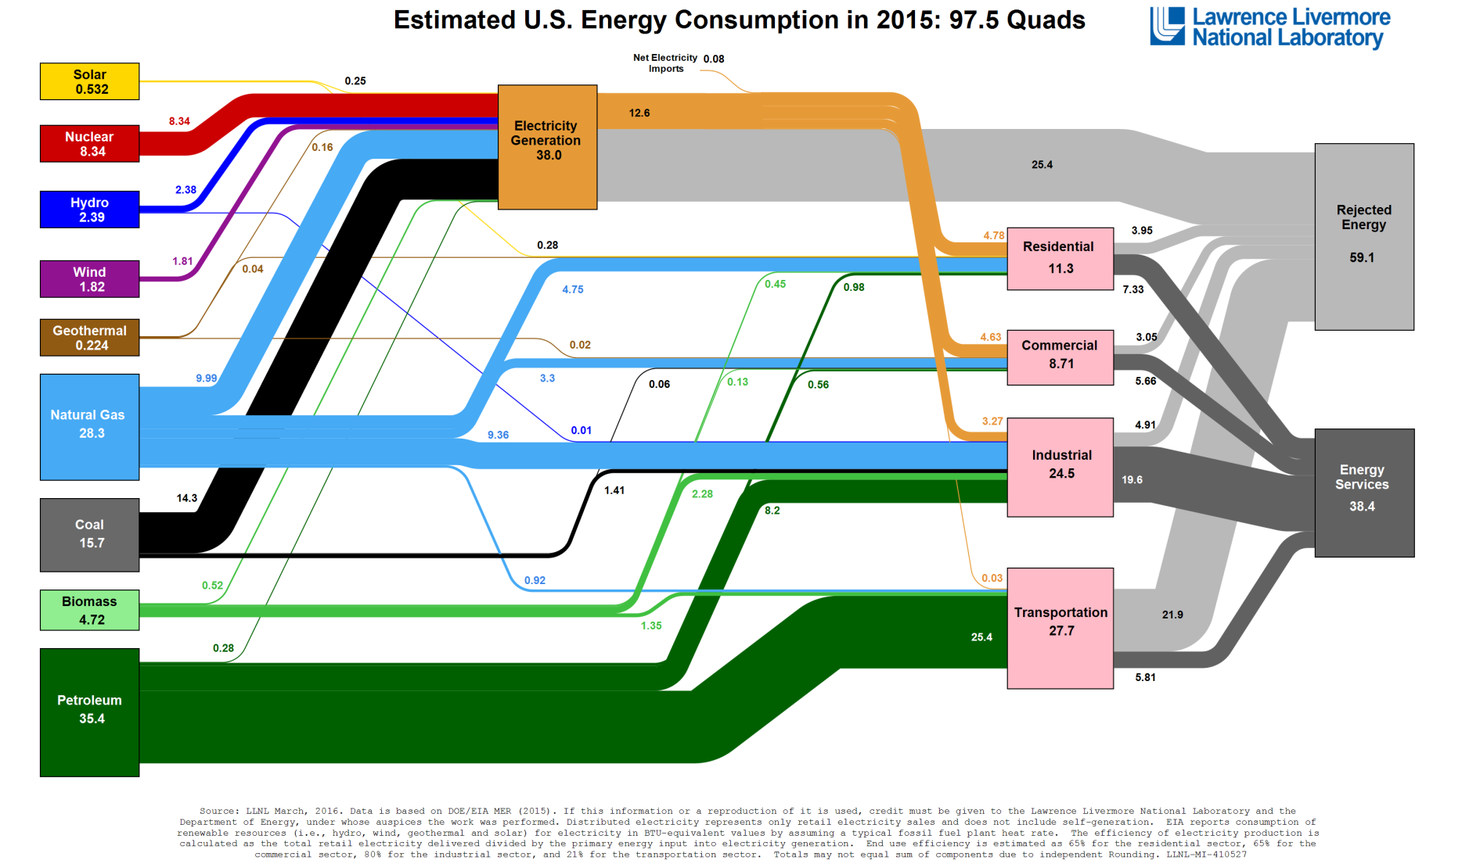
There are additional significant problems
Transportation contributes significantly to GHG emissions
https://flowcharts.llnl.gov/content/assets/images/energy/us/Energy_US_2015.png
Ron Swenson
Notes:
Note that about 1/3 of the energy consumed goes to transportation, and only 21% of that goes into doing anything useful (like moving people or things from one point to another). 89% of what is burned goes into heating the environment. That should bother you as an engineer!

Slide 19

Finally, the world is beginning to get serious about solving climate change
Rio Earth Summit in 1992
•
•
•
Kyoto Protocol 2005
•
•
•
Paris Climate Conference (COP21) 2015
A global action plan to put the world on track to avoid dangerous climate change by limiting global warming to well below 2°C
Move toward renewable energy!
http://tinyurl.com/l9uhgjv
Ron Swenson
Notes:
The international political response to climate change began at the Rio Earth Summit in 1992, where the ‘Rio Convention’ included the adoption of the UN Framework on Climate Change (UNFCCC). This convention set out a framework for action aimed at stabilising atmospheric concentrations of greenhouse gases (GHGs) to avoid “dangerous anthropogenic interference with the climate system.” The UNFCCC which entered into force on 21 March 1994, now has a near-universal membership of 195 parties.
The main objective of the annual Conference of Parties (COP) is to review the Convention’s implementation. The first COP took place in Berlin in 1995 and significant meetings since then have included COP3 where the Kyoto Protocol was adopted, COP11 where the Montreal Action Plan was produced, COP15 in Copenhagen where an agreement to success Kyoto Protocol was unfortunately not realised and COP17 in Durban where the Green Climate Fund was created.
In 2015 COP21, also known as the 2015 Paris Climate Conference, will, for the first time in over 20 years of UN negotiations, aim to achieve a legally binding and universal agreement on climate, with the aim of keeping global warming below 2°C.
France will play a leading international role in hosting this seminal conference, and COP21 will be one of the largest international conferences ever held in the country. The conference is expected to attract close to 50,000 participants including 25,000 official delegates from government, intergovernmental organisations, UN agencies, NGOs and civil society.
Governments agreed
a long-term goal of keeping the increase in global average temperature to well below 2°C above pre-industrial levels;
to aim to limit the increase to 1.5°C, since this would significantly reduce risks and the impacts of climate change;
on the need for global emissions to peak as soon as possible, recognising that this will take longer for developing countries;
to undertake rapid reductions thereafter in accordance with the best available science.

Slide 20

The Pope has even spoken out about these things
“Climate change is a global problem with grave implications: environmental, social, economic, political and for the distribution of goods. It represents one of the principal challenges facing humanity in our day. ”
Laudato Sí, June 16, 2015
Ron Swenson

Slide 21
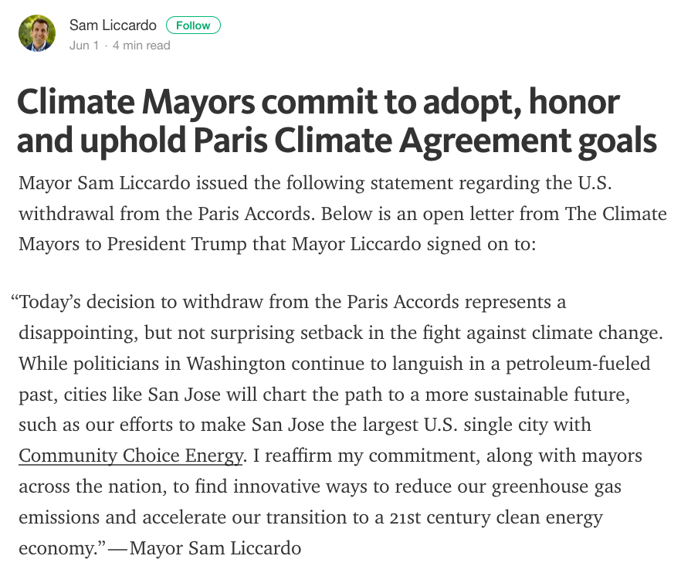
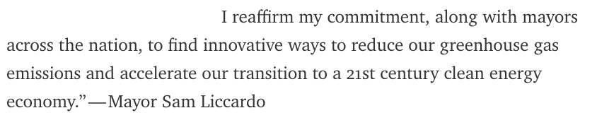
Sam Liccardo commits to uphold the Paris accord

Slide 22
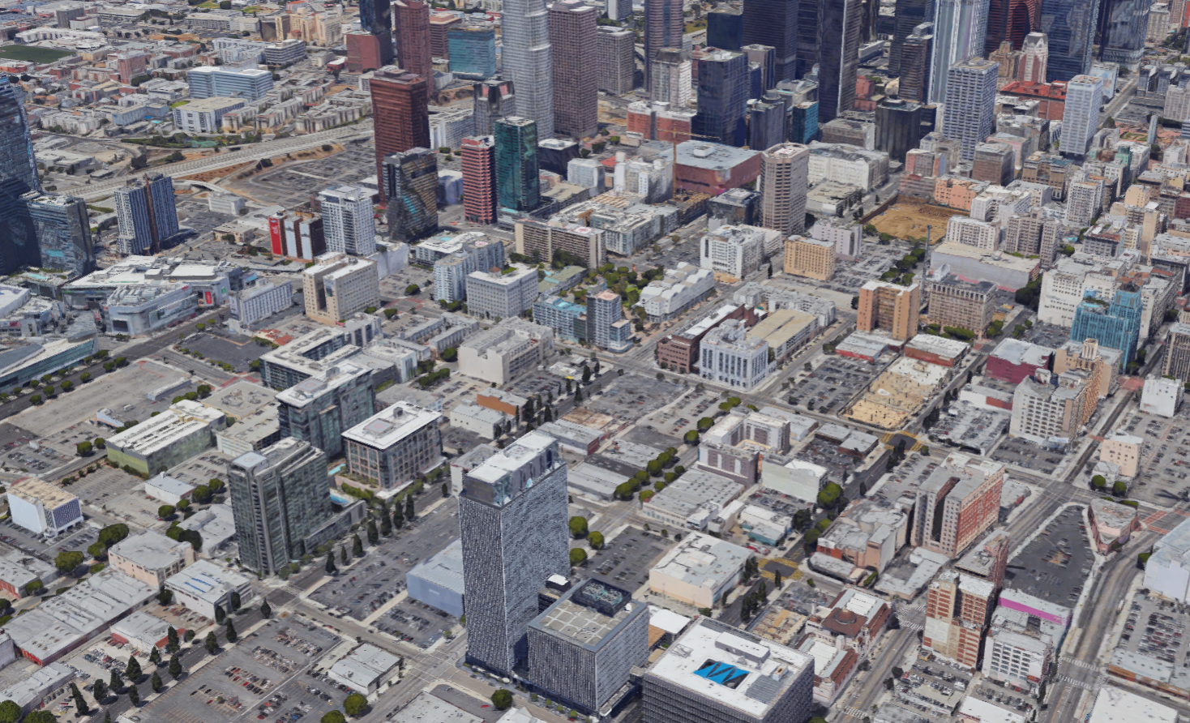
It is too late for ‘more sustainable’ solutions
We need truly sustainable mobility
Notes:
There is too much ‘incrementalism’. We need ‘moon shots’.

Slide 23
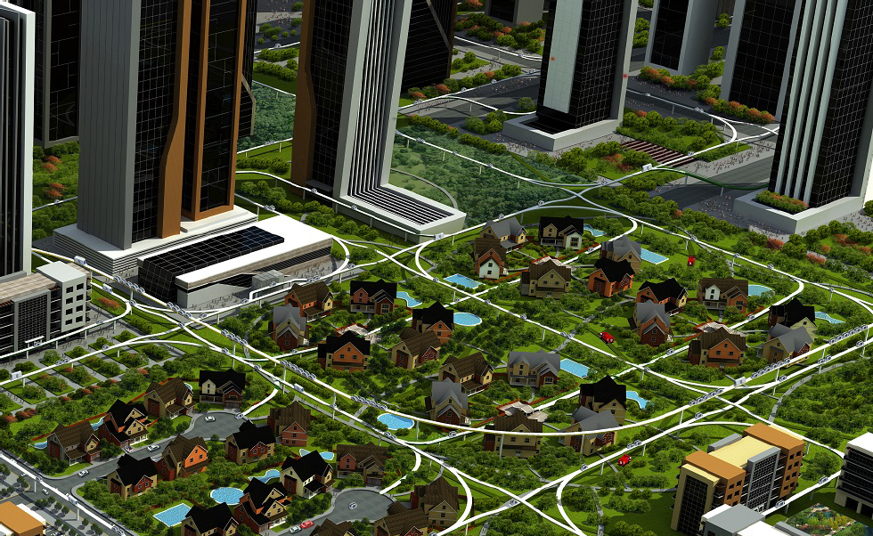
We need truly sustainable urban mobility
http://www.prtconsulting.com/

Slide 24
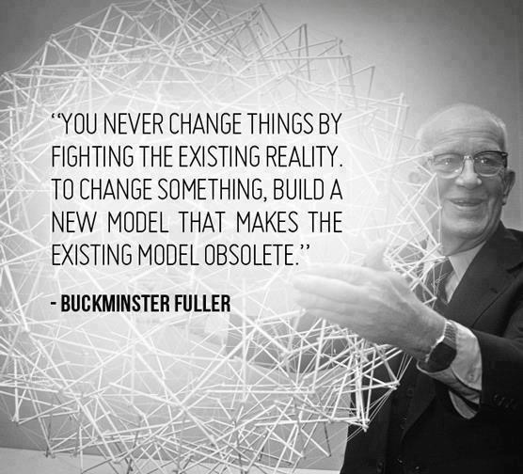
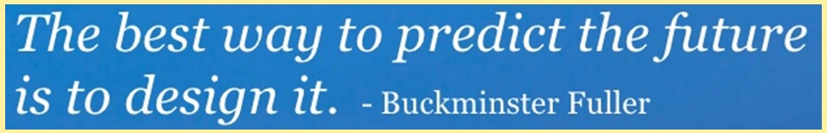
We are taking Bucky’s advice
http://images.gr-assets.com/quotes/1416673182p8/13119.jpg
Notes:
So far, we’ve seen some fundamental problems current forms of urban mobility. You now have a chance to build a new model.

Slide 25
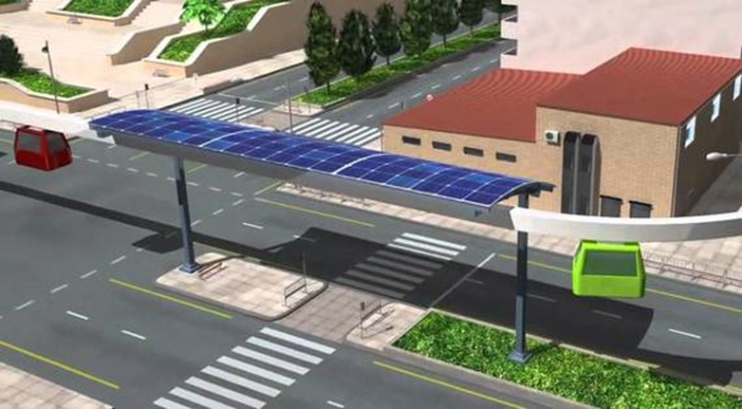
SPARTAN is a new paradigm for urban mobility
Exclusive, grade-separated guideway with solar PV panels
Utilizes existing vehicular rights-of-ways (ROWs)
Suspended driverless vehicles
Off-line stations
  Non-stop origin to destination
On demand scheduling
Taxi-like service
Facilitates transit oriented development (TOD)
Truly sustainable
Source: Jpods.com
Source: Jpods.com
Notes:
The urban form that we have now is largely configured around the automobile, buses, light rail etc. It is time to act on Buckminster Fuller’s advice, “To change something, build a new model that makes the existing model obsolete. It is critical to keep in mind that we are not simply adding a few solar panels to provide electricity to run cars, buses, etc. in the current urban form. We are talking about coming up with new designs with different configuration drivers: solar powered, elevated, networked guideways with suspended vehicles.

Slide 26
SPARTAN will positively impact the environment
Chomp!
https://flowcharts.llnl.gov/content/assets/images/energy/us/Energy_US_2015.png
Notes:
We can take a bite out of the consumption of petroleum for transportation.

Slide 27
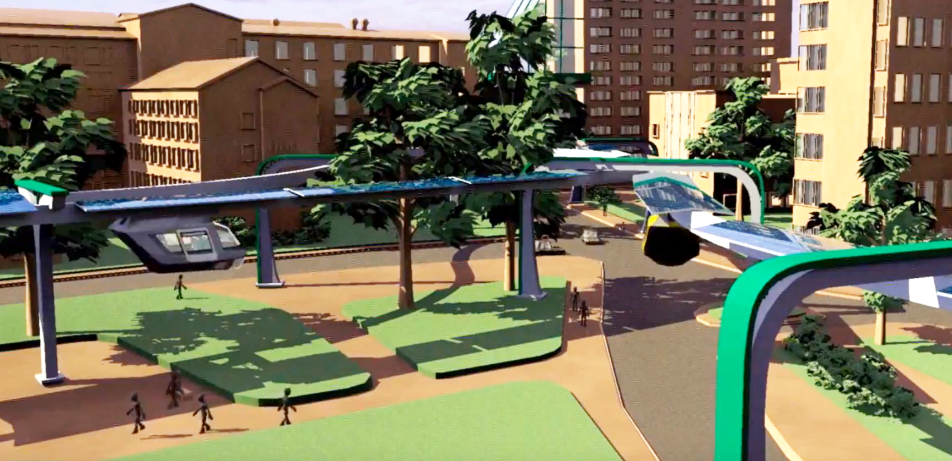
SPARTAN will lead to more human-friendly cities
Notes:
The urban form that we have now is largely configured around the automobile, buses, light rail etc. It is time to act on Buckminster Fuller’s advice, “To change something, build a new model that makes the existing model obsolete.

Slide 28
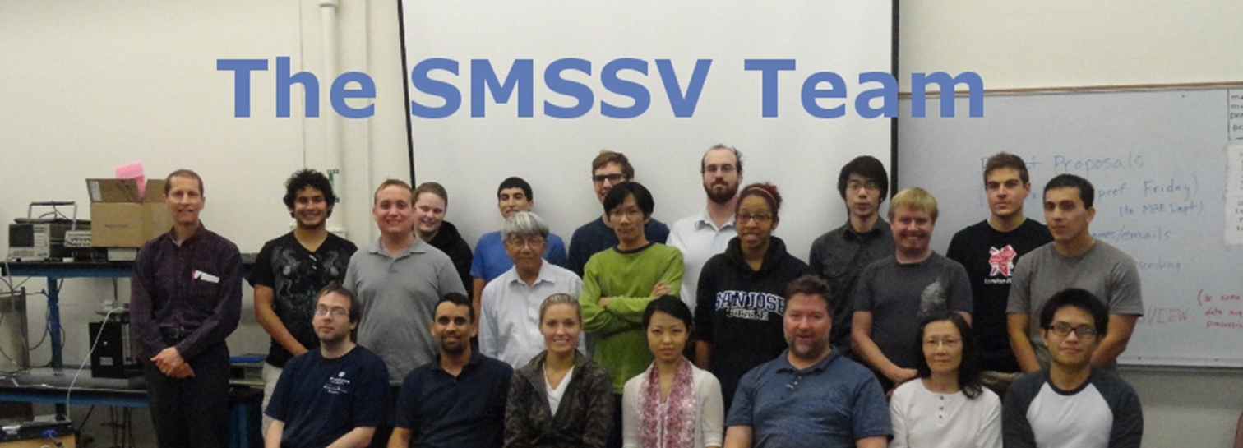
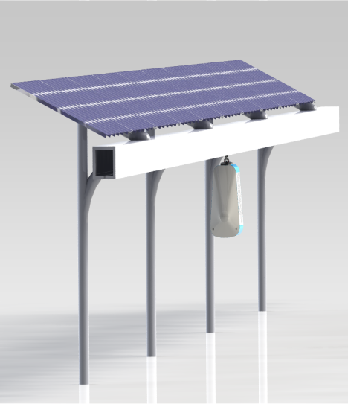
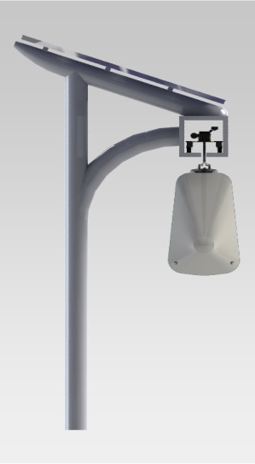
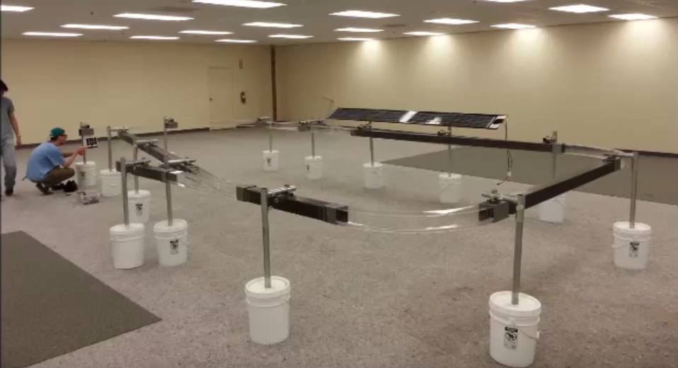
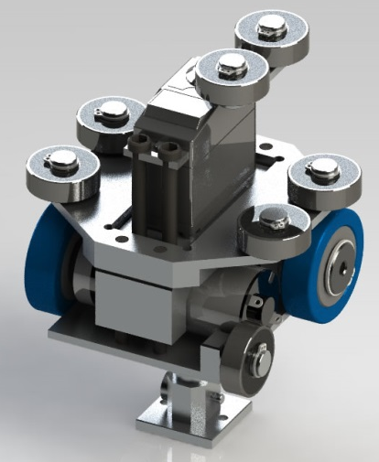
We have been developing SPARTAN technology since 2012
2012-13
11 ME
3 CmpE/SE
3 URBP
3 Business
3 volunteers

Slide 29
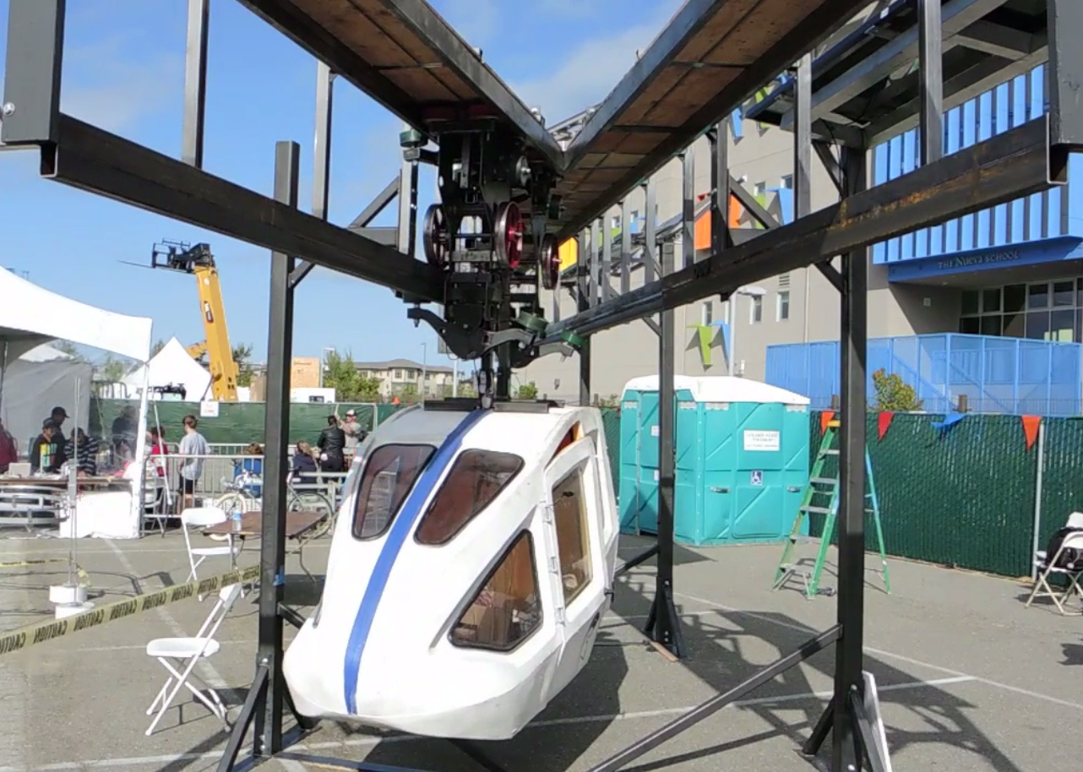
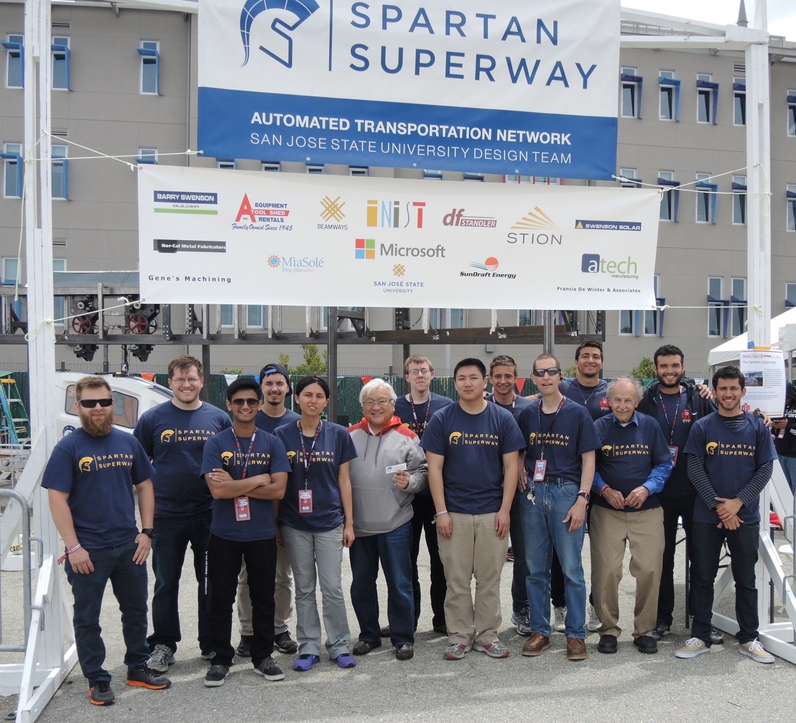
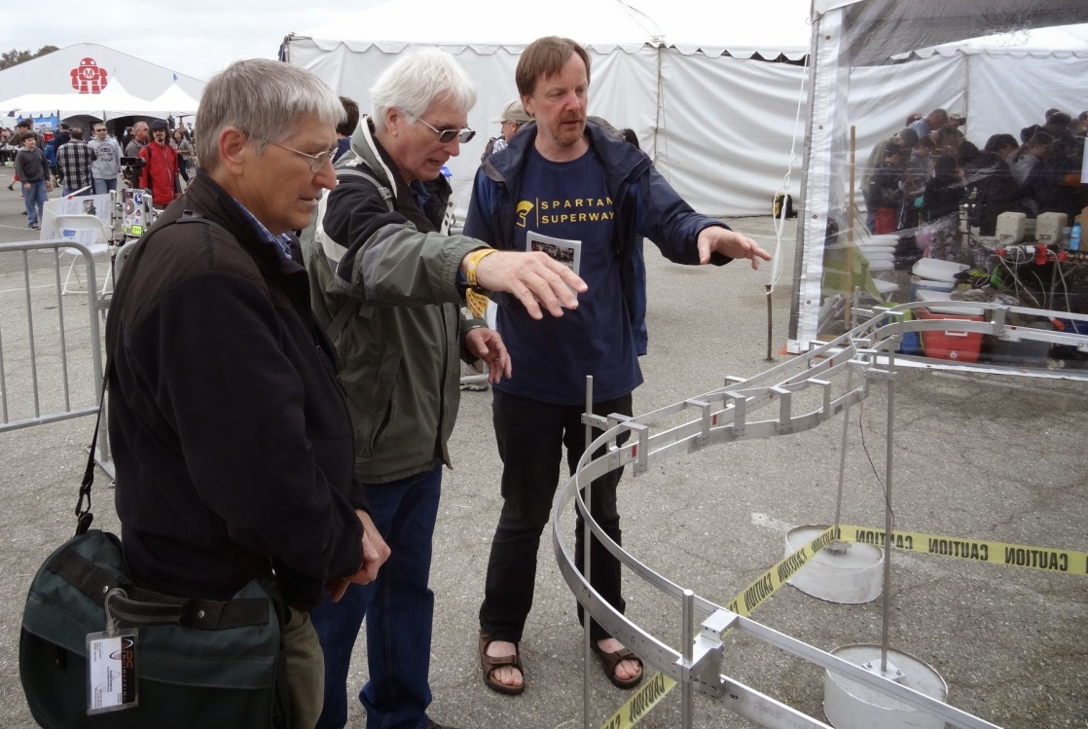
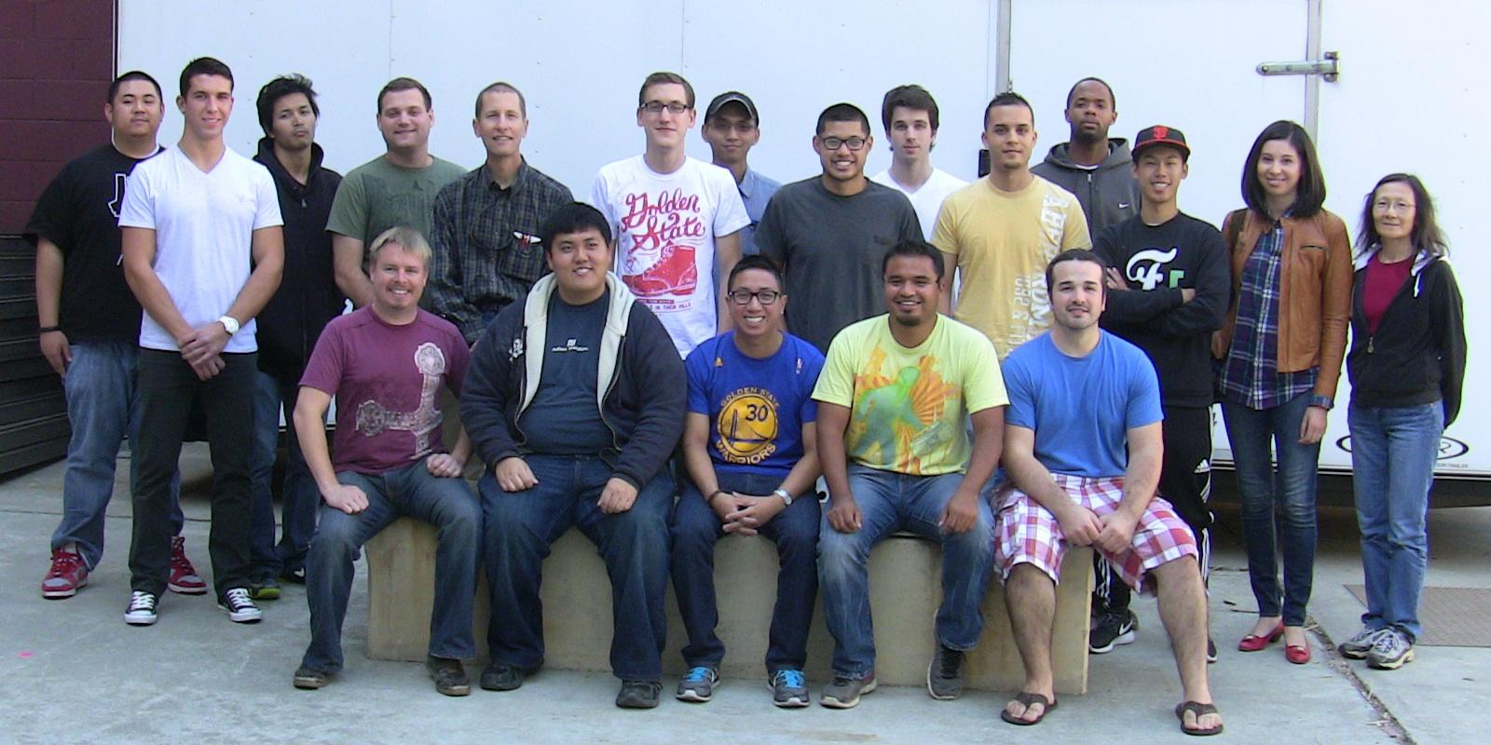
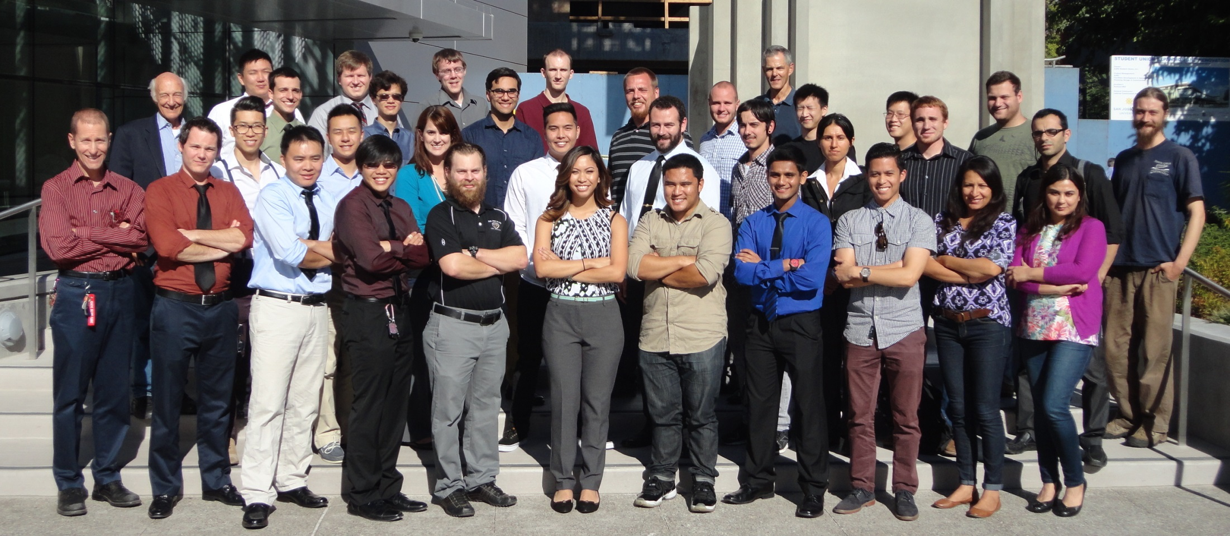
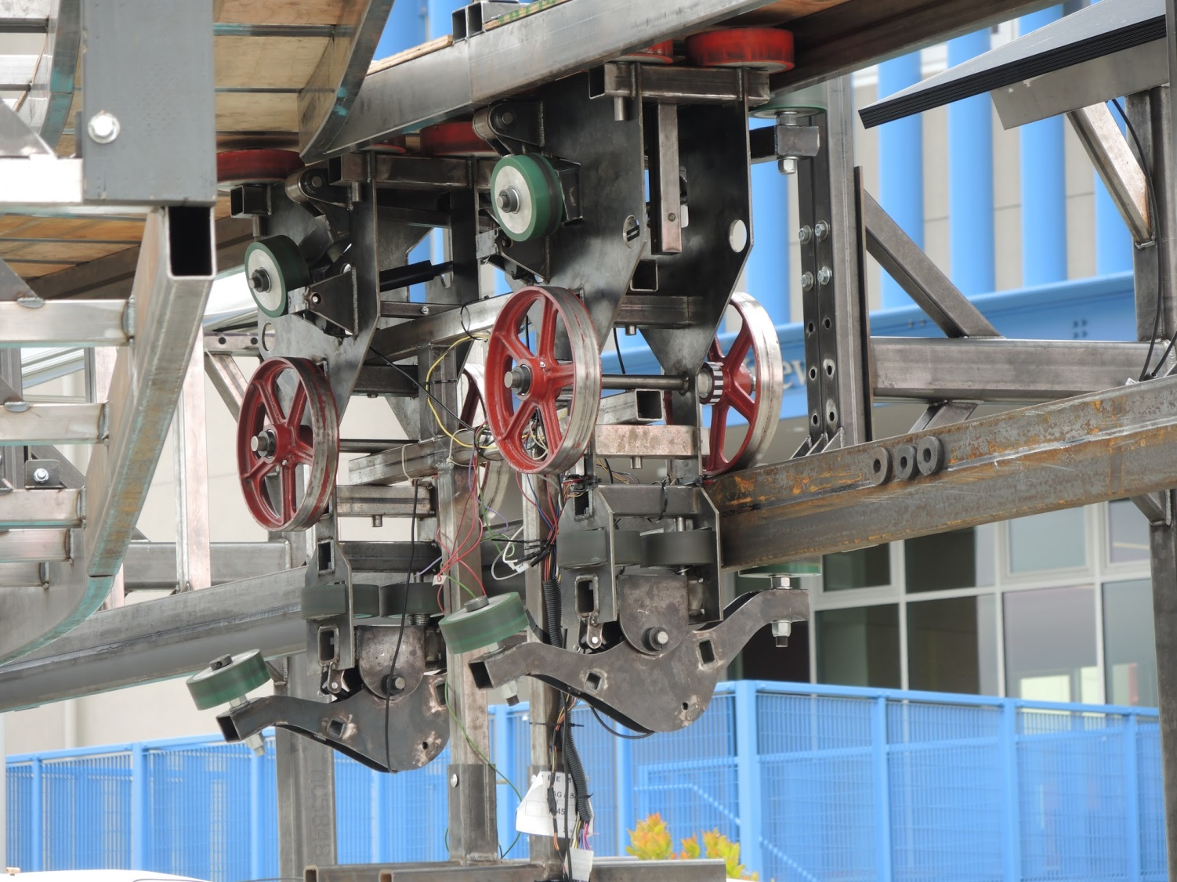
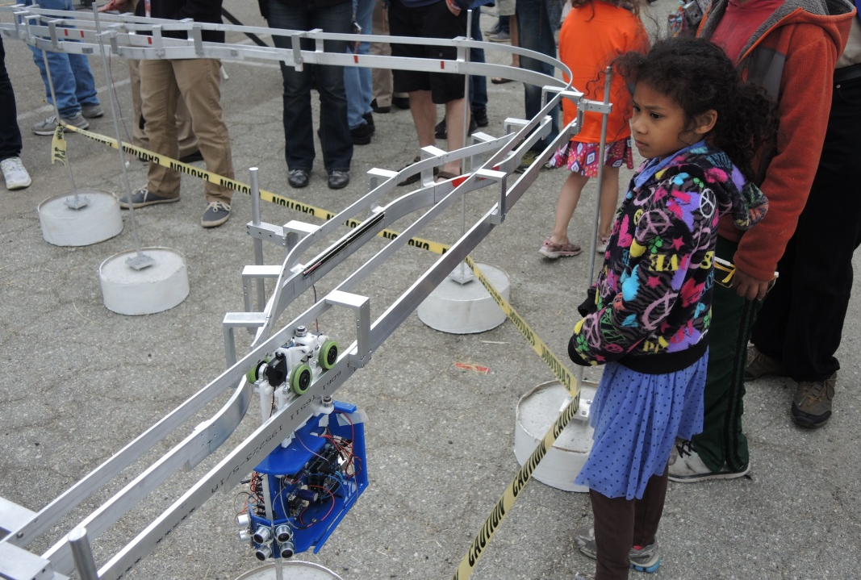
We have been developing SPARTAN technology since 2012
2013-14
15 ME
6 CmpE/SE
4 EE
2 CE
~60 DSID
3-8 volunteers

Slide 30
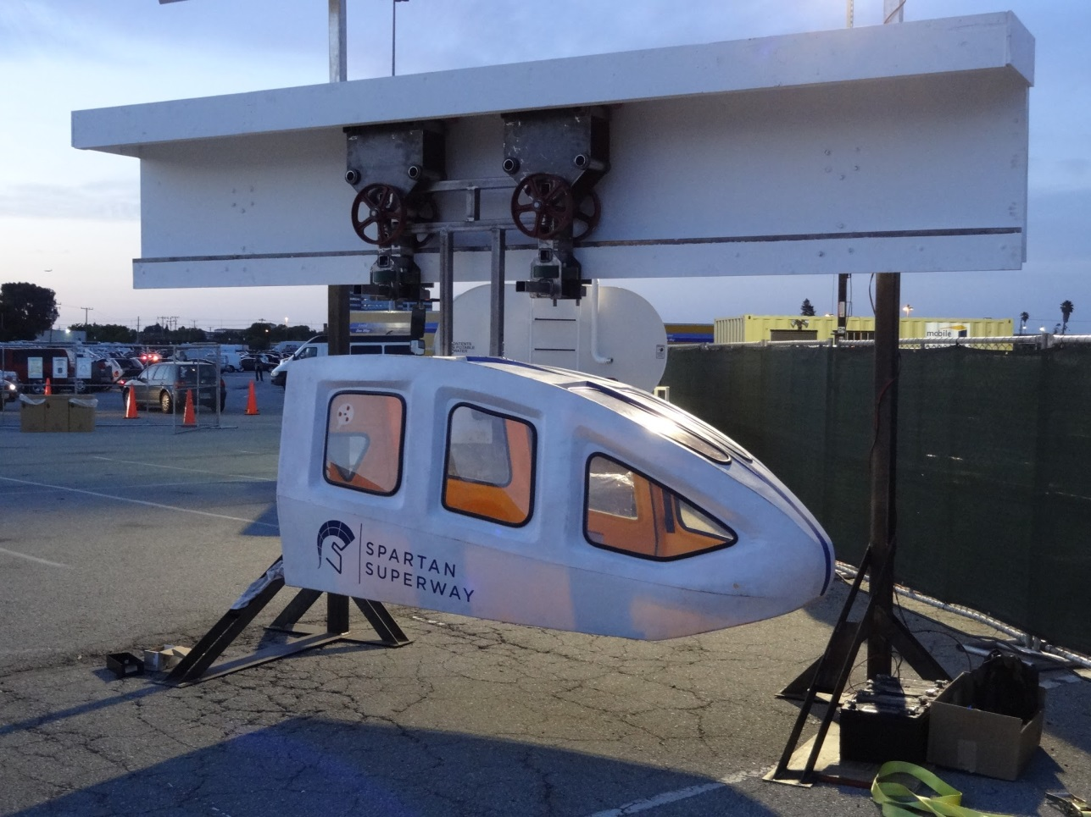
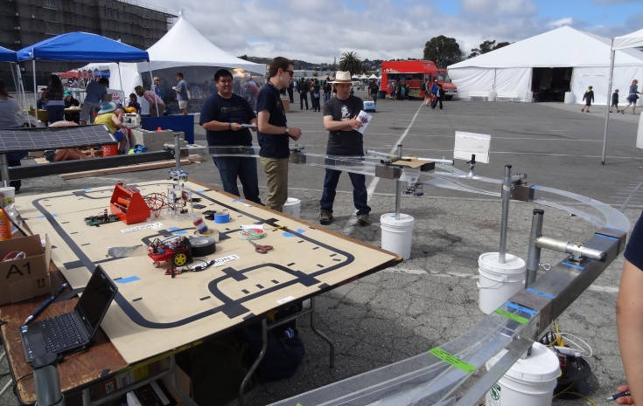
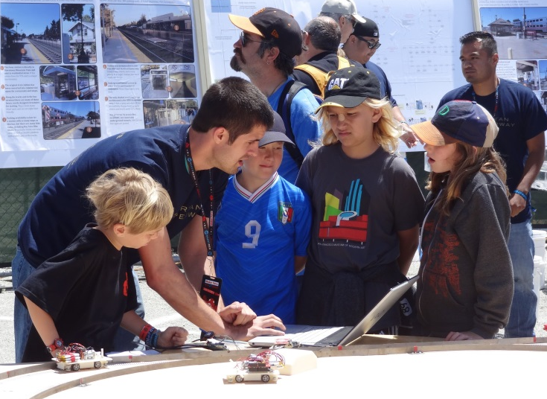
We have been developing SPARTAN technology since 2012

Slide 31


We have been developing SPARTAN technology since 2012
2014-15
26 ME
2 CmpE/SE
1 CE

Slide 32
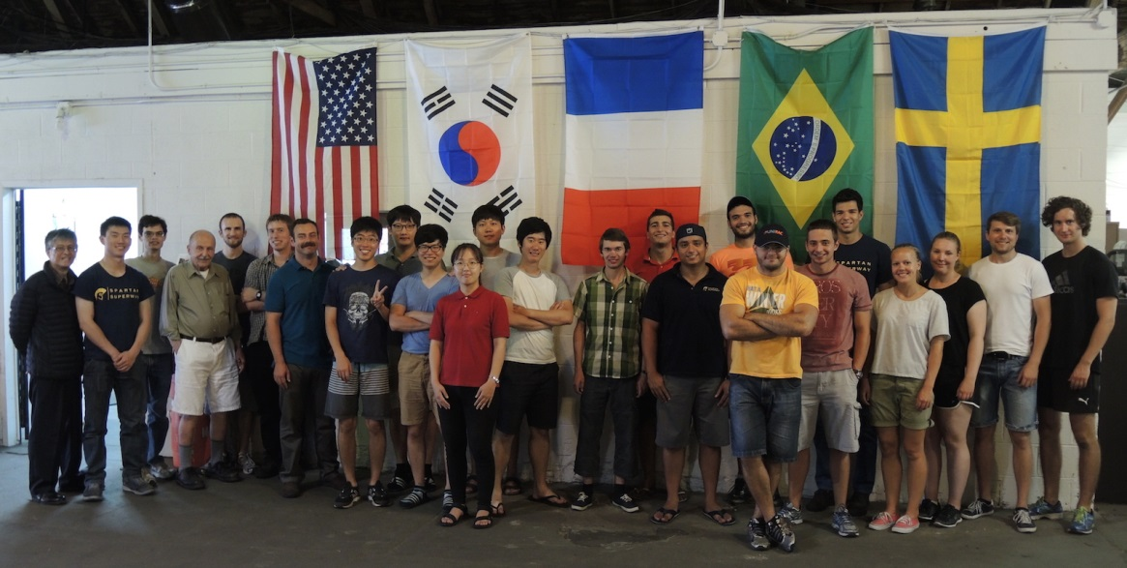
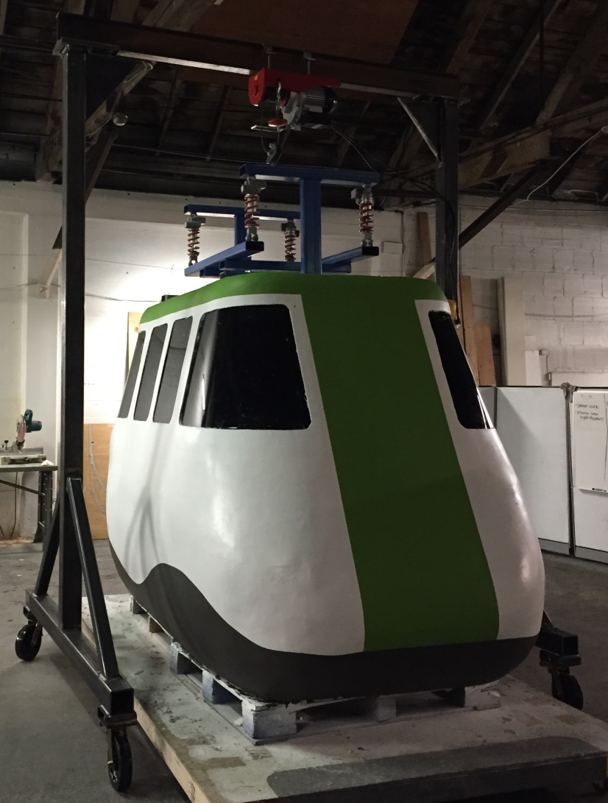
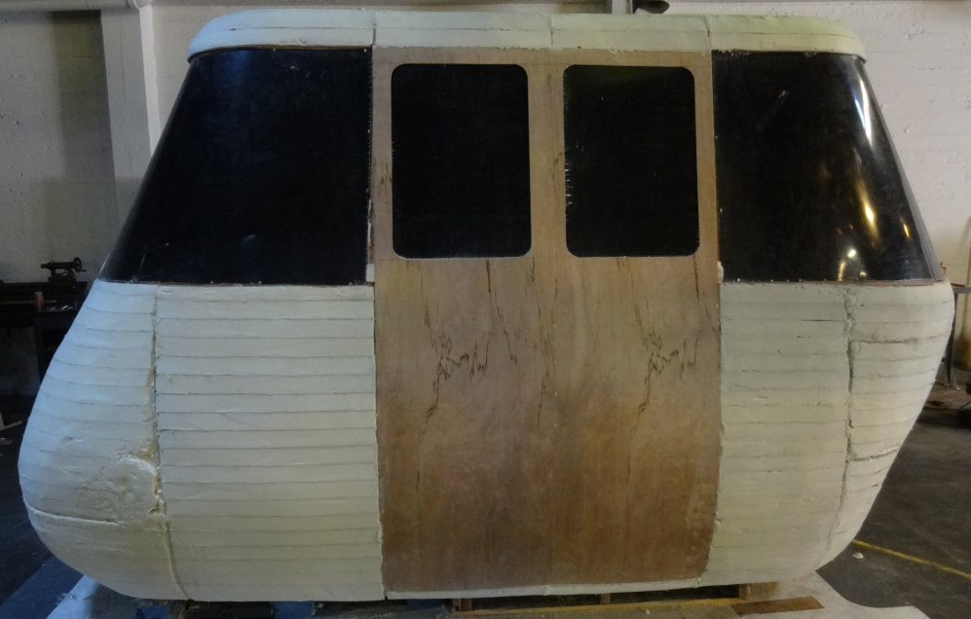
We have been developing SPARTAN technology since 2012
Summer 2015
7 from Brazil
6 from South Korea (PNU)
4 from Sweden
2 from France
4 – 6 from USA

Slide 33
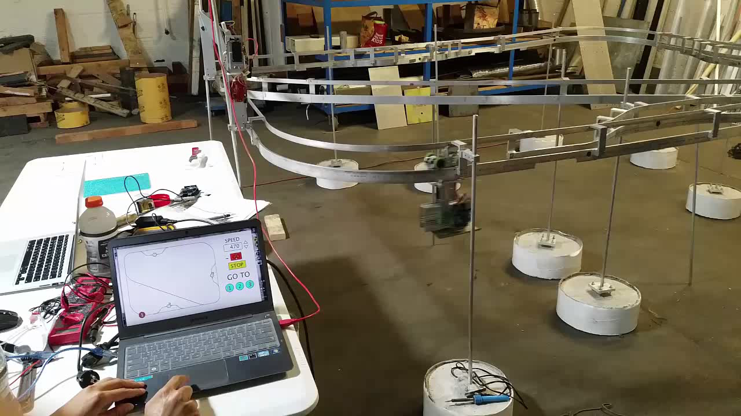
We have been developing SPARTAN technology since 2012

Slide 34
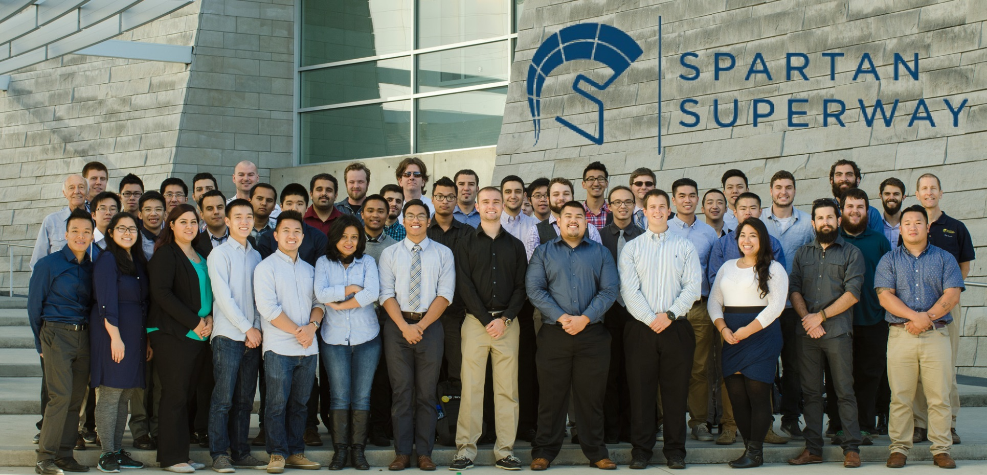
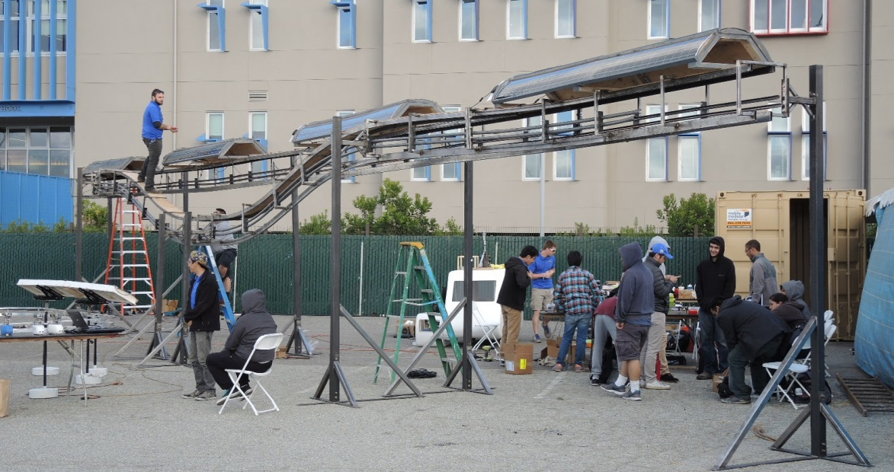
We have been developing SPARTAN technology since 2012
2015-16
46 ME
3 EE
2 MSSE

Slide 35
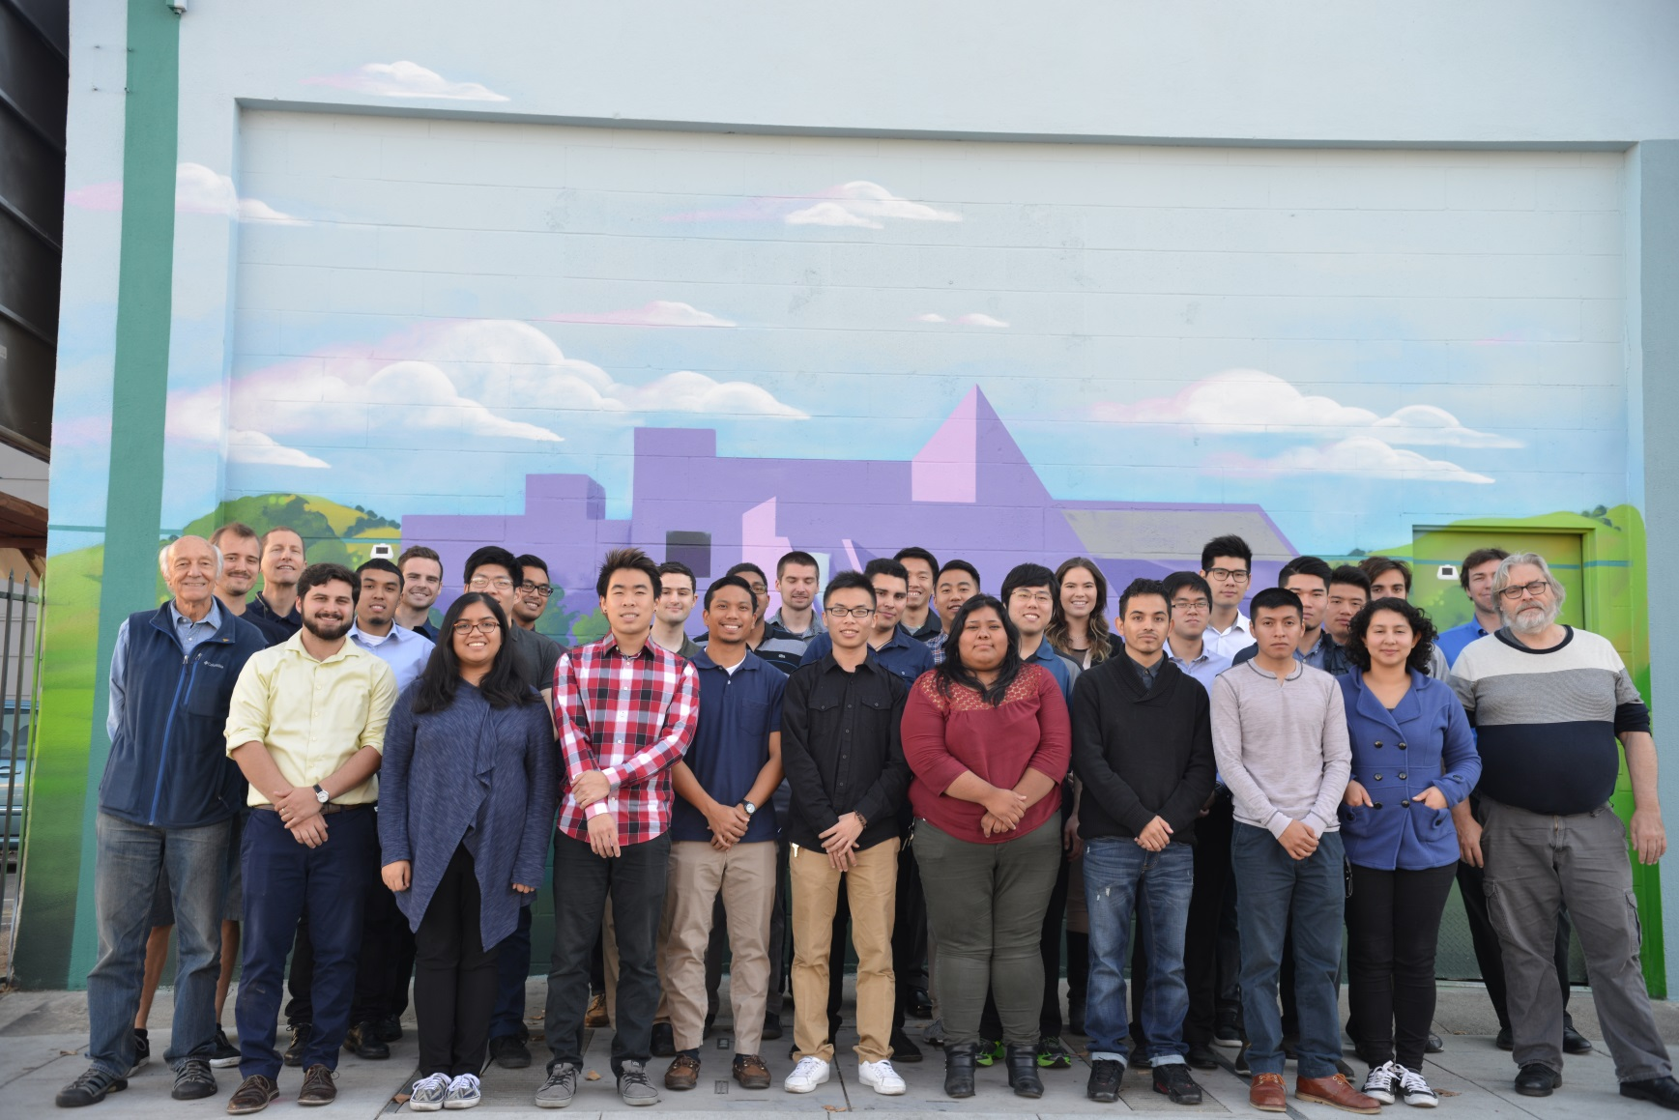
We have been developing SPARTAN technology since 2012
2016-17

Slide 36
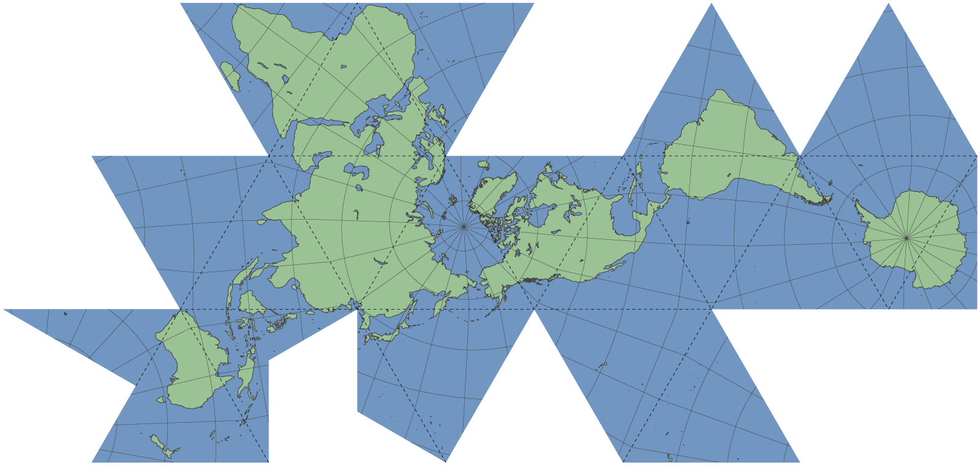
We have a growing international university research network
Cape Town
Johannesburg
Pretoria
Delft
InGHenia
BSMP
Antwerp
Linköping
Uppsala
Bogotá
Gävle
SIU
ITESM Toluca
San José State
Pusan
Notes:
We have an international research network

Slide 37
We have a growing international industry consortium
Futran, ZA
Supraways, FR
Beamways, SE
4Dialog, SE
TCS, US
Swenson Builders, US
Notes:
We have an international research network

Slide 38
This research network will open the way to SPARTAN systems around the world
Cape Town $B
Johannesburg $B
Pretoria $B
Durban $B
Paris Ring $B
Sundbyberg, SE $B
Arlanda, SE $B
Södertälje, SE $B
Bogotá, CO $B
India
?
Several, in $B
Guadalajara, MX $B
Notes:
We have an international research network

Slide 39
















Thank you!
and thanks to our generous sponsors

Slide 40





There are many opportunities for industry-academe collaboration
N
7th Street
Notes:
#werenotwaiting/ DIY Open source artificial pancrease
We are building a test track.

Slide 41
Questions?

Slide 42
SPARTAN infrastructure cost is the most competitive urban option — bar none
40 story skyscraper | $200+ Million
Metro (underground) | $500+ M / km (BART to SJ est.)
Light rail (LRT/tramway) | $110+ M / km (VTA Hwy 85 est.)
BRT | $35+ M / km (VTA hwy 85 est.)
One lane of new urban highway | $20+ M / km (various sources)
SPARTAN | $10 M / km
Notes:
From: http://news.stanford.edu/2015/01/12/emissions-social-costs-011215/ Cost of carbon (economic damage to the environment) $220/ton
From EPA: https://www.epa.gov/sites/production/files/2016-02/documents/420f14040a.pdf The average automobile emits 4.7 metric tons/yr of CO2 (18347 km)
=> a fossil fuel burning vehicle costs (4.7)($220) ≈ $1k/yr just from emissions or $0.056/km per vehicle
=> an electric vehicle that plugs into the grid will still generate carbon, because the grid is still about 32% fossil fuel fired (PG&E 2015 Power Content) => $0.018/km per vehicle
AAA (http://newsroom.aaa.com/auto/your-driving-costs/) estimates car ownership and driving costs for a small sedan at: $0.27/km
“Adding new lanes to an existing freeway can range between $2 and $10 million per lane-mile” (5-20 for new)
https://mobility.tamu.edu/mip/strategies-pdfs/added-capacity/technical-summary/adding-new-lanes-or-roads-4-pg.pdf
http://www-pam.usc.edu/volume2/v2i1a3s2.html 1996 FHA has calculated the "weighted rural and urban combined" costs per mile of interstate highway to be $20.6 million.
40 story skyscraper
$200+ Million
Metro (underground)

