Slide 1



Solar Powered Automated Rapid Transit Ascendant Networks (SPARTAN) - a new mode of sustainable transportation
BJ Furman
SJSU Mechanical Engineering
In partnership with the
International Institute of Sustainable Transportation (INIST)
29MAR2017
Notes:
Industry-Academe research partnerships to enable the human-technology frontier for next generation smarter service systems
a long-term, human-technology research agenda that will propel the smart service systems of the future
identifying the grand challenges that industry faces in creating and implementing effective service systems in the future
uncover problems and opportunities in both industry and society, and focus attention on technologies that neither industry nor academia are working on at the moment but that may be necessary to enable the next generation of service systems.
See recommendations from MTI report, Research Questions doc, Bill James emails, Ron’s Energies paper

Slide 2
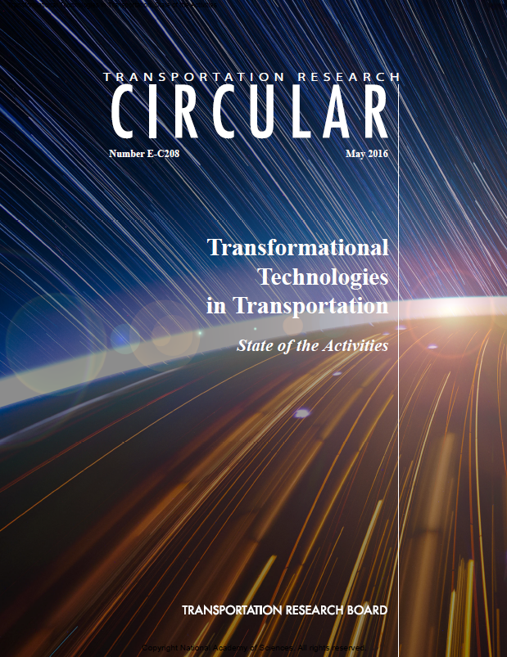
One man’s view of ‘transformational’ is another’s ‘business as usual’
Connected–automated vehicles
Shared-use services
Unmanned aerial systems (UASs)
IoT
Cybersecurity
Smart cities
NextGen (aviation operations)
3-D printing
Big data

Slide 3
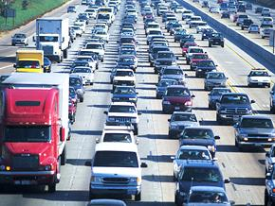
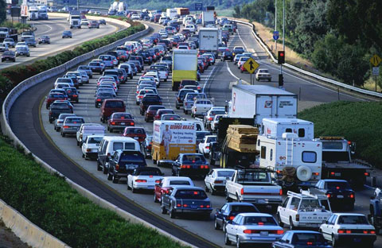
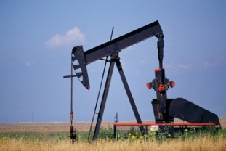
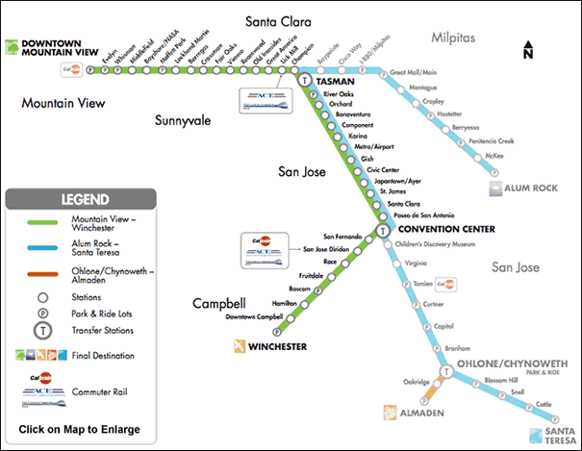
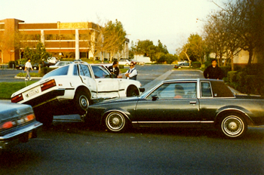
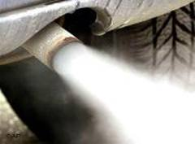
There is a herd of elephants in the room that are not being addressed
A new, truly sustainable transit paradigm is needed
thinkstockphotos.com item no. 78481939
http://evidencebasedliving.human.cornell.edu/wp-content/uploads/2012/01/traffic_jam.jpg
http://www.vta.org/images/smf/green_map_thumb.gif
http://microbiology.okstate.edu/faculty/mostafa/pics-intro/OIl%20Well.jpg
http://www.anaheim.net/depts_servc/police/411/tc.jpg
http://www.aamcocolorado.com/

Slide 4
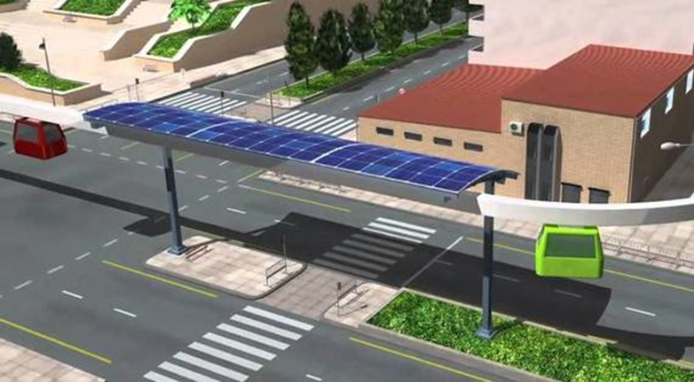
SPARTAN mobility effectively addresses inherent fundamental problems
Exclusive, grade-separated guideway with solar PV panels
Utilizes existing vehicular rights-of-ways (ROWs)
Suspended driverless vehicles
Off-line stations
  Non-stop origin to destination
On demand scheduling
Taxi-like service
Facilitates transit oriented development (TOD)
Truly sustainable
Notes:
We need another mode of mobility that will significantly change how urban transportation is done.

Slide 5
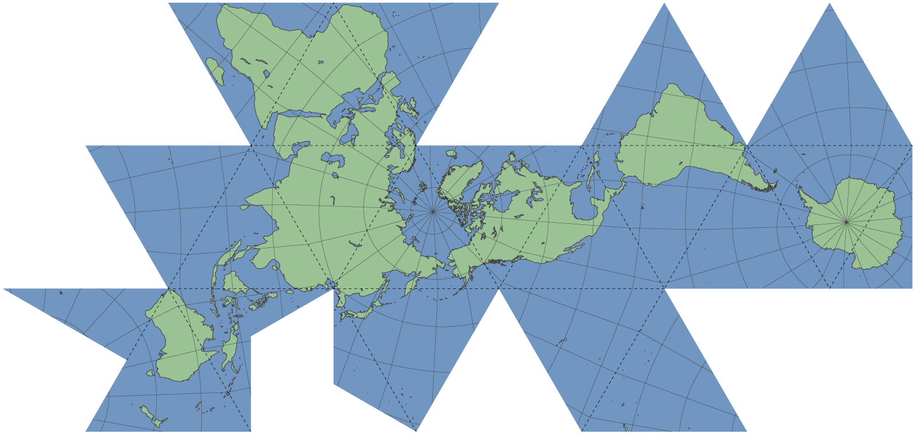
We have a growing international research network
Cape Town
Johannesburg
Pretoria
Delft
InGHenia
BSMP
Antwerp
Linköping
Uppsala
Bogotá
SIU
ITESM Toluca
San José State
Pusan
Notes:
We have an international research network

Slide 6
We have a growing international industry consortium
Futran, ZA
Supraways, FR
Beamways, SE
4Dialog, SE
TCS, US
Swenson Builders, US
Notes:
We have an international research network

Slide 7
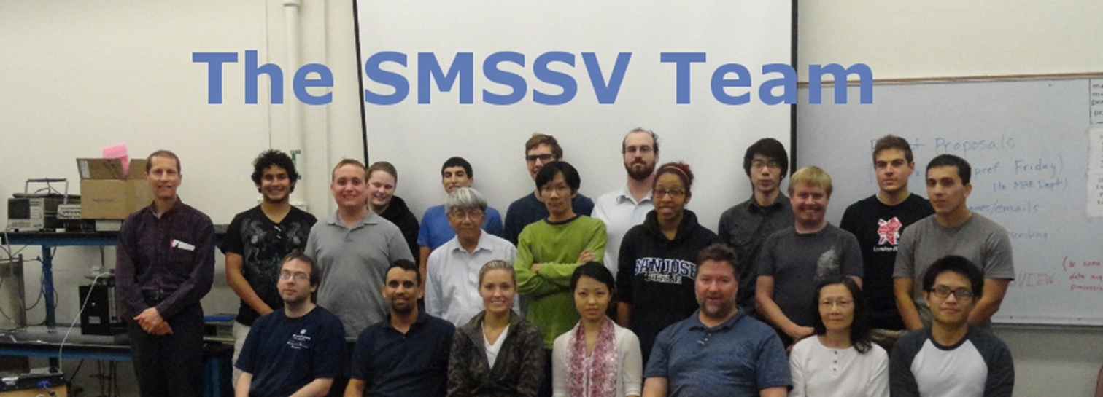
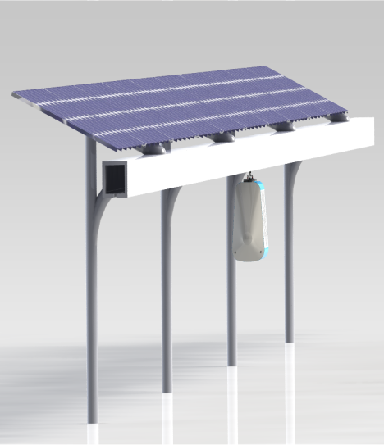
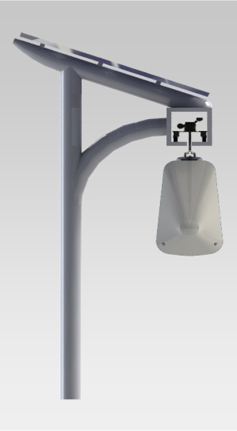
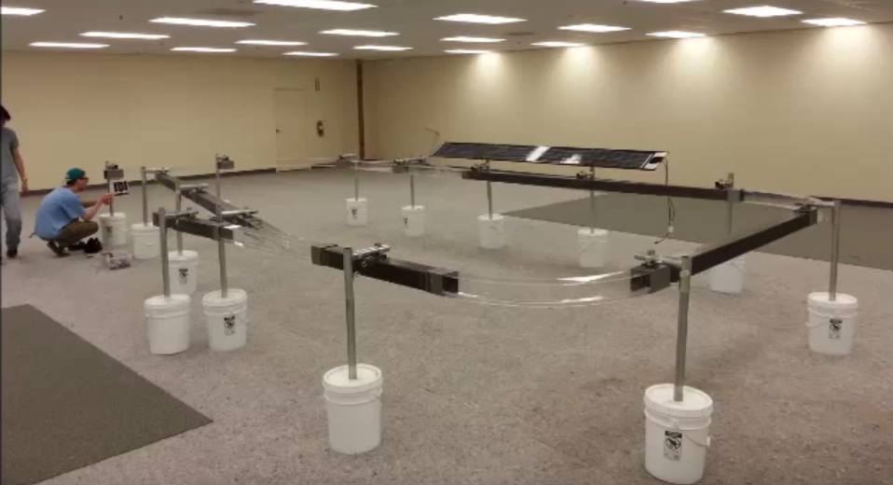
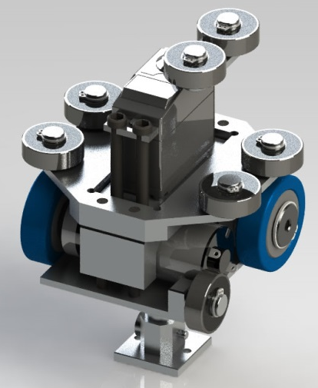
We have been developing SPARTAN technology since 2012
2012-13
11 ME
3 CmpE/SE
3 URBP
3 Business
3 volunteers

Slide 8
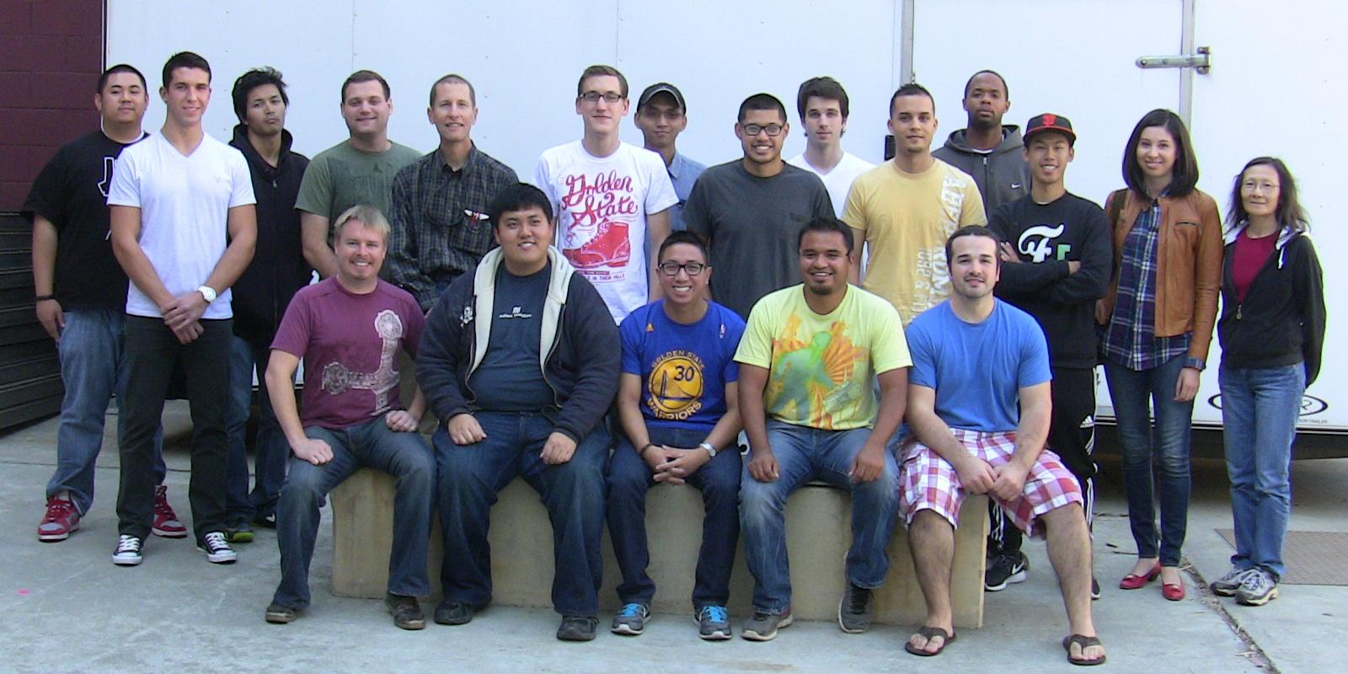
We have been developing SPARTAN technology since 2012
2013-14
15 ME
6 CmpE/SE
4 EE
2 CE
~60 DSID
3-8 volunteers

Slide 9
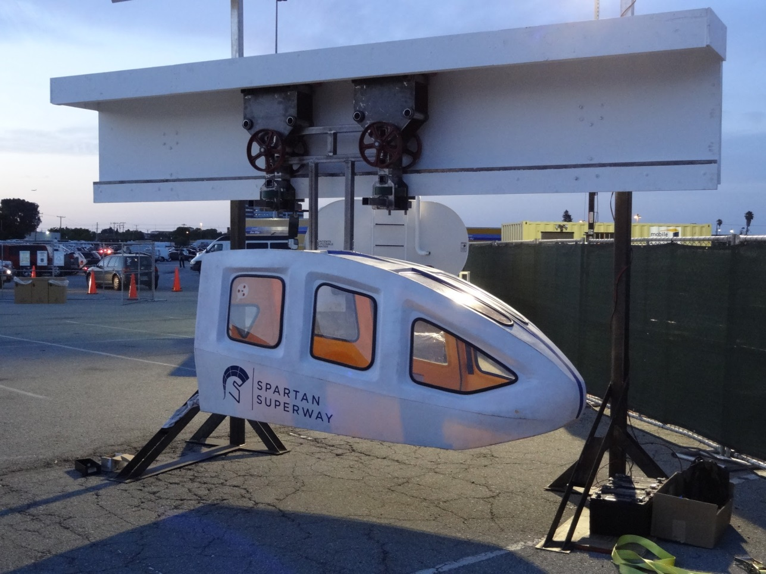
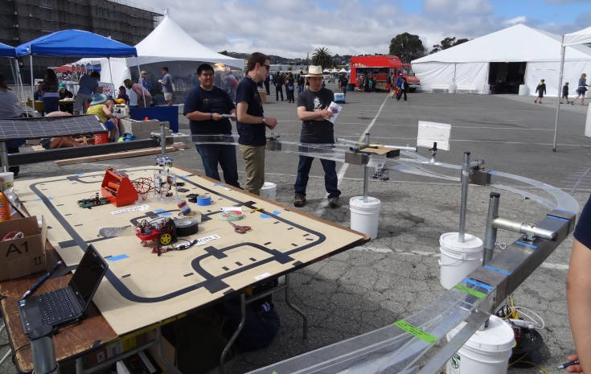
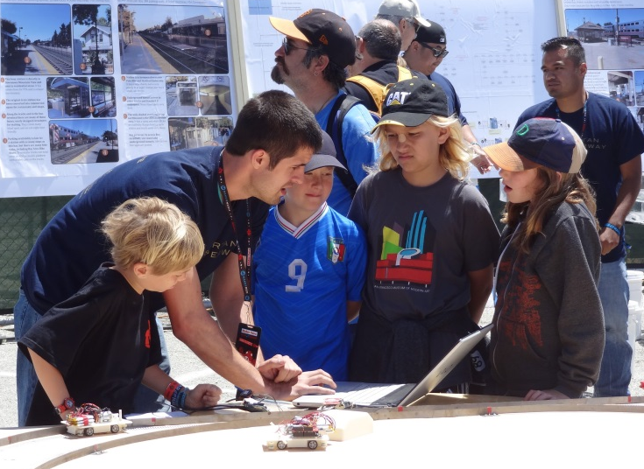
We have been developing SPARTAN technology since 2012

Slide 10
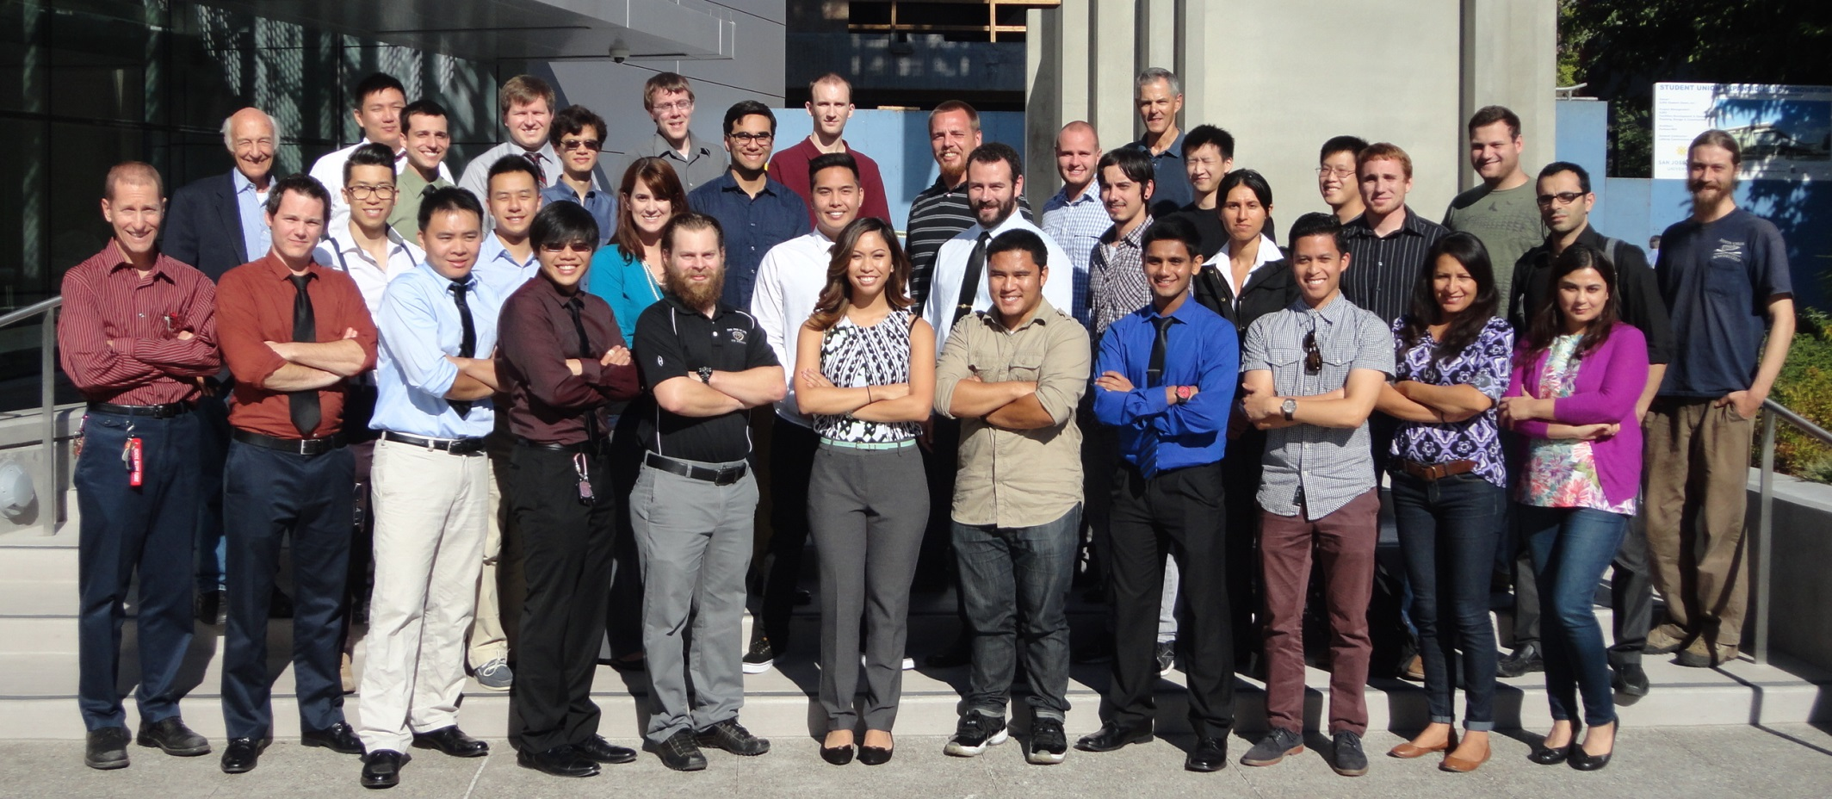
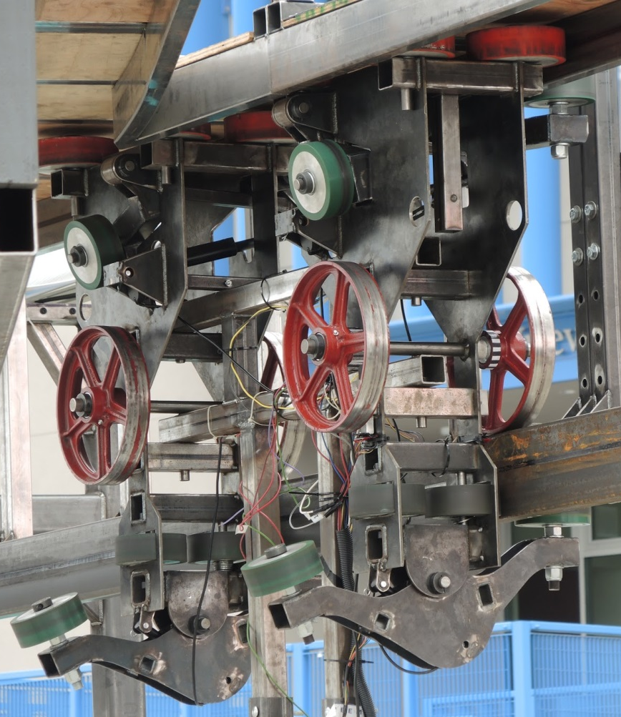
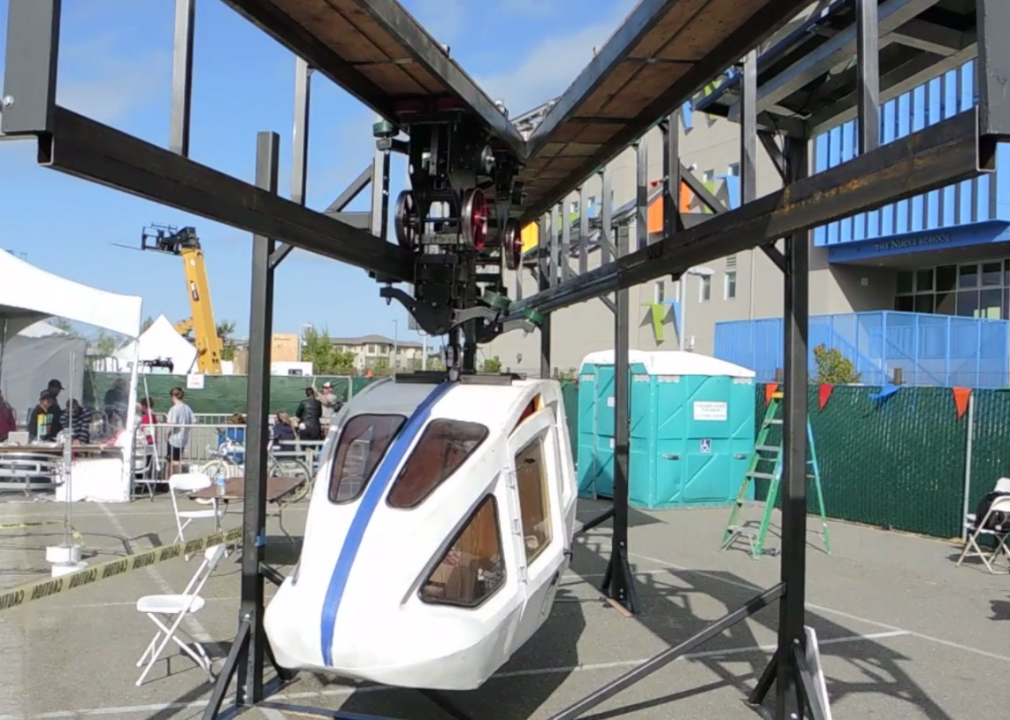
We have been developing SPARTAN technology since 2012
2014-15
26 ME
2 CmpE/SE
1 CE

Slide 11
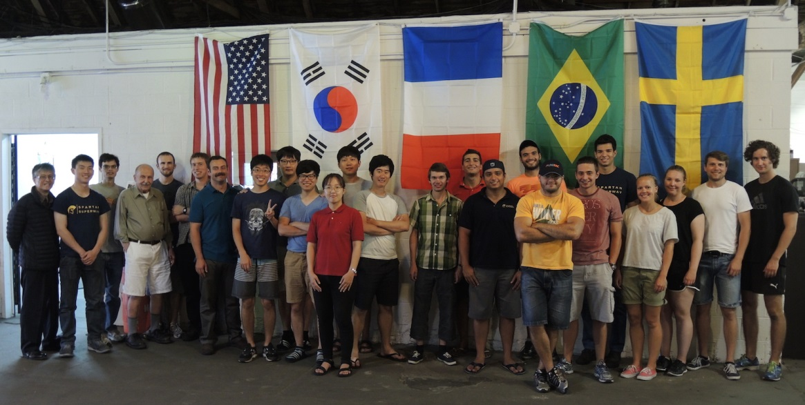
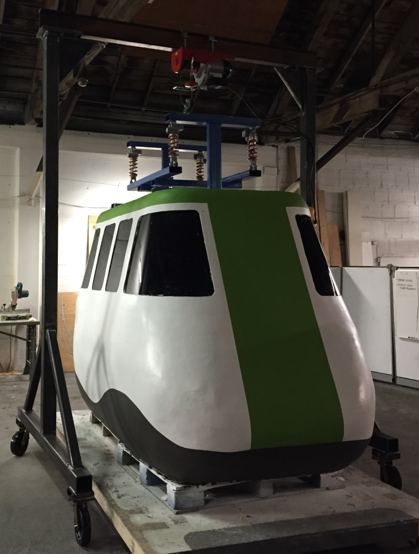
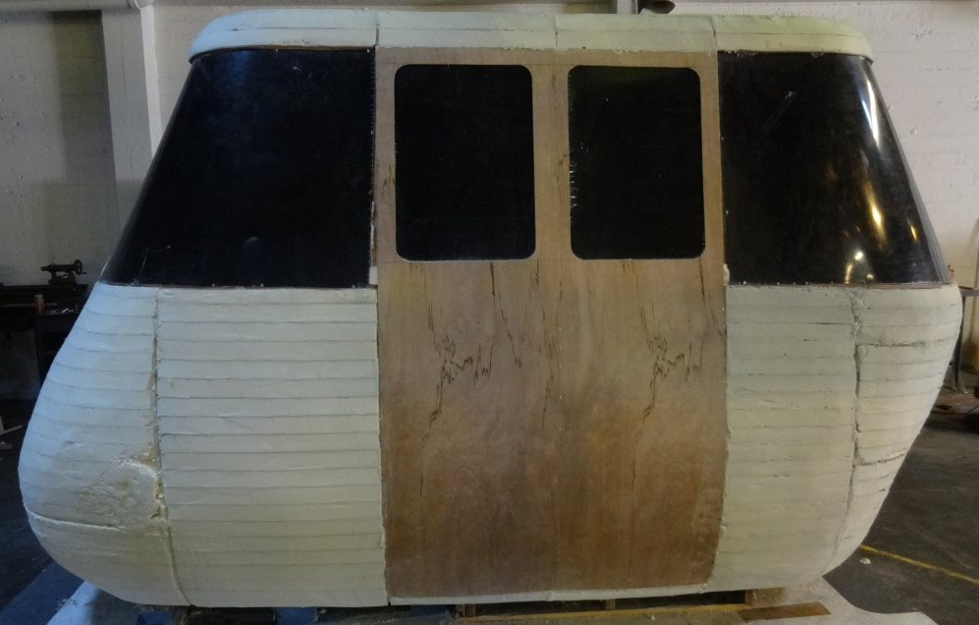
We have been developing SPARTAN technology since 2012
Summer 2015
7 from Brazil
6 from South Korea (PNU)
4 from Sweden
2 from France
4 – 6 from USA

Slide 12
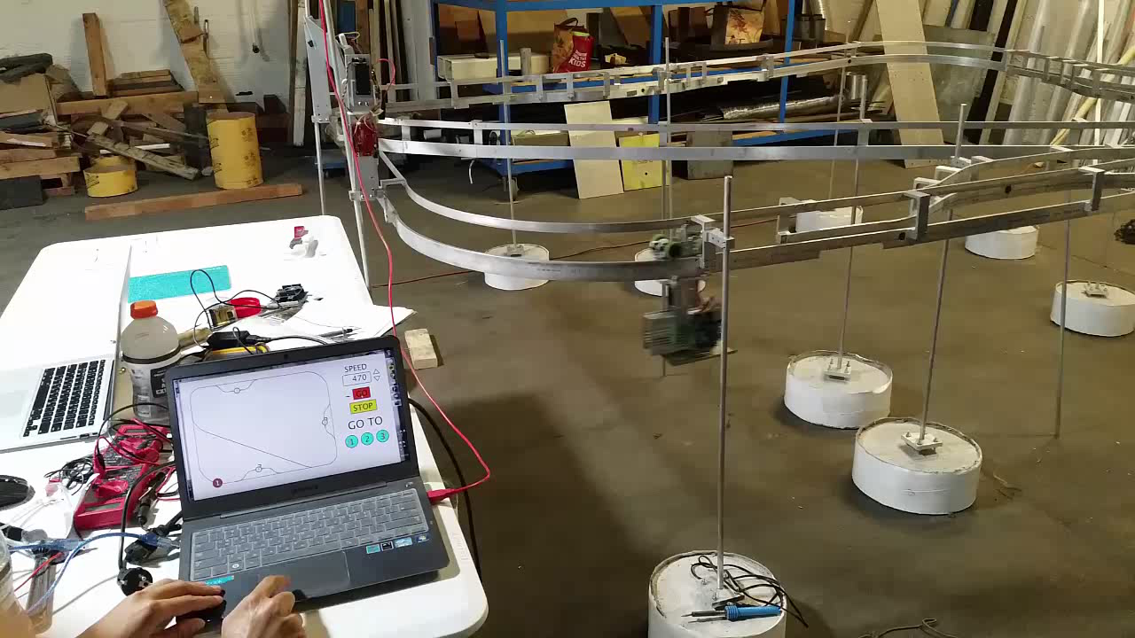
We have been developing SPARTAN technology since 2012

Slide 13
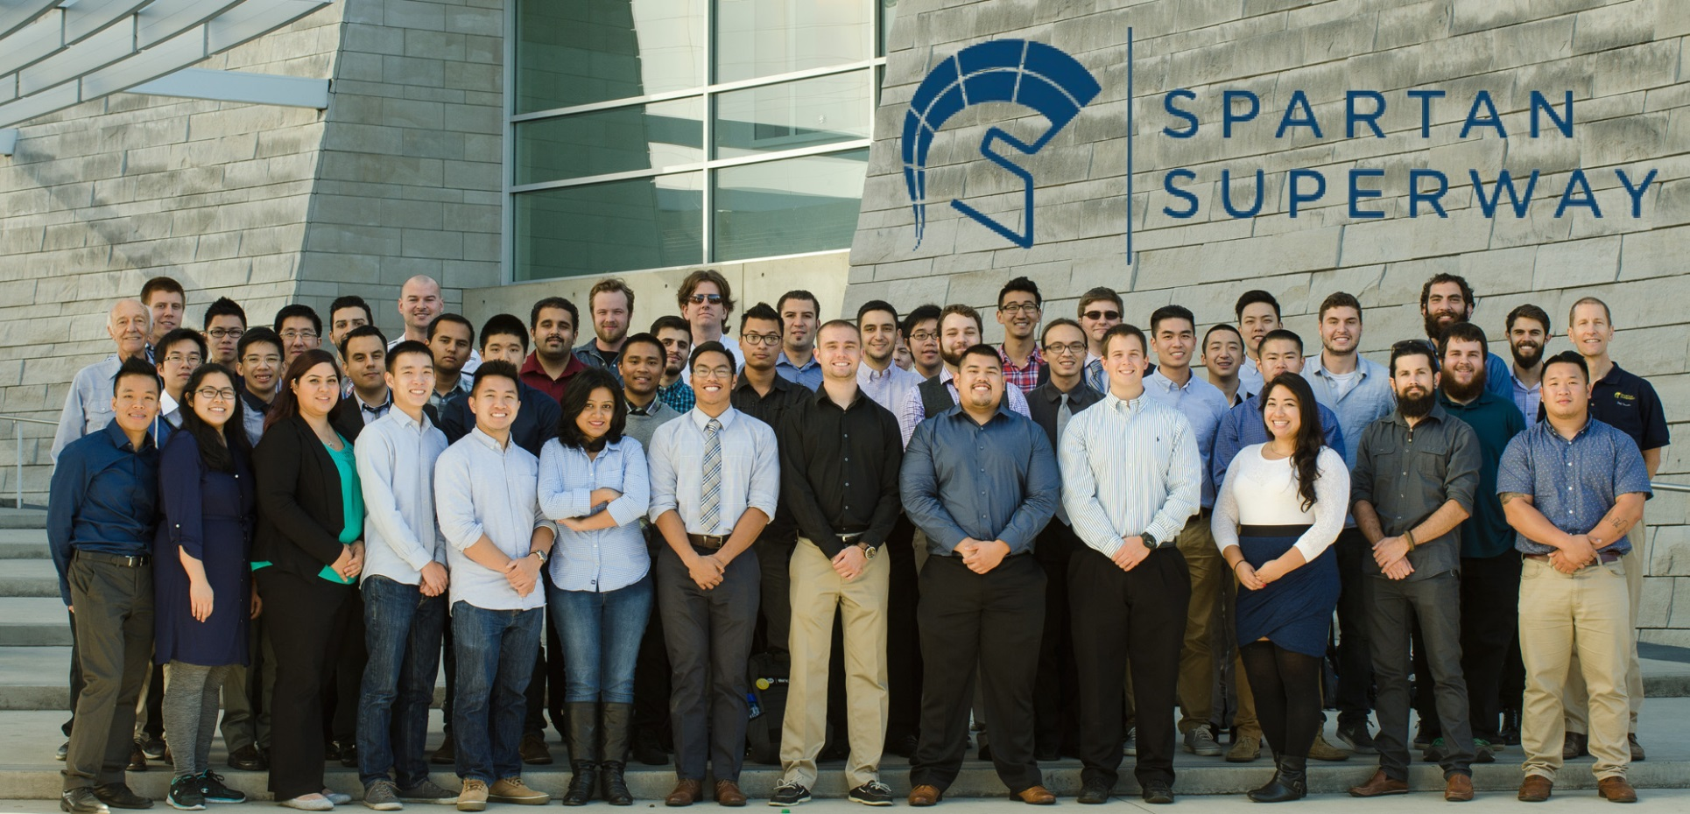
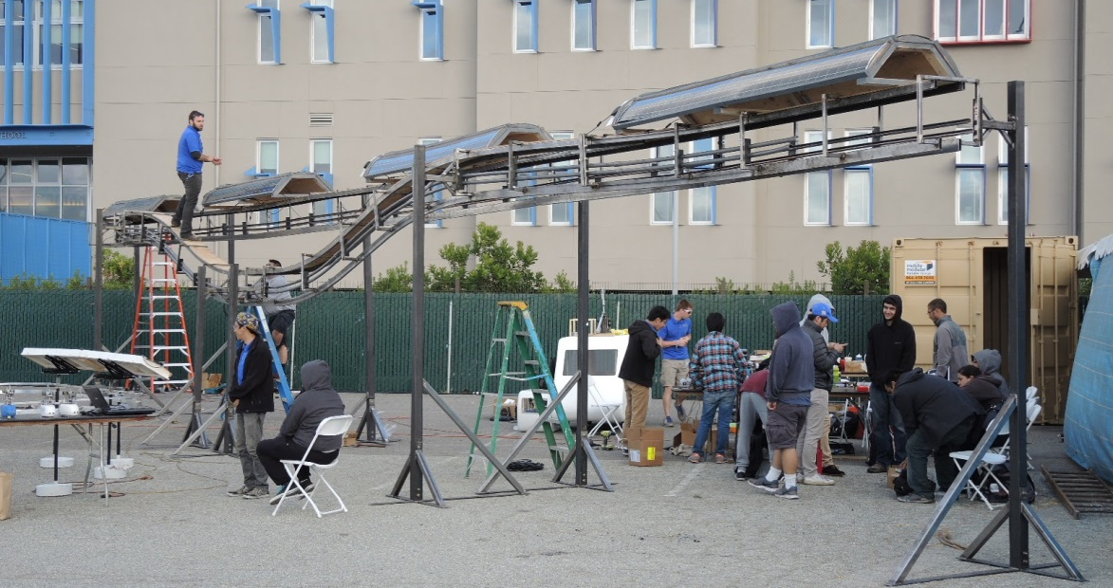
We have been developing SPARTAN technology since 2012
2015-16
46 ME
3 EE
2 MSSE

Slide 14
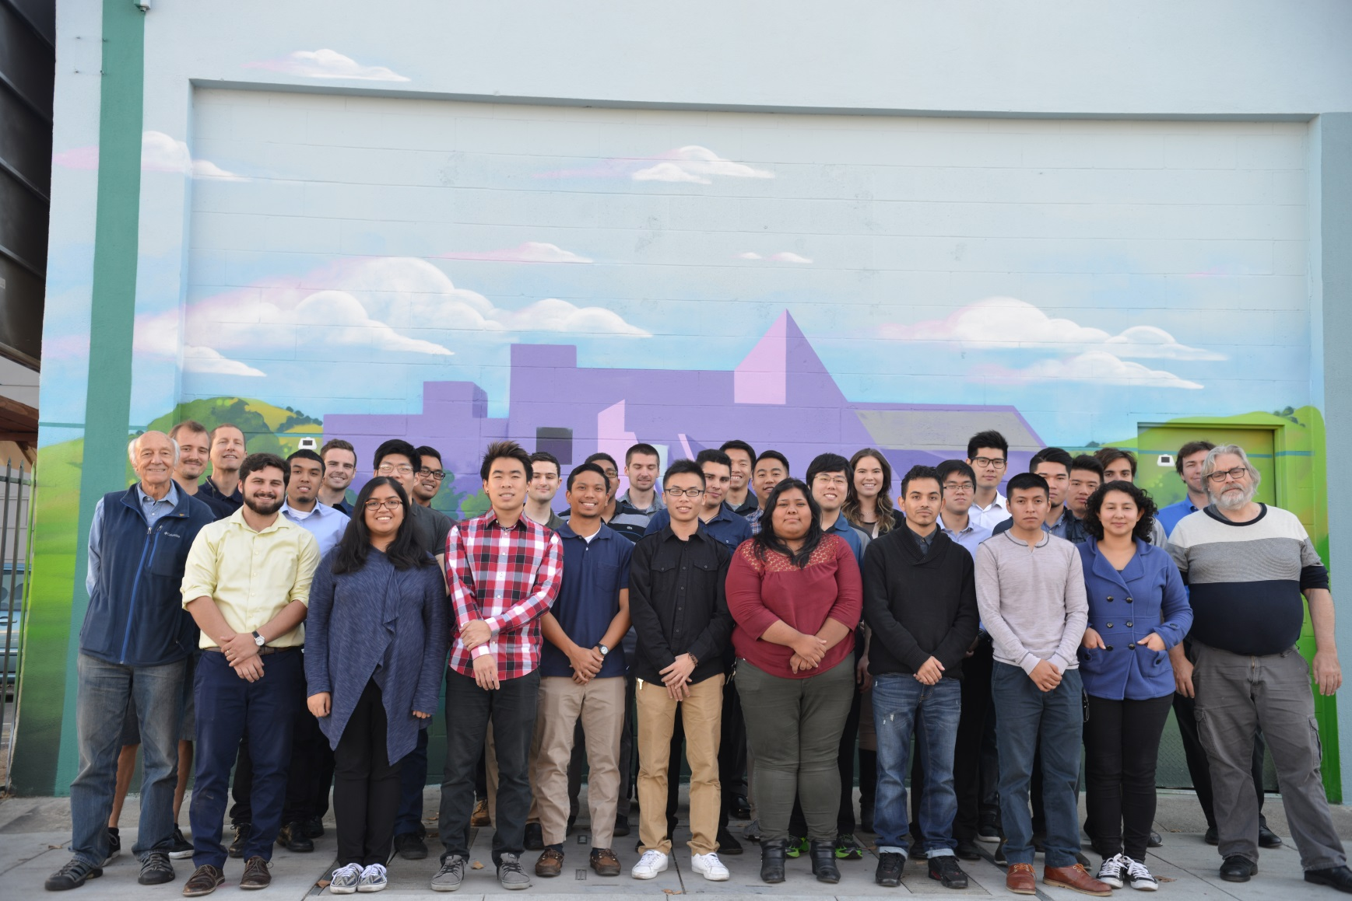
We have been developing SPARTAN technology since 2012
2016-17

Slide 15
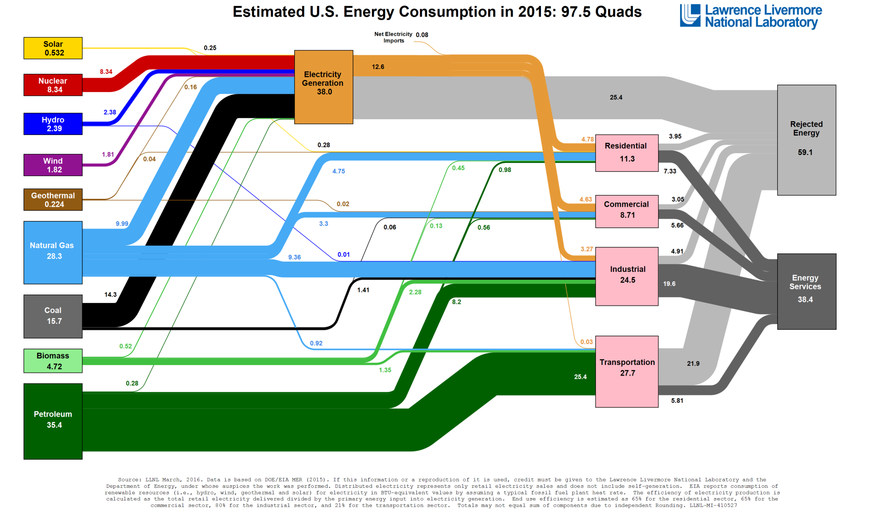
SPARTAN will impact urban mobility globally
Chomp!
https://flowcharts.llnl.gov/content/assets/images/energy/us/Energy_US_2015.png

Slide 16
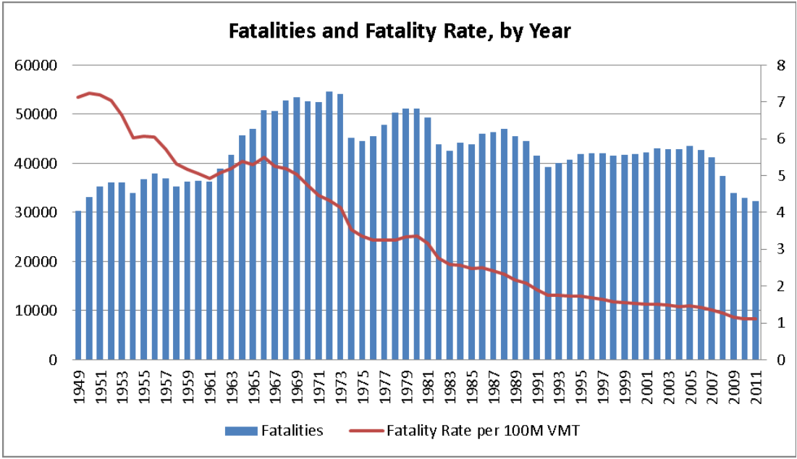
SPARTAN will impact urban mobility globally
https://crashstats.nhtsa.dot.gov/Api/Public/ViewPublication/812013

Slide 17
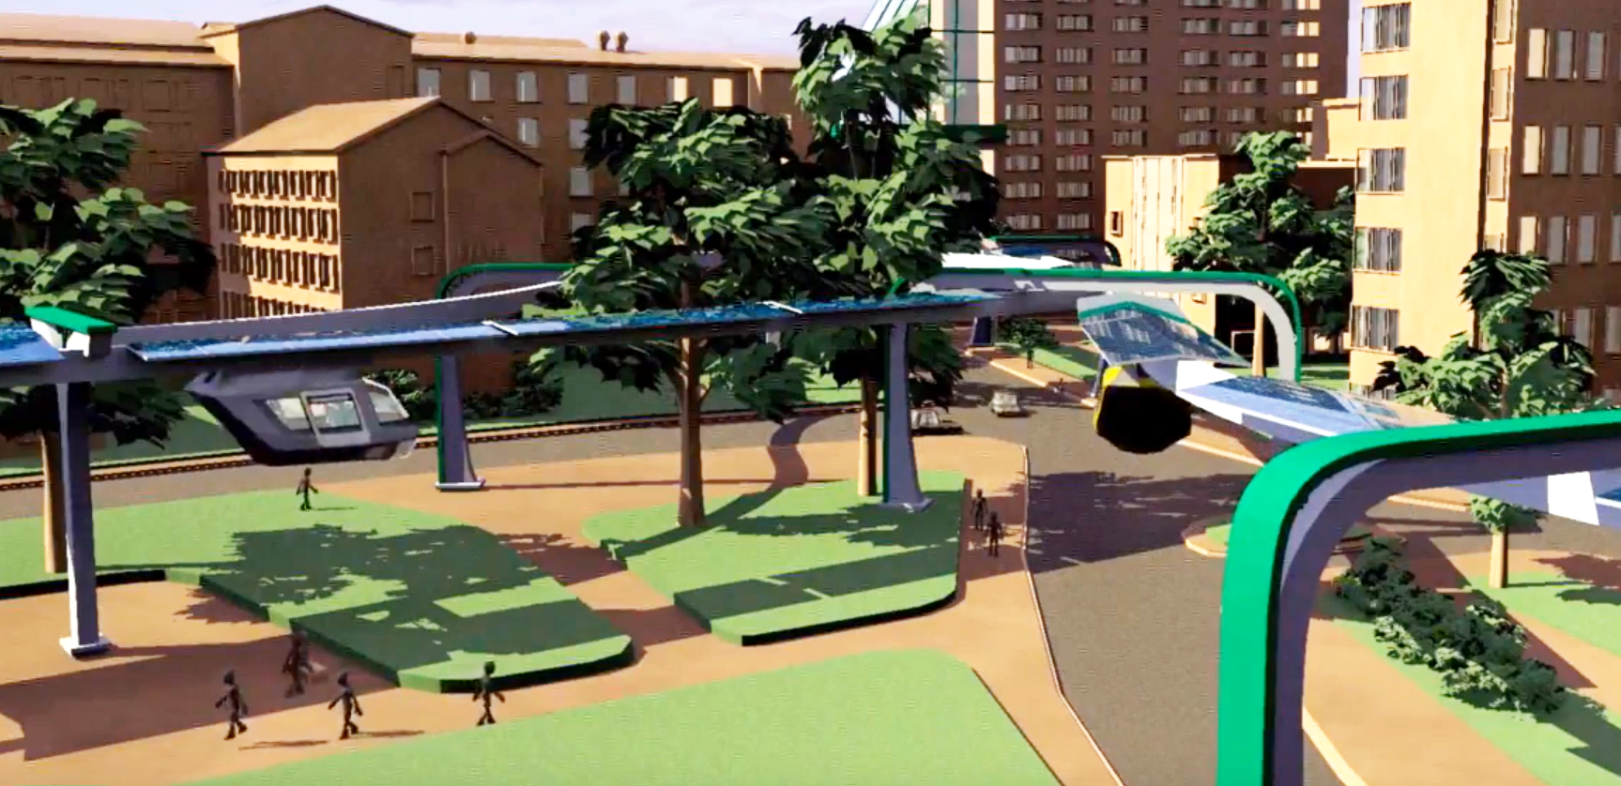
SPARTAN will impact urban mobility globally

Slide 18
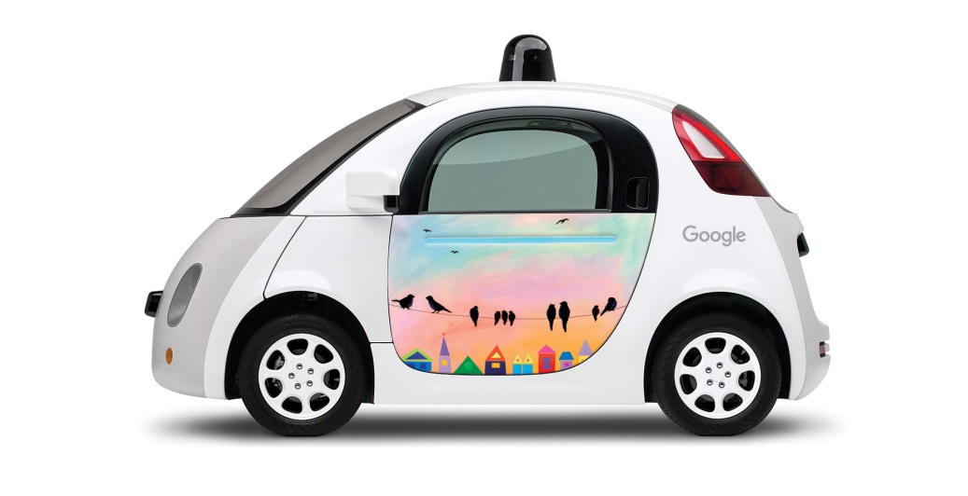
Technologies needed for SPARTAN have some overlap with EVs, AVs, ride sharing, etc., but adds others
https://waymo.com/journey/paint-the-town/mountain-view/
HMI, UI
Sensors, sensor fusion
Propulsion, batteries
Localization and mapping
Path planning
Safety
Cybersecurity
Etc.
Solar PV and grid integration
Energy storage
Architecture and urban form
Demand planning, route, and fleet optimization
Innovation in structural elements
Innovation in infrastructure installation

Slide 19
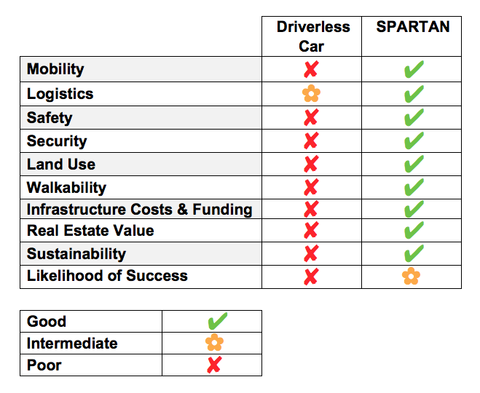
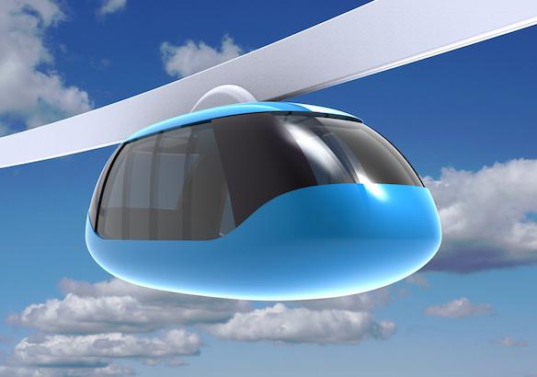
There are gaps that need to be addressed
Superway
Notes:
Need to focus resources on improving the likelihood of success of SPARTAN
Apply AV technology to SPARTAN fixed, exclusive, elevated, independent infrastructure (existing ROW, but independent of the street grid)

Slide 20
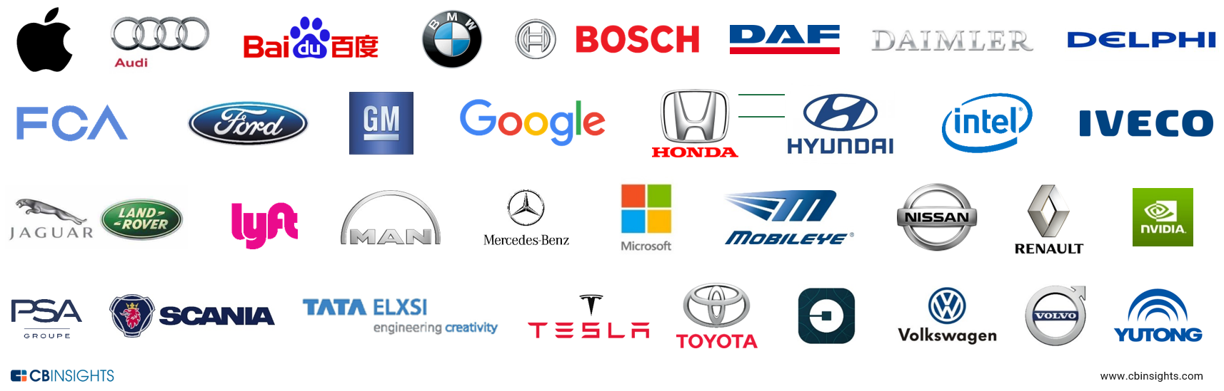
USA government is about to give industry $4B to get ✘ results
https://www.nytimes.com/2016/01/15/business/us-proposes-spending-4-billion-on-self-driving-cars.html?_r=0
Notes:
https://www.nytimes.com/2016/01/15/business/us-proposes-spending-4-billion-on-self-driving-cars.html?_r=0

Slide 21
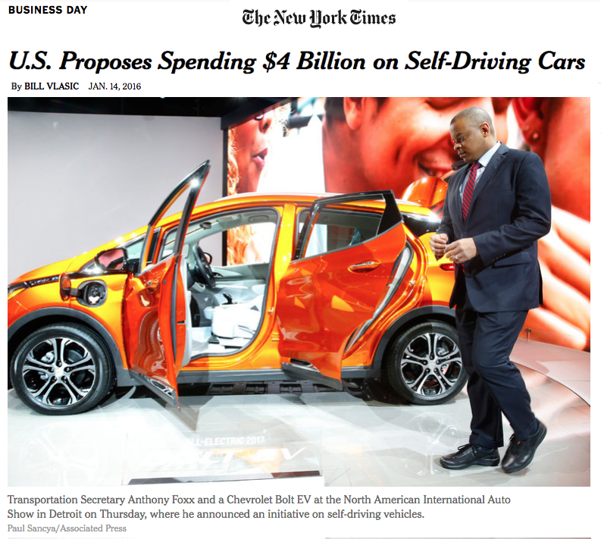
Notes:
https://www.cbinsights.com/blog/autonomous-driverless-vehicles-corporations-list/
https://www.nytimes.com/2016/01/15/business/us-proposes-spending-4-billion-on-self-driving-cars.html?_r=0

Slide 22
There are gaps that need to be addressed
All the magical technology that makes the autonomous vehicle possible is EXACTLY what is needed to bring success to the SPARTAN system.
By leapfrogging over the nearsighted frenzy in Washington and Detroit, and sticking to Silicon Valley principles of disruptive technology, social equity, and economic breakthroughs, SJSU and SV industry can help lead in this emerging global marketplace.
Notes:
Need to focus resources on improving the likelihood of success of SPARTAN
Apply AV technology to SPARTAN fixed, exclusive, elevated, independent infrastructure (existing ROW, but independent of the street grid)

Slide 23

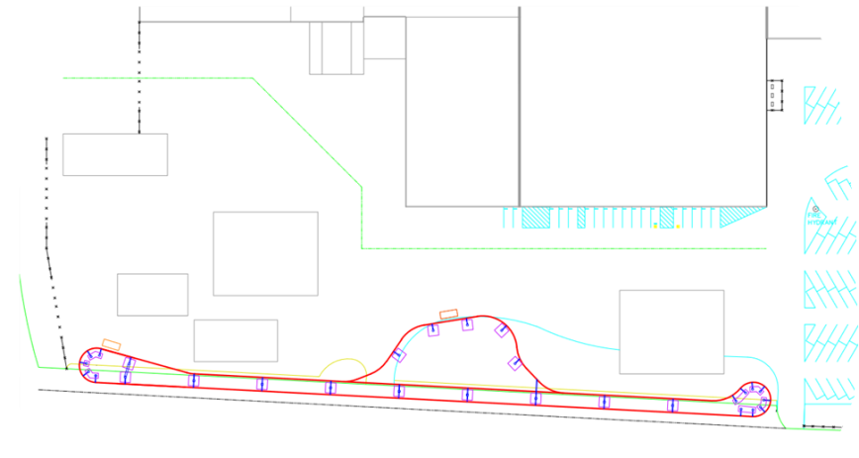
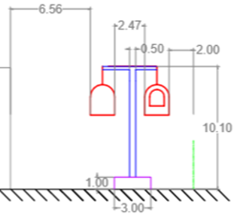
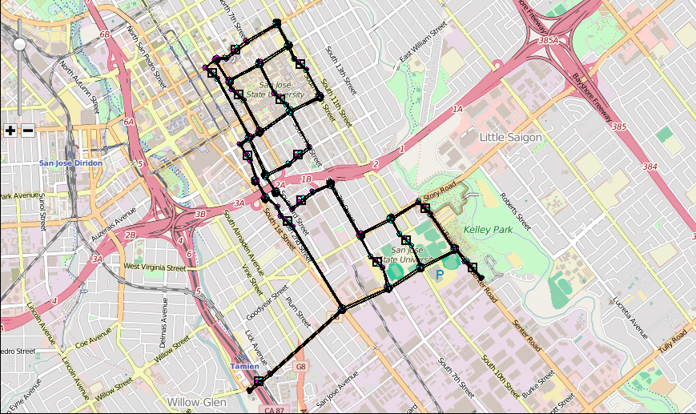
There are many opportunities for industry-academe collaboration
N
7th Street

Slide 24
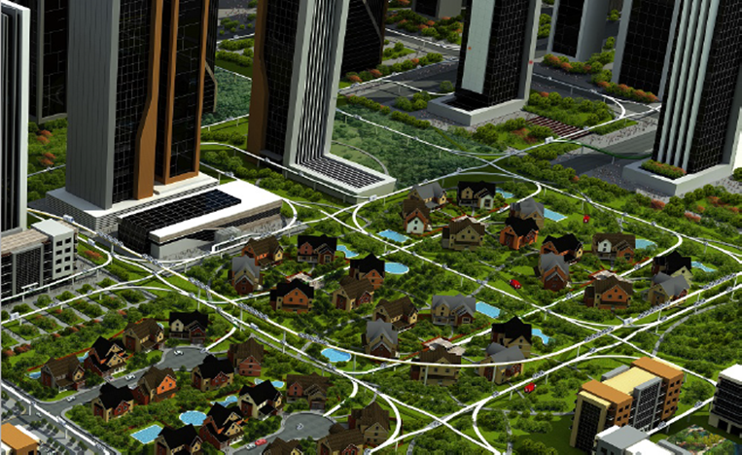

True sustainability is the configuration driver so cities are human centered, not car-centered

Slide 25




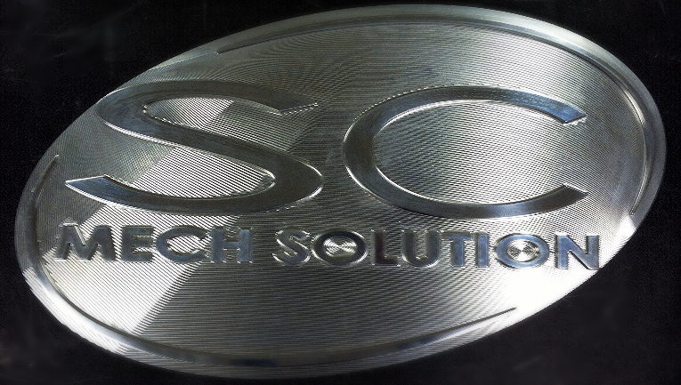











Thank you!
and thanks to our generous sponsors

Slide 26
For more information
Contact:
  Burford “Buff” Furman, burford.furman@sjsu.edu
  Eric Hagstrom, EJHagstrom@hotmail.com
Visit:
  http://www.engr.sjsu.edu/smssv/
  http://spartansuperway.blogspot.com/
  http://podcarcity.org/
  http://www.inist.org/library
  http://transweb.sjsu.edu/project/1227.html

