Slide 1

Solar Installation for an Automated Transit Network
Podcar City, Antwerp – September 21, 2016
Bufford Furman
Ron Swenson
Eric Rosenfeld

Slide 2
Presentation Overview
Introduction
Overall Progress
Next steps
Objectives

Slide 3
Hitting five birds with one stone
Energy Users
Energy Sources

Slide 4

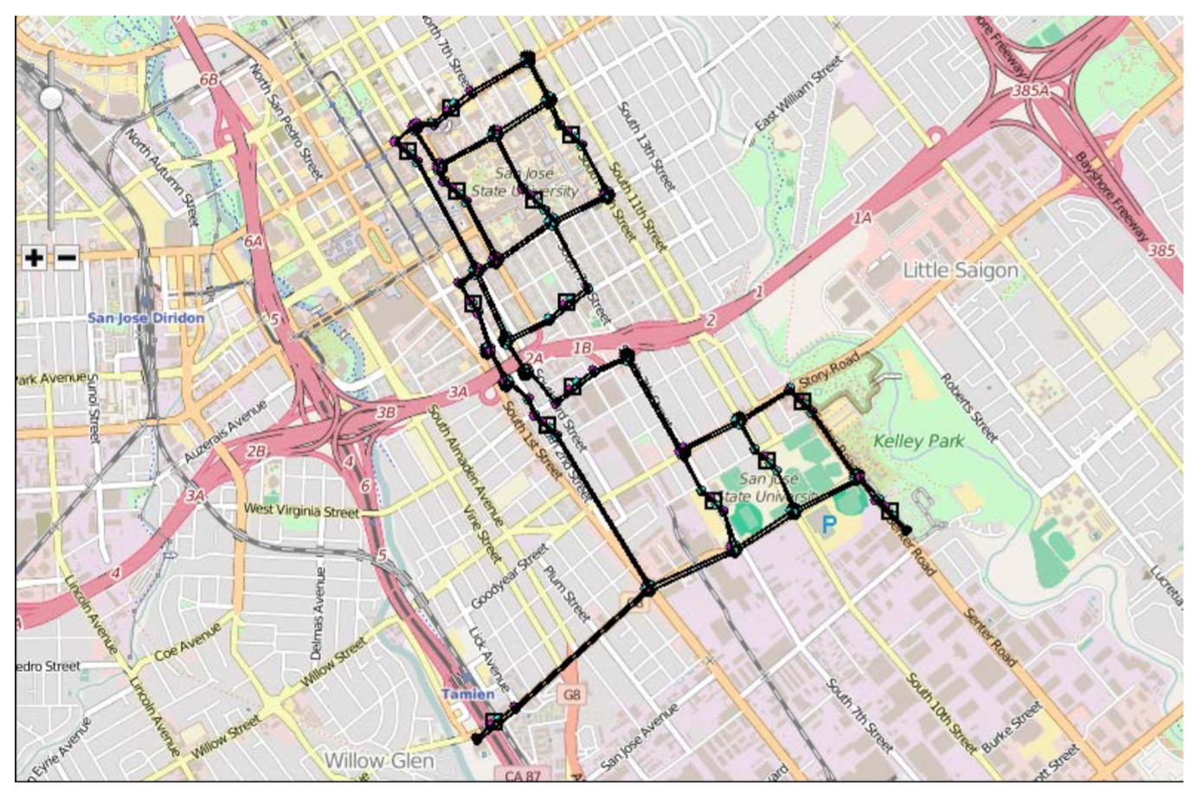

Power Estimation- Full Scale
Must know location and constraints
of the Spartan Superway transit system.

Slide 5
Pod capacity will be traffic dependent
Number of cars assumed: 88
RMS = 44 rides
Notes:
A recent study on ATN for the city of San José done by the Aerospace Corporation found that congestion on the network would occur if the maximum number of slots occupied by ATN vehicles exceeded about 70% of the total number of slots (Paige, 2012)

Slide 6
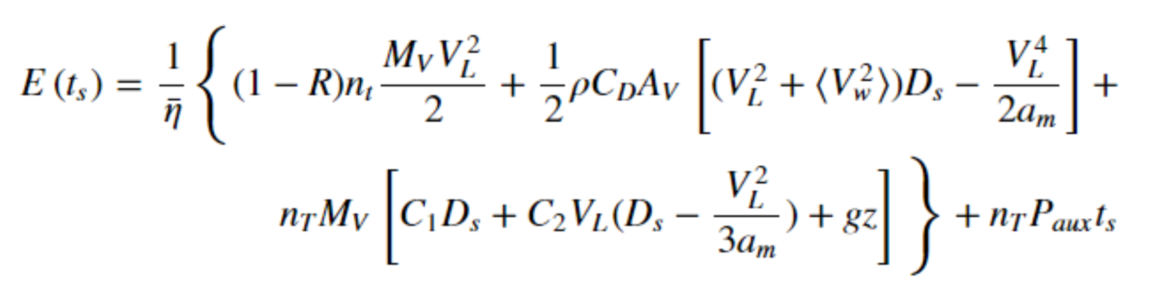
How to account for power consumption?
Air resistance
Rolling resistance
Auxiliary power
Deceleration losses
²Anderson, J. E. (1988). What determines transit energy use? Journal of Advanced Transportation ATR, 22(2), 108-132. doi:10.1002/atr.5670220203
Notes:
Show pictures of trains vs pod system. **

Slide 7
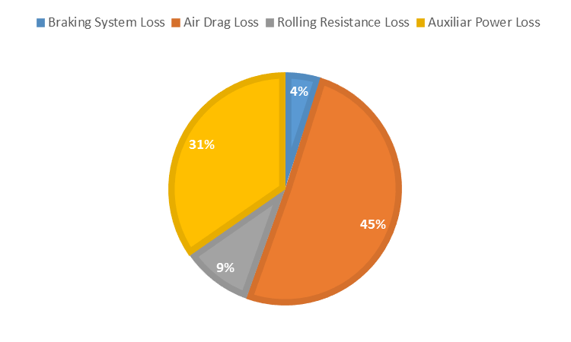
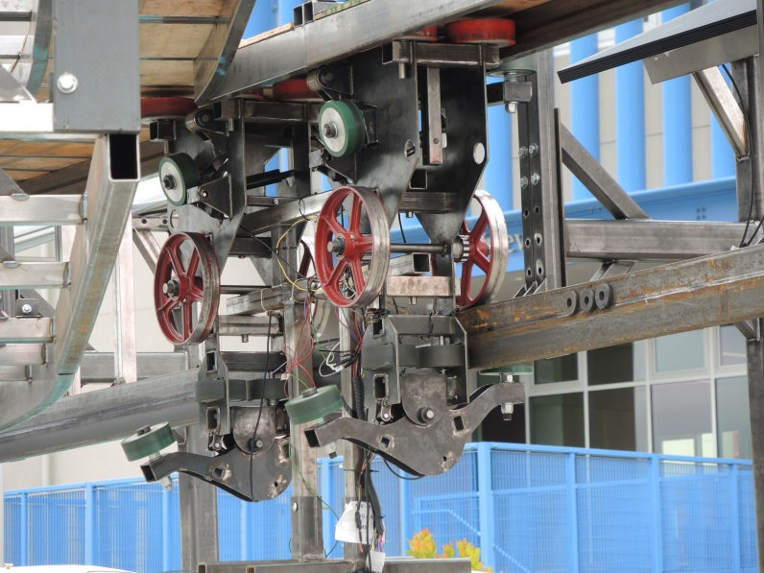
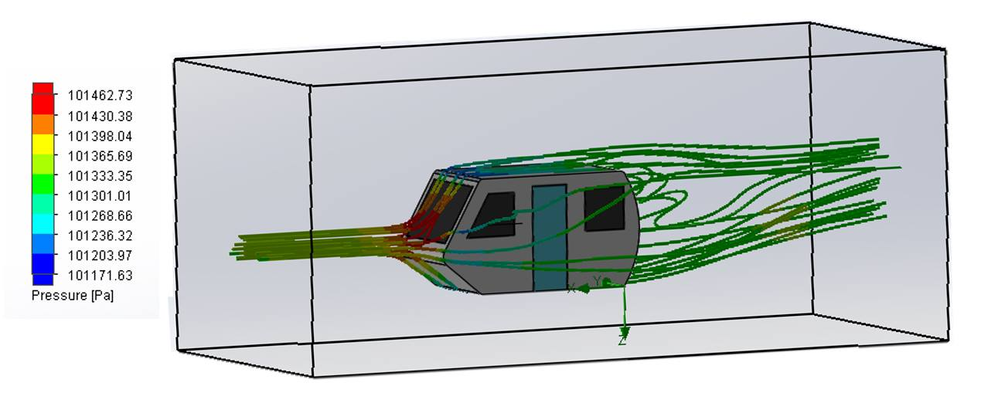
Overall Pod Car Losses
Overall pod consumption due to loss variable losses is 13.49 kW per car
C_{d}=0.65
Rolling Resistance Losses= 1.00 kW/car
Drag Force Losses= 5.09 kW/car
Notes:
Find out which wind speed was input to solidwork wind simulation.

Slide 8
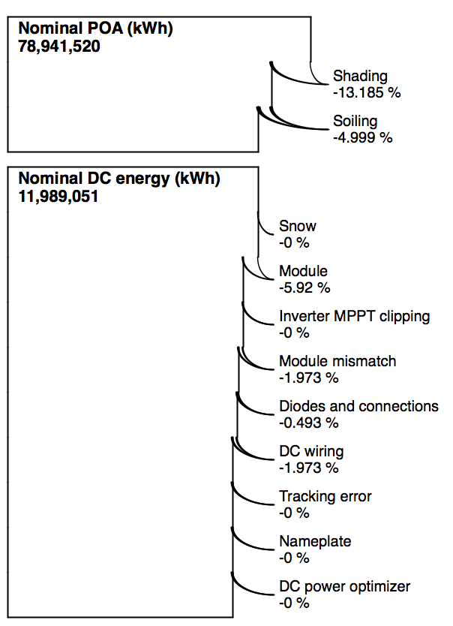
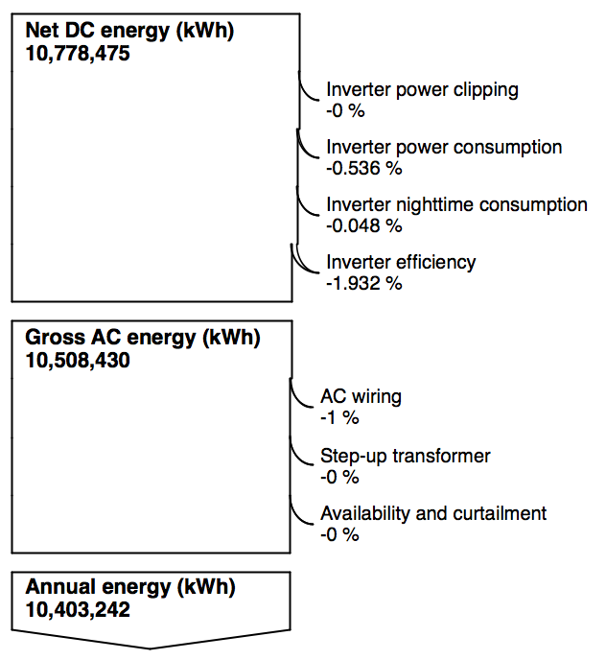
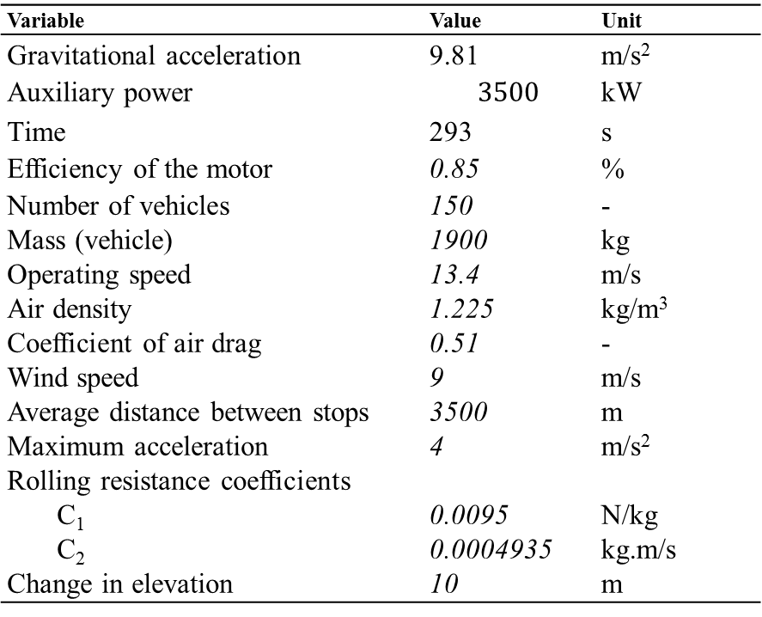
Energy Estimation
Variable | Value | Unit
Gravitational acceleration | 9.81 | m/s²
Auxiliary power | $$3500$$ | kW
Time | 293 | s
Efficiency of the motor Number of vehicles Mass (vehicle) Operating speed Air density Coefficient of air drag Wind speed Average distance between stops Maximum acceleration Rolling resistance coefficients C₁ C₂ Change in elevation | 0.85 150 1900 13.4 1.225 0.51 9 3500 4 0.0095 0.0004935 10 | % - kg m/s kg/m³ - m/s m m/s² N/kg kg.m/s m
Energy | 28,490.20 | kWh | per day
 | 10,403,242 | kWh | per year

Slide 9
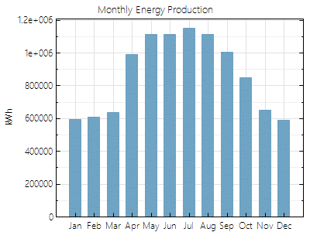
Finally we know the yearly consumption!
Yearly Production
How many solar panels do we need?
Yearly Consumption
10.4 mi kWh
The SunEdison SE-R360EzC-4y is assumed.
Flex-02 350W | Symbol | Performance
Nominal Power | W | 360.192
Efficiency | % | 18.4147
Maximum Power Current | A | 9.4
Open Circuit Voltage | V | 46.9
Area | m² | 1.956
Weight | Kg | 19.3
Number of modules: 19,600
Required area: 38,300 m²

Slide 10
A grid system will be utilized!
Notes:
Simplify grid with circles

Slide 11
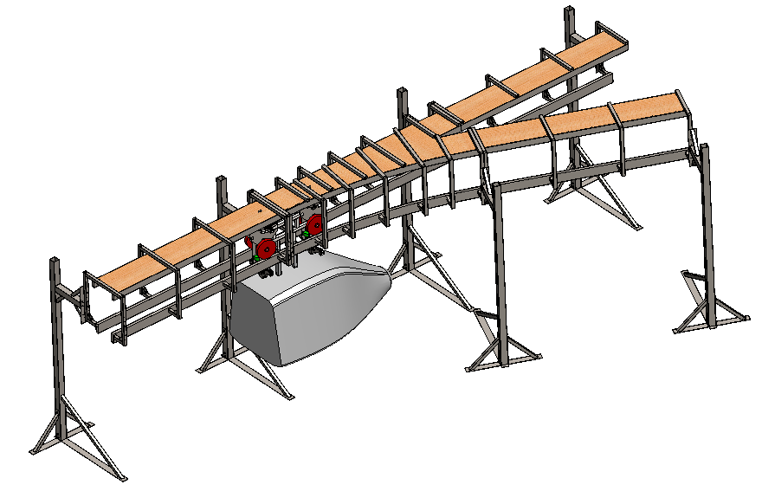
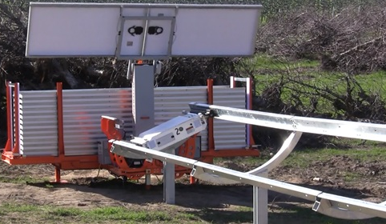
The racking system is designed for automated
installation.

Slide 12
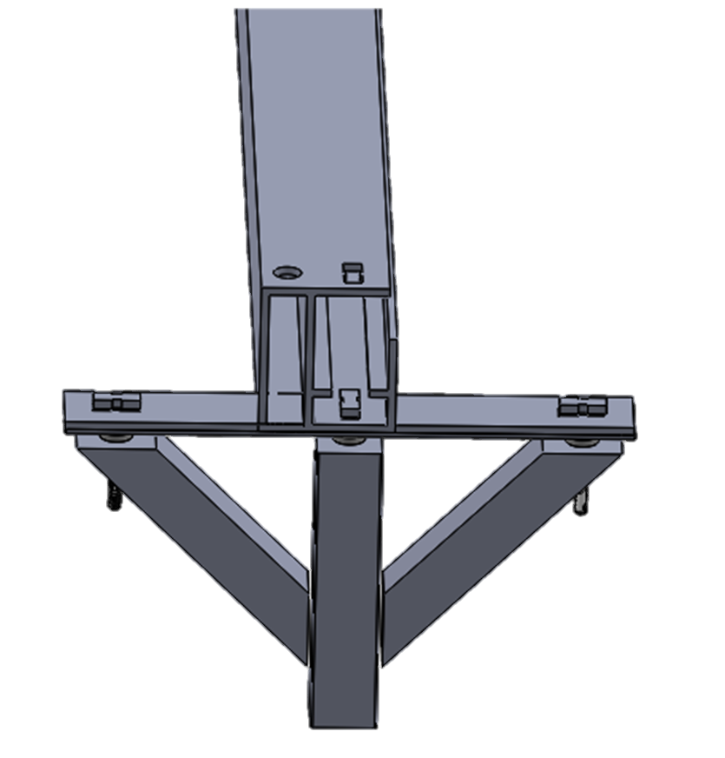
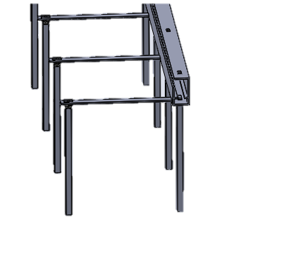
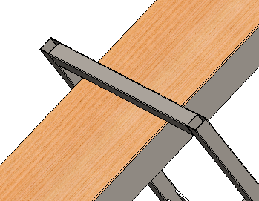
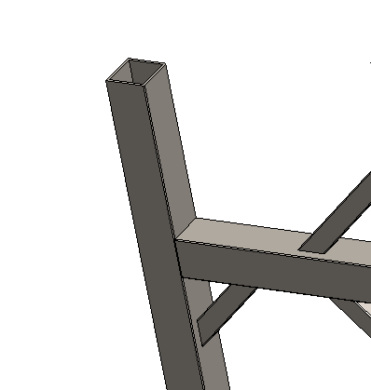
The Racking System will utilize that frame of the Spartan Superway.
Notes:
No slide

Slide 13
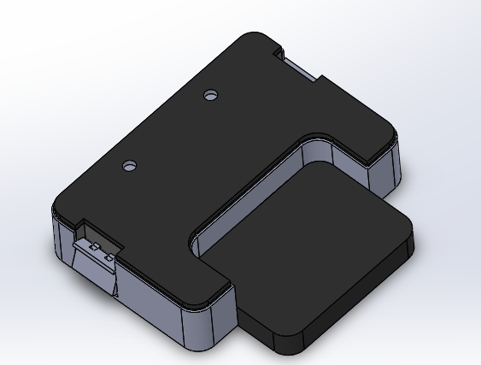
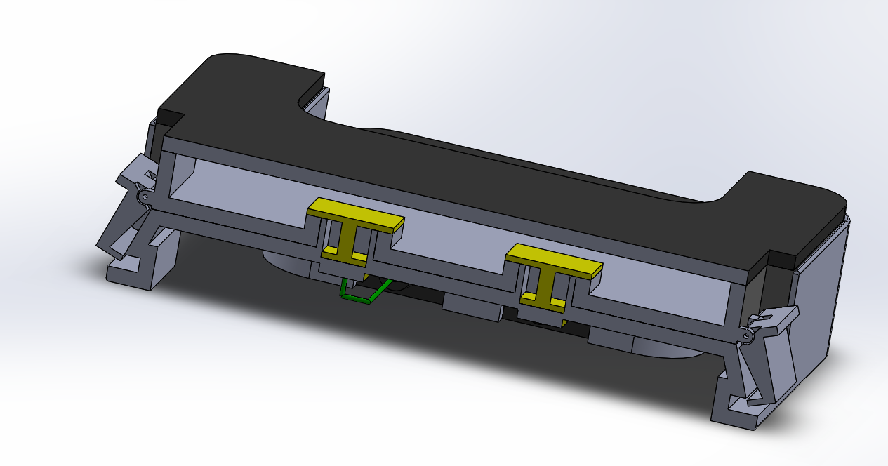
Blind-connecting maximizer for each panel
Copper Pieces
Maximizer
Connectors
Wire

Slide 14
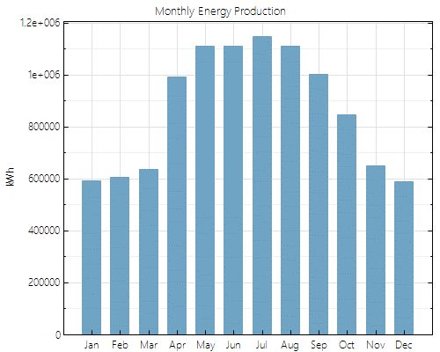
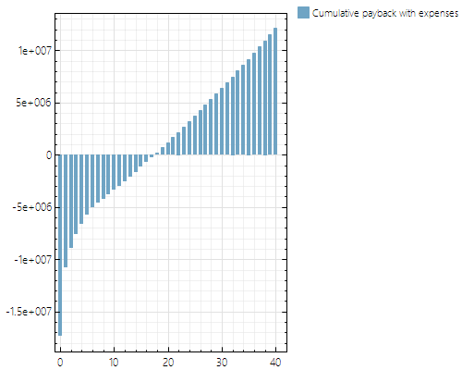
Why consider a higher installed capacity?
More leftover energy
Payback Period
Notes:
Renewable Energy Finance Tracking Initiative (REFTI) by National Renewable Energy Laboratory

Slide 15
What is next?
Improve pod car design
Implement a full scale test track
Financial Analysis
Design a racking system for the Solar PV

Slide 16











Questions?

