Slide 1
The Bogie Sub-Team
By Michael Cahill, Pedro Pereira, João Vinícius and Neto Símon

Slide 2
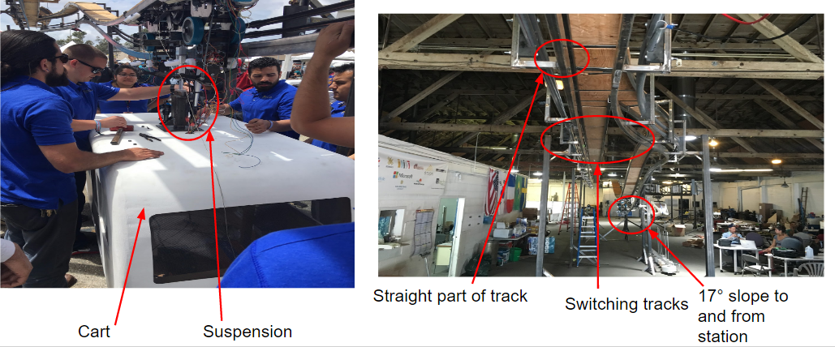
The bogie is one of the most important components for transporting a passenger

Slide 3
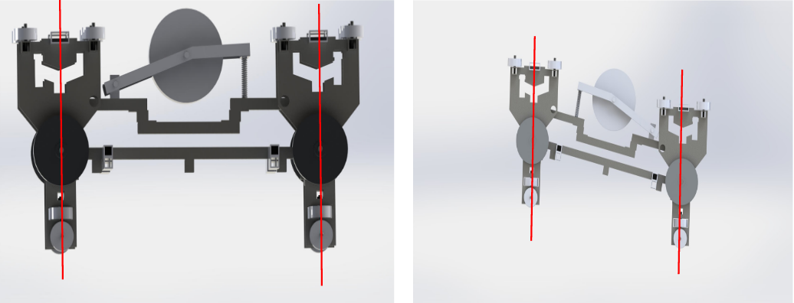
The 4-bar linkage will always make the main parts of the bogie parallel

Slide 4
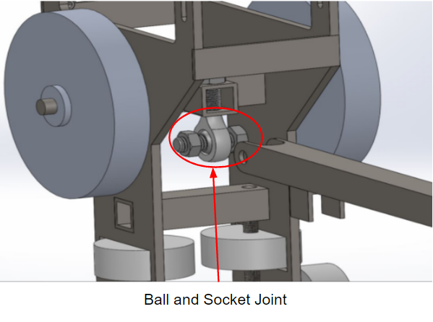
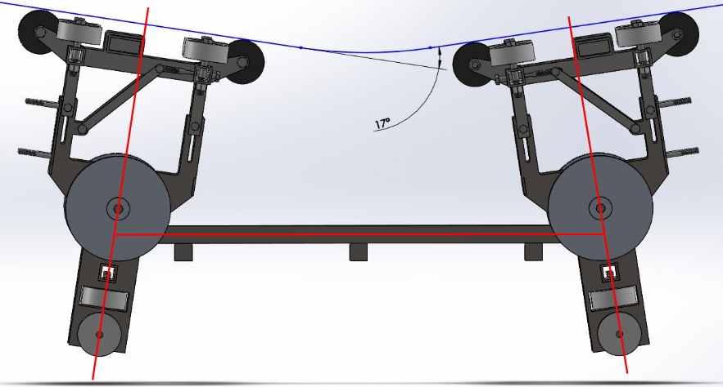
Changes were made to make the movement of the half bogies independent of each other.

Slide 5
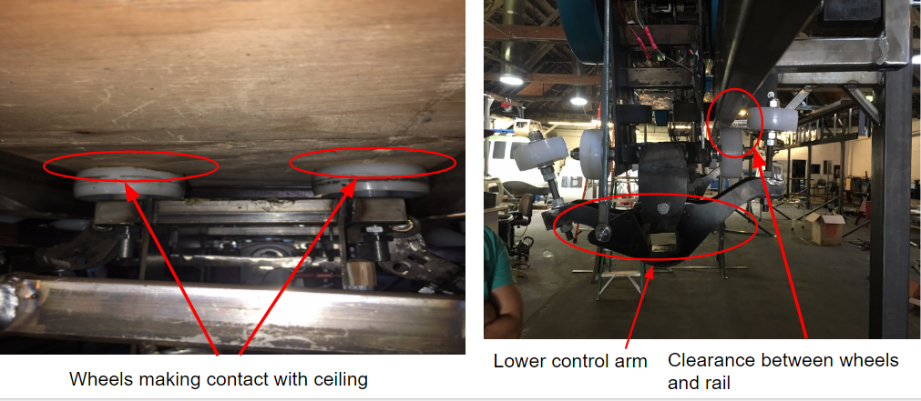
There were issues with the design and the finished bogie

Slide 6
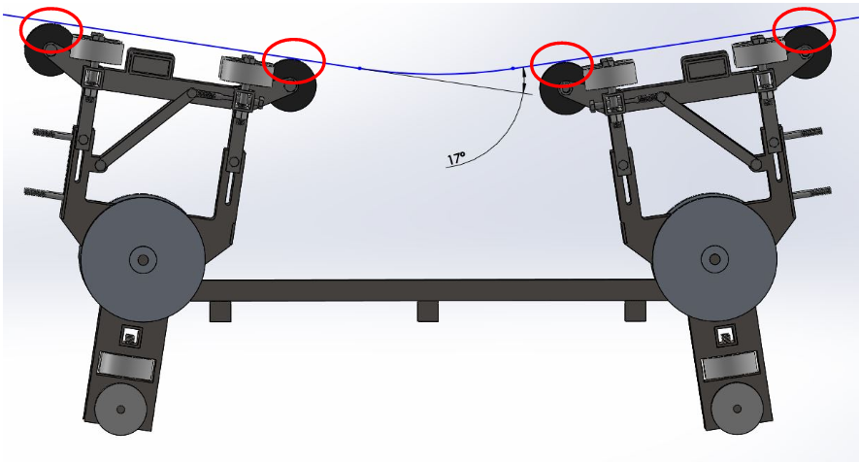
Wheels had to be attached to the top of the bogie

Slide 7
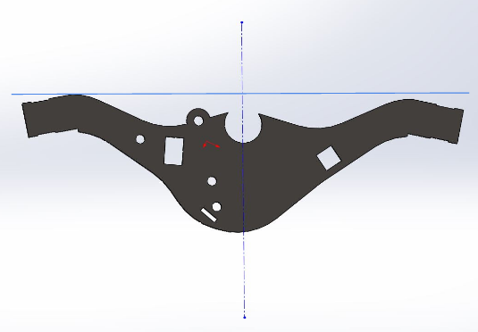
Some design errors were found in the steering system...
Not symmetric

Slide 8
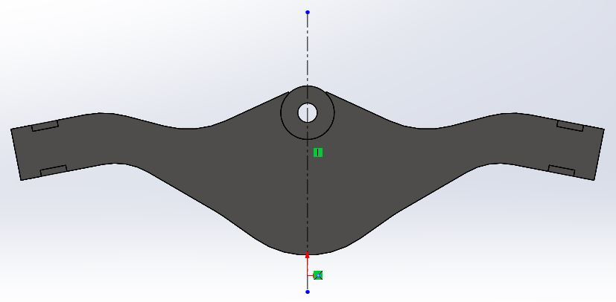
A new lower control arm had to be made...

Slide 9
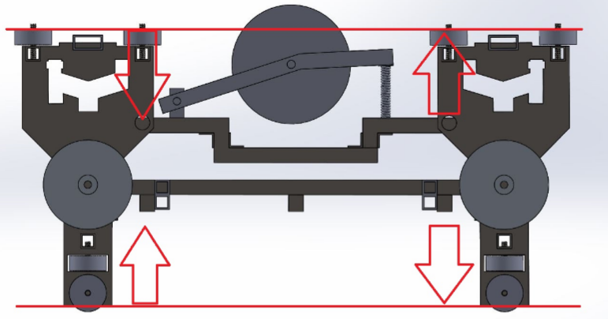
In order to easily assemble the bogie on the track we should consider a vertical retractable bogie

Slide 10
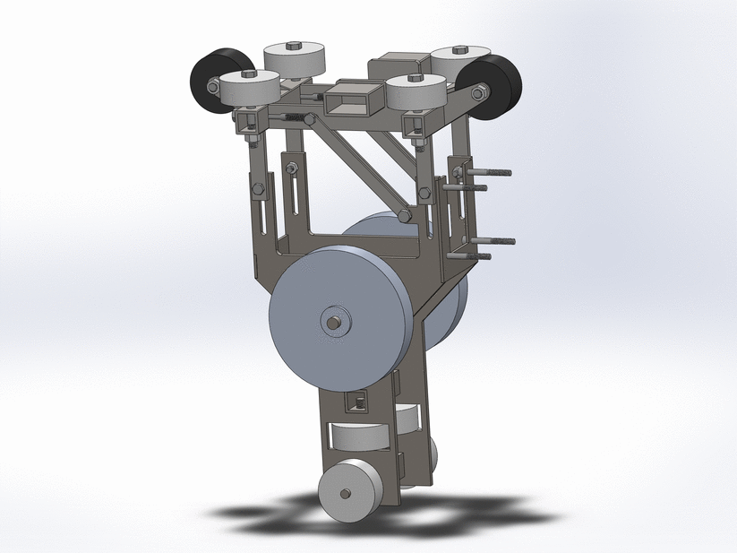
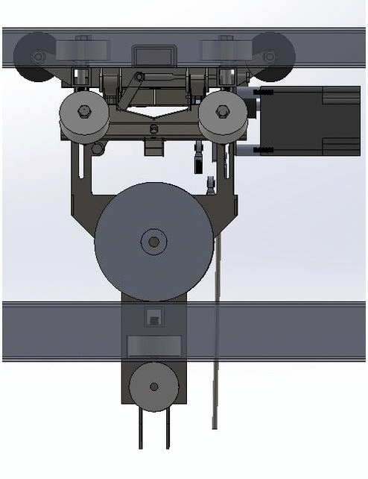
A retractable bogie had to be made to make the bogie easier to take off and put on the track.

Slide 11
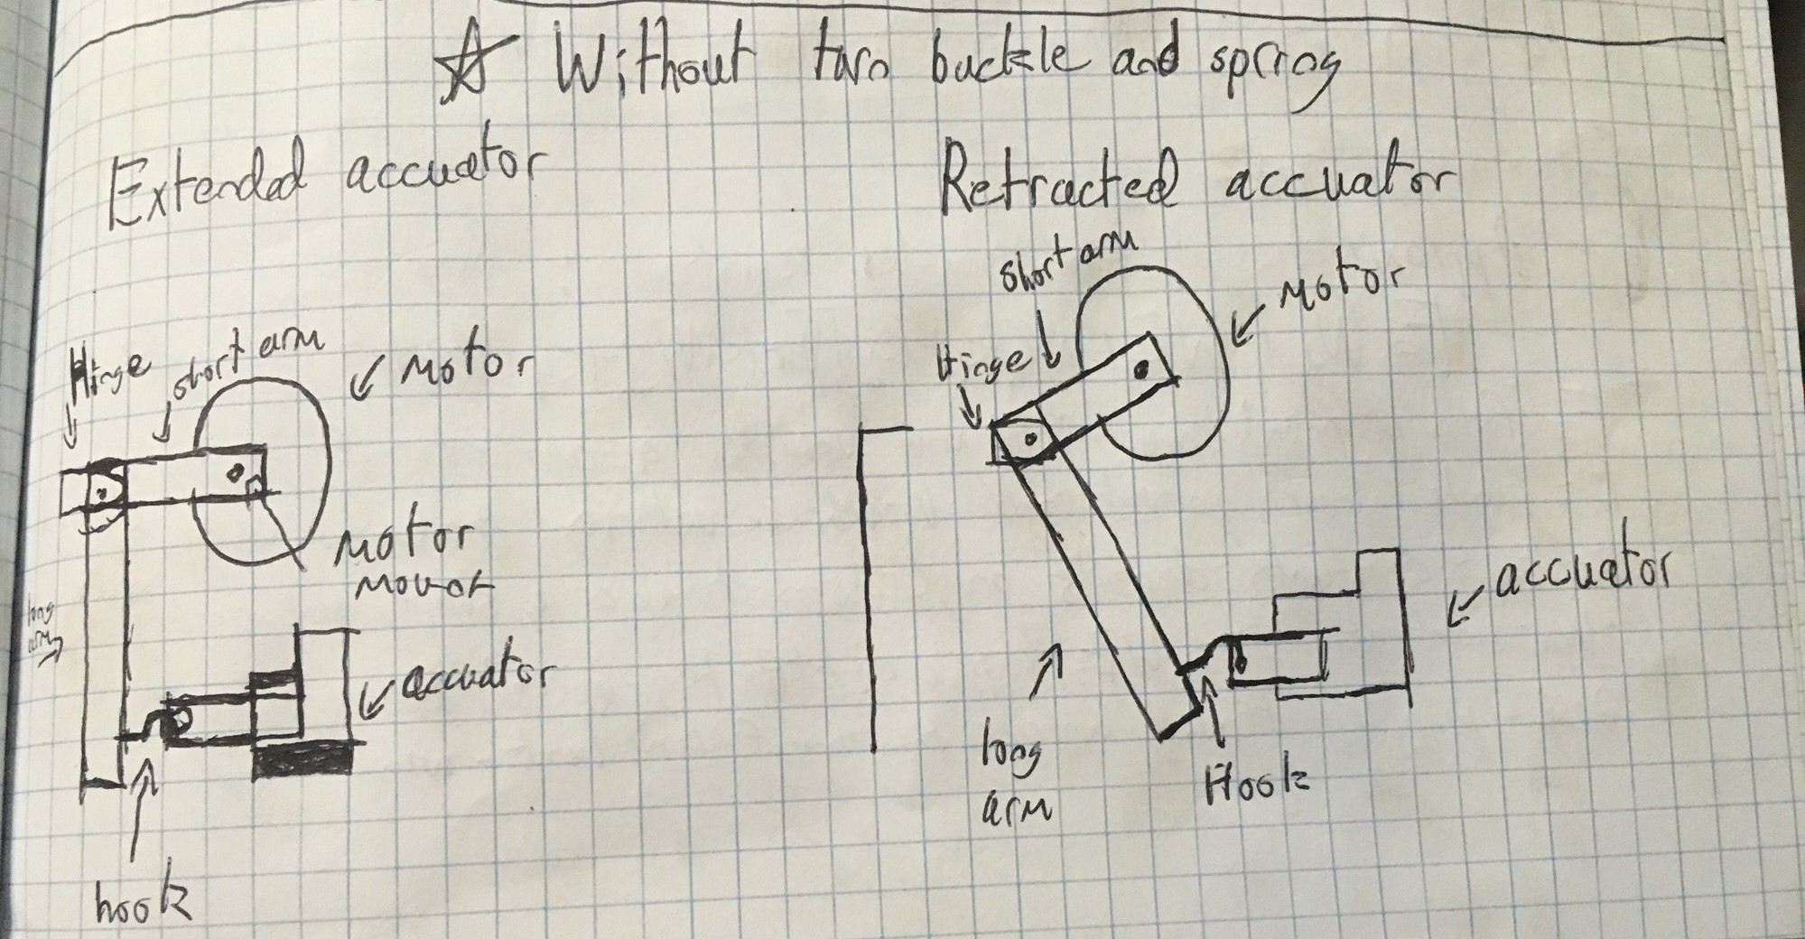
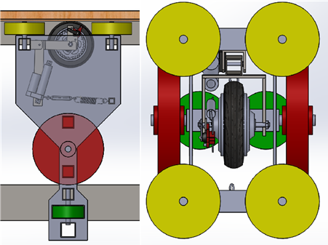
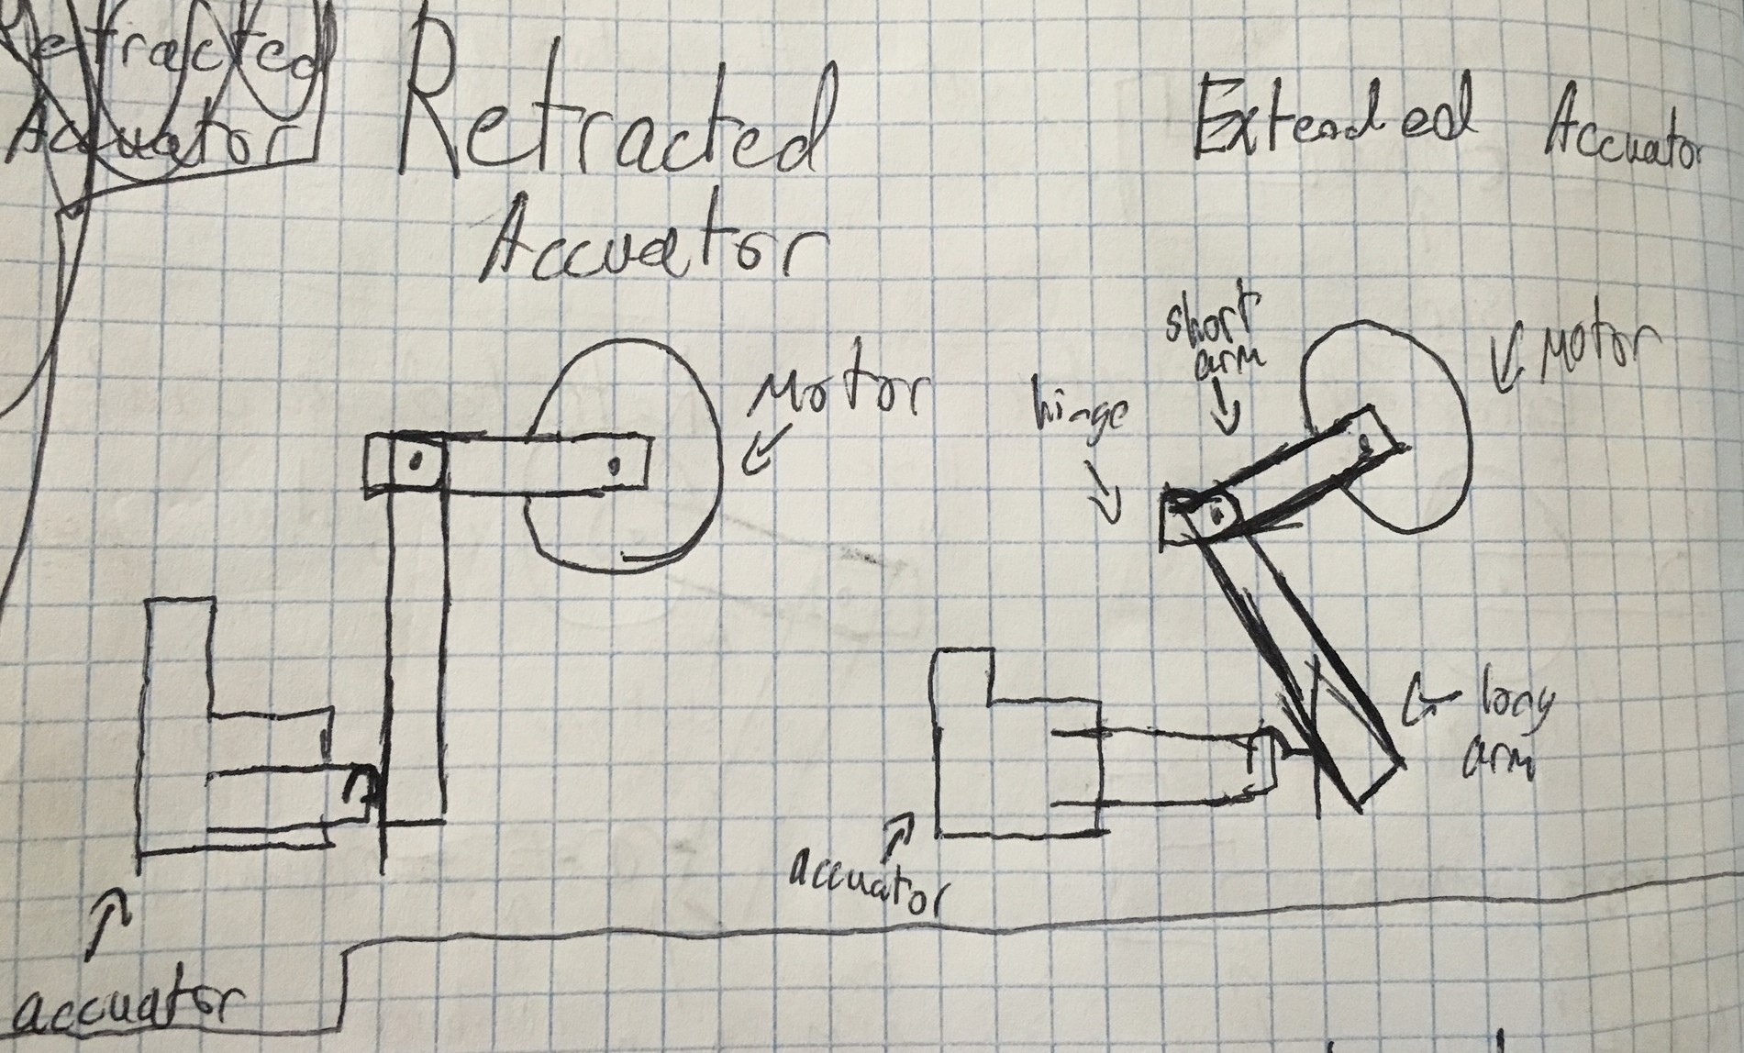
An efficient propulsion system is essential in moving the podcar...
Sketch of Automated version
2014-2015 Bogie Team’s Propulsion Design
Reversed Version depending on dimension constraints

Slide 12
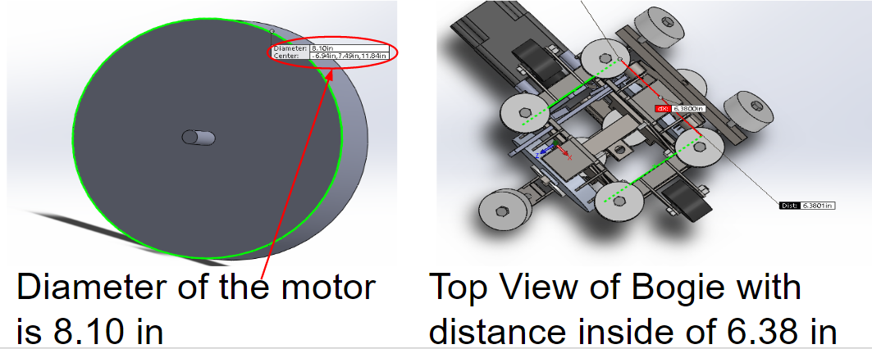
Our plan for the propulsion system had to be revised...

Slide 13
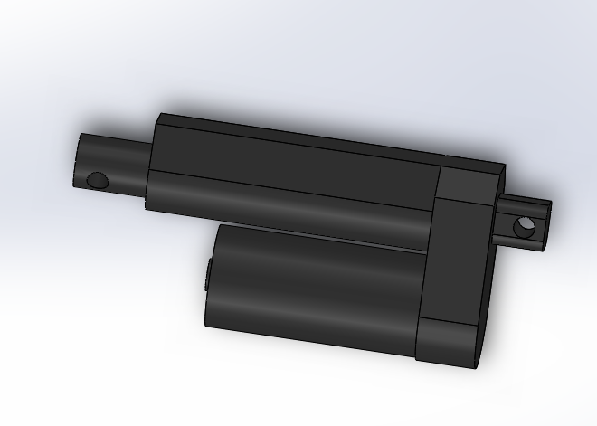
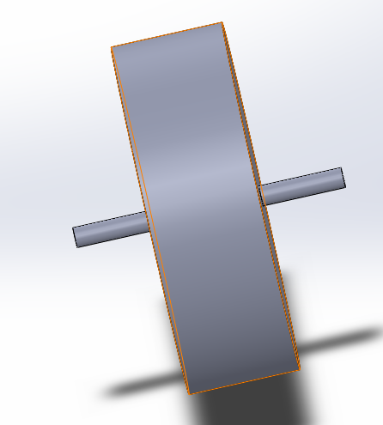
A model of the actuator and the motor that we were given had to be made...

Slide 14
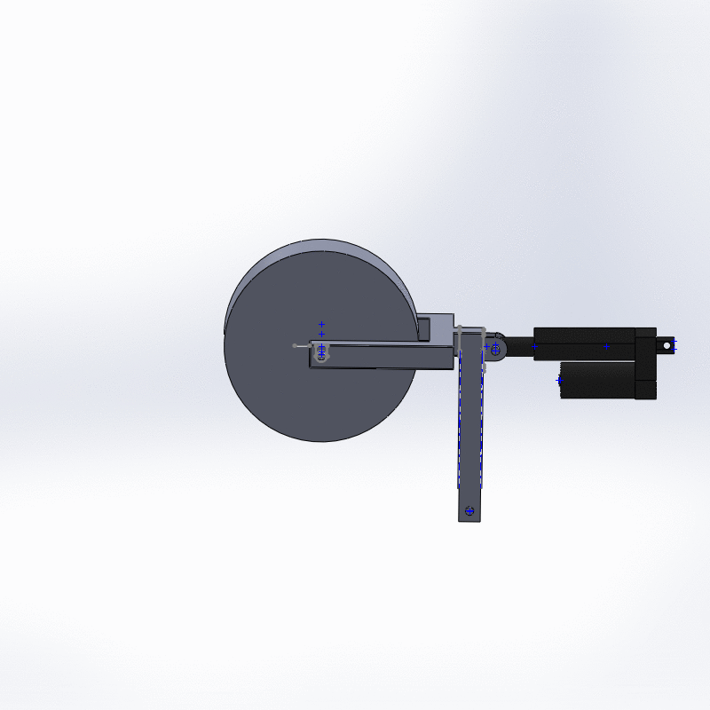
The previous mechanism was used with the new plan...

Slide 15
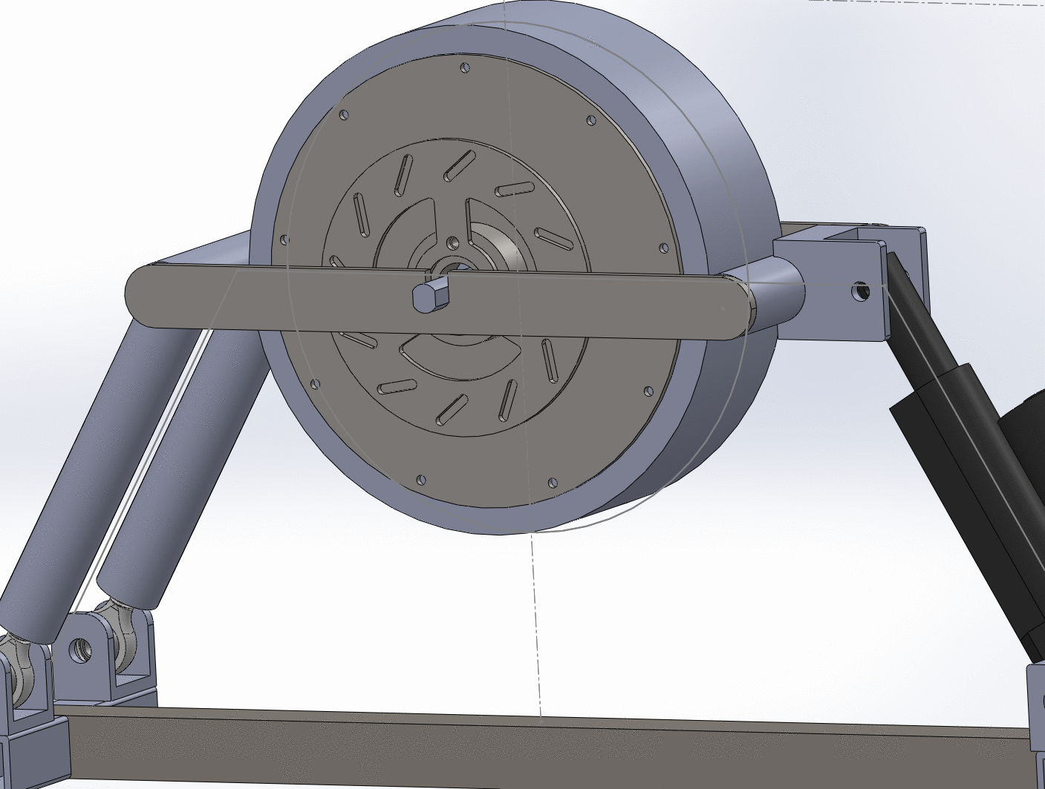
A new mechanism was implemented with the new plan...

Slide 16
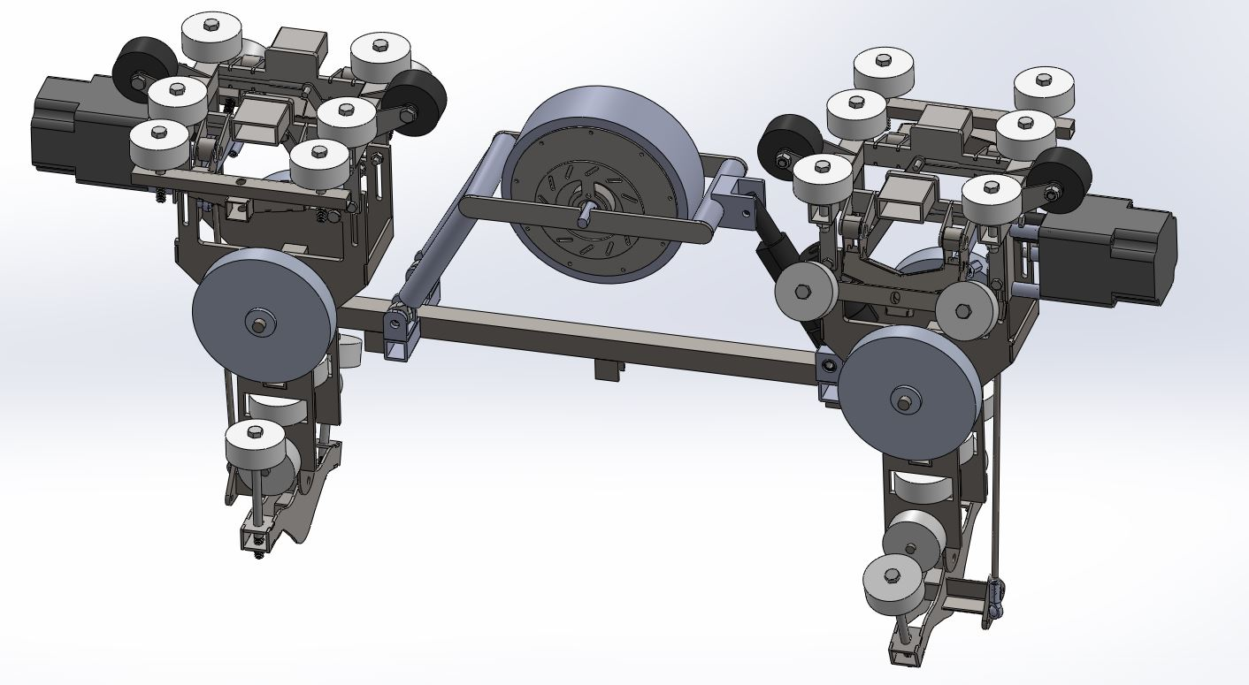
The propulsion system had to be assembled onto the bogie

Slide 17
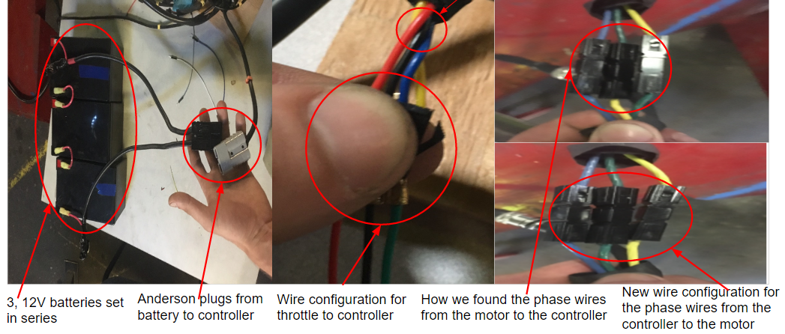
To develop a working control system it is crucial to understand how it works...

Slide 18
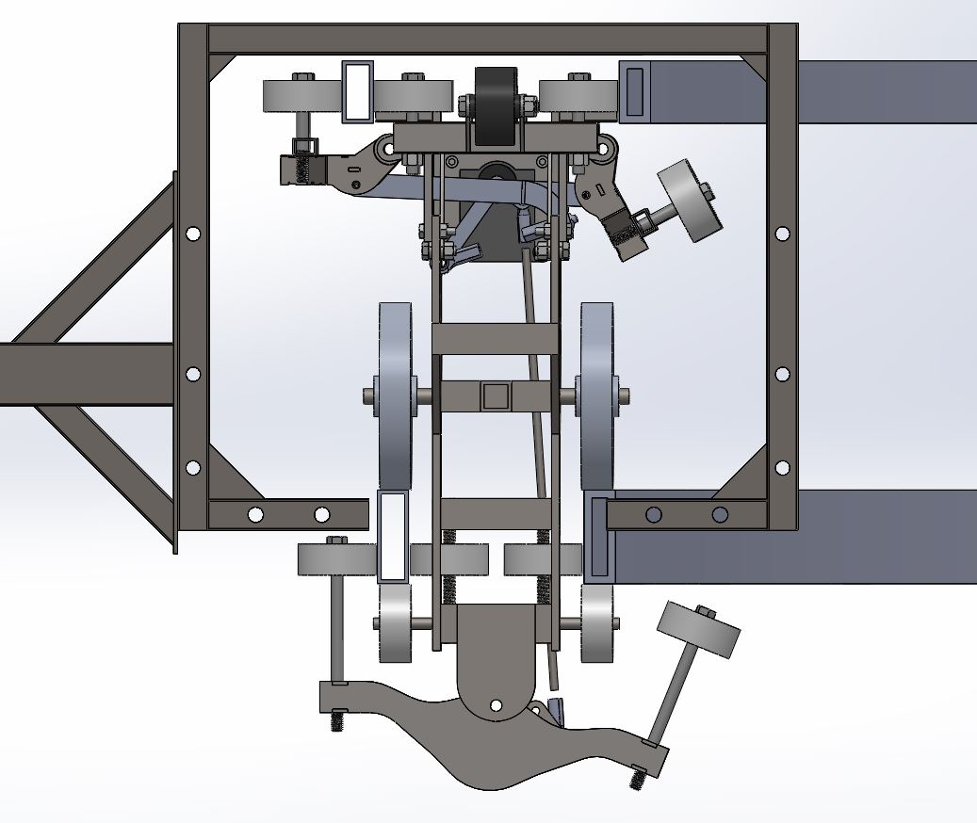
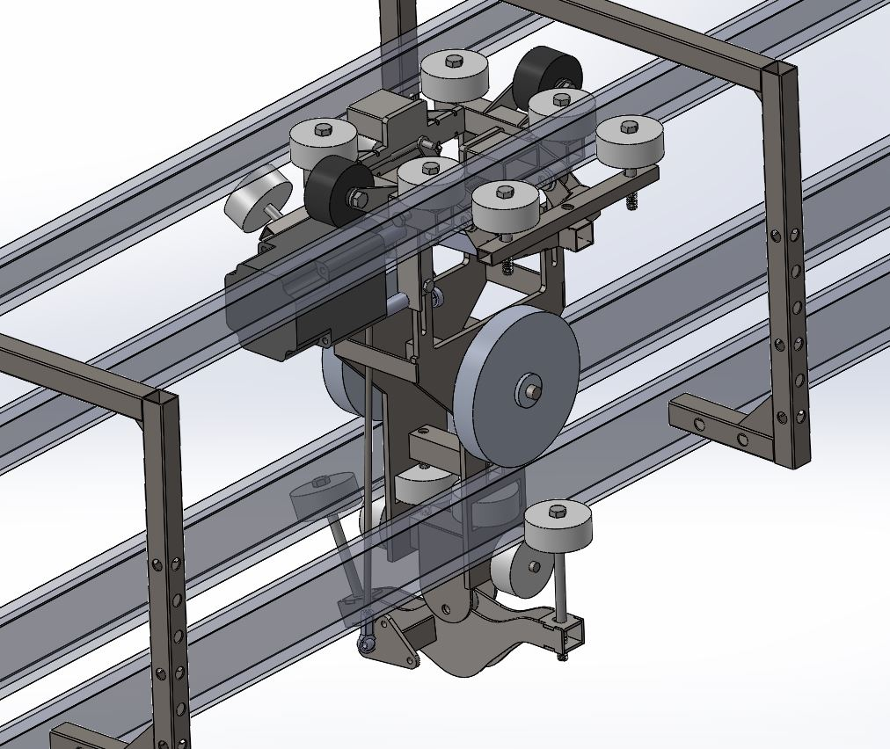
The final design of the half bogie had to be assembled on track

Slide 19
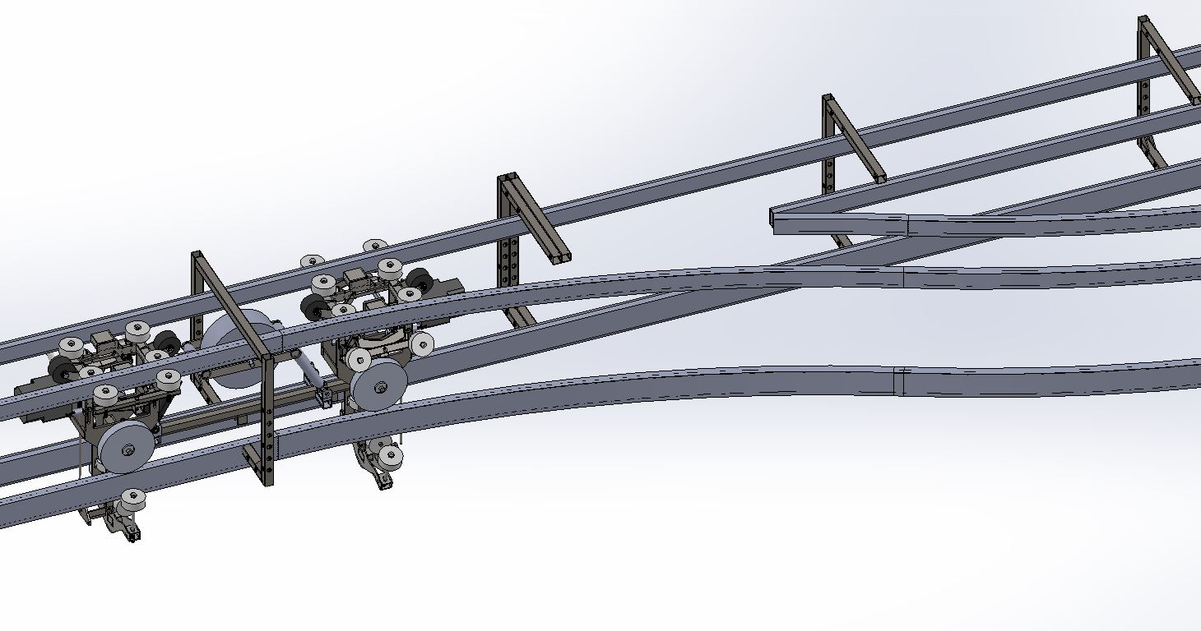
The final design of the full bogie had to be put on the track

Slide 20
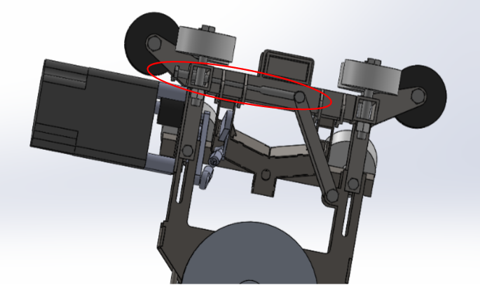
The jack system failed due to the difficulty to fabricate and the durability after fabrication
Bolt hole that caused the jack system to be a failure
Air piston would be used for jack system inside each half bogie

Slide 21
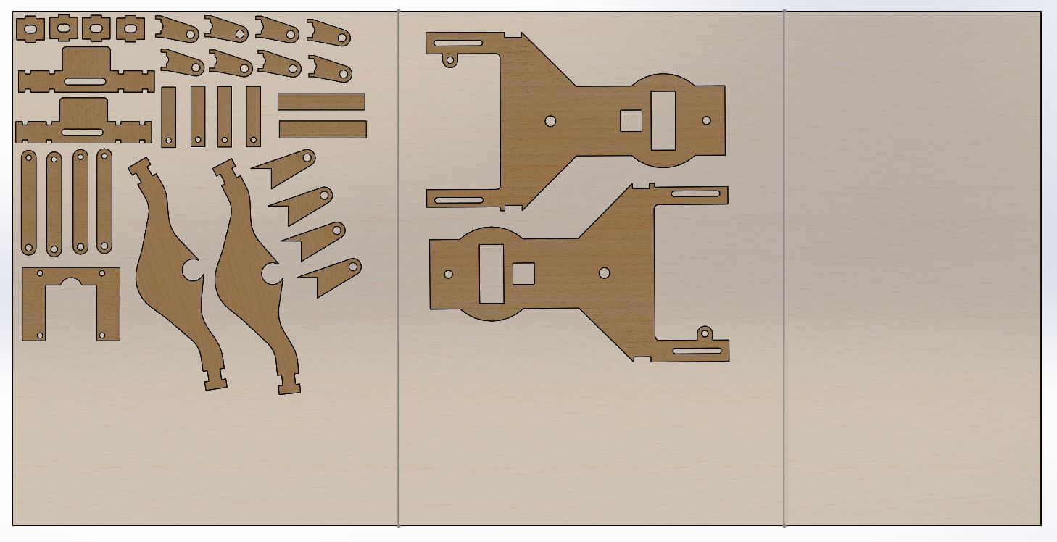
The model would have been made out of wood if there was more time

Slide 22
Thank you for paying attention

