Slide 1
Solar Energy Analysis

Slide 2
Introduction
Spartan Superway Solar Analysis Team Members:
Ali Gharakhani
David Torres
Uday Ranjeet
Justin Dixon
Suraj Thapa

Slide 3
Contents
Introduction
Background
Objective
Methodology
PVWatts Positioning Analysis
Vehicle Energy Requirements
System Solar Panel Requirements
Total Energy Capability
Conclusion

Slide 4
Background
Sustainable Mobility System for Silicon Valley (SMSSV), otherwise known as Spartan Superway, is an interdisciplinary project from San Jose State University to design a PRT (Personal Rapid Transport) system using renewable resources
The objective of the Spartan Superway is to address the following transportation issues:
Traffic congestion
Loss of productivity from time spent in commuting and/or parking
Continued use of and dependence on hydrocarbon fuels
Increased possibility of accidents that injure people and damage property
Environmental degradation from greenhouse gas emissions and by products from wear out of parts

Slide 5
Solar Analysis Objectives
Provide analysis on the power collection capabilities
Determine the mounting angle that will provide maximum annual energy output
Determine the number of solar panels per length of track required
Determine power and energy requirements for a battery system
For this analysis the following assumptions were considered:
Nominal Speed= 50 Miles/hr
Acceleration= 0.5g
Vehicle weight including passengers=1900 Kg

Slide 6
Methodology
PVWatts was used to determine the optimal tilt angle
Force and energy calculations were used to determine the number of solar panels required to operate at constant speed
Acceleration energy and max power output was calculated to determine battery requirements
A “2 to 1 spacing ratio” was used to determine the maximum number of panels that can be positioned along the track

Slide 7
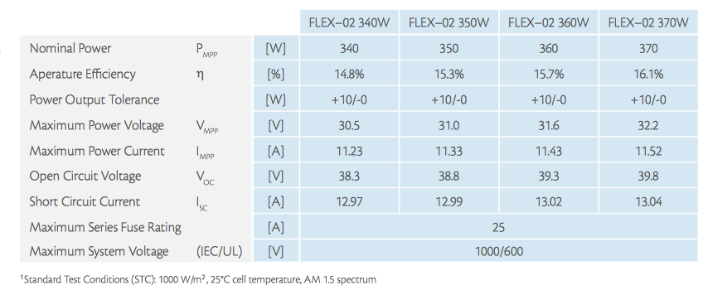
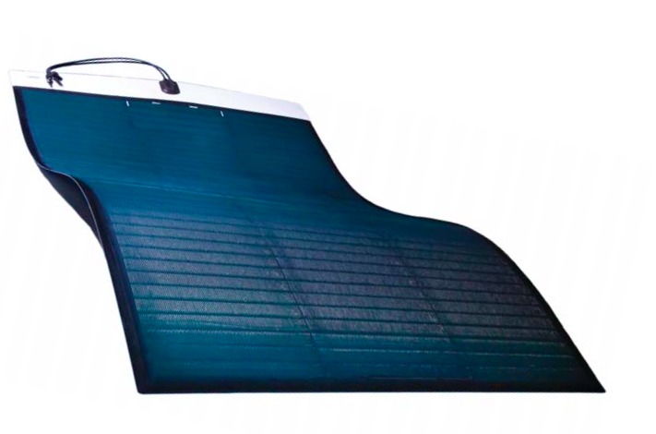
Solar Panel Specs
Type: FLEX -02 340 W

Slide 8
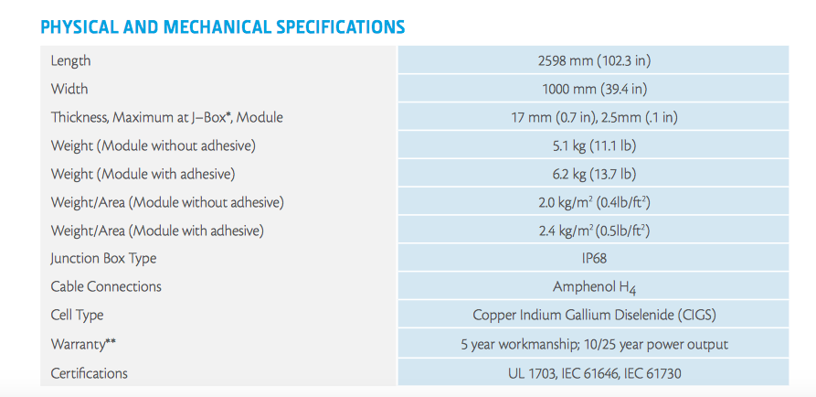
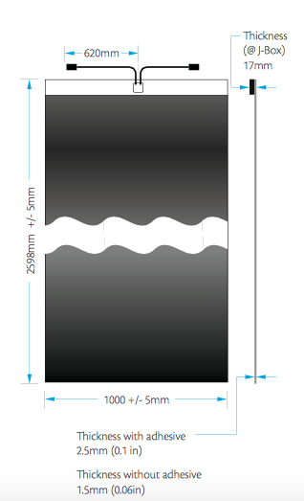
Solar Panel Specs Cont’d

Slide 9
PVWatts Positioning Analysis
The above chart was composed using the PVWatts tool at PVWatts.NREL.gov. The website uses TMY3 data to calculate direct, diffuse and ground irradiance and outputs the daily output averaged over the period of one year. By inputting an array of azimuth and tilt angles it was possible to determine which azimuth and tilt generates the most energy over the period of one year.

Slide 10
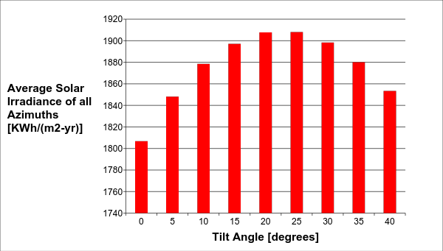
Optimal Tilt Angle (TMY3)

Slide 11
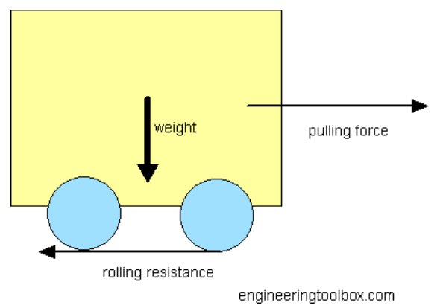
Vehicle Energy Requirements – Rolling Resistance
The rolling resistance can be expressed as
F_{r} = c W/r
where
F_{r} = rolling resistance or rolling friction
W = weight of the body
c_{l} = rolling resistance coefficient with dimension length r = radius of wheel
Constants used |  |  | Result
# of wheels | 4 |  | Fr [N] | 147
CI [m] | 3.00E-04
Mass w/ passengers[kg] | 1900
radius [in] | 6

Slide 12
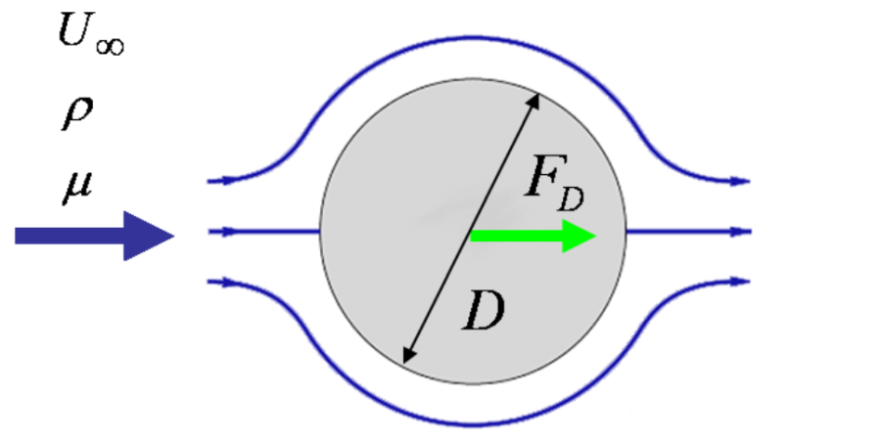
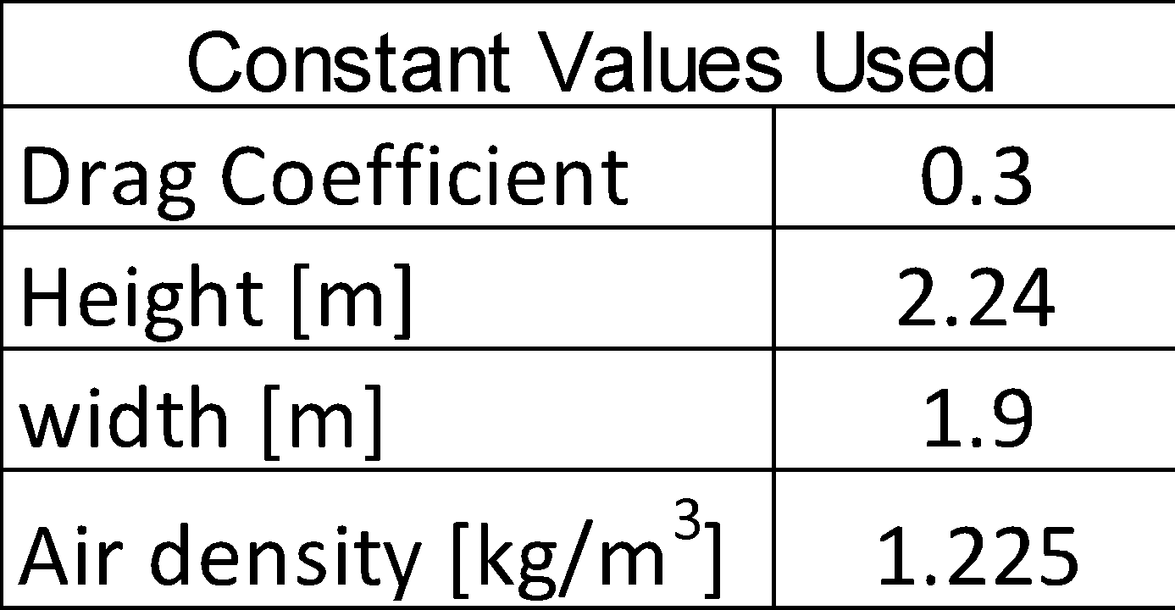
Vehicle Energy Requirements – Drag Force
Drag force can be expressed as:
F_{d} = μ 1/2 ρ U² A
where
F_{d} = drag force
μ = drag coefficient
ρ = density of fluid
U = flow velocity
A = characteristic frontal area of the body
Single Cabin Results
V [mph] | Fd [N]
5 | 2.5
10 | 9.9
20 | 40
30 | 89
40 | 159
50 | 248

Slide 13
System Solar Panel Requirements
V [mph] | Time to move 1km (s) | Energy Produced per Panel (J) | Total Energy Required (J) | Total Power Required (W) | # of panels needed per km to operate 5.5 hrs per day
5 | 447 | 152021 | 149242 | 334 | 1
10 | 224 | 76010 | 156679 | 701 | 3
20 | 112 | 38005 | 186423 | 1668 | 5
30 | 75 | 25337 | 235997 | 3167 | 10
40 | 56 | 19003 | 305401 | 5464 | 17
50 | 45 | 15202 | 394634 | 8826 | 26
The number of solar panels required to move the cabin was calculated using the following three step process:
Calculate the time required to move the cabin 1 km at the given velocity
Calculate the amount of energy produced by a single panel in that amount of time
Using the amount of energy required, the time available and the amount of energy produced by a single panel, calculate the number of panels required

Slide 14
Vehicle Energy Requirements – Acceleration Force
acceleration (m/s2) |  |  | 4.905
total drag force energy (J) |  |  | 6180
total rolling resistance energy (J) |  |  | 7289
total acceleration energy (J) |  |  | 462835
total energy during acceleration to 50 mph (J) |  |  | 476304
max power dissipated during acceleration to 50 mph (kW) |  |  | 212
max power dissipated during acceleration to 50 mph (hp) |  |  | 284
The amount of energy required during an acceleration of 0.5g up to 50 mph was calculated by discretizing time and calculating the energies required to overcome drag force, rolling resistance and inertial forces for each incremental time step.
From this calculation we can determine the energy and power output required for a battery that would be used to provide power to the vehicle during acceleration .

Slide 15
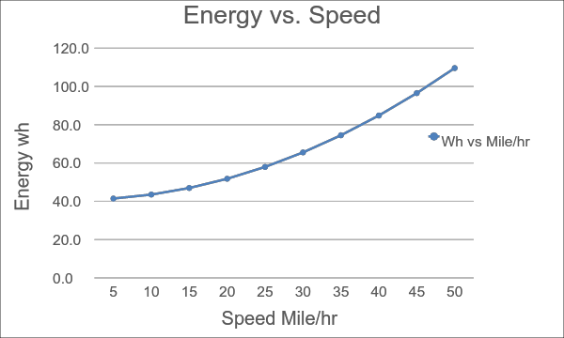
Results
The above graph shows the amount of energy required to move the vehicle at constant velocity

Slide 16
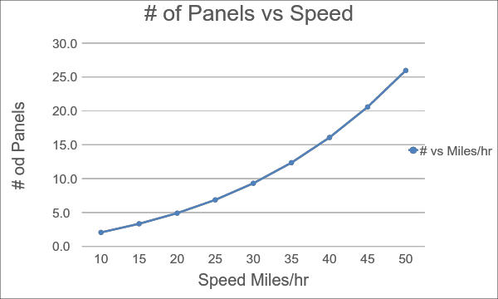
Results
The above graph shows the number of panels required to move the vehicle at constant velocity

Slide 17
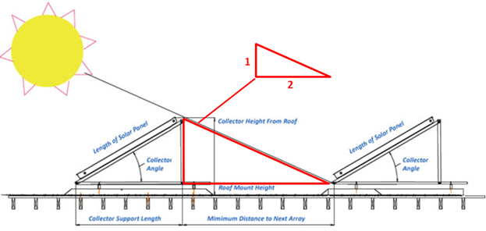
Total Energy Capability
Using a 2 to 1 spacing to height ratio, the maximum number of panels that can be included in a 1 km length is 1,234 panels. This number of panels can produce 2,308 kWh of DC energy per day on average.

Slide 18
Conclusion
The best azimuth for year round energy production considering all azimuths in San Jose is 20 degrees
Given the current dimensions, weight and rollers on the vehicle, a total of 8.8 KW are required to move each vehicle at 50 mph. At peak sun output, it would require 26 panels to achieve this power which means that for every 5.5 hours of desired operation per day 26 panels would need to be placed per km, not considering acceleration energy requirements
The maximum power output required by a battery to accelerate the vehicle up to 50 mph at 0.5g is 212 kW
The total energy output required for acceleration is 476 kJ (or 0.13 kWh)
With the current panels selected, and adequate spacing, the maximum energy output capability is 2308 kWh/day

Slide 19
References
https://www.freehotwater.com/solar-calculators/
http://miasole.com/uploads/media/FLEX-02W_Datasheet_1.pdf
www.engineeringtoolbox.com
http://pvwatts.nrel.gov/

