Slide 1

FINAL PAPER
Performance and financial analysis of solar photovoltaics systems
Elvis Falcão de Araújo

Slide 2
CONTENTS
Objective
Solar Energy: motivation
Solar Energy: limitations
Types of Solar Energy
ATN and Spartan Superway
Drawings
Simulations
Results
Conclusion

Slide 3


Objective
Project and evaluate main characteristics of solar energy collection systems to be installed in San José State University Spartan Superway Project.
Input parameters: local irradiance, system performance, electric load, system costs, taxes, federal and state investiments, electricity rates.

Slide 4
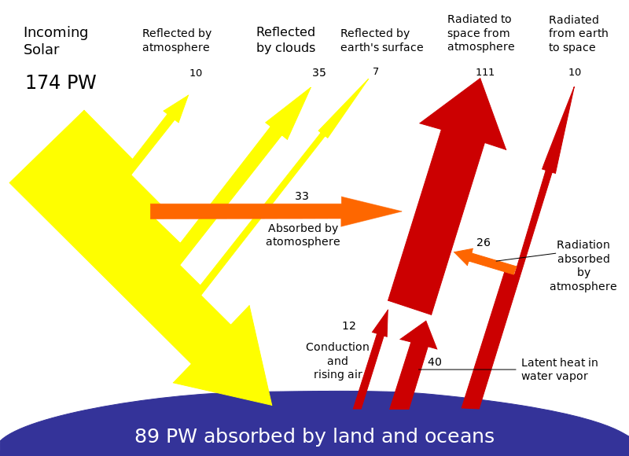

Solar Energy: Motivation
Solar radiation at Earth`s upper surface: 174000 terawatts.
Mean extraterrestrial irradiance normal to the solar beam: 1,35 kW/$m^{2}$

Slide 5
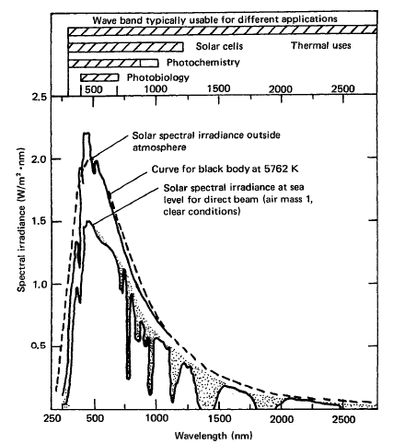

Slide 6
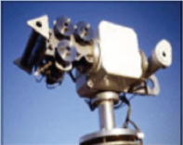
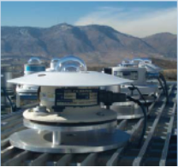
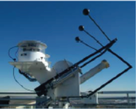
Types of radiation:
Direct (beam), measured by a pyrheliometer
Diffuse, measured by a shaded pyranometer under a tracking ball
Global, measured by a pyranometer
Reflected

Slide 7
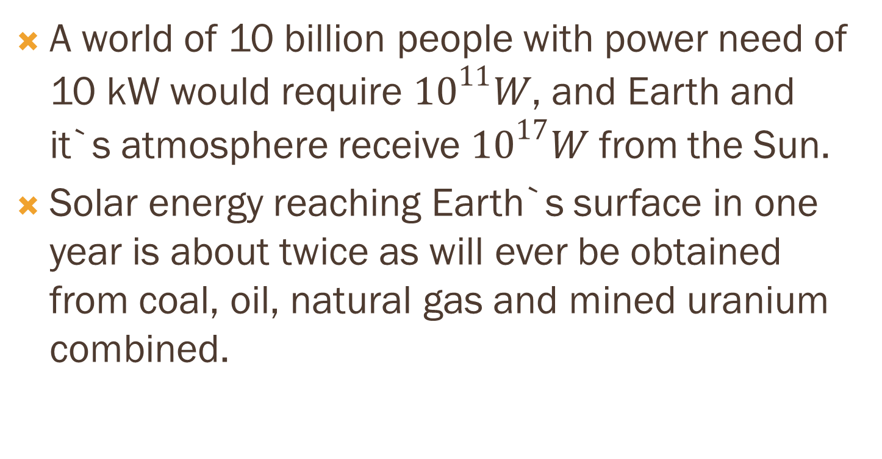
A world of 10 billion people with power need of 10 kW would require ${10}^{11}W$, and Earth and it`s atmosphere receive ${10}^{17}W$ from the Sun.
Solar energy reaching Earth`s surface in one year is about twice as will ever be obtained from coal, oil, natural gas and mined uranium combined.

Slide 8
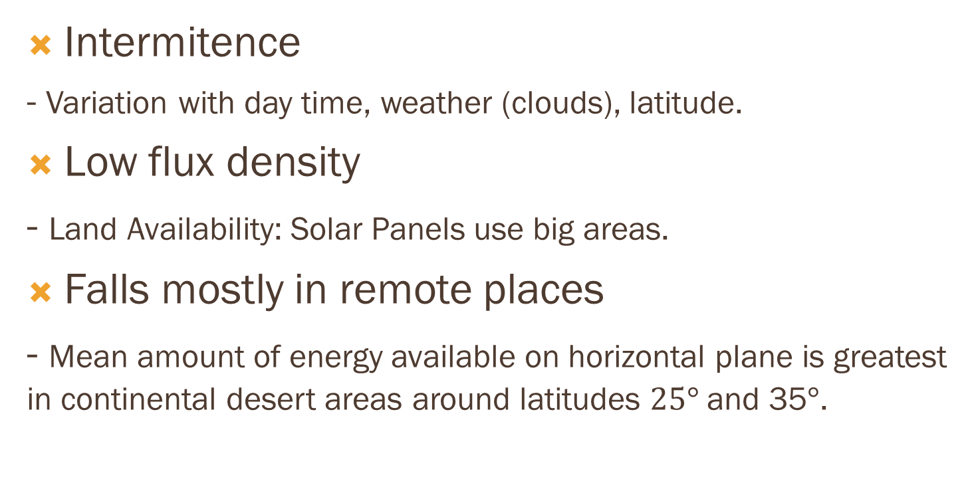
Solar Energy: limitations
Intermitence
- Variation with day time, weather (clouds), latitude.
Low flux density
- Land Availability: Solar Panels use big areas.
Falls mostly in remote places
- Mean amount of energy available on horizontal plane is greatest in continental desert areas around latitudes $25°$ and 35$°$.

Slide 9
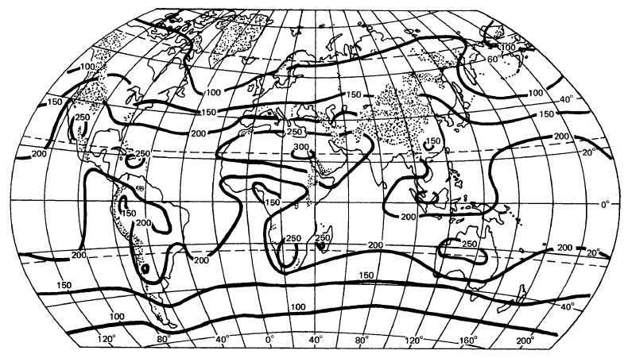

Slide 10
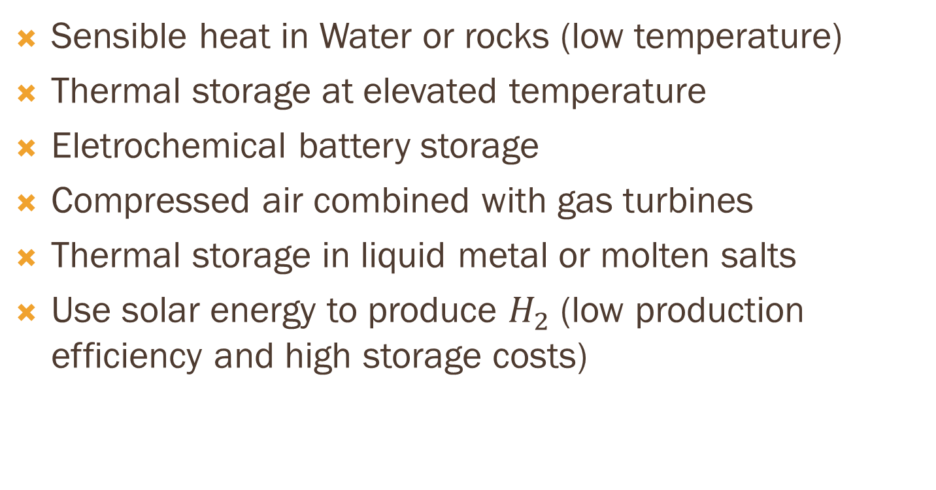
Storage means:
Sensible heat in Water or rocks (low temperature)
Thermal storage at elevated temperature
Eletrochemical battery storage
Compressed air combined with gas turbines
Thermal storage in liquid metal or molten salts
Use solar energy to produce $H_{2}$ (low production efficiency and high storage costs)

Slide 11
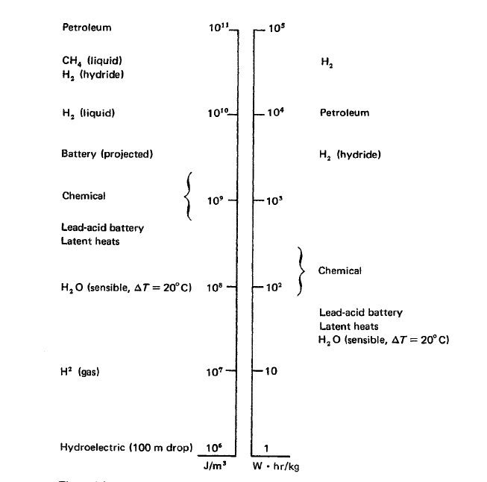

Slide 12
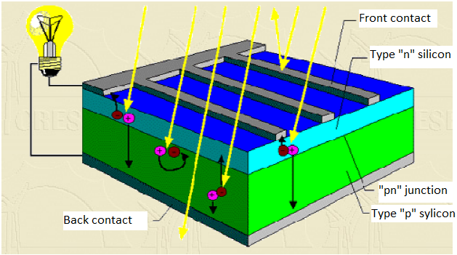
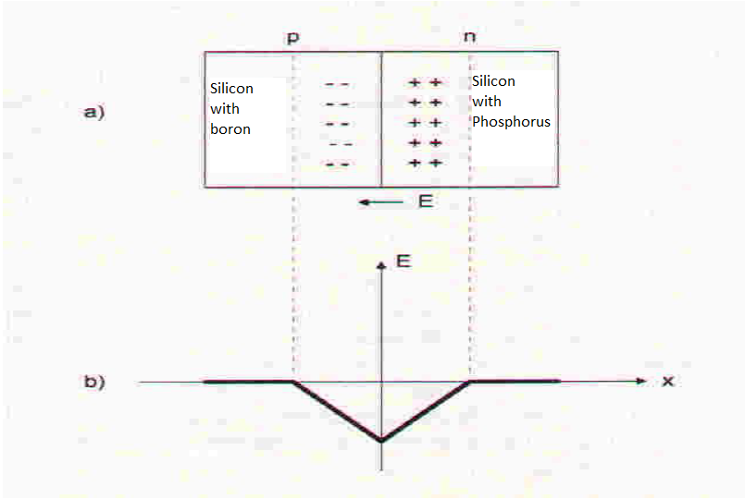
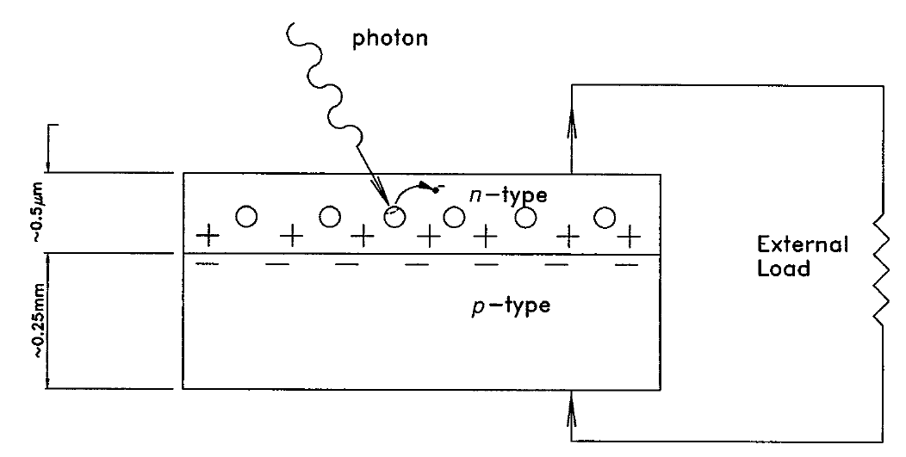
Types: Photovoltaics
PN junction and the photovoltaic effect

Slide 13
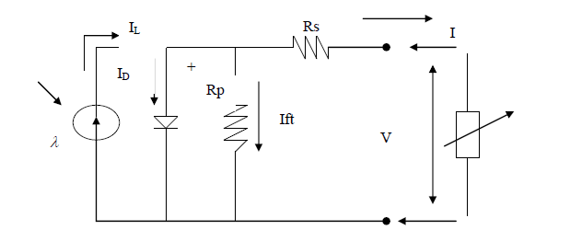

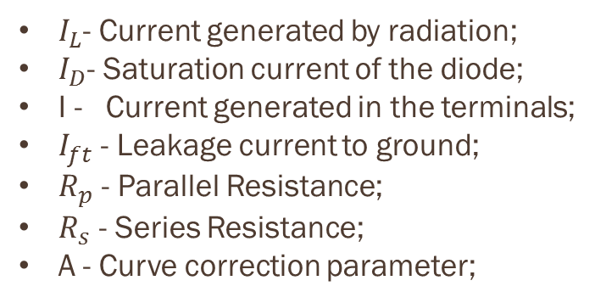
One diode electrical model of a PV cell
$I_{L}$- Current generated by radiation;
$I_{D}$- Saturation current of the diode;
I - Current generated in the terminals;
$I_{ft}$ - Leakage current to ground;
$R_{p}$ - Parallel Resistance;
$R_{s}$ - Series Resistance;
A - Curve correction parameter;

Slide 14
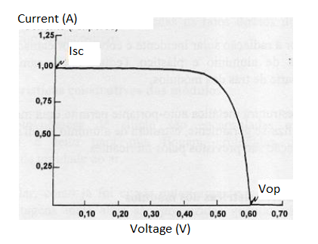
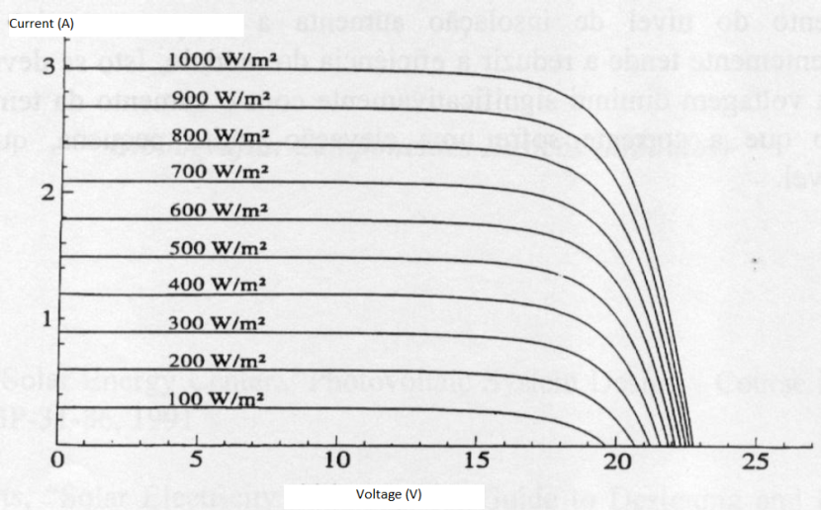

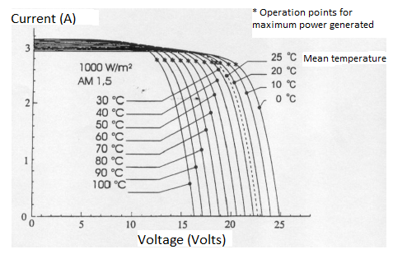


V x I characteristic curve
Dependence with irradiance
Dependence with temperature

Slide 15
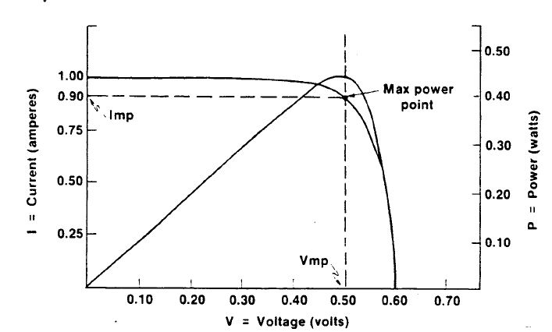
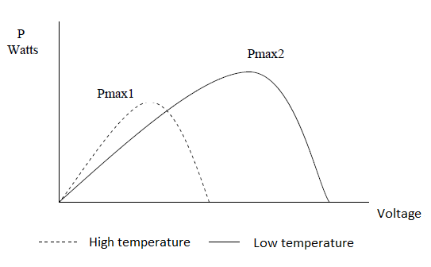

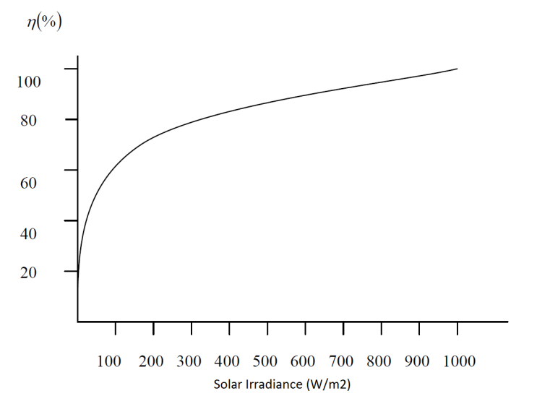

Power Curves
MPPT
Dependence with temperature
Efficiency dependence with temperature
$$η= \frac{P}{IA}$$

Slide 16
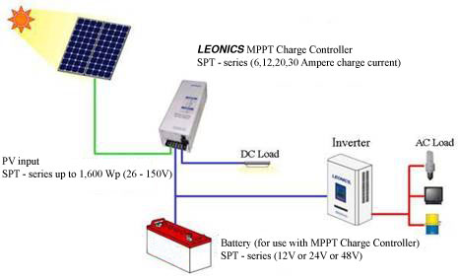
Basic Photovoltaic System

Slide 17
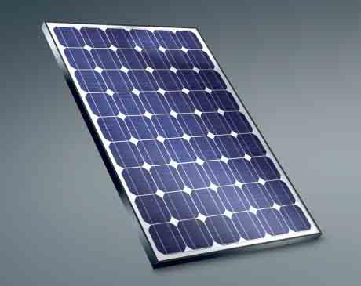
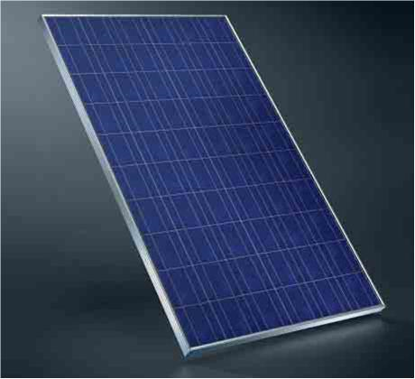
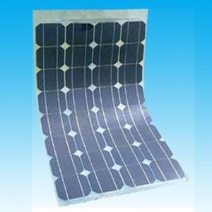
Types of Photovoltaic Modules
Monocrystaline silicon: high-purity silicon, efficiency rate of about 15 to 20%, long life spans, good performance in low conditions and the expensive type.
Polycrystalline silicon: raw silicon poured into a square mold, cheaper than monocrystaline panels and efficiency is typically 13-16%.
Thin film silicon: one or more layers of photovoltaic material deposited onto a substrate. Efficient is about 7-13%. Degrades faster than monocrystaline panels.

Slide 18



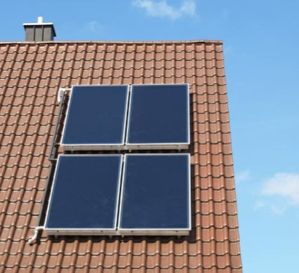
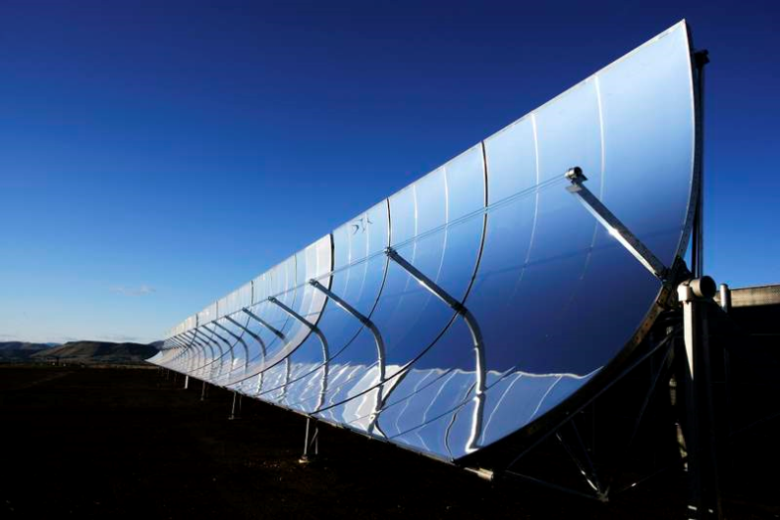
Types: Solar Thermal
Solar Thermal collectors use incident solar radiation to produce heat in a useful temperature. The basic mechanism consists in exposing the collector to solar radiation to heat the fluid inside it.
There are many types of collectors, which can use reflection or refraction of light to concentrate solar radiation and increase solar performance, for example, the parabolic trough concentrator, consisted of a parabolic shaped mirror that concentrates rays into its focus, where the heat transfer fluid flows.

Slide 19
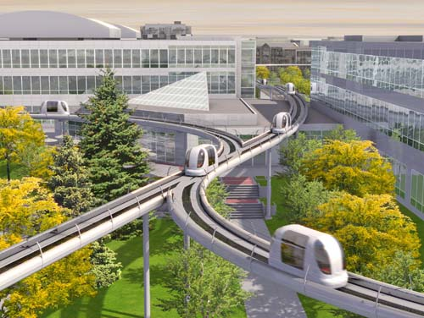
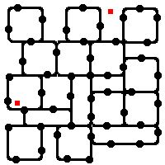
ATN and Spartan Superway
Characteristcs of an Automated Transit Network
Vehicles controlled automatically On-demand service
Non-stop service to the destination
Discrete guideway, separate from the streets.
Guideway Network where the vehicles transport people.
PRT (personal rapid transport) is a subset of ATN with personal transportation and light weight vehicles.

Slide 20
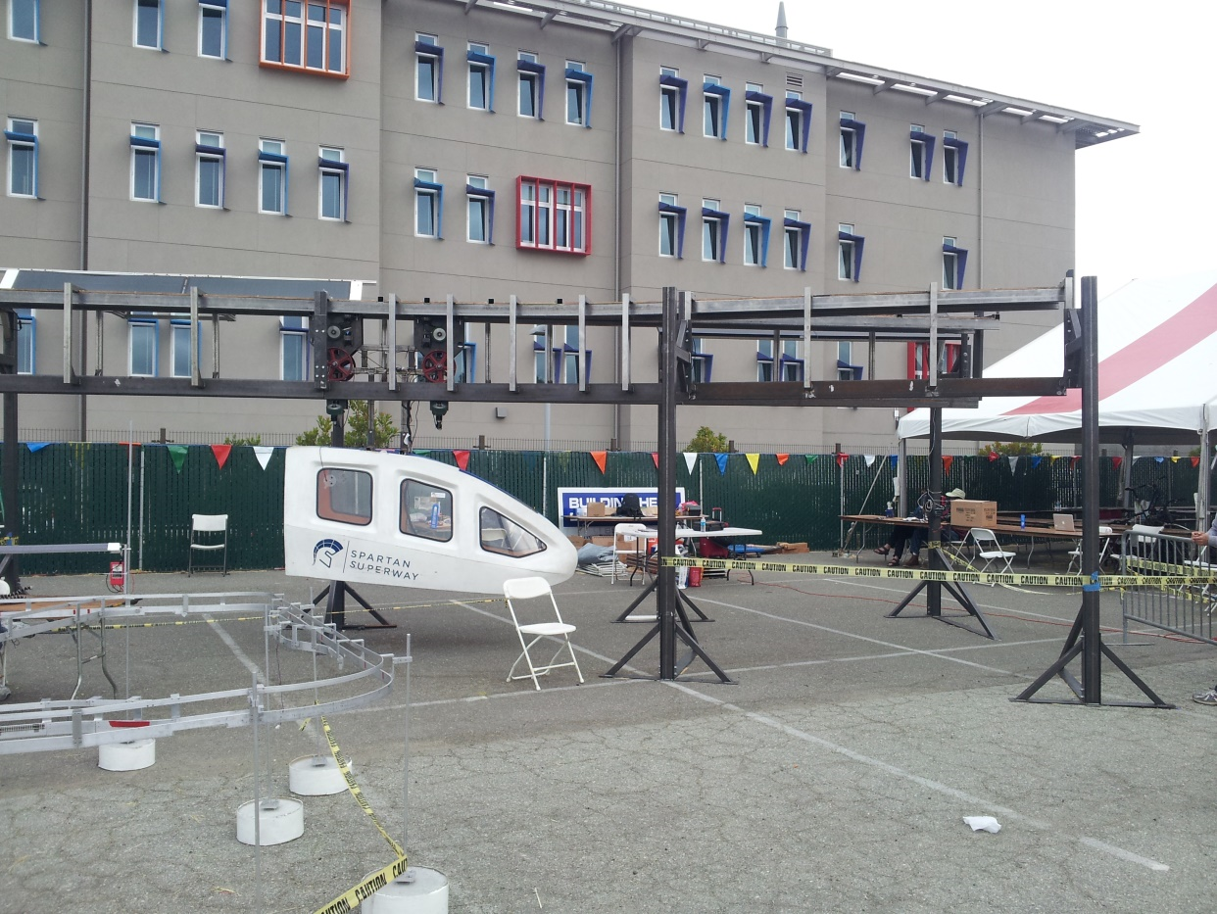
Spartan Superway
Solar powered PRT consisted of a suspended cabin.

Slide 21
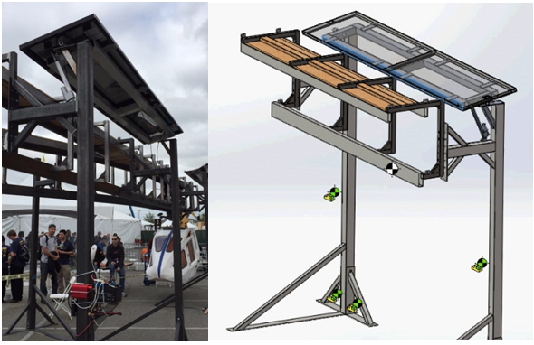
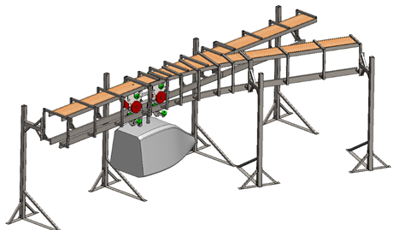
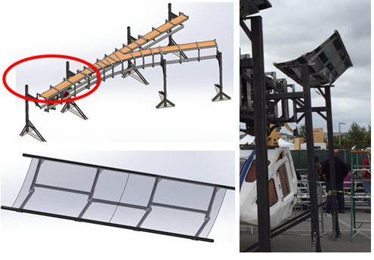
Stion rigid solar panel
SolidWorks Design
Miasole Thin Film Module

Slide 22
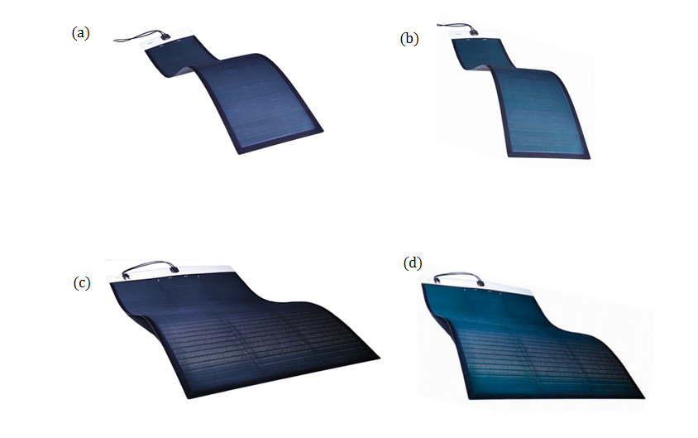
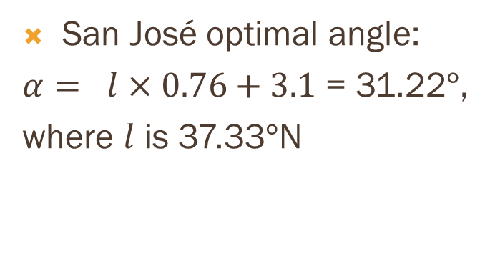
DRAWINGS
Available solar panels (donated):
FLEX-02N - Dimensions: 102.3 in x 14.6 in (a);
FLEX-02NS - Dimensions: 67.8 in x 14.6 in (b);
FLEX-02W - Dimensions: 102.3 in x 39.4 in (c);
FLEX-02WS - Dimensions: 67.8 in x 39.4 in (d);
San José optimal angle:
$α= l×0.76+3.1$ = 31.22$°$,
where $l$ is 37.33$°$N

Slide 23
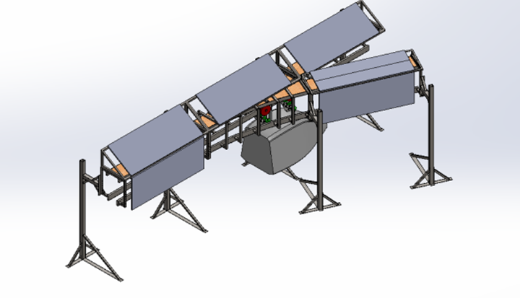
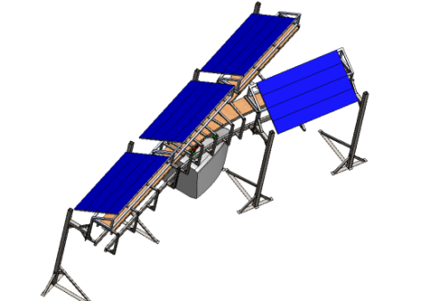
Studied Designs

Slide 24
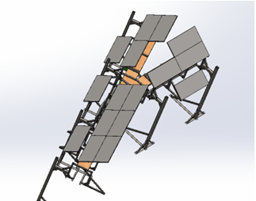
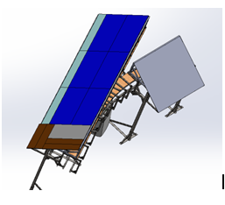
Discarded Designs

Slide 25
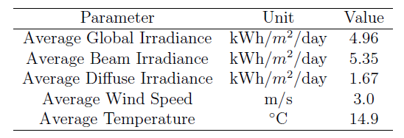
SIMULATIONS
Software used: NREL – System Advisor Model
Financial model used: Commercial System
buy and sell electricity at retail rates and displace purchases of power from the grid.
Location and Resource: San José Int. Airport
Source of weather files: TMY3 (Typical Meteorological Year Version 3)

Slide 26

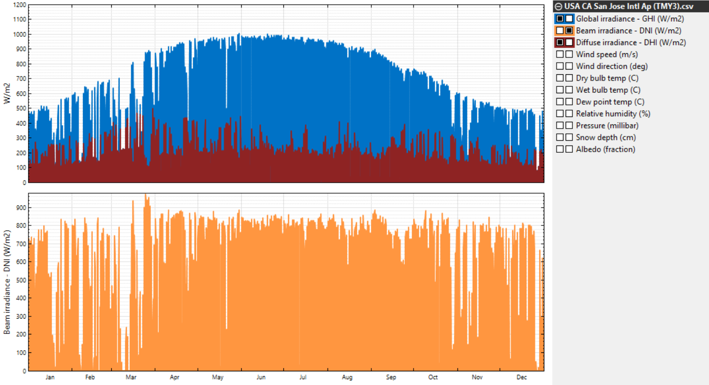

Slide 27
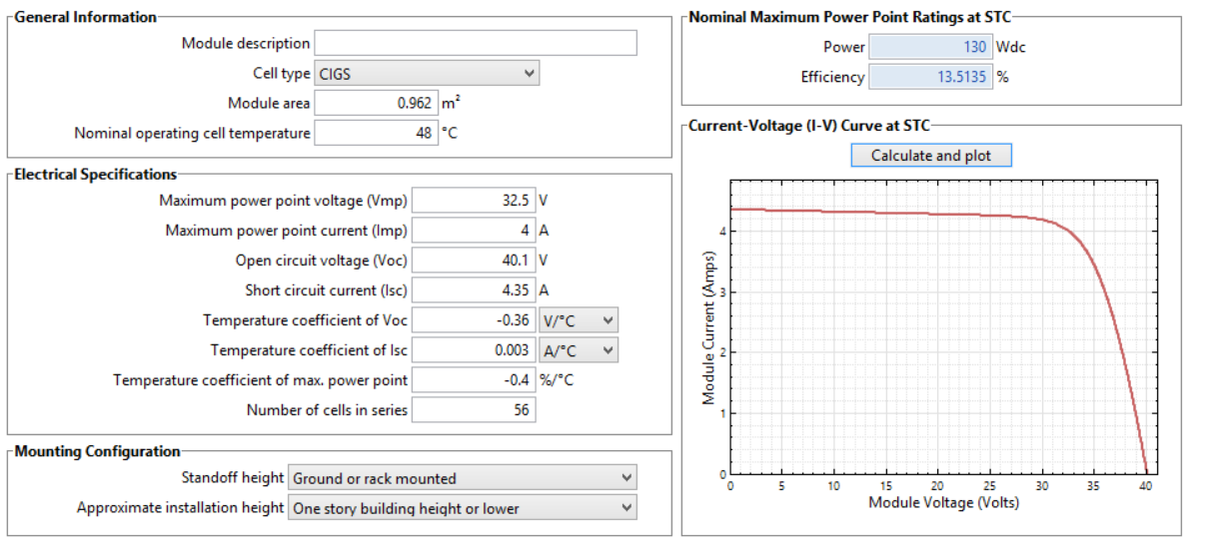

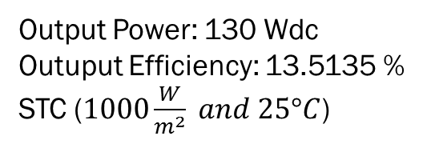

Module characteristics - Solar array 1 - FLEX 02N
$$P=V_{mp}I_{mp}$$
Output Power: 130 Wdc
Outuput Efficiency: 13.5135 %
STC ($1000\frac{W}{m^{2}} and 25°C$)
$$η=P/IA$$

Slide 28
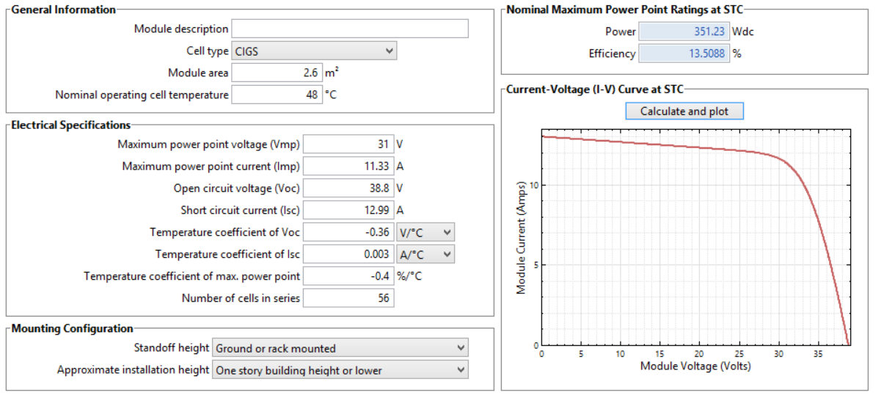
Module characteristics – Solar array 2 - FLEX 02W
Output Power: 351.23 Wdc
Outuput Efficiency: 13.5088 %

Slide 29
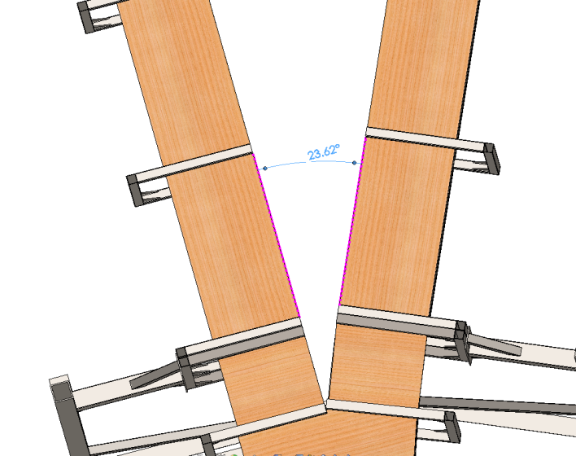
System design

Slide 30
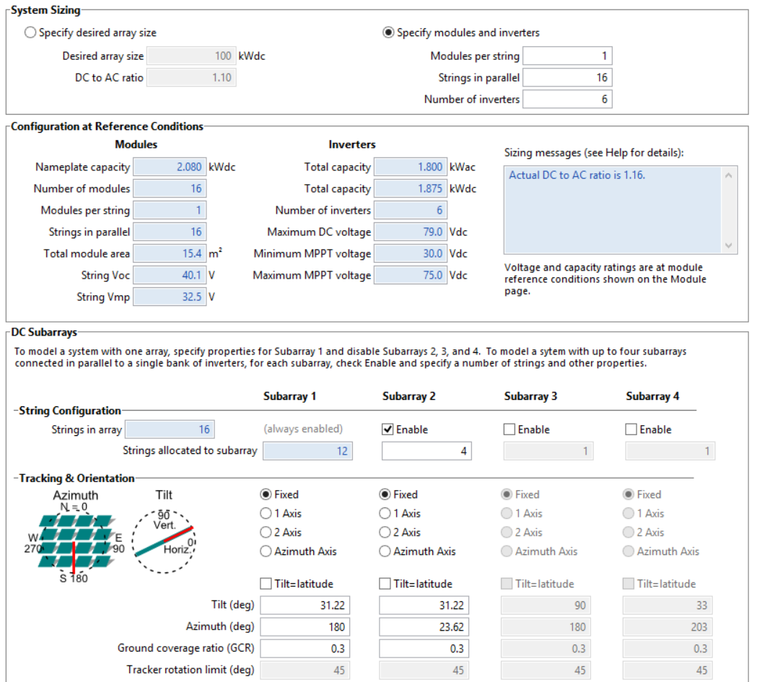







System design characteristics – Solar Array 1
Module
Fvfv
Inverter

Slide 31
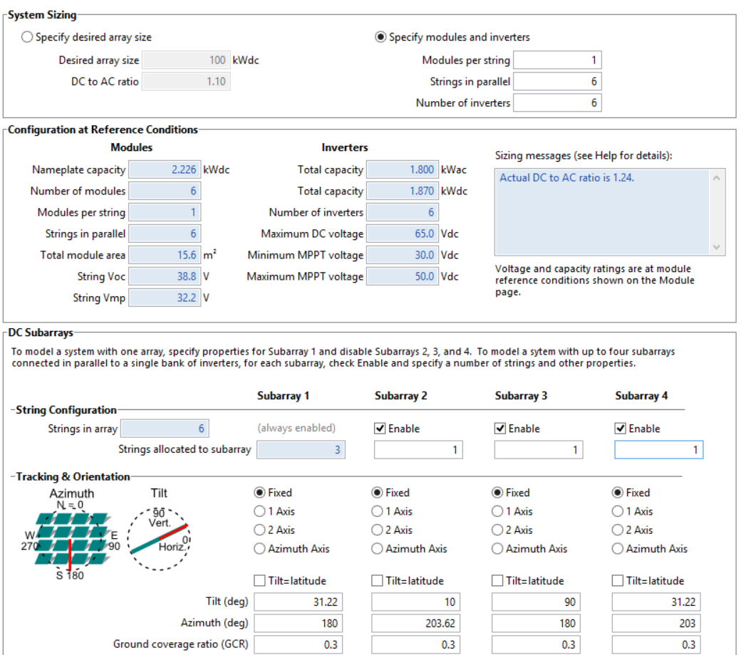
System design characteristics – Solar Array 2
It was not assumed any shading or snow that could affect module performance

Slide 32
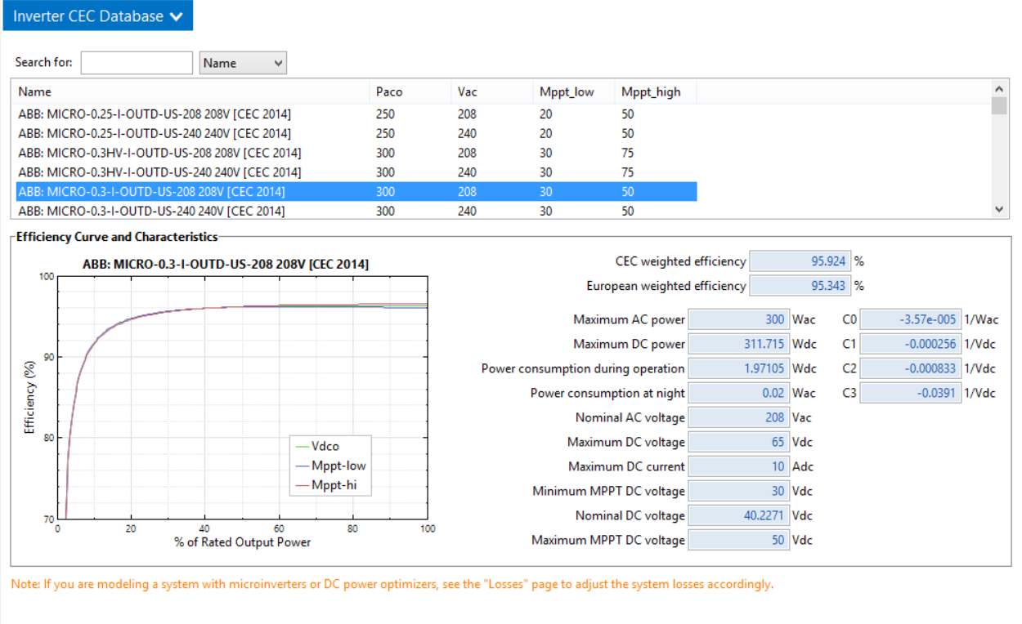
Inverter

Slide 33
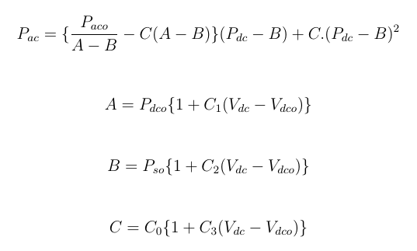

European weighted efficiency
CEC weighted efficiency
Efficiency curve equations
$P_{ac}=AC power output$
$P_{aco} =Maximum AC power$
$P_{dc}=DC power$
$P_{dco}=Maximum DC power$
$V_{dc}=DC voltage$
$V_{dc}=nominal DC voltage$
$P_{so}=Power consumption$
$$during \text{operation}$$
Tests made at 10%, 20%, 30%, 50%, 75% and 100% of ac power rating

Slide 34





Losses and Lifetime degradation
Losses assumed for the model are shown below:
Net DC Power Loss
Net DC Power output
Net AC Power Loss
Net AC Power output
Lifetime degradation assumed: 0.5%/year

Slide 35





Battery Storage – Solar Array 1
Battery Model used:
LG Model ICR18650
B4 2600 mAh

Slide 36

Battery Storage – Solar Array 2

Slide 37


Slide 38

Manual Storage Dispatch Controller

Slide 39

Battery Bank Replacement and Thermal Behavior

Slide 40

System Costs
Total direct cost for Solar Array 1: $6559,33
Total direct cost for Solar Array 2: $6717,96

Slide 41



Financial parameters

Slide 42


Federal and State Tax Rate

Slide 43
Incentive 1: California State Incentive
Property Tax Exclusion for Solar Energy Systems: It is a state implemented property tax incentive that offers 75% of system value exemption for this case of power generation system. For this model, it was considered a maximum amount of $4000.00 incentive. Other eligible technologies are Solar Water Heat, Solar Thermal Electric and Solar Thermal

Slide 44
Incentive 2: USA Federal Incentive
Business Energy Investment Tax Credit (ITC): It is a federal implemented corporate tax credit program that claims a credit of 30% of expenditures for solar systems. It also offers incentives for fuel cells, microturbines, small wind turbines and other technologies. It was considered a maximum amount of $4000.00 incentive for this model.

Slide 45

Electricity Rate

Slide 46

Electricity Load
Estimated Prototype Parameters

Slide 47

Monthly Load

Slide 48

User-entered Load data and Scale load power

Slide 49

User-entered Load data

Slide 50


RESULTS
Solar Array 1
Solar Array 2

Slide 51






Irradiance Calculation
$ρ$ = 0.2 for ground or grass, and 0.8 for snow covered
surface

Slide 52



Slide 53



Slide 54

Cash Flow for Solar Arrays 1 and 2

Slide 55
CONCLUSION
The comparison between the two analysis shows that the solar array 2 is the best choice for the solar system to be installed on the full scale model, because of the better financial and performance parameters. One of the possible reasons for this conclusion is that, in solar array 2, all the modules are facing south, which is the best performance option for solar systems in the North Hemisphere, and solar array 1 has 4 panels facing North. Also, Solar array 2 has less modules than the other one, which decreases possible losses in the subarrays, by various reasons, like wiring, mismatch, nameplate, etc.
SAM offers a lot more information than the showed here, so it is possible to make deeper analysis of the systems.

