Slide 1
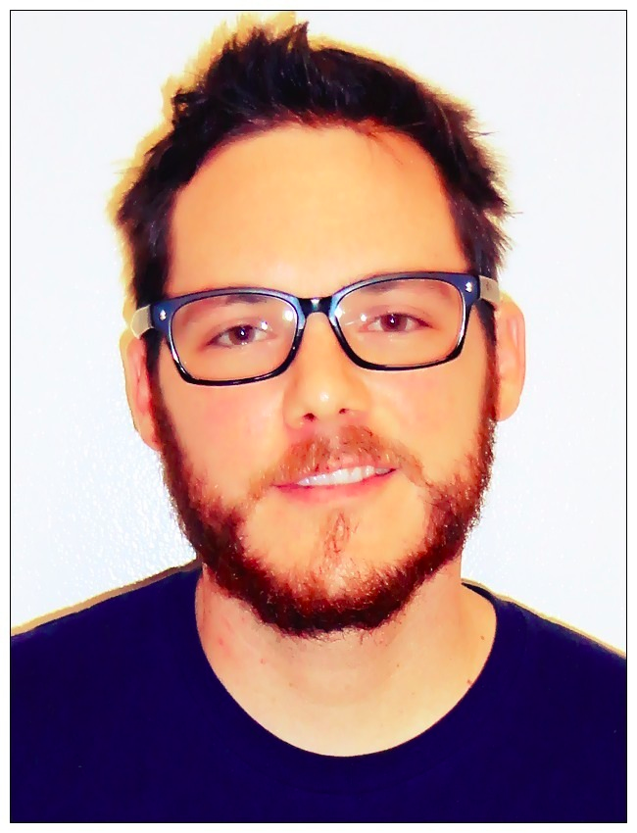
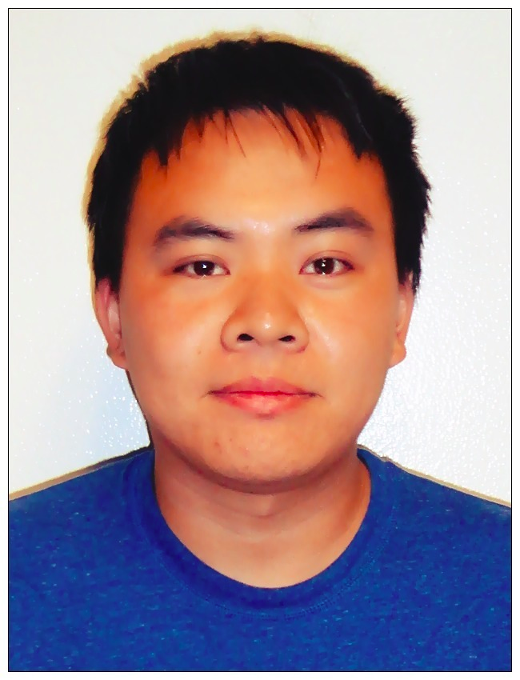
About The Speakers
Jake Pichel | Cheng-Hsien Liu
Notes:
Say thank you
Introduce ourselves
talk about who we are as students
Talk about our role in on the Superway team

Slide 2
Spartan Superway
A solar Powered Transportation Network
Sustainable Transportation Seminar Series
Notes:
Run from Powerpoint
watch movement
sit down when other people move

Slide 3
Overview
Introductions
Problems associated with current transportation system
How an Automated Transit Network[ATN] is the solution
Additional benefits of a solar powered ATN
Development work at San Jose State
Notes:
Jake

Slide 4
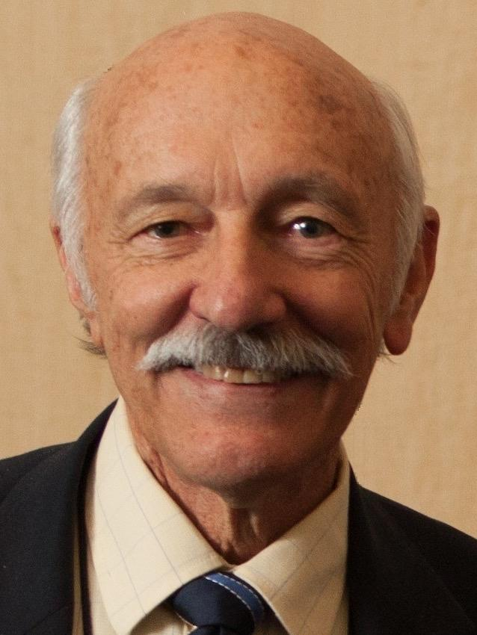
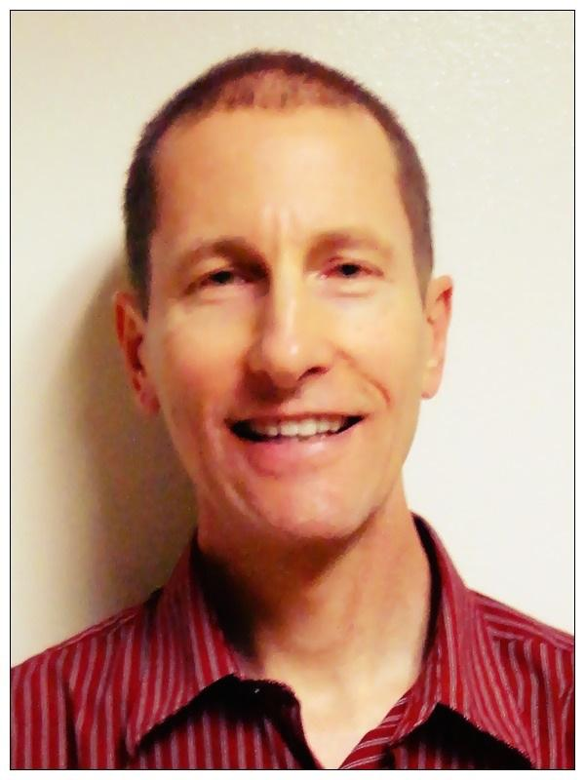
About the Visionaries
Ron Swenson
INIST
Dr. Buff Furman
SJSU- ME Professor
Notes:
Ron Swenson
Co-founder of INIST, the International Institute of Sustainable Transportation and Lead Advisor for the Spartan Superway
Ron's company Swenson Solar has developed a number of commercial solar systems.
In the 1990s he co-founded Tonatiuh, Mexico's solar race car team
He previously taught mechanical design, computer programming, and cybernetic systems at SJSU
Dr. Buff Furman
Buff is a professor in the Mechanical Engineering Department at San Jose State University and University Advisor for the Spartan Superway
His areas of teaching and research are focused primarily in Automated Transit Networks, mechatronics, precision machine design, and engineering measurements.
He is also a registered professional engineer in the state of California in mechanical engineerings
He worked at IBM in San Jose in the development of disk drive actuators and spindle motors and consults in the optomechanical and laboratory automation industries.

Slide 5
Transportation Problems

Slide 6
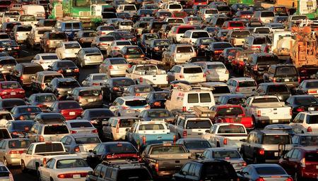
Does this look familiar to you?
http://sfpublicpress.org/news/2014-05/stanford-divests-bay-area-still-spews-carbon
Notes:
Bob: Casual talk with examples illustrating the current transportation issues (1min 30sec)

Slide 7
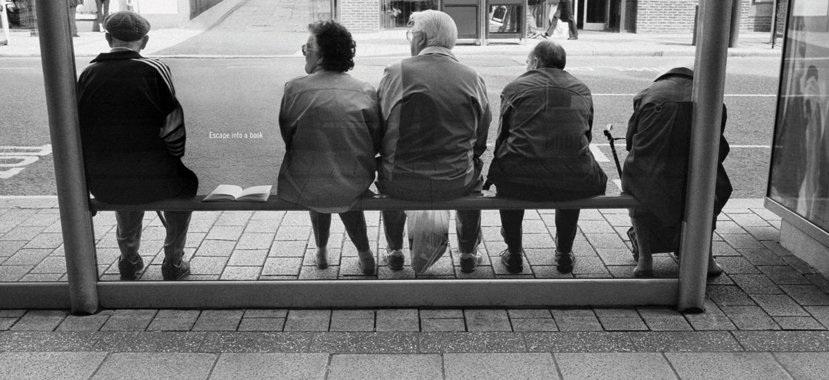
Where is the bus??

Slide 8
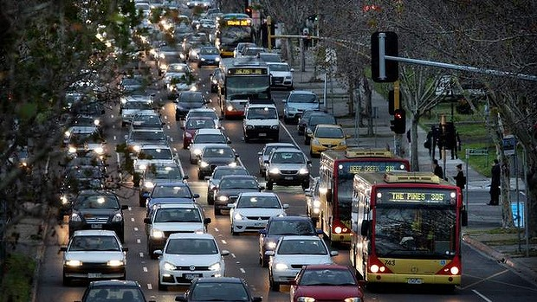
http://socialpsycling.blogspot.com/

Slide 9
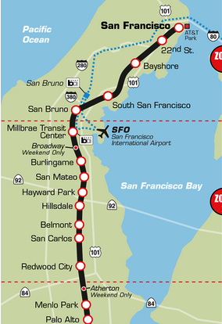
13 STATIONS!!!
Notes:
see ron’s slide for bus

Slide 10
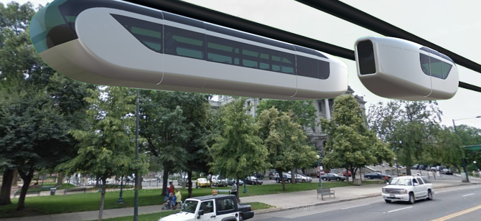
ATN using suspended vehicles
http://swifttram.com/products/
Notes:
introduce the concept and ATN
Comment: make next slide includes an offline station

Slide 11
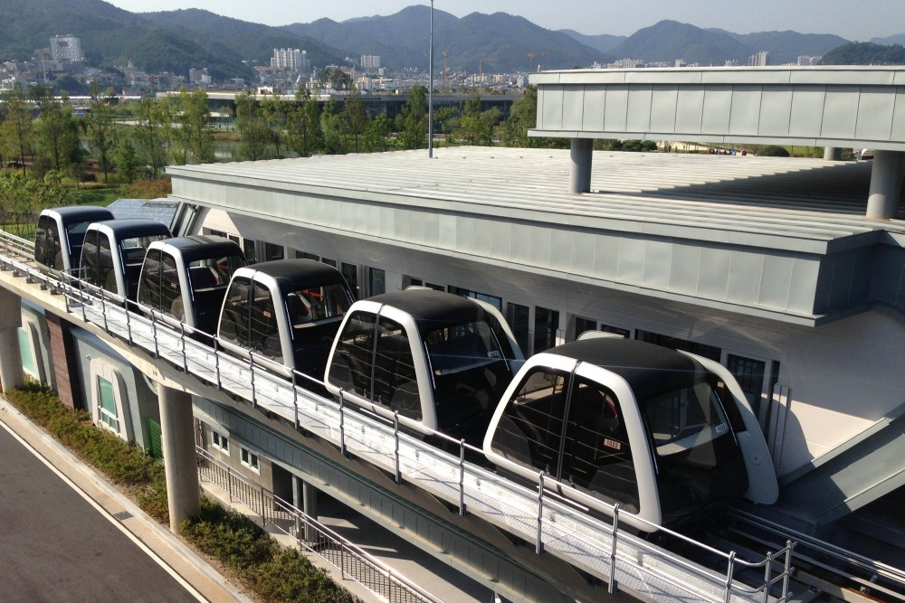
Notes:
Off-line station picture

Slide 12
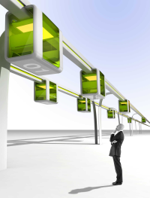
ATN offers advantages over current transit system
*Non-stop origin- to- destination
*Personal vehicle
*Automated
*On demand service
*Separated and
elevated guideway
http://www.podcarcity.org/arlanda
Notes:
brief history of ATN (30sec)
A small vehicle is personal, not necessary small
Comment: Change picture to some suspended system, check previous Superway teams, Bengt’s picture in the mineta report

Slide 13
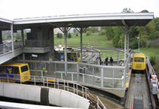
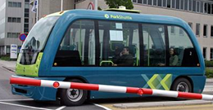
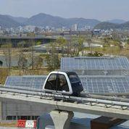
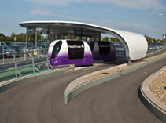
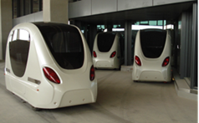
There are more ATN systems than you think...
Morgantown , West Virginia
(photo courtesy Trans.21)
Rivium shuttle, Netherland
(photo courtesy Trans.21)
Vectus PRT, South Korea
Cybercab, Masdar City
(2getthere 2011)
(London Heathrow, ULTra Global PRT http://www.ultraglobalprt.com/photos-videos/photos/)
Notes:
Quickly go through the list (30sec)
make images appear with click, or expand to help guide audience’s attention

Slide 14
Energy Problem

Slide 15
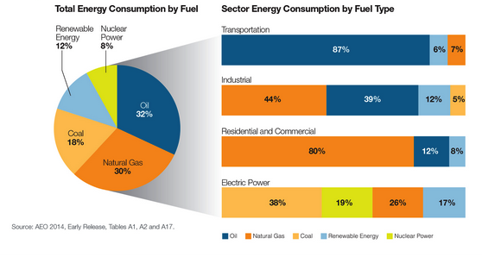
The United States is highly dependent on fossil fuels for energy
Notes:
Comment: Add next slide that shows change graphic to a pie chart, energy usage by sector
2012-08-29
mention that we past the hubbert peak for fossil fuel production and that we’ll never run out, only slow down production
See Ron’s slide on peak oil well
talk to Chris about peak oil

Slide 16
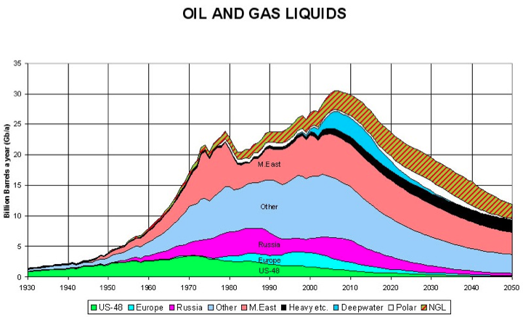

Slide 17
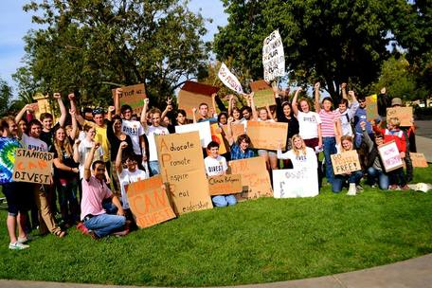
You sure know this!!
We made history, but we're not done yet.
Today, more than 400 colleges and universities across the country are calling on their institutions to divest from the fossil fuel industry.
We launched the Fossil Free Stanford campaign in 2012 requesting that Stanford…
1. Immediately freeze any new investment in fossil-fuel companies, and
2. Divest within five years from direct ownership and from any commingled funds that include fossil-fuel public equities and corporate bonds.
As young people, we refuse to sit idly by and accept a future wrought with climate destruction.
Stanford is a leader in innovation and sustainability.
Notes:
Briefly talk through the FOSSIL FREE STANFORD project… (30sec)

Slide 18
We’re trying to replace fossil fuels with...
Notes:
Add slide that shows a picture of Ron’s plantronic solar installation pi chart?

Slide 19
Let’s see how we can help solve both problems at the same time!!
Notes:
Combining the use of renewable energy and ATN system

Slide 20
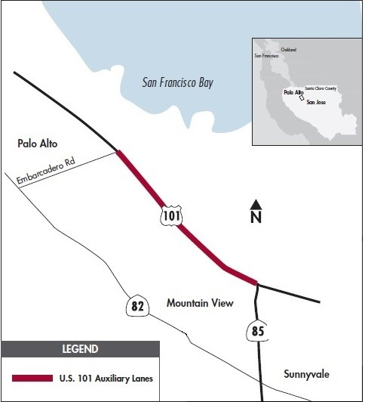
Solution is to get cars OFF the road, not make room for more
$72 Million dollars to widening 101 3.2 miles
$22.5 M/mi
Average ATN build cost is between $15 and $20 M/mi
Notes:
As some of you who live nearby know, the VTA begun a project last summer to put a new lane spanning 3.2 miles in hopes to ease traffic congestion. VTA.org state that this will cost approximatly $72M, thats $22.5M per mile! The band-aid fix of extending freeways wider or changing an offramp to ease traffic is backward thinking. As Cheng-Hsien mentioned before, a mile segment of an ATN’s built in South Korea and Sweden averaged around $15 - $20 M per mile. In order to decrease traffic, a city needs to get cars OFF the road, not make room for MORE. On a dollar to dollar basis, an ATN is vastly more valuable than extending a Highway
BART wants $4 billion for a 2 mile extension down into santa clara and alum rock
Significant improvement in utilization of resources
About $2 million per mile for adding a lane in a freeway
ATN would only require $120,000 per mile and 10,000 per pod (page 172)

Slide 21
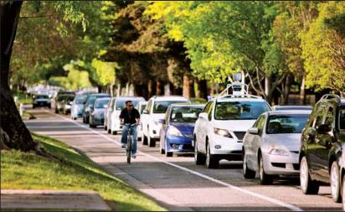
Self driving cars are impressive, but they still get stuck in traffic
Notes:
They still get stuck in traffic, Point to car
enough gas, engine problems
carbon emissions
ATN’s go at a constant speed and weave in and out from one another. So no stop and go.
So many things that go wrong, enough gas, engine problems and again, the carbon emissions and traffic problem. See that Google self-driving car stuck in traffic? Again, the solution is to get cars OFF the road.
Google should be in the conversation because of how related their cars and ATN overlap.

Slide 22
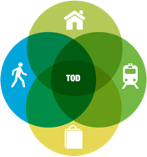
ATN’s plays well with TOD
Notes:
Reduced household driving and thus lowered regional congestion, air pollution and greenhouse gas emissions
Walkable communities that accommodate more healthy and active lifestyles
Increased transit ridership and fare revenue
Potential for added value created through increased and/or sustained property values where transit investments have occurred
Improved access to jobs and economic opportunity for low-income people and working families
Expanded mobility choices that reduce dependence on the automobile, reduce transportation costs and free up household income for other purpose
Transit-oriented development, or TOD, is a type of community development that includes a mixture of housing, office, retail and/or other amenities integrated into a walkable neighborhood and located within a half-mile of quality public transportation. At Reconnecting America, we believe it is essential that TOD creates better access to jobs, housing and opportunity for people of all ages and incomes.

Slide 23
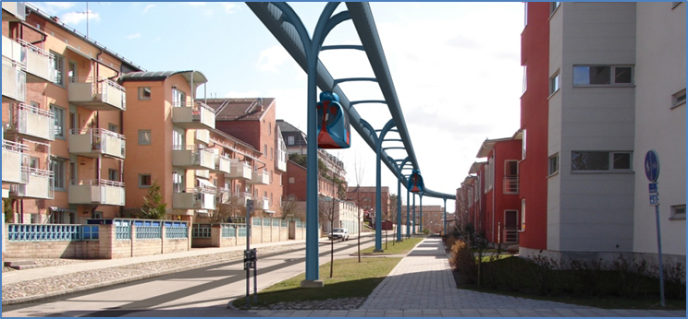
Notes:
Successful TOD provides people convenience
affordable
and active lifestyles
create places where our children can play and our parents can grow old comfortably.

Slide 24
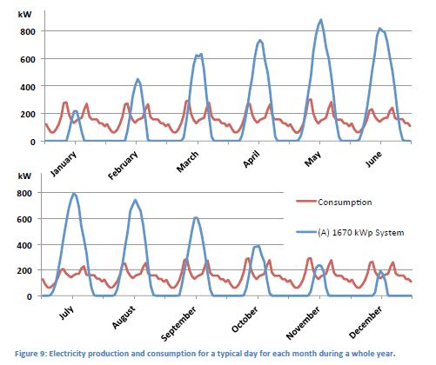
Solar-powered ATN is a game-changing innovation for urban transportation
Power (KW)
Time (Month)
Notes:
Research was from Uppsala university on solar powered ATN shows that 1 meter wide solar panels collect more than enough energy to run the system.
Jake:
Why solar powered ATN makes sense? Engineering design will enable pods to travel up to 30 mph solely by solar energy. This is all possible by using solar cells mounted on top of the ATN
A study was completed on the power consuption/production that a Solar powered ATN would use anually. As you can see in the graph, production from the solar cells vastly outwieghs the ATN
consumptoin. All thie extra energy can then be supplied back into the grid. Especially when a city needs it most, during peak hours!
Beamways: Calculated to 0,05 kWh/vkm.
ULTra/2GetThere: About 0,1 kWh/vkm.
Vectus: About 0,15 kWh/vkm. (Linear motor).
Electric car: 0,25 kWh/vkm (Nissan Leaf).
Electric Bus: Around 0.15 kWh/pkm (1.5 kW/vkm).
Tram: 0.15 kWh/pkm (2.9 kWh/vkm, Göteborg).

Slide 25
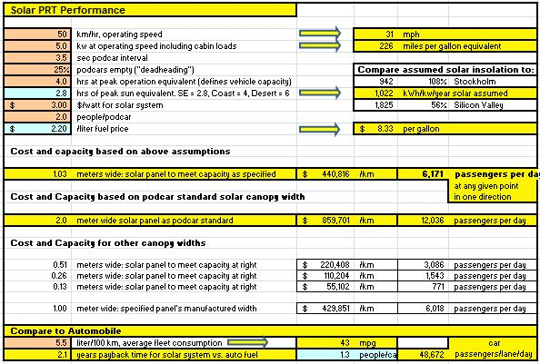
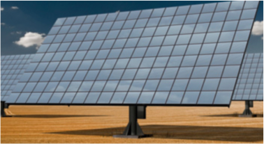
Solar powered ATN system has a fast payback
Notes:
This is a model that shows the capacity and cost efficiency associated with implementing a solar powered system
Bottom LIne: A 1.12 m wide solar panel placed on top of an ATN would provide about 46,000 passengers/km per day and cost about $750,000 to establish. This essentially pays for itself in about 2 years time!!
A hypothetical study was completed which compared cars to a solar PRT [or personal rapid transit] system. The bottom line here is that just over a meter wide solar panel mounted on top of an ATN would could cart over 48,000 people per day in one direction.

Slide 26
Benefits of an ATN
Notes:
Combining the use of renewable energy and ATN system

Slide 27
It’s clear people can’t drive in the U.S.
Compare to:
4 fatalities/year from roller coasters in the U.S.
U.S. Department of Transportation
Notes:
A suspended railway wouldn’t only bring value to a city, but also increase the safety of it’s inhabitants. As you may know, people can’t drive in the U.S
Implementing an ATN is a simpler problem. Cars = 2 degree of freedom, it can move forwards and turn. On the other hand, a pod has 1 degree freedom because it is on a track. The result is simpler problem to solve. No way to fall, swerve, ect
The National Highway Traffic Safety Administration stated that in 2012, 4,743 pedestrians and 726 bicyclists were killed in crashes
and an estimated 76,000 were injured in traffic crashes in the United States
This means, on average, a pedestrian was killed every 2 hours and injured every 7 minutes in traffic crashes and accounts for 14% of fatalities in the U.S.
Drunk driving would decrease because the pods are automated, less cars would be on the road, thus
Touch on less smog in a major city

Slide 28
We are going vertical
1900
1998
2019
Last 20 years we have doubled!!
Notes:
Start with “our cities are going vertical
emphasize that vertical growth for transportation is cheap and inexpensive
more cost efficient than car overpass
Jake:
Vertical space is valuable real estate. Anywhere tall buildings exist, an increase in real estate value follows. As seen here...
Between 1901 and 1998 all of the buildings to have held the title of “world’s tallest” (9) were in the US. Their height
increased by 275m during this period. Over the past 16 years the world’s tallest buildings (3) have been in Asia/Middle East with a 386m height increase. When the Kingdom Tower development (1km) is completed in 2019 it will mean the height of the world's tallest building will have doubled in 10 years.
The trend of looking up for new value is in line with an ATN that is suspended about the current roadways. Implementing this sort of system would only increase the value of urban real estate. Thus, bringing more value and new growth with it.

Slide 29
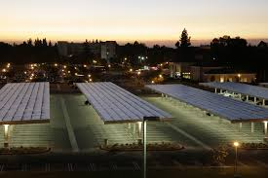
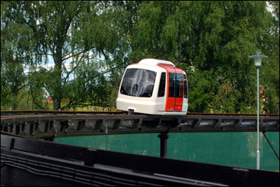
Universities around the globe believe in ATN’s as the future of transportation
Notes:
Jake:
Fresno state: A Photovoltaic (PV) Solar Parking Structure: The structure covers 722 parking spaces on 5.5 acres in Parking Lot V. This solar system is estimated to provide 20% of core campus power.
uppsalla: 400-metre (1,312 ft) test track in Uppsala, Sweden which has 40 pods and 2 stations. This test system was presented at the 2007 PodCar City conference in Uppsala, Sweden.
Presido MBA students made a business plan for an ATN.

Slide 30
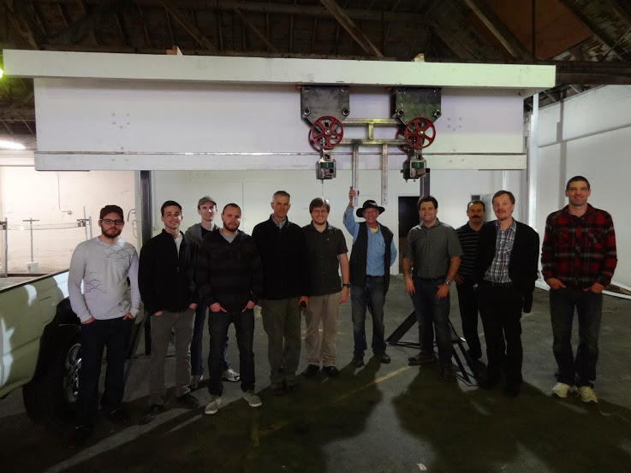
Introducing Spartan Superway!!!

Slide 31
Spartan Superway
Interdisciplinary student organization

Slide 32
ATN Development
*Energy consumption
*Network Transportation
*Aesthetics
*Safety Concern

Slide 33
Overall Goals: Seeing is believing
Demonstrate controls concept
R & D feasibility of powering an ATN using solar energy
Build to demonstrate a full scale portion of the track
Design a pod that satisfies both aerodynamic constraints as well as user experience/confort
Show off at Maker Faire
Notes:
Further develop a ATN solution by:
Build a 1/12th scale demonstrating overall controls part
Further research and develop the feasibility and implementation of powering an ATN using solar energy
Build to demonstrate a full scale portion of the track
Design a pod that satisfies both aerodynamic constraints as well as user experience/confort
Maker Fair
Pretty much flush out the details and push the ATN envelope

Slide 34
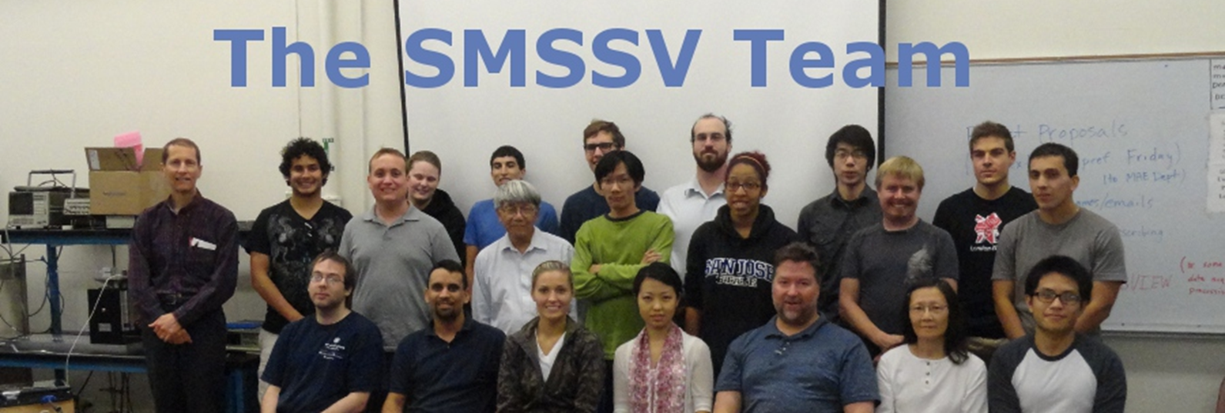
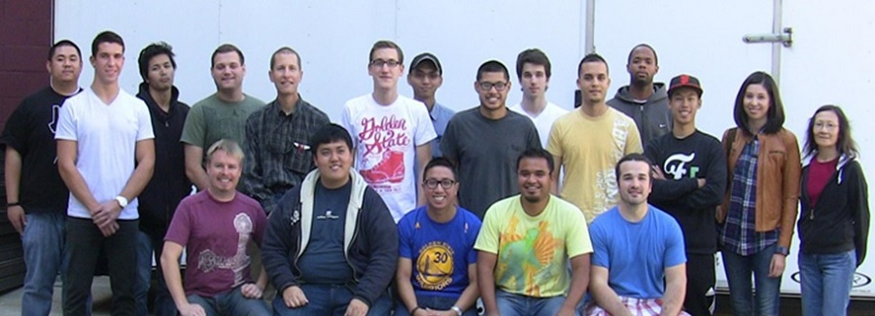
Spartan Superway has made a lot of progress
2012-2013
2013-2014
2014-2015
Notes:
About the General Superway Team Jake (4-6 minutes)
3 year effort formed in 2012-2013 academic school year, group not shown. It is primarily a mechanical engineering senior design project, but other departments such as
computer engineering, computer science, Civil engineering, urban and regional planning department.
1st year- general concept design and 1/12th scale iteration
2nd year - revamp of 1/12th scale, full scale, industrial design, user interface
bob will go into what we are currently doing

Slide 35
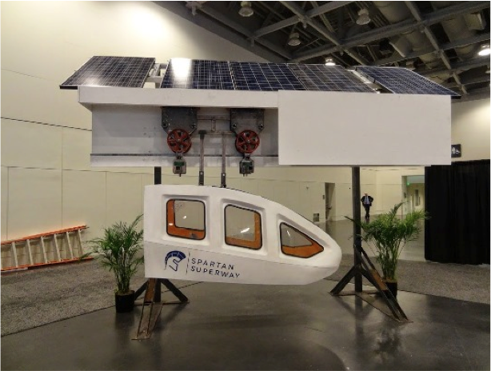
1st Iteration of the Full Scale
Notes:
improved scale model
built full
Built Full Scale
ReVamped 1/12th scale
Industrial Design Cabin
Maker Faire

Slide 36
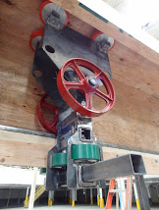
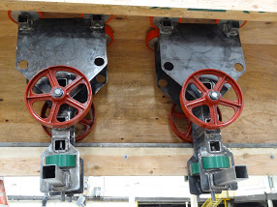
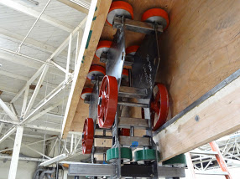
Full Scale Bogie Design
Notes:
Mention patent by Bengt Gustaffson’ who works at beamways in sweden
we are refining, make presentation positive. Do not say we are fixing problems, only learning a better way to solve them

Slide 37
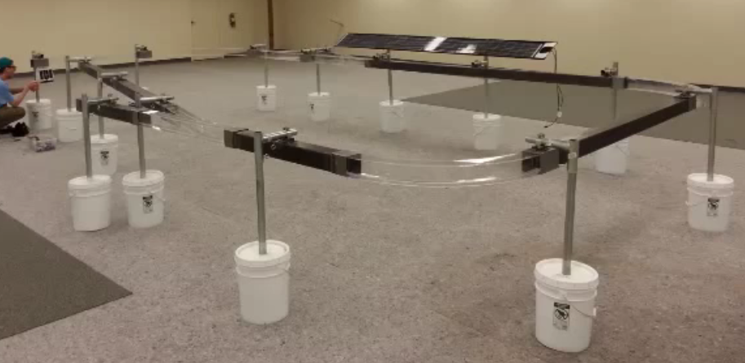
1st Iteration of the 1/12th scale model
https://www.youtube.com/watch?v=4UeYCyxl5yc
Notes:
Show Video?
Then explain Made of both cut acrylic and steel beams
3d printed cabin and bogie
control system was composed of SJSU one board and arduinos

Slide 38
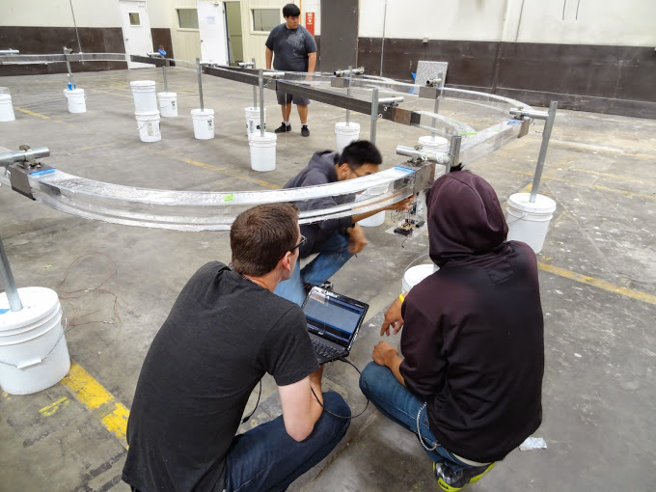
1/12th Model
Track composed of Acrylic and steel
3D printed Cabins
Tech included:
Arduino
SJSU 1 Board
Proximity Sensors
Hall Sensors

Slide 39
SJSU Human Factors students made an ATN user interface

Slide 40
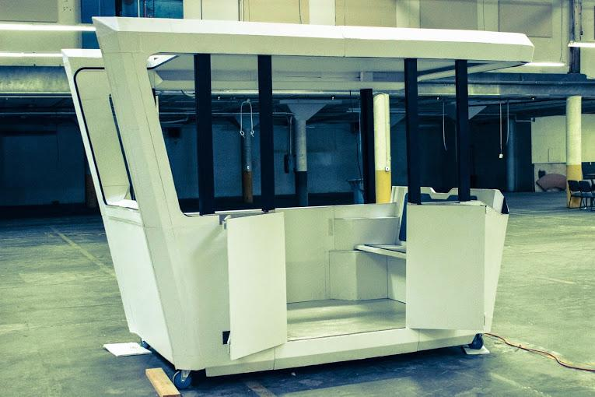
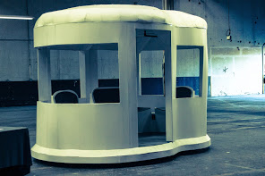
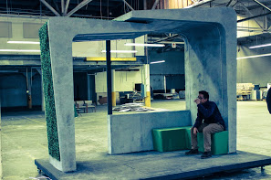
Industrial Designed Cabin and Station Concepts

Slide 41
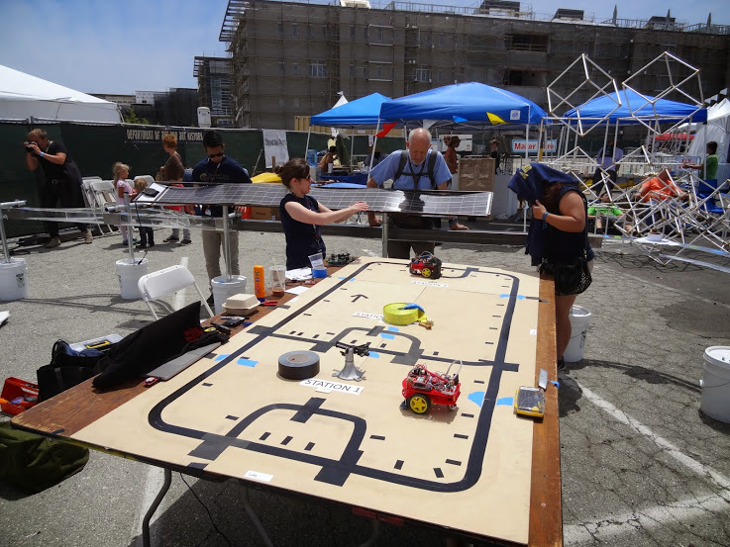
Line Following Bot
Notes:
Demonstration of the automated control system
Follows a line using a digital encoder
Computer engineer

Slide 42
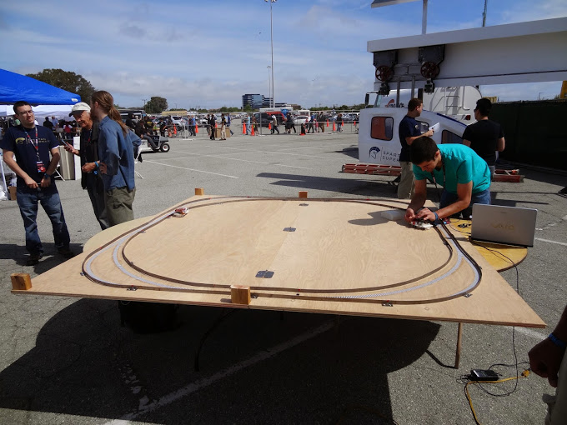
Collision control
Notes:
A track was built to show an autonomusly vehicle circle around the track while utilizing encoder sensors, proximity sensors, amongst others.

Slide 43
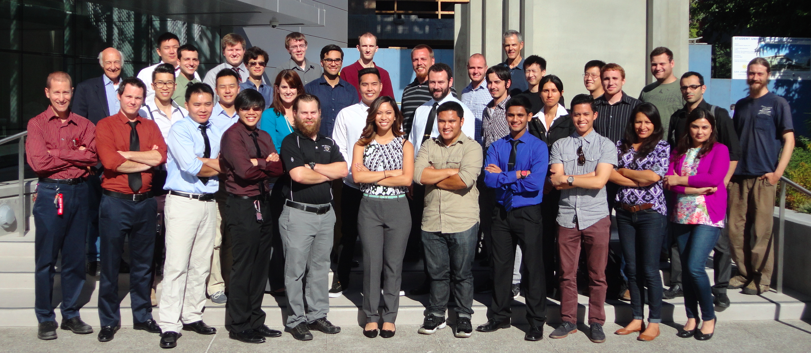
Superway 2014-2015 Team

Slide 44
Four sub-teams...
Solar Team
-Design and fabricate 1/12th scale and full scale
sun tracking system
Cabin Team
-Design the internal interface ,structure and decide on
material for the cabin
12th scale Team
-Redesign and build the 1/12th scale model
Full Scale Team
-Design and build the additional track and add
switching mechanism to bogie

Slide 45
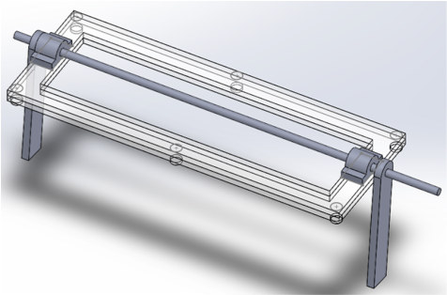
Solar Team

Slide 46
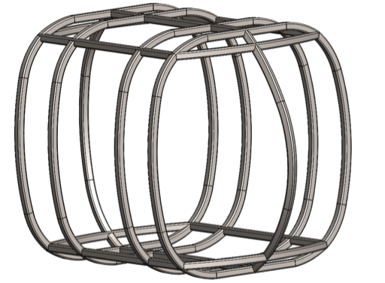
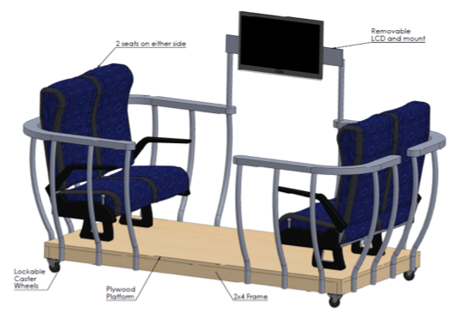
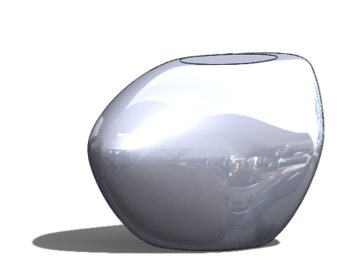
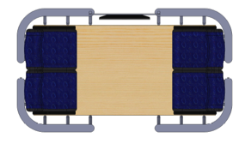
Cabin Team

Slide 47
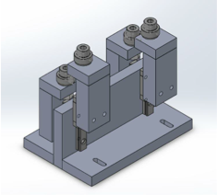
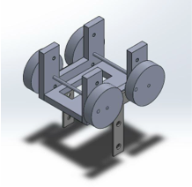
1/12th Scale Team
Seeing is Believing!!

Slide 48
1/12th Scale Team, Cont
Raspberry Pi

Slide 49
Full Scale Team...

Slide 50
Full Scale Team, Cont

Slide 51
Recap
Feasibility of Solar power and ATN
Advantage over other technology
Combining ATN and Sustainable energy
Effort made in Spartan Superway
Current progress and future plan
Notes:
RECAP and CONCLUSION… we’re not done yet, and we invite you to make history with us.

Slide 52
Next Steps for ATN and Superway
Maker Faire
Solar Skyways
Keep perfecting
Keep Raising Awareness
Notes:
Maker Faire
get it into San Jose
Ask ron and Furman about next steps

Slide 53
Solar-powered ATN

Slide 54
*Navigation system
*Software
*Solar energy
*Switching mechanism
*Urban Planning
*Bengt’s design
*ATN capacity
*Adding stations
*Back up energy

Slide 55
1/12th Scale Navigation and Power

Slide 56
Spartan Superway Software
Python
C
Ardunio (Modified C ++)
C # for GUI

Slide 57
Solar Energy
Beamways: Calculated to 0.05 kWh/vkm.
ULTra/2GetThere: About 0.1 kWh/vkm.
Vectus: About 0.15 kWh/vkm. (Linear motor).
Electric car: 0.25 kWh/vkm (Nissan Leaf).
Electric Bus: Around 0.15 kWh/pkm (1.5 kW/vkm).
Tram: 0.15 kWh/pkm (2.9 kWh/vkm, Göteborg).
vehicle-kilometre[vkm] as a measure of traffic flow, determined by multiplying the number of vehicles on a given road or traffic network by the average length of their trips measured in kilometres
Notes:
vkm = Units of transportation measurement: describes the unit of measurement used to measure the quantity and traffic of transportation used in transportation statistics, planning, and their related fields.
vehicle-kilometre[vkm] as a measure of traffic flow, determined by multiplying the number of vehicles on a given road or traffic network by the average length of their trips measured in kilometres

Slide 58
Switching mechanism design

Slide 59
Switching mechanism, cont.

Slide 60
Bengt Gustaffson Patent
Track Design
Bogie Design

Slide 61
Bengt Gustaffson Patent Cont...
Bogie and Track Design

Slide 62
ATN system Capacity
NETWORK CAPACITY
Line capacity
The ATN could surpass the capacity of 1 lane of freeway
Station capacity
The capacity depends on the scale of the station

Slide 63
More stations can be added depends on the needs

Slide 64
Back up plan
Storing the sunlight
- Compressed air energy storage
- Store energy: Electric motor drives compressor
- Deliver energy: Reverse the process
Back up electricity power
Battery in each pod
Nearest station

Slide 65
Urban planning

Slide 66
Join us on making the history

Slide 67
http://www.sjsu.edu/getinvolved/studentorgs/

