Slide 1
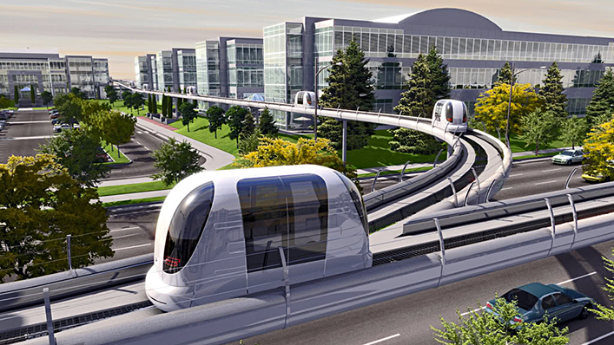
Automated Transit Network
Elvis Falcao
Igor de Assis
Ubiratan Castro
Racy Dias
Daniel Olivo
San Jose State University
Spartan Superway
05/22/2015
[1]
Notes:
This file presents an assertion-evidence template for making effective slides for scientific presentations. Although much about the layout and typography contrasts sharply with the defaults of PowerPoint, these changes are done so to make the slides more effective at communicating technical information. The design advocated by this template arises from Chapter 4 of The Craft of Scientific Presentations, 2nd edition (Springer, 2013). The homepage for this template exists at the following website:
http://writing.engr.psu.edu/assertion_evidence.html
Right now you are viewing the notes pages. To work on the slides, click on “Slide” under “View.” Tip: When creating a new presentation, save this file as the name of your presentation. Warning: You are more than welcome to use this template for your presentation slides. You may not, though, distribute this template for profit or distribute this template without giving credit to the source: http://writing.engr.psu.edu/
This slide is for the title slide of a presentation. Consider inserting an image that helps orient the audience to the title. You should not leave this slide until the audience feel comfortable with the title. Forcing yourself to spend more time with this slide is good because a common mistake in presentations is to leave the title slide too soon. Because of this mistake, many in the audience do not have the chance to comprehend the key details of the title. See pages 172-184 in The Craft of Scientific Presentations, 2nd ed. (CSP).
This template shows one layout for the slide. You might want to rearrange the placement of the body’s wording to accommodate a different sized image. On the next slide is a sample title slide. You should delete the examples after you create your own slides.

Slide 2
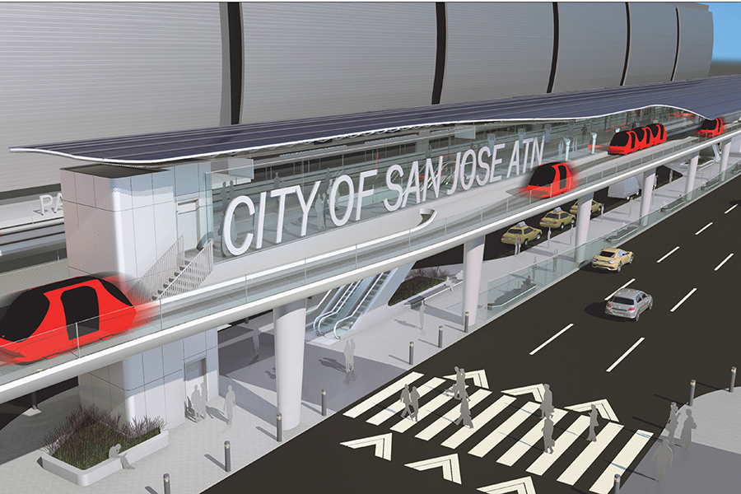
This presentation focuses on describing ATN: what is it, how was its development, characteristics and examples of ATN around the world.
What is ATN
Characteristics
Historic
ATN around the world
[2]
Notes:
Mapping slide for the presentation (note that a background slide or a slide justifying the importance might precede this slide). A common mistake with mapping slides is to give the audience simply an unmemorable bulleted list of topics (including the names “Introduction” and “Conclusion” and “Questions”). Such a list is quickly forgotten after the slide is removed.
On a mapping slide, take the opportunity to show a key image or perhaps a representative image for each major section of the presentation. In the second case, each image would be repeated on the first visual of the corresponding section and would remind the audience that they have arrived to a major section of the presentation’s middle.
In regards to the names “Introduction” and “Conclusion,” every talk has those sections, and the names are ignored by audiences. So why state them? Also, for the divisions that you do have, find a logical and parallel grouping. Note that groups of two’s, three’s, and four’s are much easier to remember and are not so nearly intimidating as groups of five’s, six’s, and seven’s. See the discussion of mapping slides in The Craft of Scientific Presentations, 2nd ed. (pages 177-181).

Slide 3
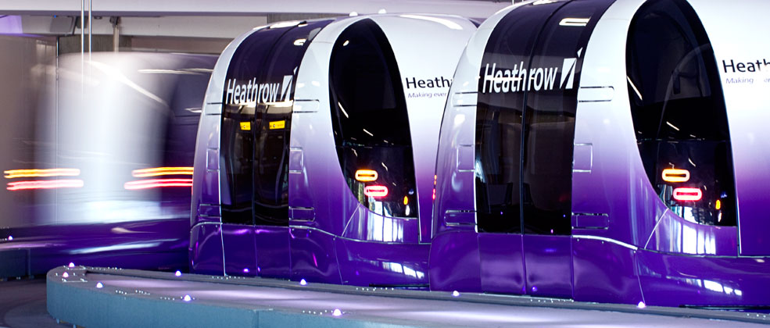
What is ATN?
“Sustainable transit systems with automated operational capabilities featuring small automated vehicles operating on a network of specially built guide ways”. [3-4]
[5]
Notes:
Sample mapping slide.
Reference:
Katrina Aspmo, Torunn Berg, and Grethe Wibetoe, “Atmospheric Mercury Depletion Events (AMDEs) in Polar Regions During Arctic Spring,” presentation (Oslo, Norway: University of Oslo, 16 June 2004).

Slide 4
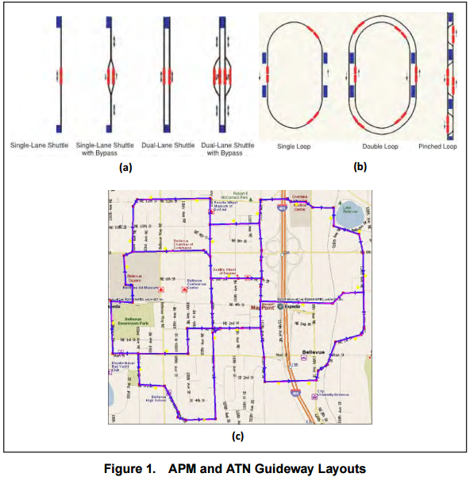
ATN functionality is significantly different from other transit modes, yet it shares some similarities with the more familiar automated people movers (APM).

Slide 5
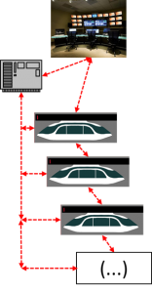
An ATN is a complex system with a lot of components. One of them are the software and Electric/electronic hardware.
Notes:
An ATN is a complex, large-scale, and geographically extensive mobility device consisting of the following components:
(a) Software Software is the core of an ATN system. It integrates all the other components, orchestrating them to deliver a functioning mobility service. Central controls manage vehicle movements, on-demand trip scheduling in real time, empty vehicle management, and responses to irregular operations including accidents, guideway intrusions, crime, and terrorist incidents. They require debugging, maintenance, and protection by skilled technicians. (b) Electric/electronic hardware Electric and electronic components, comprising power rails (or battery changing, recharging), substations, communications, sensing, and station equipment.

Slide 6
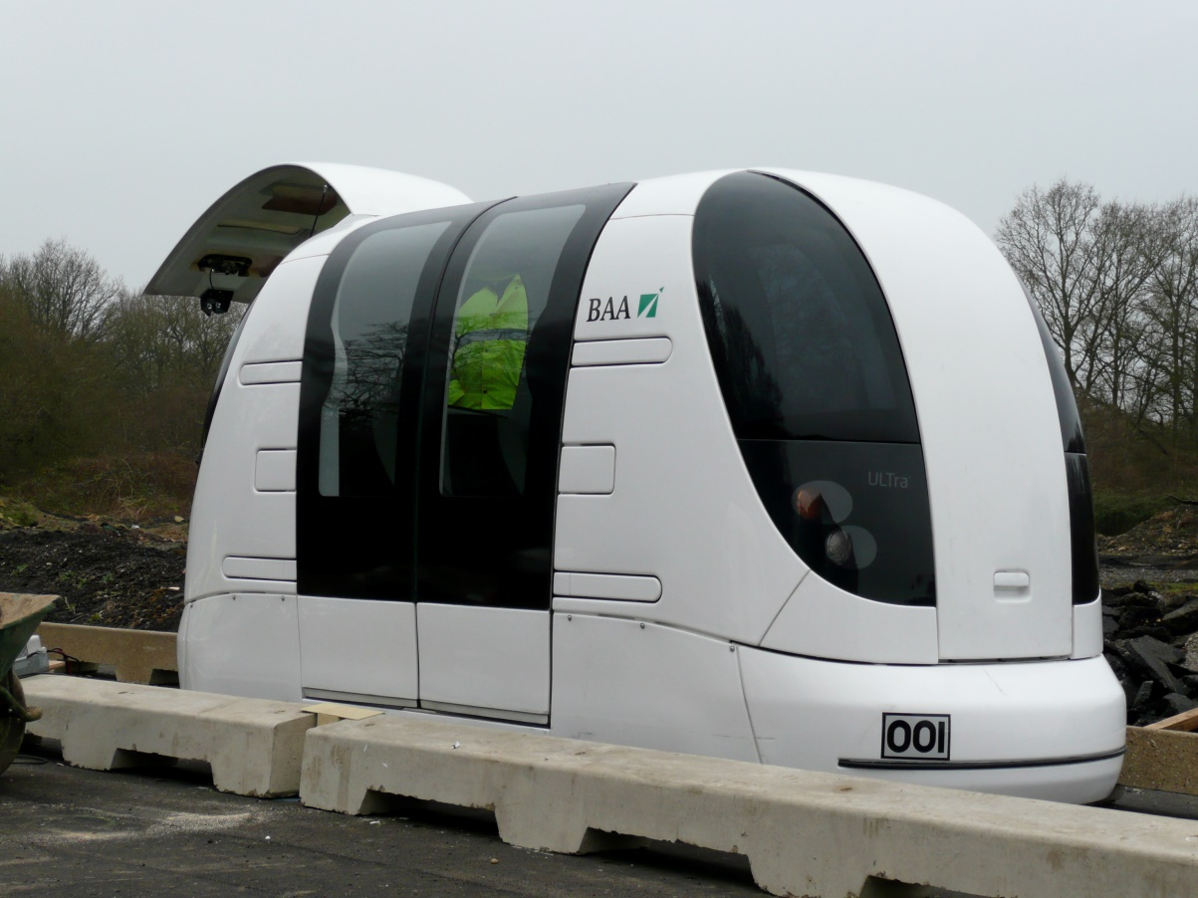
Characteristics
Faster transportation (no transfer or stop at intermediate)
No human drivers (safe), Available at any time of day, Exclusive Access and Fully connected network [6].
[6]
Notes:
Direct origin-to-destination service with no need to transfer or stop at intermediate stations
2. Small vehicles available for the exclusive use of an individual or small group traveling together by choice
3. Service available on demand by the user rather than on fixed schedules
4. Fully automated vehicles (no human drivers) that can be available for use 24 hours a day, seven days a week
5. Vehicles captive to a guideway that is reserved for their exclusive use5
6. Small (narrow and light relative to LRT and BRT) guideways usually elevated but also at or near ground level or underground
7. Vehicles able to use all guideways and stations on a fully connected network

Slide 7
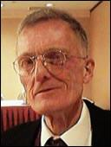
Historic
Dohn Fichter started developing concepts in 1953
[7]
Notes:
The idea of PRT can be traced back to many inventors and researchers that worked
independently to address the need for better urban transportation. An historical review
of PRT development prepared by J. Edward Anderson in 1998 credits the earliest work
on PRT to Donn Fichter who started developing concepts in 1953 that resulted in a
1964 publication entitled, “Individualized Automated Transit and the City” (Anderson
1998). This early book addressed the need for a total transportation system that could
integrate into the cityscape with the smallest and lowest-cost guideways possible and a
service designed to support the individual needs of travelers with the smallest and
lightest possible vehicles. Anderson’s review also chronicles numerous other early PRT
development programs (1998).
This slide shows one orientation for the image and text in the body of the slide. Other orientations appear in this template. Choose the one that best supports your headline assertion.
Some institutions will insist that you place an institutional logo on each slide. Other institutions recommend a logo on the first slide and the last. If you do place a logo on each slide, make sure that logo is at the bottom of the slide rather than the top. Placing the logo at the top (the place on a slide that receives the most emphasis) shifts the emphasis away from the work.

Slide 8
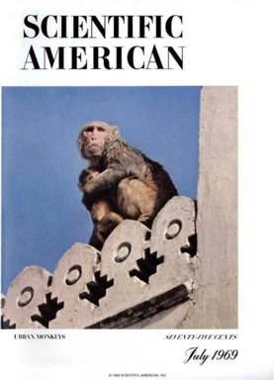
After 1964, federal institutes started spending efforts to support the ATN program.
[8],[9]
Notes:
Sample slide from second section of the presentation’s middle. The image was such that there was no need for subordinate descriptions.
Reference:
Jared Rochester, “Three Primary Products of an Explosive,” presentation (Aberdeen, MD: US Army Research Laboratory, 5 December 2005).

Slide 9
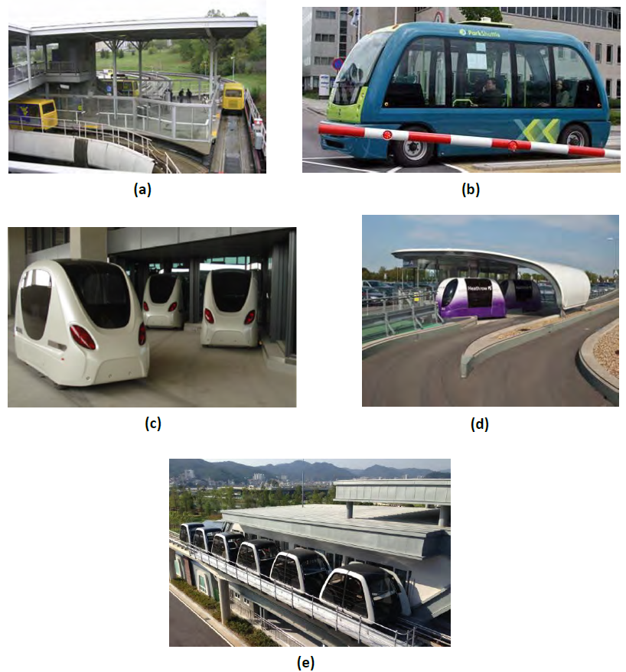
Nowadays, there are five ATN Systems on-work around the world.
Morgantown ATN,
West Virginia University (1975)
Parkshuttle Rivium , outside Rotterdam (1999)
Masdar City, Abu Dhabi (2010)
Terminal 5 Shuttle, London Heathrow Airport (2011)
(e) Nature Park Shuttle Suncheon Bay, South Korea (2014)
[10]
Notes:
Blank slide for drafting a body slide.

Slide 10
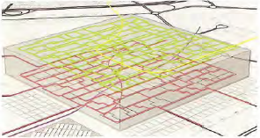
ATN in Masdar City, Abu Dhabi
The project concept arose before 2007 by architects and consultants working for Abu Dhabi government. Norman Foster & Parters and Mott MacDonald made the design.
[11]
Notes:
Body slide from the second section of the presentation’s middle. For the first body slide of this second section, consider repeating the corresponding image (or equation) from the mapping slide. Use the headline to make an assertion about this topic. In the body of the slide, support that headline assertion with images and needed callouts. See Chapter 4 of The Craft of Scientific Presentations, 2nd ed.
This slide shows one orientation for the image and text in the body of the slide. Other orientations appear in this template. Choose the orientation that best supports your headline assertion.

Slide 11
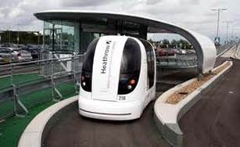
Masdar City ATN has offline station bays and is guided by magnets imbedded in paviment . The transportation system uses power from on-board batteries, which eliminates the need for electric guideway .
Notes:
Sample slide from the middle of a presentation. Notice how animation works to allow the speaker to present fairly complex connections in a way that the audience can digest. Notice how the arrows show connections—something that bullets could not achieve.
Reference
This slide is a composite slide from a number of mechanical engineering seniors in ME 4006, a laboratory course at Virginia Tech. These presentations occurred during the Fall 2004 semester.

Slide 12
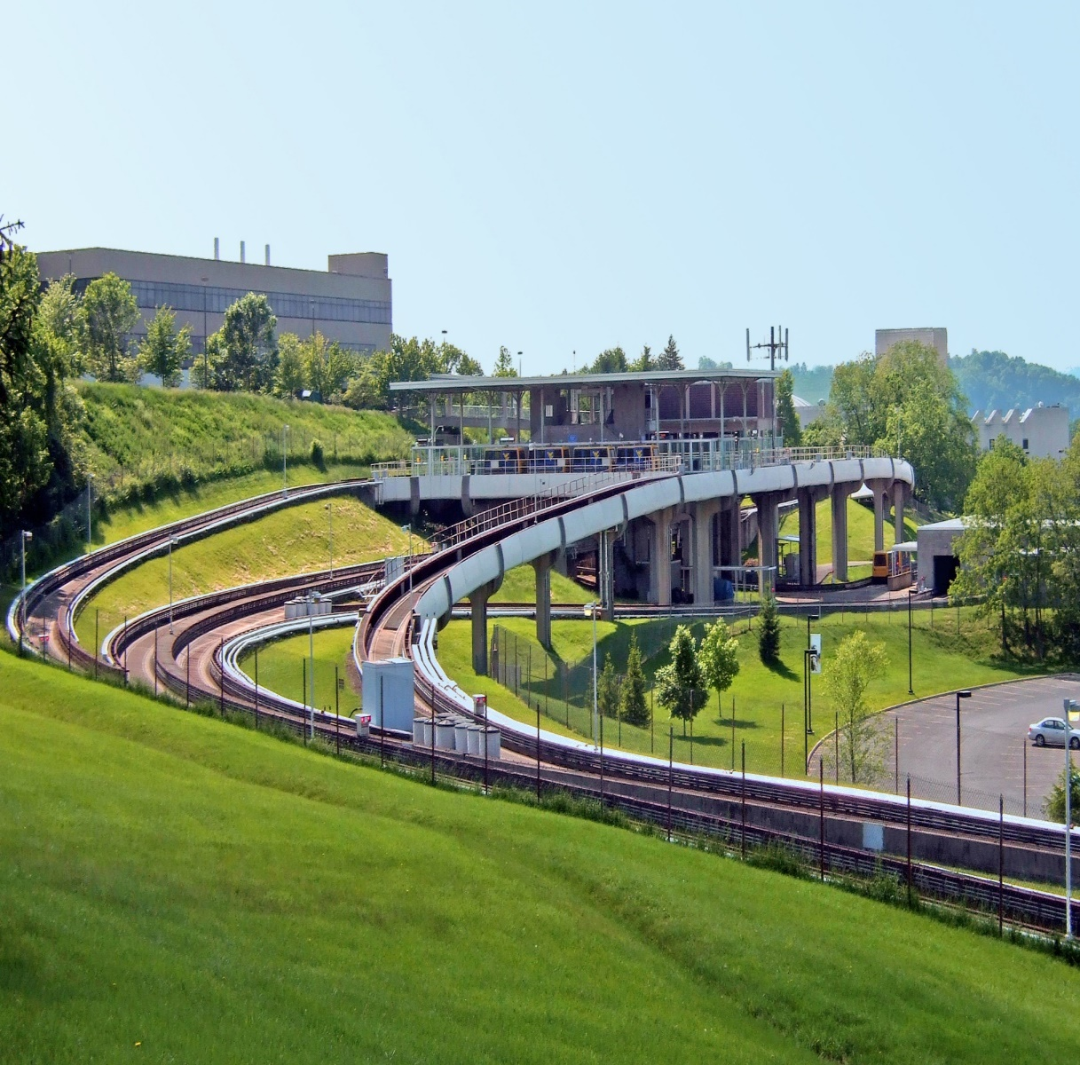
Morgantown, West Virginia USA
[12]
Notes:
Blank slide for drafting a body slide.

Slide 13
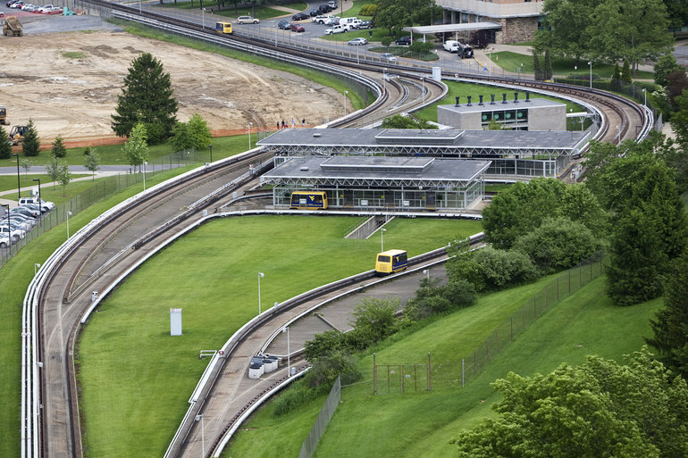
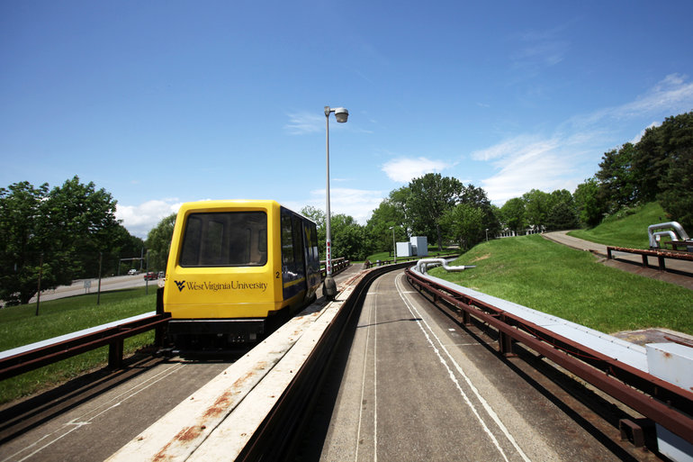
The system is a fully automated, on-demand, off-line station transit system
[13]
[14]
Notes:
Blank slide for drafting a body slide.

Slide 14
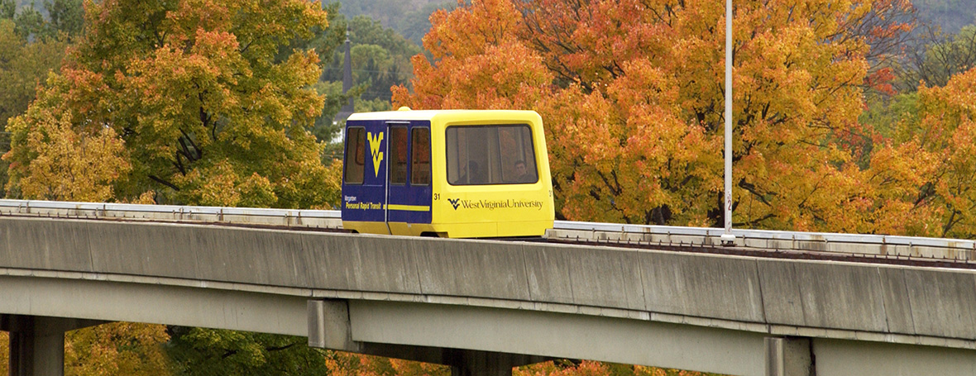
The opening date was the central concern, while the cost-effective construction was left aside.
Heavy structure
[15]
Notes:
Blank slide for drafting a body slide.

Slide 15
Parkshuttle Rivium metro-feeder, Rotterdam
[16]
Notes:
Blank slide for drafting a body slide.

Slide 16
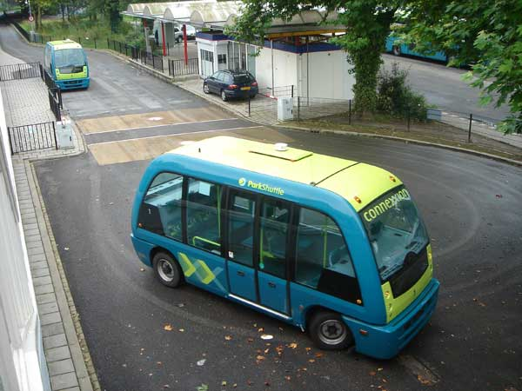
This ATN uses power from on-board batteries, which eliminates the need for guideway electrification.
[17]
Notes:
Blank slide for drafting a body slide.

Slide 17
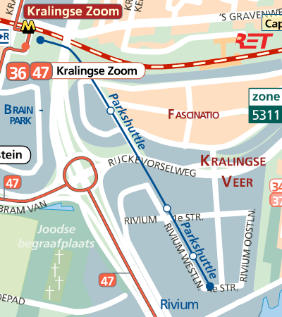
The system is operated against costs similar to that of a bus line, but provides a much better service level
Buses route
ATN route
[18]
Notes:
Blank slide for drafting a body slide.

Slide 18
Heathrow Pod

Slide 19
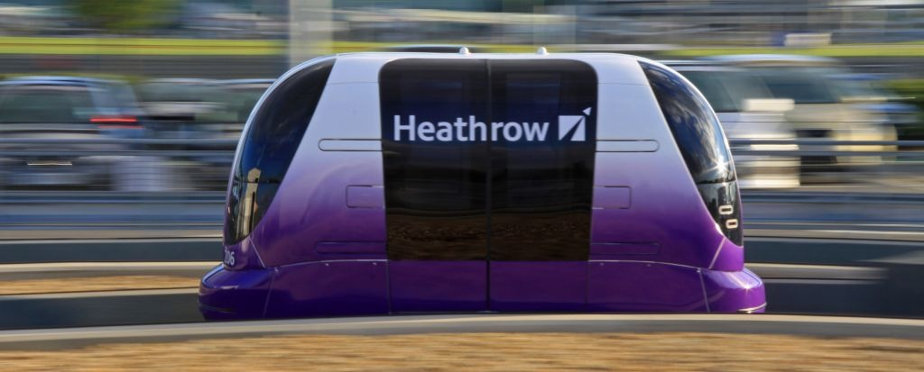
Description
Each vehicle has 4 seats and enough room for accompanying luggage
The system runs up to a maximum speed of 25 MPH (40KpH).
The capacity of Heathrow pod is 164 vehicles per hour per direction. Equivalent to a maximum of 656 passengers per hour per direction [1]
[19]

Slide 20
Design
3.8Km of Guideway with 21 vehicles connecting 3 stations, 2 within Business Car Park one in Terminal 5 [20].
[21]

Slide 21
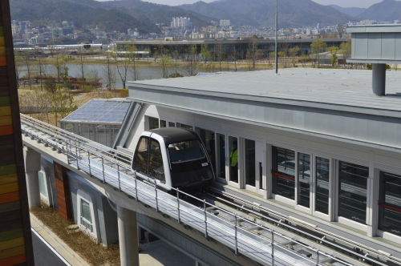
Suncheon Wetlands SkyCube
Location: Suncheon Bay, South Korea
Live operation from September 2013,
40 vehicles with seating capacity for 6 to 9 passengers;1313 passengers per hour,
On demand service and ability to travel in small and intimate groups,

Slide 22
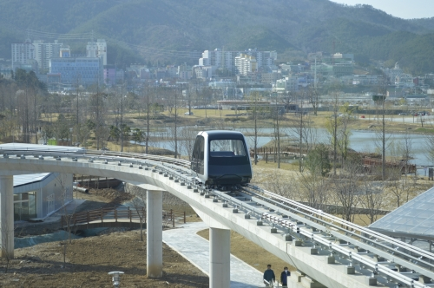
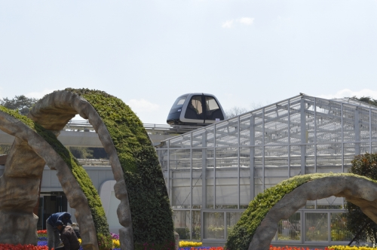
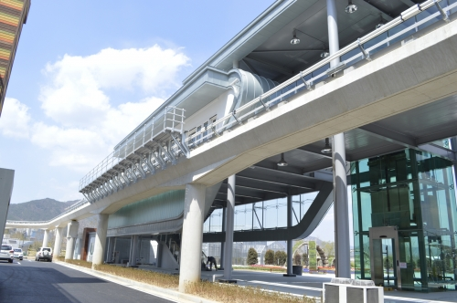
Suncheon Wetlands SkyCube
Location: Suncheon Bay, South Korea
No emissions;
On demand service and ability to travel in small and intimate groups;
All vehicles are controlled via a distributed control system;
Vehicles are powered by a current collection system installed along the guideway;
Notes:
Sample conclusion slide. Notice how the presenter showed the connection between words blocks on this slide—a strategy that is much more effective than a bullet list, which hides the connections between details.
Reference:
Manning Seltzer, “Failure Analysis of the Ice Detector in the Austria 13 Helicopter,” presentation (Hartford, CT: Sikorsky Helicopter, 30 April 2004).

Slide 23
References
[1] - http://www.advancedtransit.org/
[2],[10],[11] – FURMAN, Bufford., FABIAN, Lawrence., ELLIS, Sam., MULLER, Petter., SWENSON, Ron., “Automated Transit Networks (ATN): A Review of the State of the Industry and Prospects for the Future.”; Mineta Trasnportation Institute; September 2014.
[3] - http://www.advancedtransit.org/
[4] – http://en.wikipedia.org/wiki/Personal_rapid_transit
[5] – http://en.wikipedia.org/wiki/Personal_rapid_transit
[6] – http://en.wikipedia.org/wiki/Personal_rapid_transit
[7] – https://www.advancedtransit.net/atrawiki/index.php?
title=Fichter,_Donn
[8] – HAMILTON, William F., NANCE, Dana K., “Systems Analysis of Urban Transportation”, Scientific American, July 1969.
Notes:
Blank slide for drafting a body slide.

Slide 24
[9] – COLE, Leon M., HAAR, Charles M., “Tomorrow's Transportation: New Systems for the Urban”, U.S. Department of Housing and Urban Development, 1968.
[10]http://en.wikipedia.org/wiki/Morgantown_Personal_Rapid_Transit
[11] http://www.governing.com/topics/transportation-infrastructure/personal-rapid-transit-system-morgantown-west-virginia.html
[12] http://www.governing.com/topics/transportation-infrastructure/personal-rapid-transit-system-morgantown-west-virginia.html

Slide 25
[13] http://westvirginia.forums.rivals.com/threads/visitors-guide-to-morgantown.1682/
[14] http://www.advancedtransit.org/advanced-transit/applications/rivium/
[15] http://www.fransmensonides.nl/parkshuttle.htm
[16] http://t.connectedcities.eu/showcases/parkshuttle.html
[19] http://www.advancedtransit.org/advanced-transit/applications/heathrow/
[20]http://www.passengerterminaltoday.com/viewnews.php?NewsID=33092
[21] http://www.ultraglobalprt.com/wp-content/uploads/2011/09/VehicleSeating_Large.jpg

